Slide 1
Sons of the American Legion College Concordia, Ks
Produced By: Sons of the American Legion
Detachment of Kansas
2023
Notes:
Title Page

Slide 2
Introduction
This course is designed to assist members of the Sons of the American Legion who have an interest in assuming one of the various offices of an SAL Squadron.
The purpose of this course is to prepare and to assist the member (candidate) in the preparation and deployment of their duties
As the student completes each module, they will have a better perspective as to the requirements of the position and be better prepared to assume their position and carry out the duties of the office.
The content that is presented here is intended to assist and develop.
Completion of this course does not necessarily mean that any particular person or candidate is automatically qualified upon course completion.

Slide 3
Statement of Policy ADOPTED BY THE NATIONAL EXECUTIVE COMMITTEE THE AMERICAN LEGION, MAY 5 - 6,1938
"Resolved, That the same policies now in effect for use and control of The American Legion emblem shall apply to the use and control of the emblem of the Sons of The American Legion.
Resolved, That there can be no fundamental difference or conflict between the Constitution, By-Laws, offices, resolutions and policies of The American Legion and the Sons of The American Legion, but that The American Legion provisions, wherever applicable, shall cover any instance of such difference and conflict, and the conflicting provisions of the Sons of The American Legion shall be deemed void."

Slide 4
Statement of Status
The Sons of The American Legion is a legally constituted organization, instituted and recognized by official action of The American Legion in National Convention assembled, empowering the National Executive Committee to assume complete authority over the organization. This authority was assumed, fully accepted and approved May 4 - 5,1993.

Slide 5
Statement of Status
It must be constantly borne in mind that each squadron exists through sponsorship of the individual post of The American Legion and is subject to such rules, regulations and supervision as shall be created by the sponsoring post not in conflict with rules and regulations set up by the National Executive Committee. Recognition of district and detachment organizations of "Sons have been approved by the National Executive Committee to more effectively coordinate the activities of the Sons of The American Legion and the District and Department of The American Legion.

Slide 6
Our Parallels with The American Legion
The American Legion National Organization | Sons of The American Legion National Organization
The American Legion Department | Sons of The American Legion Detachment
The American Legion District | Sons of The American Legion District
The American Legion Post | Sons of The American Legion Squadron

Slide 7
Administration of Squadrons
Module 1 – Squadron & Post Relationship
Module 2 – Squadrons and Membership
Module 3 – Organizational Structure
Module 4 – Officers Duties
Module 5 – The Squadron Advisor
Module 6 – What the Squadron Decides
Module 7 – Squadron Organization
Module 8 – Recruiting and Retention
Module 9 – Proof of Eligibility
Module 10 – Life Membership

Slide 8
Programs & Responsibilities
Module 1 – Membership
Module 2 – Americanism
Module 3 – Children & Youth
Module 4 – VA&R & VAVS
Module 5 – Legislative
Module 6 – Public Relations
Module 6 – Squadron Report Forms
Module 7 – National Report Forms
Module 8 – Detachment Convention

Slide 9
Leadership & Management
Module 1 – Self Assessment
Module 2 – Leadership Characteristics
Module 3 – Team Building
Module 4 – Time Management

Slide 10
Squadron & Post Relationship
Legally, the S.A.L. is a program, not an independent organization. The S.A.L. is not a recognized, legal corporate entity because it is organized under the auspices of The American Legion. Therefore the final authority on control of funds and assets rests with the Post and not the Squadron.

Slide 11
Squadron & Post Relationship
Squadrons must meet at least once a month, but are not required to meet at their sponsoring Legion Post. The Squadron may establish its own meeting date, time and location.
An American Legion Post can withdraw its sponsorship of a Squadron even after the Squadron Charter has been issued.

Slide 12
Squadron & Post Relationship
The Squadron always retains jurisdiction - which means that the Squadron must act on a matter first before the sponsoring Post can approve or veto the activity.
A committed and dedicated Squadron Advisor is absolutely vital to the success of any Squadron. A Squadron Advisor negotiates with the Legion on behalf of the Squadron, advocates the Squadron’s intentions and efforts and educates the Legion Membership about the S.A.L.

Slide 13
Squadron & Post Relationship
Squadrons need to develop a niche; do 3 or 4 activities very well to make the Squadron a real asset to the sponsoring Post and community. Advertising these activities to the sponsoring Post and community will help build support for the S.A.L. and attract new members.

Slide 14
Squadrons and Membership
All membership in the Sons of The American Legion exists through a Squadron. Some Detachments have Headquarter Squadrons to receive members not near an existing Squadron.

Slide 15
Squadrons and Membership
Each Squadron is the judge of its own membership. This means the applicants can only join a certain Squadron if that Squadron elects the applicant into membership. Just because someone is eligible does not mean the applicant automatically is a member. In addition, members can only be disciplined, suspended or expelled from the SAL. by their own Squadron.

Slide 16
Squadrons and Membership
Squadrons cannot discriminate against applicants on the basis of race, creed, color, age or religion. This is Federal Law.
Every member present at a meeting must "cast his own vote". There is no proxy voting in Squadron meetings.

Slide 17
Squadrons and Membership
Every member in good standing has the right to fully participate in all Squadron meetings and events. Good standing means that the member's dues are paid up and he is not under suspension, expulsion or other form of discipline.

Slide 18
What the Squadron Decides
Annual Squadron Dues rate and how/when the dues rate can be changed.
Which officers to have and their duties.
The process and schedule for nominating and electing Squadron Officers.

Slide 19
What the Squadron Decides
How delegates to the Annual Detachment Convention are chosen.
The number of members that must attend a meeting for the legal transaction of business (”quorum").
When and where to meet each month.
The qualifications for Life Membership.
Which eligible applicants to admit to membership.
What programs or activities to sponsor.

Slide 20
Fundamentals of Squadron Organization
Each Squadron should have a permanent mailing address that doesn't change with the election of new officers and is secure so that mail is not lost or misplaced.
Each Squadron is required to have a Squadron Constitution and By Laws, approved by their sponsoring Post and on file with the Detachment Judge Advocate.

Slide 21
Fundamentals of Squadron Organization
Each Squadron should maintain a current membership mailing list. A computerized database or mailing label master is very useful.
Squadron meetings should be held at a well-known, easily accessible meeting place chosen by the Squadron.

Slide 22
Fundamentals of Squadron Organization
Each Squadron should maintain a checking account for its Squadron Treasury. Squadron Officers who are authorized to sign checks should be properly bonded to protect the Squadron against theft (embezzlement).

Slide 23
Fundamentals of Squadron Organization
Upon election of new Squadron officers, each Squadron is required to submit a Squadron Officer Report Form to the Detachment Adjutant. Without this information the Squadron will not be allowed to vote at the Detachment Convention and will not receive information from the Detachment.

Slide 24
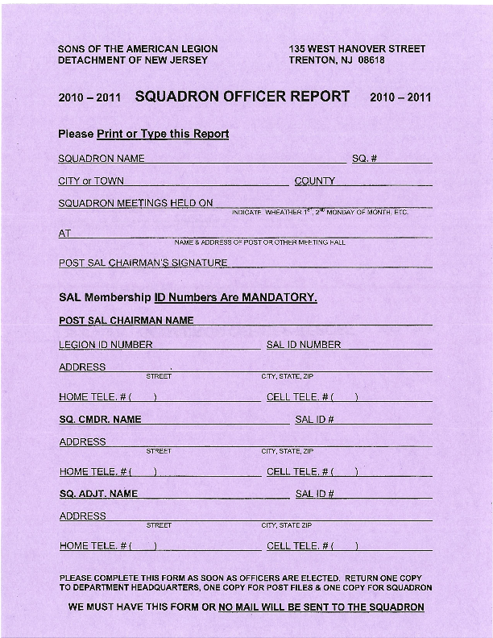
Sample
Certification
Of
Squadron
Officers
Report Form

Slide 25
Fundamentals of Squadron Organization
When a member moves, or a new member is signed up, be sure to record his correct address, and all contact information using the Membership Transmittal Form.

Slide 26
Recruiting & Retention
Assess you current Squadron membership makeup by:
Abilities (physical limitations)
Age groups (How old are they?)
Residence (Where do they live?)
Attendance (Are they involved?)

Slide 27
Recruiting & Retention
Whom should the Squadron actively recruit as members?
All Legion members and sons.
Dual members.
Enthusiastic individuals.

Slide 28
Recruiting & Retention
Are you raising the bar? What is the long term potential of each new recruit?
Will he be active?
Will he be a leader?
Can he help recruit more members?
Is he genuinely interested or just interested in the bar?

Slide 29
Recruiting & Retention
What is required of new members?
Dues should cover operating costs.
New members should attend their first meeting to submit their application.
New members should be assigned a mentor.

Slide 30
Recruiting & Retention
Keeping in touch with your Members
Newsletters are very important
Email messages
Phone calls
Building Squadron spirit
Community service projects
Donations to charity
Awards and attention
Publicity

Slide 31
Proof of Eligibility
Proof of membership eligibility is required for each member and must be kept on file in the Squadron's records indefinitely
Foster child status does not qualify as eligible

Slide 32
Proof of Eligibility
Applicants must be a lineal descendant of the veteran through whom eligibility is established. A lineal descendant means a direct bloodline or a legally inferred bloodline such as:
Mother of Father/Son
Grandparent/Grandson
Stepparent/Stepson
Adopted parents/Adopted son
Great-grandparents/great-grandson.

Slide 33
Proof of Eligibility
Each applicant must provide a true copy of one of the following documents:
DD214
Discharge & Separation Form
Honorable Discharge Certificate
Legion parents current membership card

Slide 34
Proof of Eligibility
Eligibility cannot be established through:
Brothers
Sisters
Cousins
Aunts
Uncles

Slide 35
Life Membership
Life Membership can only be conferred by a members' own Squadron. Election to Life Membership must be recorded in the minutes of the Squadron meeting.
Each Squadron determines the qualifications for Life Membership. Life Member-ship is an honorary title.

Slide 36
Life Membership
Each Squadron assumes the obligation to pay Detachment and National dues each year during the members' lifetime. This is a financial liability for the Squadron.
Life Membership is non-transferable and is only valid as long as the member remains in the Squadron that conferred the honor.

Slide 37
Life Membership
Squadrons must keep ac-curate records regarding Life Members. The National Organization will not acknowledge or record "Life Membership" status on membership cards of membership records.

Slide 38
Life Membership
Life Membership regalia, such as commemorative membership card, embroidered patch and lapel pins are available for purchase through National Emblem Sales.

Slide 39
Organizational Structure
National Organization
(Policy & Programs)
Detachment
(Administration & Publicity)
District
(Coordination)
District
(Coordination)
District
(Coordination)
Squadron
Membership
&
Activities
Squadron
Membership
&
Activities
Squadron
Membership
&
Activities

Slide 40
Squadron Officers Duties
Squadron Commander
Chief Executive Officer
Spokesman for the Organization
Supervises all other officers

Slide 41
Squadron Officers Duties
Squadron Commander
This individual is entrusted with the important duty of teaching and protecting the cardinal principles of the Sons of The American Legion and the supervision of duties of all other officers of the squadron. He is guided by the squadron constitution and by the decision of the squadron as a body. Yet, responsibility for the squadron's success rests largely upon his shoulders.

Slide 42
Squadron Officers Duties
Squadron Vice Commander
Deputy Chief Executive Officer
Acts for the Commander in his absence or removal
Chief recruiting officer
Responsible for organizing activities and programs

Slide 43
Squadron Officers Duties
Squadron 1st Vice Commander
The responsibilities of this office are devoted largely to the membership enrollment activities of the squadron and other duties as assigned by the Commander. There is nothing more important to the life and blood of the squadron then the membership. The First Vice Commander should be willing and able to fill in for the Squadron Commander if the need arises.

Slide 44
Squadron Officers Duties
Squadron 2nd Vice Commander
The responsibilities of this office are concerned primarily with patriotic observances, the development of squadron activities, and planning entertainment and social features that may be scheduled in conjunction with squadron meetings.

Slide 45
Squadron Officers Duties
Squadron Adjutant
Chief Administrative Officer
Official record keeper (minutes, reports, etc.) Official correspondent for the organization
Certifies officers and delegates

Slide 46
Squadron Officers Duties
Squadron Adjutant
This officer is the secretary of the squadron, maintaining contact with individual squadron members and higher levels of the organization, keeping squadron records, and publishing any necessary orders, announcements, and instructions.

Slide 47
Squadron Officers Duties
Squadron Finance Officer
Fiscal Officer
Keeps financial records, Administers the treasury
Handles receipts, deposits and disbursements .

Slide 48
Squadron Officers Duties
Squadron Finance Officer
This officer has the responsibility of receiving squadron moneys and paying all Squadron bills when the Squadron Commander, and/or the Post Officials have given authorization for payment. The Finance Officer should have financial reports ready for every Squadron meeting.

Slide 49
Squadron Officers Duties
Squadron Chaplain
Spiritual Officer
Offers prayers at all organization functions
Officiates at memorial services and funerals
Sends condolences and get well messages .

Slide 50
Squadron Officers Duties
Squadron Chaplain
This officer is responsible for the spiritual leadership of the squadron. In addition to attending all meetings, he should be ready upon occasion to take part in the initiation of new members, dedication ceremonies, and the funeral services of a comrade. His opening and closing prayers should be in tune with the type of meeting being attended. The Chaplain needs to be aware of the sick and injured members of the Squadron and take it upon himself to send the appropriate cards or well wishes.

Slide 51
Squadron Officers Duties
Squadron Historian
Archives Officer
Prepares annual report of the organization
Maintains and preserves important records

Slide 52
Squadron Officers Duties
Squadron Historian
This officer maintains a current record of the activities of the squadron as a means of continuing a historical account of its endeavors over the years. The Historian should start a scrapbook, take pictures, send articles to newspapers, and become the public relations persons of the squadron.

Slide 53
Squadron Officers Duties
Squadron Judge Advocate
Legal Counsel
Offer’s rulings on parliamentary procedures, constitutionality, etc.
Advises the Commander and other officers about their authority when asked
Serves as parliamentarian

Slide 54
Squadron Officers Duties
Squadron Sergeant-At- Arms
Security Officer
Maintains order and decorum during meetings
Has custody of the colors and other physical assets
Responsible for setting p the meeting room

Slide 55
Squadron Officers Duties
Squadron Sergeant-At-Arms
This officer is the sentinel or outer guard of the squadron. In addition to being the custodian of the flag and squadron standards, he should be ready at all times to assist the Squadron Commander. During meetings, he is the eyes and ears for the Commander, keeping the flow of traffic to a minimum during meetings and announcing and escorting any guests to the speakers table.

Slide 56
Role of The Advisor
Must be a Legion Member of the Sponsoring Post
Major focal point “GO between” for Post and SAL Squadron
Focal Point for Squadron
Focal Point for Legion Post
Someone who wants the job
Wears two (2) hats (not necessarily dual member)
Provides Guidance (mentor)

Slide 57
Role of Advisor
Critical To Success of Program.
Advocate – Act as Liaison between Squadron and Post.
Must have strong Leadership Qualities.
Desire to see SAL Program grow.
Develop Great working Relationship with SAL Leaders.
Provide advice and oversight when necessary with all operations of Squadron.
Assist & Advise to ensure proper “Operation” of Squadron.

Slide 58
Role of The Advisor
Advisor Functions
Monitor Administrative matters (address changes, data forms, preparation of membership cards, membership registers
Recognition and Encouragement
Communications with members

Slide 59
Role of The Advisor
Advisor Functions
SAL Interests
Growth (membership)
Renewals
Membership Teams
Activities based on age
Preparation of Reports for Post/Dept
Get involved with Post (Joint Activities)
SAL meetings (be in attendance)
Assist with Bulletins; Newsletters

Slide 60
Advisor’s Responsibilities
To represent the best interest of both the Squadron and the Post
To Advise
To Mentor
To Provide Leadership

Slide 61
Advisor’s Responsibilities
To Observe (see that meetings of the Sons of The American Legion are conducted according to the Bylaws, Roberts Rules of Order.)
Insure that Squadron operations do not conflict with Post policy and procedure
All meetings to be with God and Country to be treated with the proper ritual, tradition, and decorum.
Respect the Flag

Slide 62
Advisor’s Responsibilities
See that all members needs are being met and all programs and events held by the Sons of The American Legion are conducted in the best interest of the sponsoring Post and The American Legion Family.
Proper protocol is observed when working with all members of the Legion Family

Slide 63
Advisor Tools
Squadron Handbook
American Legion Officers Guide and Ceremonies Guide
Detachment Information & Officers
Legion Experience

Slide 64
Self Assessment Do you have the Skills?
I look for positive challenges during periods of change…
I’m willing to take risks and learn from mistakes…
I regularly acknowledge others’ accomplishments…
I reflect the values I claim to believe in…
I look for ways to share power…

Slide 65
Self Assessment Do you have the Skills?
I delegate tasks with authority and decisiveness…
I have written long range plans and I am committed to them…
I know how to motivate other people…
I know how to promote team effort and spirit…
I regularly give honest, constructive feedback to my team…

Slide 66
Self Assessment Do you have the Skills?
I make decisions in a timely manner…
Striving to answer “YES” on each of these questions is a worthy goal for any leader. Any questions that you answered with “SOMETIMES” or “NO”, should become your goals for improvement. Leadership is a quality that you must possess to be successful.
Take some time and list your leadership goals and strive to achieve these goals.

Slide 67
Self Assessment The Basics… You Must:
Treat all members equally and give each personal attention as required.
Keep the promises that you make to all team members.
Be consistent and act positively, Even if you feel negatively.
Set a good example and support organization policies and procedures.

Slide 68
Self Assessment The Basics… You must:
Stay calm, Understand that others tend to imitate a leader’s reactions under pressure.
Provide opportunities to meet and exchange ideas with your team members.
Make sure all of your goals are clearly communicated and understood.

Slide 69
Leadership Characteristics
Be Honest
“to thy own self be true”
Be Ambitious
an ambitious person wants to improve things than can be improved: himself, his organization and his community.
Be Enthusiastic
an enthusiastic person is a happy, cheerful person. He enjoys life.

Slide 70
Leadership Characteristics
Be curious
a curious person is not a troublemaker, and he is never concerned with personalities, as such. He has the ability to distinguish right from wrong, and make a stand for the higher qualities.
Be Poised
to be poised is to have the ability to think fast and adapt to situations, to be able to put others at ease. A poised person is tactful, kind, and considerate; cultivates a sense of humor and is able to accept criticism graciously.

Slide 71
Leadership Characteristics
Be Self-Confident
a self-confident man does the best with what he has and is proud of it. He is an individual, not a carbon copy; he is reasonable and tolerant.
Know Your Organization and Its Programs
the ability to seek out and assimilate information needed to help in the administration of programs is one of the requirements of a leader, but actual practice in the programs themselves is the only way of developing this skill.

Slide 72
Leadership Characteristics
Look the Part
our leaders represent our organization in the community. What the community thinks of our leaders, they quite often think of our organization. Common sense will often tell you what is right and what is not.

Slide 73
Leadership Characteristics
A leader is one who has followers. A leader deserves to have followers if he has earned recognition. Authority alone is no longer enough to command respect.
A leader sees things through the eyes of his followers.
A leader does not say, “Get going!” Instead, he says, “Let’s go!”

Slide 74
Leadership Characteristics
A leader assumes that followers are working with him, not for him. He considers them partners in the work, and sees to it they share in the rewards.
A leader duplicates himself in others. He helps those under him to grow big because he realizes that the more big people an organization has, the stronger it will be.
A leader does not hold people down; but lifts them up.

Slide 75
Leadership Characteristics
A leader has faith in people; believes in them, trusts them, and thus draws out the best in them!
A leader uses his heart as well as his head. After the facts have been seen, he lets his heart take a look too.
A leader is a self-starter. He creates plans and sets them in motion. He is a person of thought and of action - both dreamer and doer!

Slide 76
Leadership Characteristics
A leader has a sense of humor, is not a “stuffed shirt”, can laugh at himself- has a humble spirit.
The future belongs to those who prepare for it; and developing tomorrow’s leaders - active members, chairmen and officers - is our challenge. You too can excel in “The Art of Leadership.”

Slide 77
Leadership Characteristics
Set goals
A leader must help the group identify group goats and assist in achieving them. Goal identification provides aim and direction for program development. Goals should be made viable and understandable for the membership.
Take the Initiative
The true leader moves out in front making suggestions and offering different courses of action. The leader cannot wait for the group to come to him. He must be ready to start the action.

Slide 78
Leadership Characteristics
Be Cooperative
Authoritarian leadership is characteristic of dictatorial situations. Force and threat are its only tools. The Democratic leader shows a willingness to want to cooperate. It must always be remembered that the leader cannot do it alone.
Communicate Effectively
The leader must develop a comprehensive set of 2-way communication systems. The leader must send and receive messages effectively. That means the leader must improve listening, writing, speaking and non-verbal skills.

Slide 79
Leadership Characteristics
Show Empathy
The leader must have feelings for those that he leads. He must be able to put himself in the other person’s shoes. The leader must know the frustrations, fears, limitations and problems as viewed from the other persons’ point of view.
Be Creative and Original
New problems and new challenges require different approaches. Every opportunity should be provided to allow creative suggestions for program development.

Slide 80
Leadership Characteristics
Be of Service
Some people think a leader dominates the group to get them to do what he wants. Instead, research indicates that a person will be considered a leader when he has something to offer as a service to a group.
Inspire Others
The leader must provide the environment that will motivate the membership toward achievement of determined goals.

Slide 81
Leadership Characteristics
Show Appreciation
The leader must show appreciation for every effort and every contribution made by the members of the group. Appreciation achieves the highest returns and does not cost a cent. Develop a system of rewards.
Encourage Active Participation
People who are actively involved in a program are more highly motivated. In a game situation, would you rather watch or participate? Members must be encouraged to become active in making decisions, solving problems and taking part in meetings. Only then, will members be highly motivated.

Slide 82
Leadership Characteristics
Demonstrate a positive Attitude
The best way for a leader to fight apathy is with positive offensive. Every opportunity must be extended to show confidence and satisfaction toward the program and for the people involved in its activities.
Build Self-Esteem
A leader builds self-esteem and self-worth in its membership. This is one of the strongest motivational forces. Everyone wants to count, - be important, and - think they are valued. In addition, we are made to feel good about ourselves by those around us.

Slide 83
Leadership Characteristics
Be Enthusiastic
An enthusiastic leader develops enthusiastic group members. Enthusiasm generates momentum and helps build high morale. Everyone wants to be a winner and a winner displays enthusiasm.

Slide 84
Team Building Characteristics
Regardless of the situation or work environment, effective teams demonstrate certain common characteristics. Leaders need to develop these characteristics in their teams. An effective leader makes sure ⇒ ⇒

Slide 85
Team Building Characteristics
Team members understand and share the leader’s vision.
Group members respect and ideally like one another.
Individuals derive satisfaction from being a member of the team.
Communication is open and all members are encouraged to participate in discussion and, where possible, decision-making.

Slide 86
Team Building Characteristics
The group has a sense of team pride.
There is little conflict on the team, and when conflict occurs, it is handled using consensual decision making techniques.
Group members are encouraged to cooperate with each other.
Group decision-making and problem –solving is commonly practiced.

Slide 87
Team Building Characteristics
The group learns to work in a relaxed fashion.
Team recognition and credit for a good job is freely given.
Team members understand and share goals, objectives, and mission.

Slide 88
Seven Basics of Team Leadership
As the leader of your team, you must ensure that the mood of your group is consistently upbeat and the activities it pursues are productive. Seven ways to help accomplish this are listed on the next frame:

Slide 89
Seven Basics of Team Leadership
Treat all members equally and give each personal attention as required
Keep the promises I make to all team members.
Be consistent and act positively, even if I feel negatively.
Set a good example and support organization policies and procedures.
Stay calm, I understand that others tend to imitate a leader’s reactions under pressure.
Provide opportunities to meet and exchange ideas with my team members.
Make sure all my goals are clearly communicated and understood.

Slide 90
Seven Basics of Team Leadership
If you find yourself guilty of not following any of the seven basics, take time to decide how to remedy the situation. Leadership, like other skills, can be continually improved through practice, practice, and practice!

Slide 91
CHARACTERISTICS OF TEAM MEMBERS
Each member of any team has individual strengths and weaknesses. As a team leader, you must learn to use your team’s attributes to get the job done as efficiently as possible.

Slide 92
CHARACTERISTICS OF TEAM MEMBERS
You also have your personal characteristic, which needs to be considered. Use the information you discovered earlier about your style of leadership and then apply similar characteristics to your team players. You can best motivate your team to perform when assignments match personalities.

Slide 93
CHARACTERISTICS OF TEAM MEMBERS
THE TRADITIONAL TEAM PLAYER
Is drawn to close relationships
Changes slowly
Is predictable
Is patient
Prefers a secure situation
Likes to identify with the organization
Supports the status quo
Is possessive
Looks for loyalty
Likes an easy-going, relaxed atmosphere
Views the team as important

Slide 94
CHARACTERISTICS OF TEAM MEMBERS
THE ANALYTICAL TEAM PLAYER:
Likes established operating procedures
Does not like sudden change
Believes that precision works and is accurate at all costs
Has very high standards for self and others
Tends to worry
Is conventional
Tends to hold back opinions unless certain they are right
Is very conscientious
Is slow decision maker
Takes a rational, problem-solving approach to tasks

Slide 95
CHARACTERISTICS OF TEAM MEMBERS
THE DOMINATING TEAM PLAYER:
Likes prestige and position
Is easily bored
Likes challenge and change
Measures worth in terms of accomplishments
Likes direct answers from others
Does not like to be controlled by others
Has high self-assurance
Is very assertive and decisive
Is a good risk-taker
Plays a game to win
Is quick am impatient
Is forceful and demanding

Slide 96
CHARACTERISTICS OF TEAM MEMBERS
THE CHARISMATIC TEAM PLAYER:
Thrives on popularity and social recognition
Likes freedom from detail and control
Uses intuition well
Is sympathetic
Is friendly
Uses verbal skills well
Is trusting
Is good at persuading and charming people
Acts impulsively and emotionally
Acts confident and comfortable with self-promotion
Is enthusiastic

Slide 97
Building the Team
“None of us is as
smart as all of us”

Slide 98
Building the Team
P.E.R.F.O.R.M. is a good place to start
P urpose & Values
E mpowerment
R elationships and Communication
F lexibility
O ptimal Performance
R ecognition and Appreciation
M orale

Slide 99
Building the Team
As you look at his new acronym, P.E.R.F.O.R.M. please recognize that the by-products of building a great team are optimal performance, (winning), and good morale—members will be excited about being part of the team. To get high performance and high morale requires providing a clear purpose with shared values and goals, unleashing and developing skills (empowerment and flexibility), creating team power (relationships and communication), and keeping the accent on the positive (recognition and appreciation).

Slide 100
Building the Team
Lets pretend that “Building the Team” is like playing on a Hockey Team…
Control of the P.U.C.K. is of maximum importance

Slide 101
Building the Team
P Providing Clear Purpose and Values
A Compelling Reason for Being
Create a challenge, a reason for being, a “holy grail” that commits and motivates people to work together.
Set clear and compelling goals and strategies, both for the individual and the team.
Be clear on your values.
Create a team charter that formalizes commitments to each other and clearly states what the team wants to accomplish, why it is important, and how the team will work together to achieve results.

Slide 102
Building the Team
U Unleashing and Developing Skills
Developing Your Bench Strength
Start with the basics. Build individual skills that will bolster team skills.
Provide feedback to build skills, confidence, and accountability.
Learn each other’s roles.
Build a sense of personal and collective power by using your individual and collective skills to achieve extraordinary results.

Slide 103
Building the Team
C Creating Team Power
None of us is as smart as all of us. (Synergistic harmony).
Build a game plan for the team and stick to it.
Share leadership.
Reward team work.
Rotate positions to build flexibility, introduce change, and build mental and physical skills.
Turn individual skills into team skills.

Slide 104
Building the Team
K Keeping the Accent on the Positive
Repeated Reward and Recognition
Look for behaviors that reflect the purpose and values, skill development, and team work, and reward, reward, reward those behaviors.
Catch people doing things right or approximately right.
Redirect toward the goal; do not punish.
Link all recognition and reward back to the purpose and goals.

Slide 105
Building the Team
“None of us is as
smart as all of us”

Slide 106
Time Management
“Getting Organized”

Slide 107
Stephanie Winston, a well-known consultant on managerial productivity and author of The Organized Executive says, “Getting organized is not an end in itself: it is a means to get where you want to be.”
Focus on where you want to be and what results you want to achieve.
Analyze what you spend time on that contributes to the results you want to achieve.
Organize to meet your goals.
Analyze habits and attitudes that block your effectiveness and learn ways to overcome those habits and attitudes.

Slide 108
Time Management
LEADERS AND TIME MANAGEMENT
“If you want to make good use of your time, you’ve got to know what’s most important and then give it all you got”
Lee Iacocca
President, Chrysler Corp

Slide 109
Time Management
Effective leaders do not travel at reckless speeds… Instead, they:
keep a steady pace,
expect the unexpected
know how to delegate for results, and
don’t waste other people’s time.

Slide 110
Time Management
Controlling time begins with planning. Every work-related action you perform should take you closer to achieving your goals. These actions should also be prioritized according to the relative importance of your goals.
You should maintain a calendar or desk journal that allows you to write action steps for your goals each day.

Slide 111
Time Management
Set aside some time each week (i.e. first thing Monday morning), to go over your goals and determine action steps that need to be taken during the coming week.
Schedule those steps as if they were appointments to be kept during the week. Group common tasks together. For instance, try to set aside a specific time each day to make and return phone calls. This will help eliminate some interruptions.

Slide 112
Time Management
If you have to be away from your office for a meeting or appointment, identify any errands or other meetings you can schedule in that geographic area. This will eliminate wasted motion and reduce time spent traveling.

Slide 113
Time Management
WATCH OUT FOR TIME THEFT!
Q. What happens when members don’t know how to do their jobs, can’t do their jobs because something prevents them, or do not want their jobs?
A. Members become less productive and interested. They commit “time crime.”

Slide 114
Time Management
Time crime is the disappearance of time at the organization’s expense. Time crime takes may forms. Do you recognize any of these? Check those you have experienced:
Inappropriate staffing for the amount of work; too many or too few members.
Procrastination.
Low morale causing negative attitudes and group complaining sessions.
Members saying they forgot what day the meeting or function was.
Members spending more time in lounge area or outside the Post instead of at the meeting or function.
Members who always have an excuse as to why they cannot participate.
Members who say they will show up but never do.
Lack of cooperation with other parts of the organization.

Slide 115
Time Management
10 COMMANDMENTS OF TIME MANAGEMENT:
Plan your activities DAILY.
Do high priority actions FIRST
Learn to delegate effectively.
Group similar activities to save time.
Learn how to handle interruptions efficiently.
Learn to say “NO” to non-critical tasks.
Eliminate inefficient habits.
Mark appointments, meetings, and deadlines on your calendar and review it daily.
Do ONLY those tasks that are appropriate for your position.
Learn the difference between “urgent” and “important”

Slide 116
Time Management
“I would willingly stand at street corners, hat in hand, begging passersby to drop their unused minutes into it”
Barnard Berenson
Art critic, as he neared
90 years of age

Slide 117
Sons of The American Legion National Membership History Since 1993
Notes:
1993 – 161,376
1994 – 172,276
1995 – 180,501
1996 – 189,701
1997 – 201,302
1998 – 211,256
1999 – 223,140
2000 – 234,738
2001 – 247179
2002 – 266,176
2003 – 280,206
2004 – 284,580
2021-

Slide 118
Membership
Know the Program
Set your goal now.
Make it realistic and attainable.
Be aware of the “National Goal Dates”
Make sure that you communicate this goal throughout your Squadron.
Know who your resources are at the Detachment Level
Membership Card Processing

Slide 119
Exact Date Changes each Year Membership Target Dates Sons of The American Legion
September 10%
October 25%
November 35%
December 45%
January 60%
February 75%
March 80%
April 90%
May 100%
*July 105%
*Delegate Strength Target Date
Notes:
Be sure to explain the significance of the 100% target date as it applies to the pre-printed membership cards for the subsequent year.
Also explain the significance of the 105% target date as it applies to National Convention strength.
Make sure that everyone understands that 2004 membership renewals can still be transmitted beyond the 105% date. But that they should begin to collect and transmit 2005 membership at the same time.

Slide 120
Membership Card Processing
Download Processing Instructions from the Internet or Contact your Department/Detachment Headquarters
Become Familiar with the Process
If you are not sure what to do – ASK
Sample Member Record Card

Slide 121
Renewal Membership Cards
If the card is already printed with the name and address of a current member on the opposite side:
Preprinted Membership CARDS

Slide 122
Renewal Membership Cards
When the member pays their dues, fill in the date and your initials on the 3-part card (upper center); sign the member’s card; (make no further entries for a renewal unless a correction is needed).
Preprinted Membership CARDS

Slide 123
Renewal Membership Cards
If the name is misspelled, or the number of years of continuous membership is either omitted or wrong, use a #2 pencil to place an X in the “correction” box on the left section. Pencil is required for automated equipment to pick out this card for necessary correction. Print or type the correct name and/or correct number of years of continuous membership on left and center sections.
Preprinted Membership CARDS

Slide 124
Renewal Membership Cards
Do not use this card to correct an address. Send a completed Member Data Form to your Department Headquarters if address has not already been reported by member
Preprinted Membership CARDS

Slide 125
Pre-Printed Member
Record Card

Slide 126
Sample Blank Member
Record Card

Slide 127
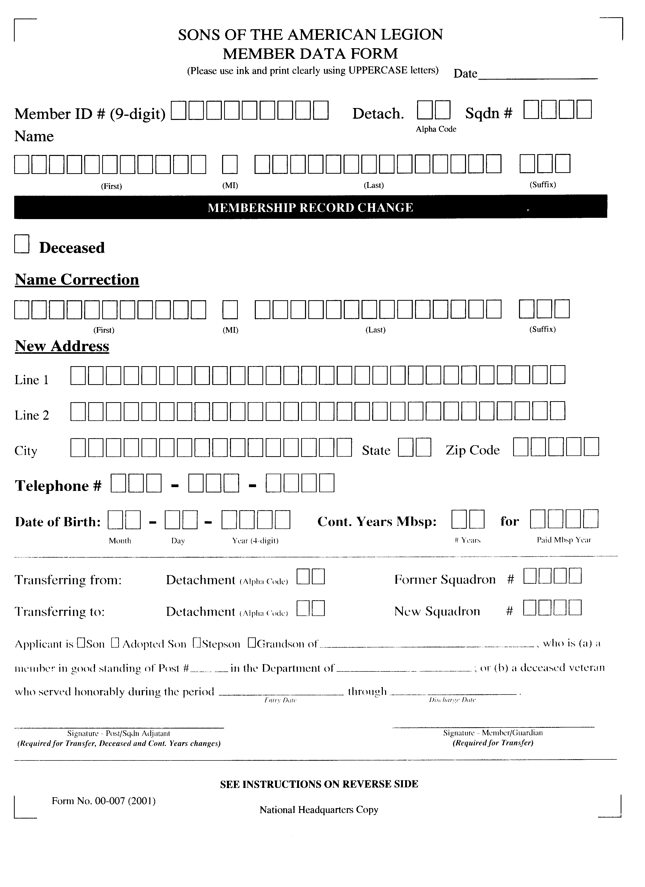
Sample
S.A.L.
(CURRENT)
Member
Data
Form

Slide 128
“New Member” Membership Cards
Use it for a new or transferred member at the time dues are paid.
Type or print the member’s name and years of continuous membership on the Official Membership Card, and sign the card.
Type or print in both sets of boxes on the left and center sections in the space reserved for this purpose: Years of continuous membership; first name, middle initial, last name, mailing address; City, State, Zip Code.
Blank Card

Slide 129
“New Member” Membership Cards
Put an ‘X” in the proper box the middle portion at the upper center to show Renewal, Now Member, or Transfer.
Date and initial the center section.
Mail the left and center sections along with Department and National dues per capita to Department Headquarters. Do not separate the two parts.
Blank Card

Slide 130
“New Member” Membership Cards
Give or mail the member’s official card promptly (the section at the right).
Do not at any time change or strike over the Membership ID Number.
lf the SAL member also belongs to The American Legion, put an “X’ in the box provided for this purpose at the center section of the card.
Blank Card

Slide 131
Programs
Americanism
Legion Baseball
Scouting
Boys State
Boys Nation
Oratorical
Jr. Shooting Sports
Color Guards
Community Service
Flag Education
Citizens Flag Alliance

Slide 132
Americanism
Since its origin, the Sons of The American Legion has extended its activities beyond helping veterans and their families. The Americanism Commission's responsibilities include fighting anti-American activities, educating citizens on Americanism principles, distributing information about the United States government and promoting Americanism education in schools.

Slide 133
Americanism
In order to "foster and perpetuate a true spirit of Americanism" much of its work involves education and citizenship programs especially those for ‑young people such as Boy Scouts, Boys State, and Junior Shooting Sport, etc.

Slide 134
Programs
Children & Youth
National Child Welfare Foundation Inc. (CWF)
Children’s Miracle Network. (CMN)
Special Olympics
Spinoza Bears
Josh Animals

Slide 135
Children & Youth
The mission of the Sons of The American Legion's Children and Youth Commission is to help all children realize their full potential. Three basic goals are:
To help strengthen families
To serve children's physical, intellectual, emotional and spiritual needs
And to support other organizations that help children and youth

Slide 136
Children & Youth
Through the Children and Youth Committee, the Sons of The American Legion supports local, state and federal legislation that would benefit children's status; disseminates information on American Legion programs for children; provides donations to the American Legion Child Welfare Foundation, and supports health and other programs that seek to prevent children's problems.

Slide 137
The American Legion Child Welfare Foundation
Our Mission Though created by The American Legion in 1954, the American Legion Child Welfare Foundation, Inc. is a separate 501 (c) 3 corporation. Our foremost philanthropic priority is to provide other nonprofit organizations with a means to educate the public about the needs of children across this nation.

Slide 138
The American Legion Child Welfare Foundation
History In 1952, Department Commander Dr. Garland D. Murphy, Jr. of Arkansas, came to The American Legion with an offer to provide a valuable contribution if we could figure out some way his gift could be used solely for children. After much study and discussion, the idea of a foundation was adopted. Later that year, the National Executive Committee appointed a special committee to determine the feasibility of establishing such a proposed foundation.

Slide 139
The American Legion Child Welfare Foundation
Eventually, on October 15, 1953, the National Executive Committee approved the establishment of the Foundation and entered into a trust agreement with Dr. Murphy. Legal work was completed, and on July 9, 1954, the Foundation was duly incorporated under the laws of the State of Indiana. At that time, Dr. Murphy assigned to the Foundation deeds to fractional mineral rights on nearly 10,000 acres of land in the oil-rich Williston Basin in Montana and North Dakota.

Slide 140
The American Legion Child Welfare Foundation
In 1955, it gave its first three grants totaling $22,500 to three organizations. The Delinquency Control Institute, the National Association for Retarded Children, and the National Society for the Prevention of Blindness were the first three beneficiaries.
Since 1988, S.A.L. has raised more than $6 million and has been awarded to organizations to assist the children of this country from the American Legion Child Welfare Foundation, Inc.

Slide 141
The American Legion Child Welfare Foundation
What if... In it’s 48th year of service, the Foundation awarded $283,900 to 11 organizations. The demand for grant money to serve our nation’s children continues to rise. The Board has initiated a campaign to appeal to Posts and Units to include a line item for the Child Welfare Foundation in their annual budgets. If Posts alone earmarked as little as $25 a year, this would raise over $700,000 in yearly contributions. With these added funds, The American Legion could touch the lives of thousands of children throughout this nation

Slide 142
The American Legion Child Welfare Foundation
In its 64th year, The American Legion's Child Welfare Foundation has awarded $766,761 to 24 nonprofits. These grants, determined during the annual meeting of the CWF board of directors in Indianapolis on Oct. 14, have been awarded to support youth-serving projects that seek to enhance the lives of children by addressing their physical, mental, emotional and spiritual needs. Since the foundation made its first three grants in 1955, more than $15 million has been awarded to assist the needs of children.
The following are the CWF grants awarded for 2019:

Slide 143
CWF Grants - 2019
American Printing House for the Blind of Louisville, Ky., was awarded $21,029 for its project, “Braille Tales: Sharing the Joy of Reading.” This grant will provide Braille Tales books to 2,500 visually impaired children throughout the country.
Building Better Days of Edgewater, Md., was awarded $10,000 for its project, “Power of Play.” This project provides pediatric patients with a building toy to take their mind off of treatments. The American Legion Auxiliary supports this grant.
Children’s Hospital and Medical Center Foundation of Omaha, Neb., was awarded $12,000 for its project, “Safe Sleep Education Program.” This project will fund Halo Sleep Sacks to more than 1,500 hospitals in North America.
Children’s Organ Transplant Association of Bloomington, Ind., was awarded $6,000 for its project, “The American Legion Family Friendly Fundraising Initiative.” This project will create The American Legion Family Friendly Fundraising Guide online to support COTA families and local post activities throughout the nation.
Families Helping Families NOLA of New Orleans was awarded $10,000 for its project, “Computer Coding for young people with Autism.” This project will provide success for youth with autism.
Father Flanagan’s Boys Home of Boys Town, Neb., was awarded $35,000 for its project, “Boys Town National Hotline: suicide prevention and mental health outreach.” This project will fund 18 weeks of online outreach in 2019 for the Boys Town Hotline.
Gift of Adoption of Techny, Ill., was awarded $25,000 for its project, “Adoption Support for Vulnerable Children.” This project will fund the final needs to complete the adoption of vulnerable children in the United States, giving them permanent families and the chance to thrive.
Gulf Coast Council – Boy Scouts of Pensacola, Fla., was awarded $7,000 for its project, “Rebuilding the Adventure for Generations to Come - Youth Camping Program.” This project will sponsor a handicap water lift for Scouts summer camping program.

Slide 144
CWF Grants - 2019
John Hopkins All Children’s Hospital of St. Petersburg, Fla., was awarded $25,200 for its project, “Pragmatic Acquisition of Language Skills, P.A.L.S. - A therapeutic Social Skills Group.” This project will provide a program for small group instruction of students on the high-end autism spectrum who have near-normal to above-average verbal and nonverbal skills.
Mercy Medical Angels (MMA) of Virginia Beach, Va., was awarded $51,000 for its project, “Angel Wings and Wheels for Children.” This project will maintain MMA's website to more effectively promote its services for children and to promote its MayDay4KIDS annual campaign to raise funds.
National Autism Association of Portsmouth, R.I., was awarded $58,408 for its project, “Big Red Safety Box.” This project will fund Big Red Safety Boxes designed to educate, raise awareness and provide tangible tools that may assist in preventing and responding to dangerous wandering-related incidents in the autism community.
Organization for Autism Research of Arlington, Va., was awarded $14,250 for its project, “A Parent's Guide to Research: 2019 Outreach.” This project will print and distribute the revised resource.
Our Military Kids of McLean, Va., was awarded $53,905 for its project, “Empowering a Generation of Military Kids.” This project will fun award packets, publish their quarterly newsletter and annual impact report, update the program website, and produce a benefits video.
Pediatric Brain Tumor Foundation of Asheville, N.C., was awarded $15,500 for its project, “The Starfolio Resource Notebook for Families of Children with Brain Cancer.” This project will provide a free resource notebook designed to help families of newly diagnosed patients partner with their child's health care team and organize medical information during treatment.

Slide 145
CWF Grants - 2019
St. Vincent Hospital Foundation of Indianapolis was awarded $6,714 for its project, “Peyton Manning Children's Hospital at St. Vincent Healing Arts Program.” This project will fund the Healing Arts Program and services that are offered to any child hospitalized at Peyton Manning Children's Hospital at St. Vincent.
The American Legion National Headquarters of Indianapolis was awarded $51,000 for its project “2019 American Legion National Youth Programs Scholarships.” This grant will provide academic scholarships to the following youth programs: Boys Nation, Junior Shooting Sports, Baseball and Eagle Scout of the Year.
The American Legion National Headquarters of Indianapolis was awarded $75,000 for its project “The American Legion Temporary Financial Assistance Program-2019.” This grant will provide temporary financial assistance to children of veterans in need of shelter, food, utilities and clothing.
The American Legion National Headquarters of Indianapolis was awarded $138,000 for its project “The American Legion National Oratorical Contest-2019.” This grant will provide scholarships for youth competing in the 2019 American Legion Oratorical Contest.
The Common Strand Foundation of Dumfries, Va., was awarded $28,500 for its project “Children of PTSD Victims.” This grant will fund a website with kid-friendly downloadable reference material to help children cope with their situation and create a more balanced and nurturing home environment.
The Eight and Forty Foundation of Lake Dallas, Texas, was awarded $15,000 for its project “Breath Better Today for a Healthier Future.” This grant will fund 300 children (with asthma, allergies or cystic fibrosis) the cost of breathing treatment, equipment or medication.

Slide 146
CWF Grants - 2019
ThinkFirst Foundation of Naperville, Ill., was awarded $13,380 for its project, “Protecting Babies from Injury.” This grant will produce five brochures, identification cards and CellSlip pouches to new parents that cover a host of injuries that could cause death or disability.
Too Small to Fail of New York was awarded $50,000 for its project, “Increasing Access to Early Language Development Resources through Diaper Banks.” This grant will add 10 additional diaper banks in especially high-need communities with a focus on agencies that serve military and veteran families.
Truth in Nature of Vila Rica, Ga., was awarded $20,000 for its project, “Truth in Nature Program Expansion.” This grant will fund the opening of new chapters of outdoor Christian ministries for boys from fatherless and single parent homes in the following states: Louisiana, Georgia, South Carolina, North Carolina and Michigan.
United Through Reading of San Diego was awarded $24,875 for its project, “United Through Reading App Book Sponsorship.” This grant will fund books for 5,000 military children.

Slide 147
Children’s Miracle Network
Children's Miracle Network —the alliance of premier hospitals for children—
is a non-profit organization dedicated to saving and improving the lives of children by raising funds for children’s hospitals across North America. Each year the 170 Children's Miracle Network hospitals provide the finest medical care, life-saving research and preventative education to help millions of kids overcome diseases and injuries of every kind.

Slide 148
Josh & Friends
Josh is a sick child’s best friend. He’s a happy-go-lucky retriever, but that wasn’t always the case. Not long ago, the playful pup faced serious surgery, and he shares his story in I'll Be O.K. He talks about hospital visits, tests, and surgery from a dog’s point of view, a perspective shared by children. In I'll Be O.K., Josh doesn’t just bark out facts, he opens his heart and shares his fears, the same ones faced by children. Josh makes a promise to be with a child, and he keeps it. Young Alicia knows that, and her story shows exactly how children can lean on Josh. Most hospitals even allow Josh to accompany a child through pre-op procedures and rejoin the patient in recovery. Even when mom and dad aren’t around, Josh will be there, reminding children that everything will be O.K.

Slide 149
Josh & Friends
Josh and his story have been endorsed by a prestigious group of educators, medical professionals and corporate sponsors including the Children’s Miracle Network, The American Veterinary Medical Association and The American Legion Family (The American Legion, The American Legion Auxiliary and Sons of the American Legion). A portion of each purchase price goes to the Children’s Miracle Network. Find out exactly how purchasing Josh helps by reading our mission.

Slide 150
Spinoza’s “Buddy Bear” Project
Spinoza was created as a healing gift of love. The "buddy bear project" was created for people to extend hope and encouragement to children in their communities.
Spinoza is a powerful form of therapy that benefits children throughout their lives. Spinoza also provides families with an effective tool for facilitating communication in a time of uncertainty or loss.

Slide 151
Special Olympics
The Special Olympics Schools & Youth initiative is committed to increasing the participation of youth without intellectual disabilities in Special Olympics activities by establishing school-based Special Olympics Programs and activities, such as Special Olympics Get Into It (SO Get Into It™, a free service-learning curriculum celebrating diversity) and local, national, regional and global Youth Summits

Slide 152
Special Olympics
The Schools & Youth initiative encompasses several related goals:
Develop new constituencies and leaders for the Special Olympics movement
Promote greater understanding and acceptance of similarities and differences in others among school-age youth
Involve school-age youth in a variety of activities centered on Special Olympics, including participation in Special Olympics sports and events that will enable them to play a positive role in their schools and communities.

Slide 153
Special Olympics
Young people are capable of conveying important information and helping to spread the message of the Special Olympics movement around the world. To help facilitate this, members of the Special Olympics Global Youth Advisory Council contribute to the SO Get Into It Gazette available on the SO Get Into It Web site.

Slide 154
Special Olympics
The Global Youth Advisory Council is made up of alumni from Global Youth Summits conducted every two years at the Special Olympics World Winter or Summer Games. Upon returning home, the Council posts stories and images in the Gazette about terrific activities in their schools and hometown communities.

Slide 155
Veterans Affairs & Rehabilitation
The founders of The American Legion realized that one of the organization's major concerns would be the plight of disabled veterans. The Sons of The American Legion concurs and focuses in on volunteering man‑hours, donating money and equipment for veterans in Veterans Administration facilities, State Veterans Hospitals and Nursing Homes.

Slide 156
Veterans Affairs & Rehabilitation
With our parent organization, The American Legion, being the Nation's largest veterans service organization, it provides medical consultants and attorneys who provide representation before the Department of Veterans Affairs on behalf of its members and veterans everywhere.

Slide 157
Legislative Affairs
The Sons of The American Legion needed a vehicle to effectively present its legislative proposals to The American Legion for amplification to Congress. Thus, the Legislative Affairs Commission was formed. But in addition to this job, the Commission's rapid dissemination of information from local, state and national legislative bodies to our members allows the Sons of The American Legion to respond to issues and rally its members into action.

Slide 158
Public Relations
The goals on the Public Relations Commission are:
Work in concert with other Commissions and Committees and assist them in achieving their goals associated with public and media relations.
To provide the organizations in each Detachment, District and Squadron with news and information that is going on at the National level of the organization and across the country.

Slide 159
Community Service
This broad‑ranging division of the Sons of The American Legion deals with the interaction of members of local Squadrons and other volunteer, civic and service organizations in the community.
Areas such as:
Blood Donations
Food shelves
Boy Scouts
Recycling efforts

Slide 160
Community Service
Areas such as:
Drug education programs
Senior Centers
Interaction with local schools
Sponsorship of Color Guards, Drill Teams ,and Drum and Bugle Corps
Whether it concerns donating money, equipment or man-hours, the impact that members of the Sons of The American Legion Squadrons have in their "hometowns" is indeed far-reaching.

Slide 161
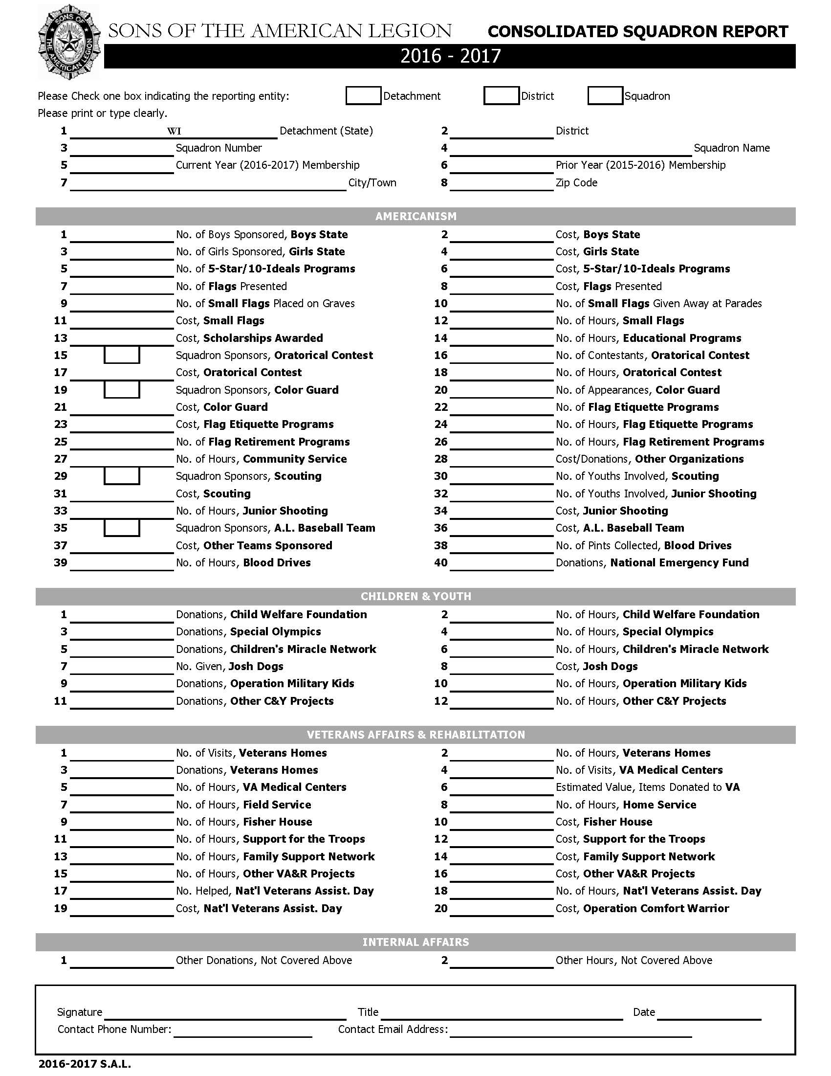
Squadron
Consolidated
Report
Form

Slide 162
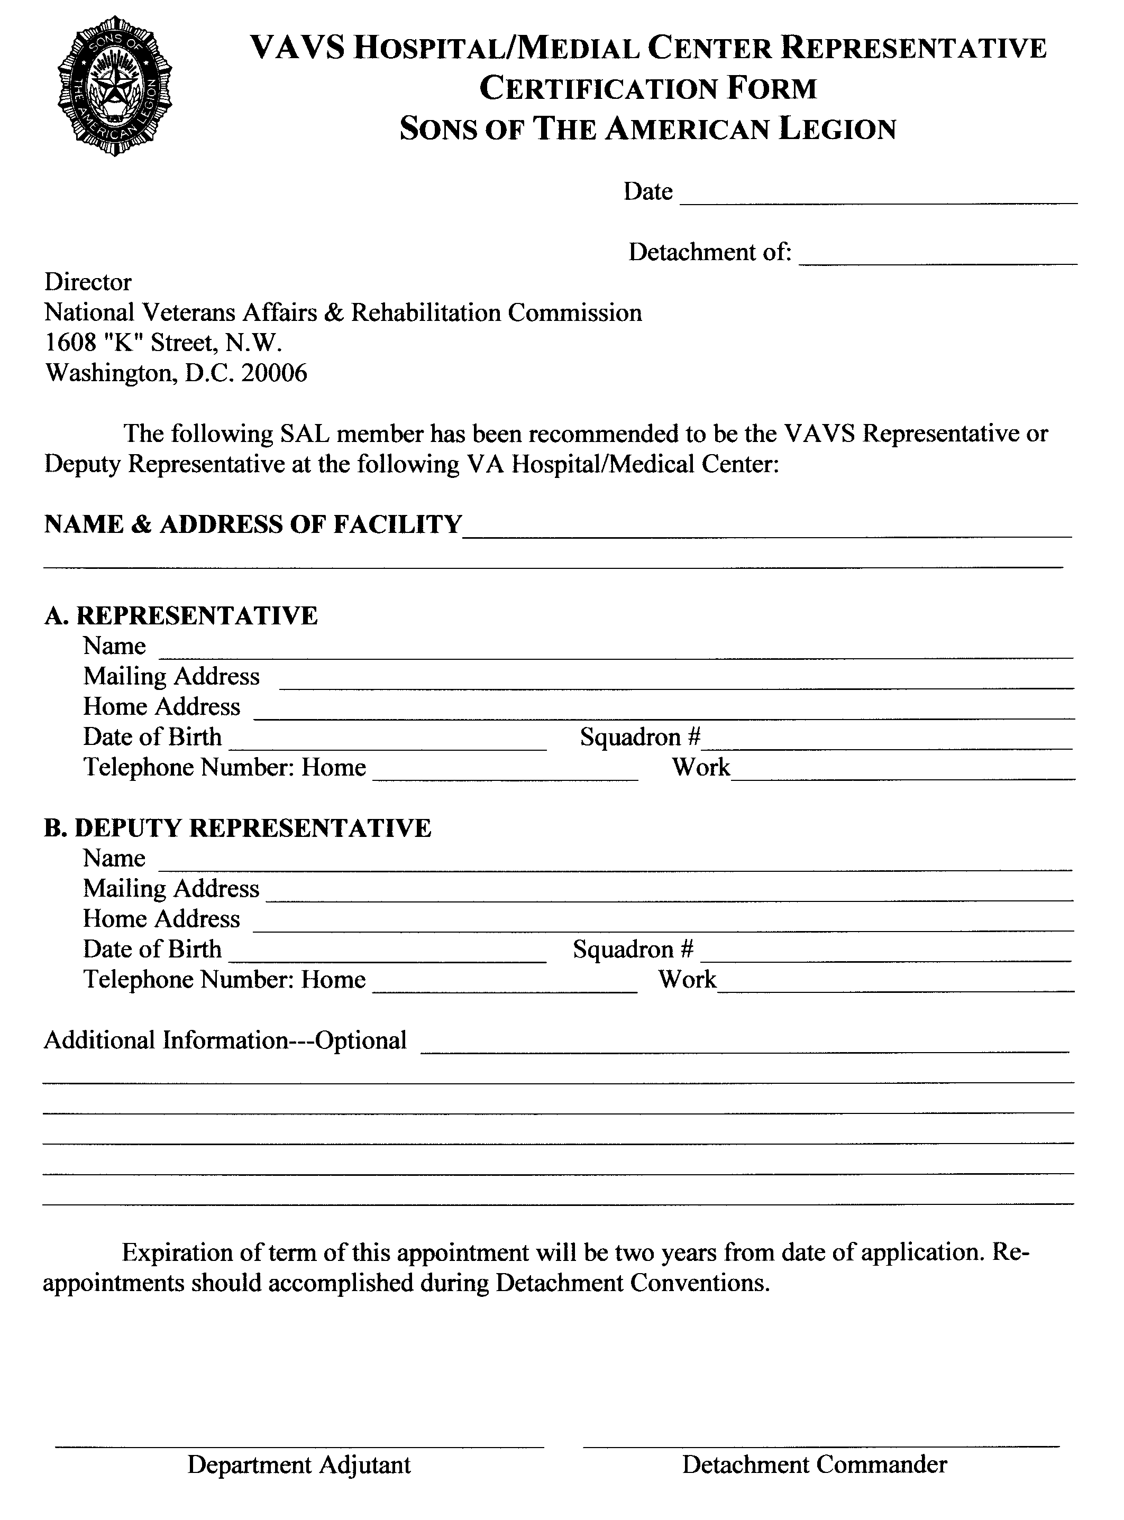
VAVS
Certification
Report
Form
Page 1

Slide 163
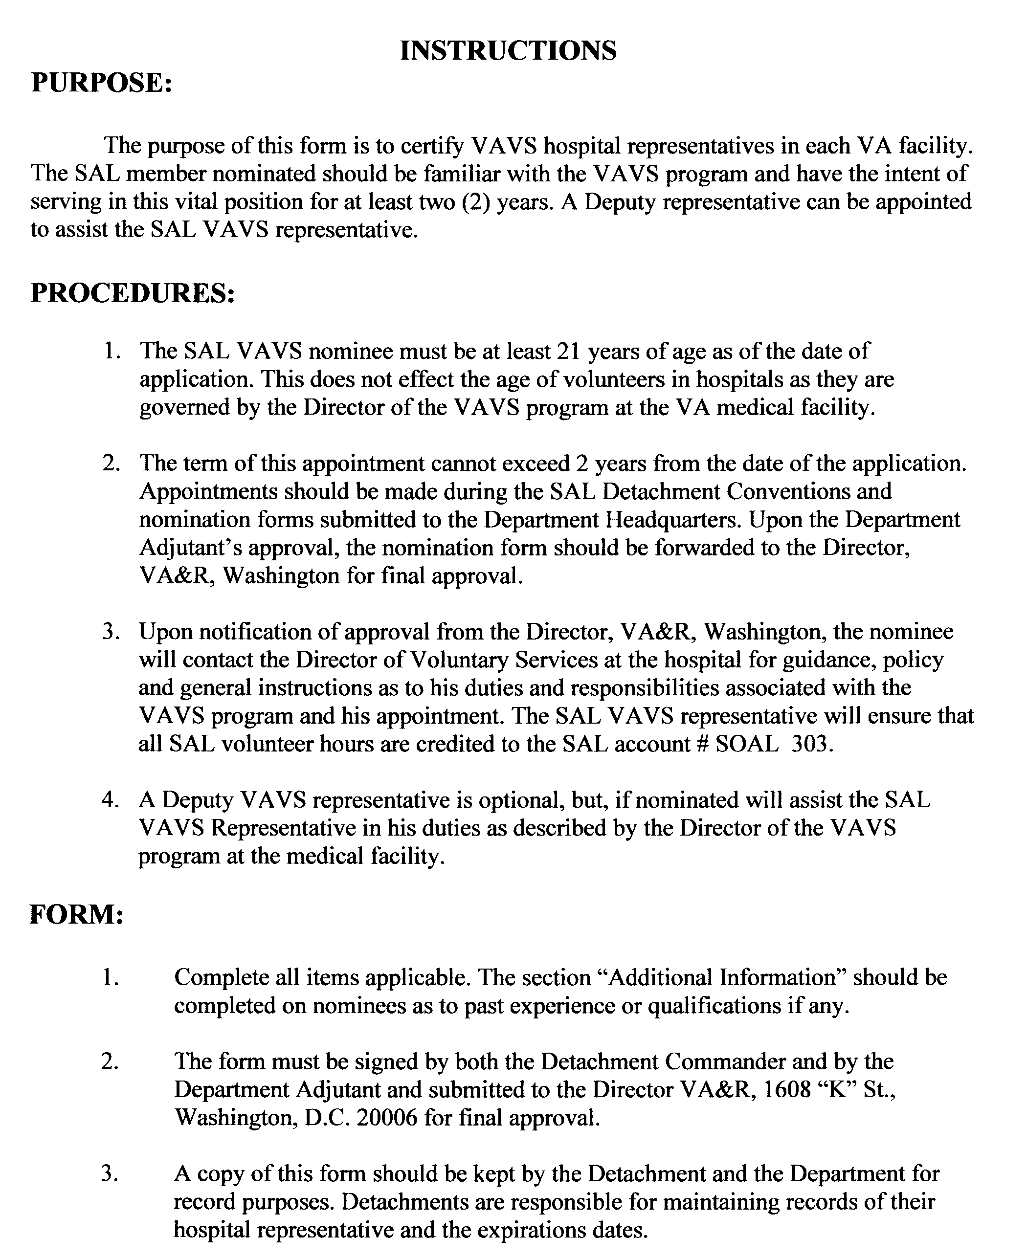
VAVS
Certification
Report
Form
Page 2

Slide 164
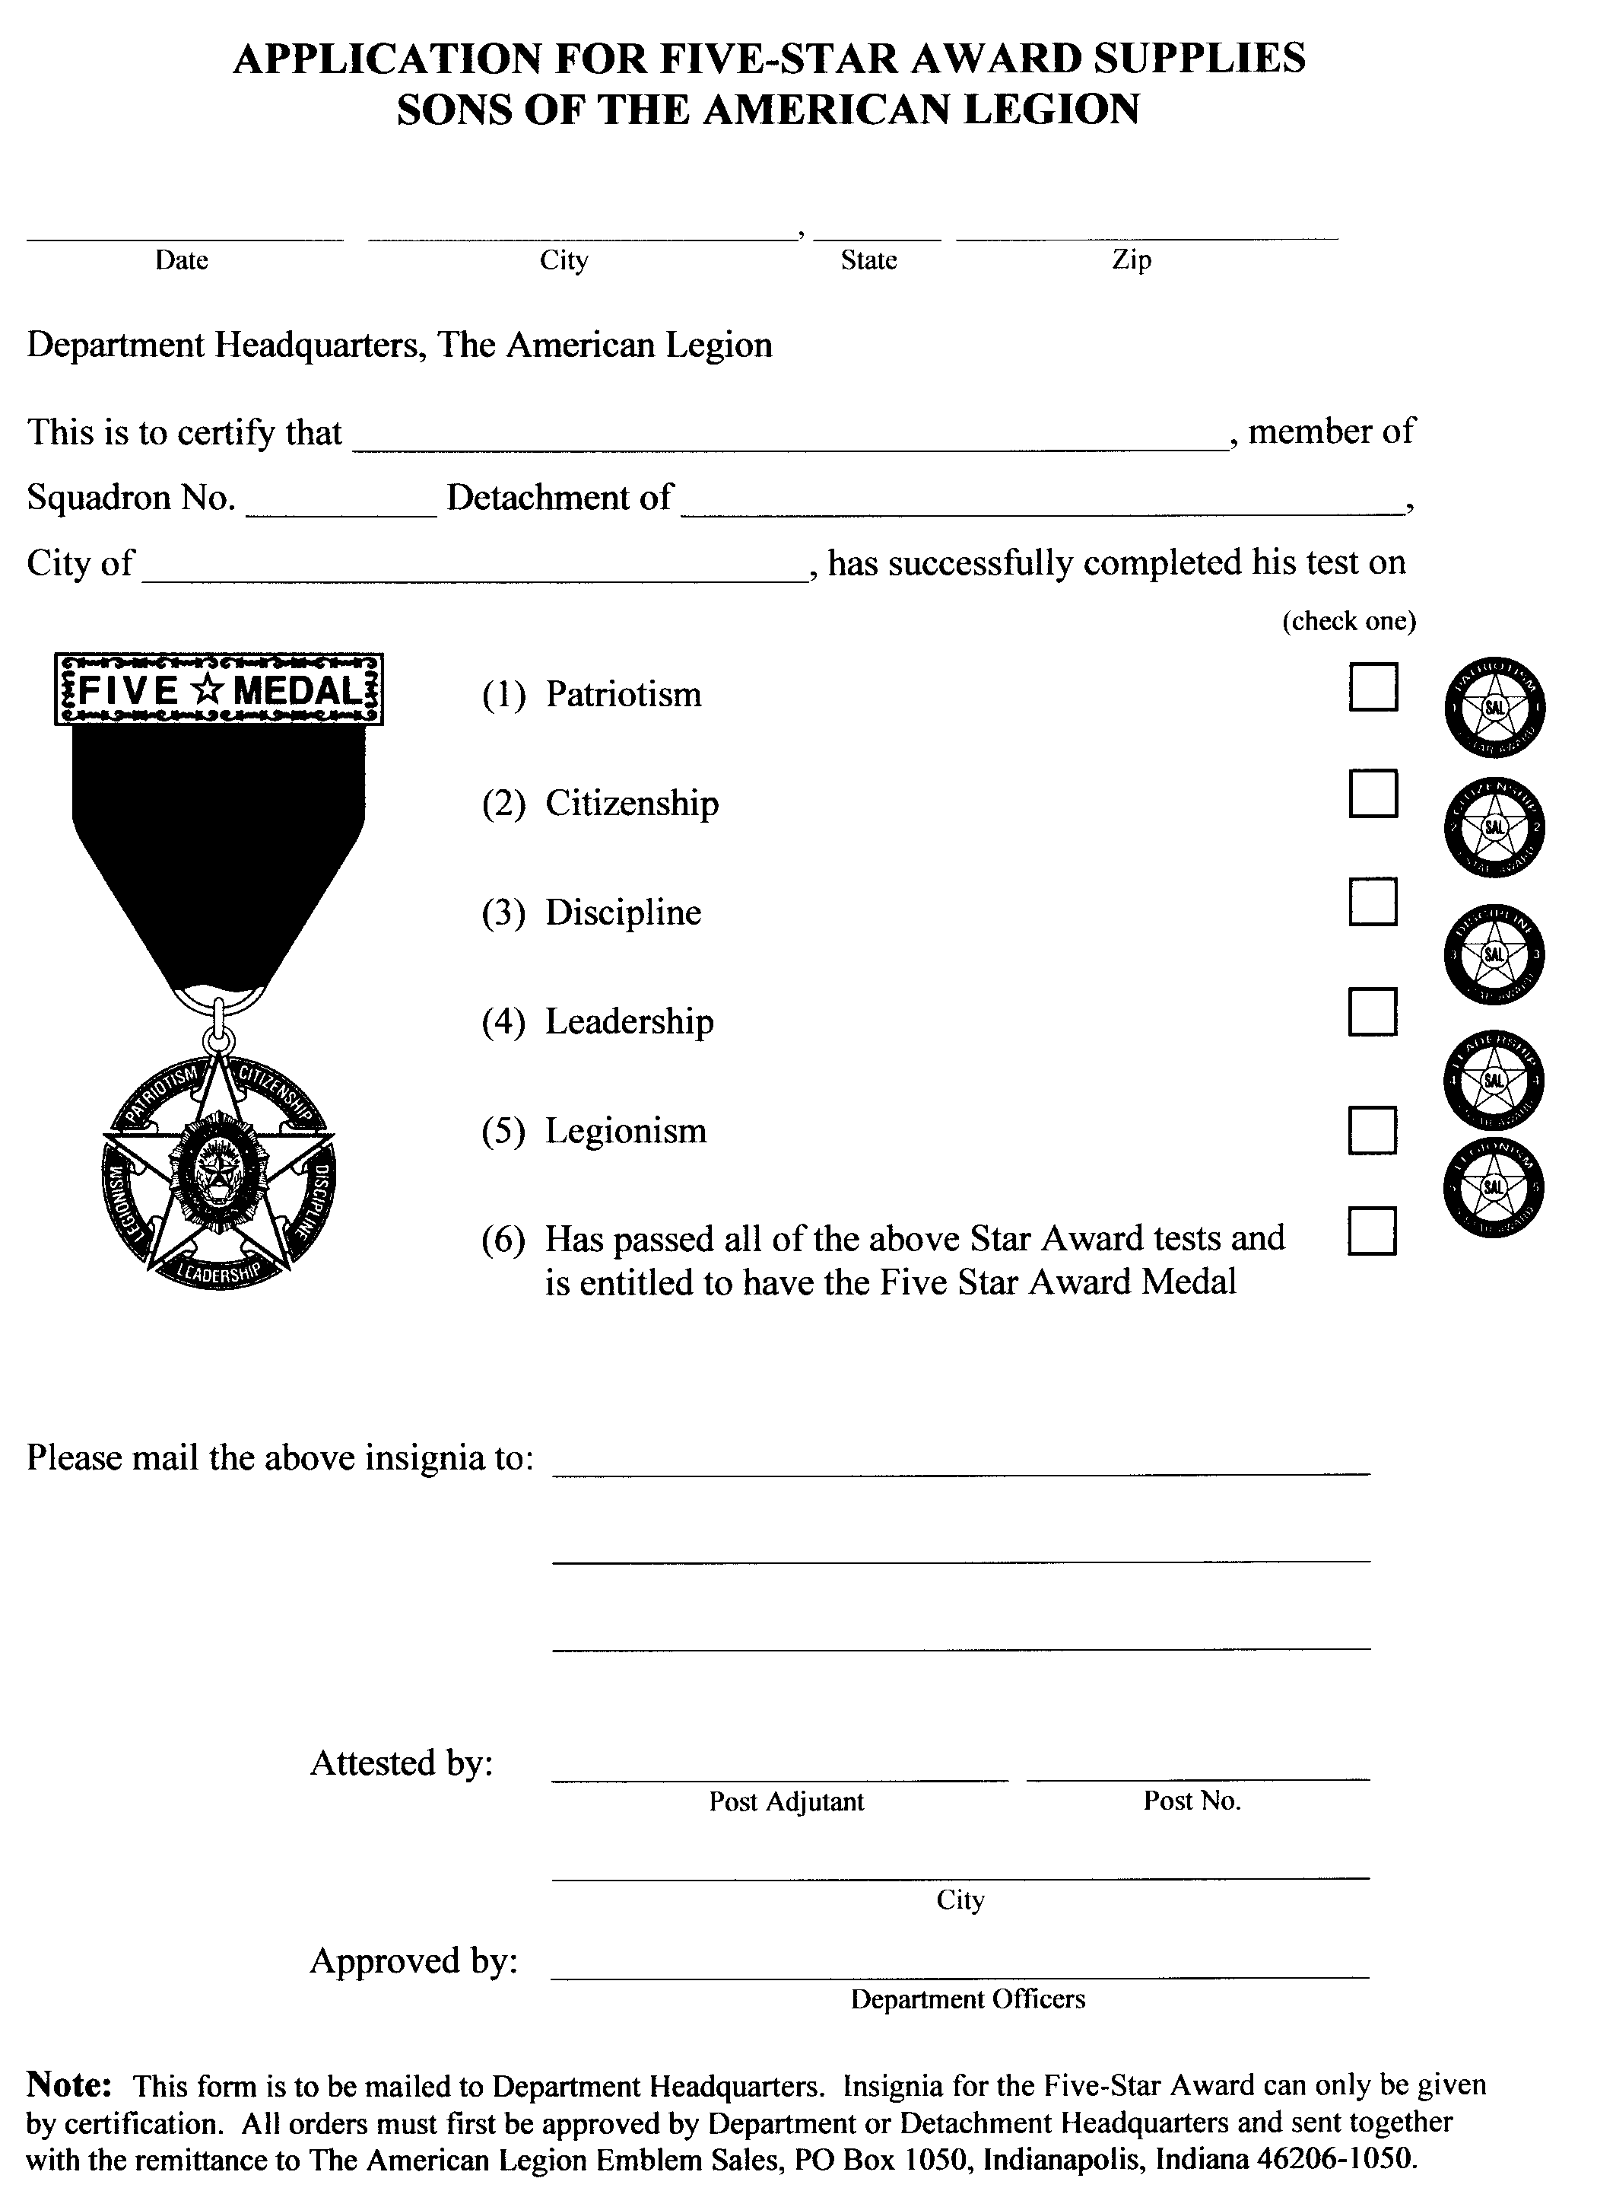
Application
For
5 – Star
Award
Supplies

Slide 165
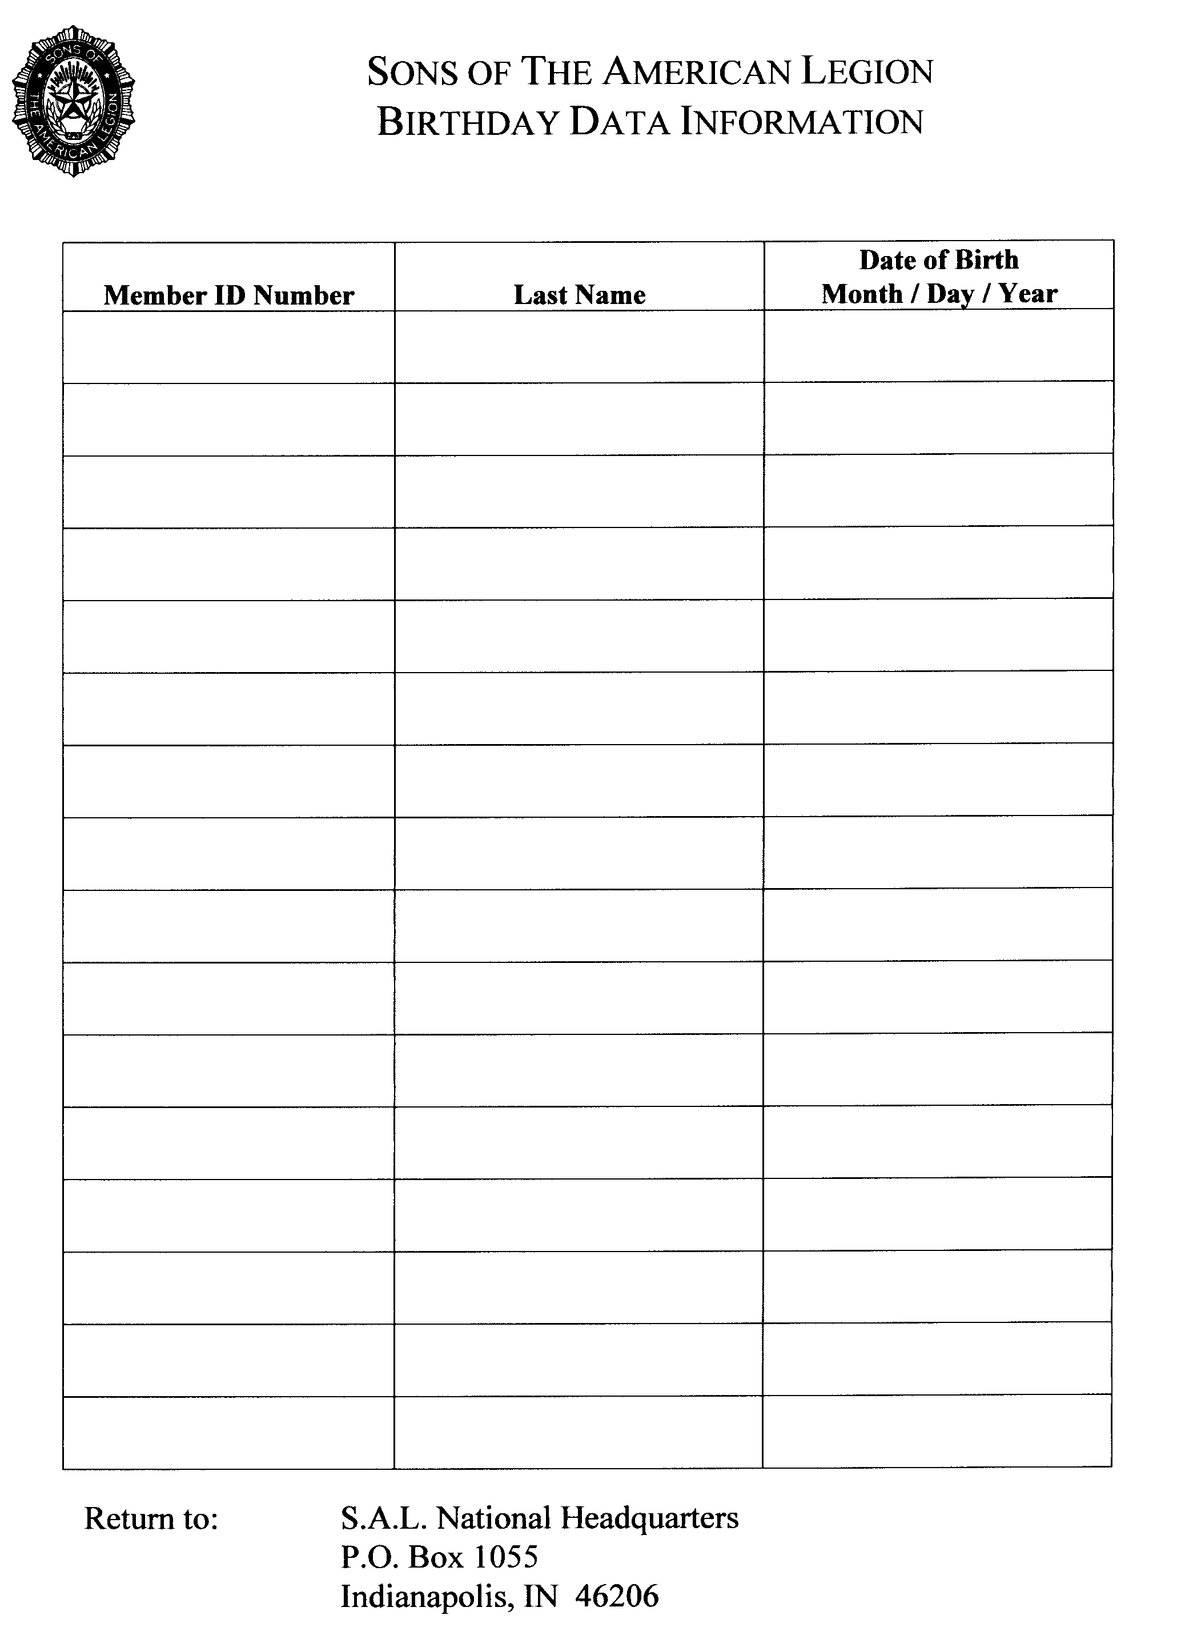
Birthday
Data
Report
Form

Slide 166
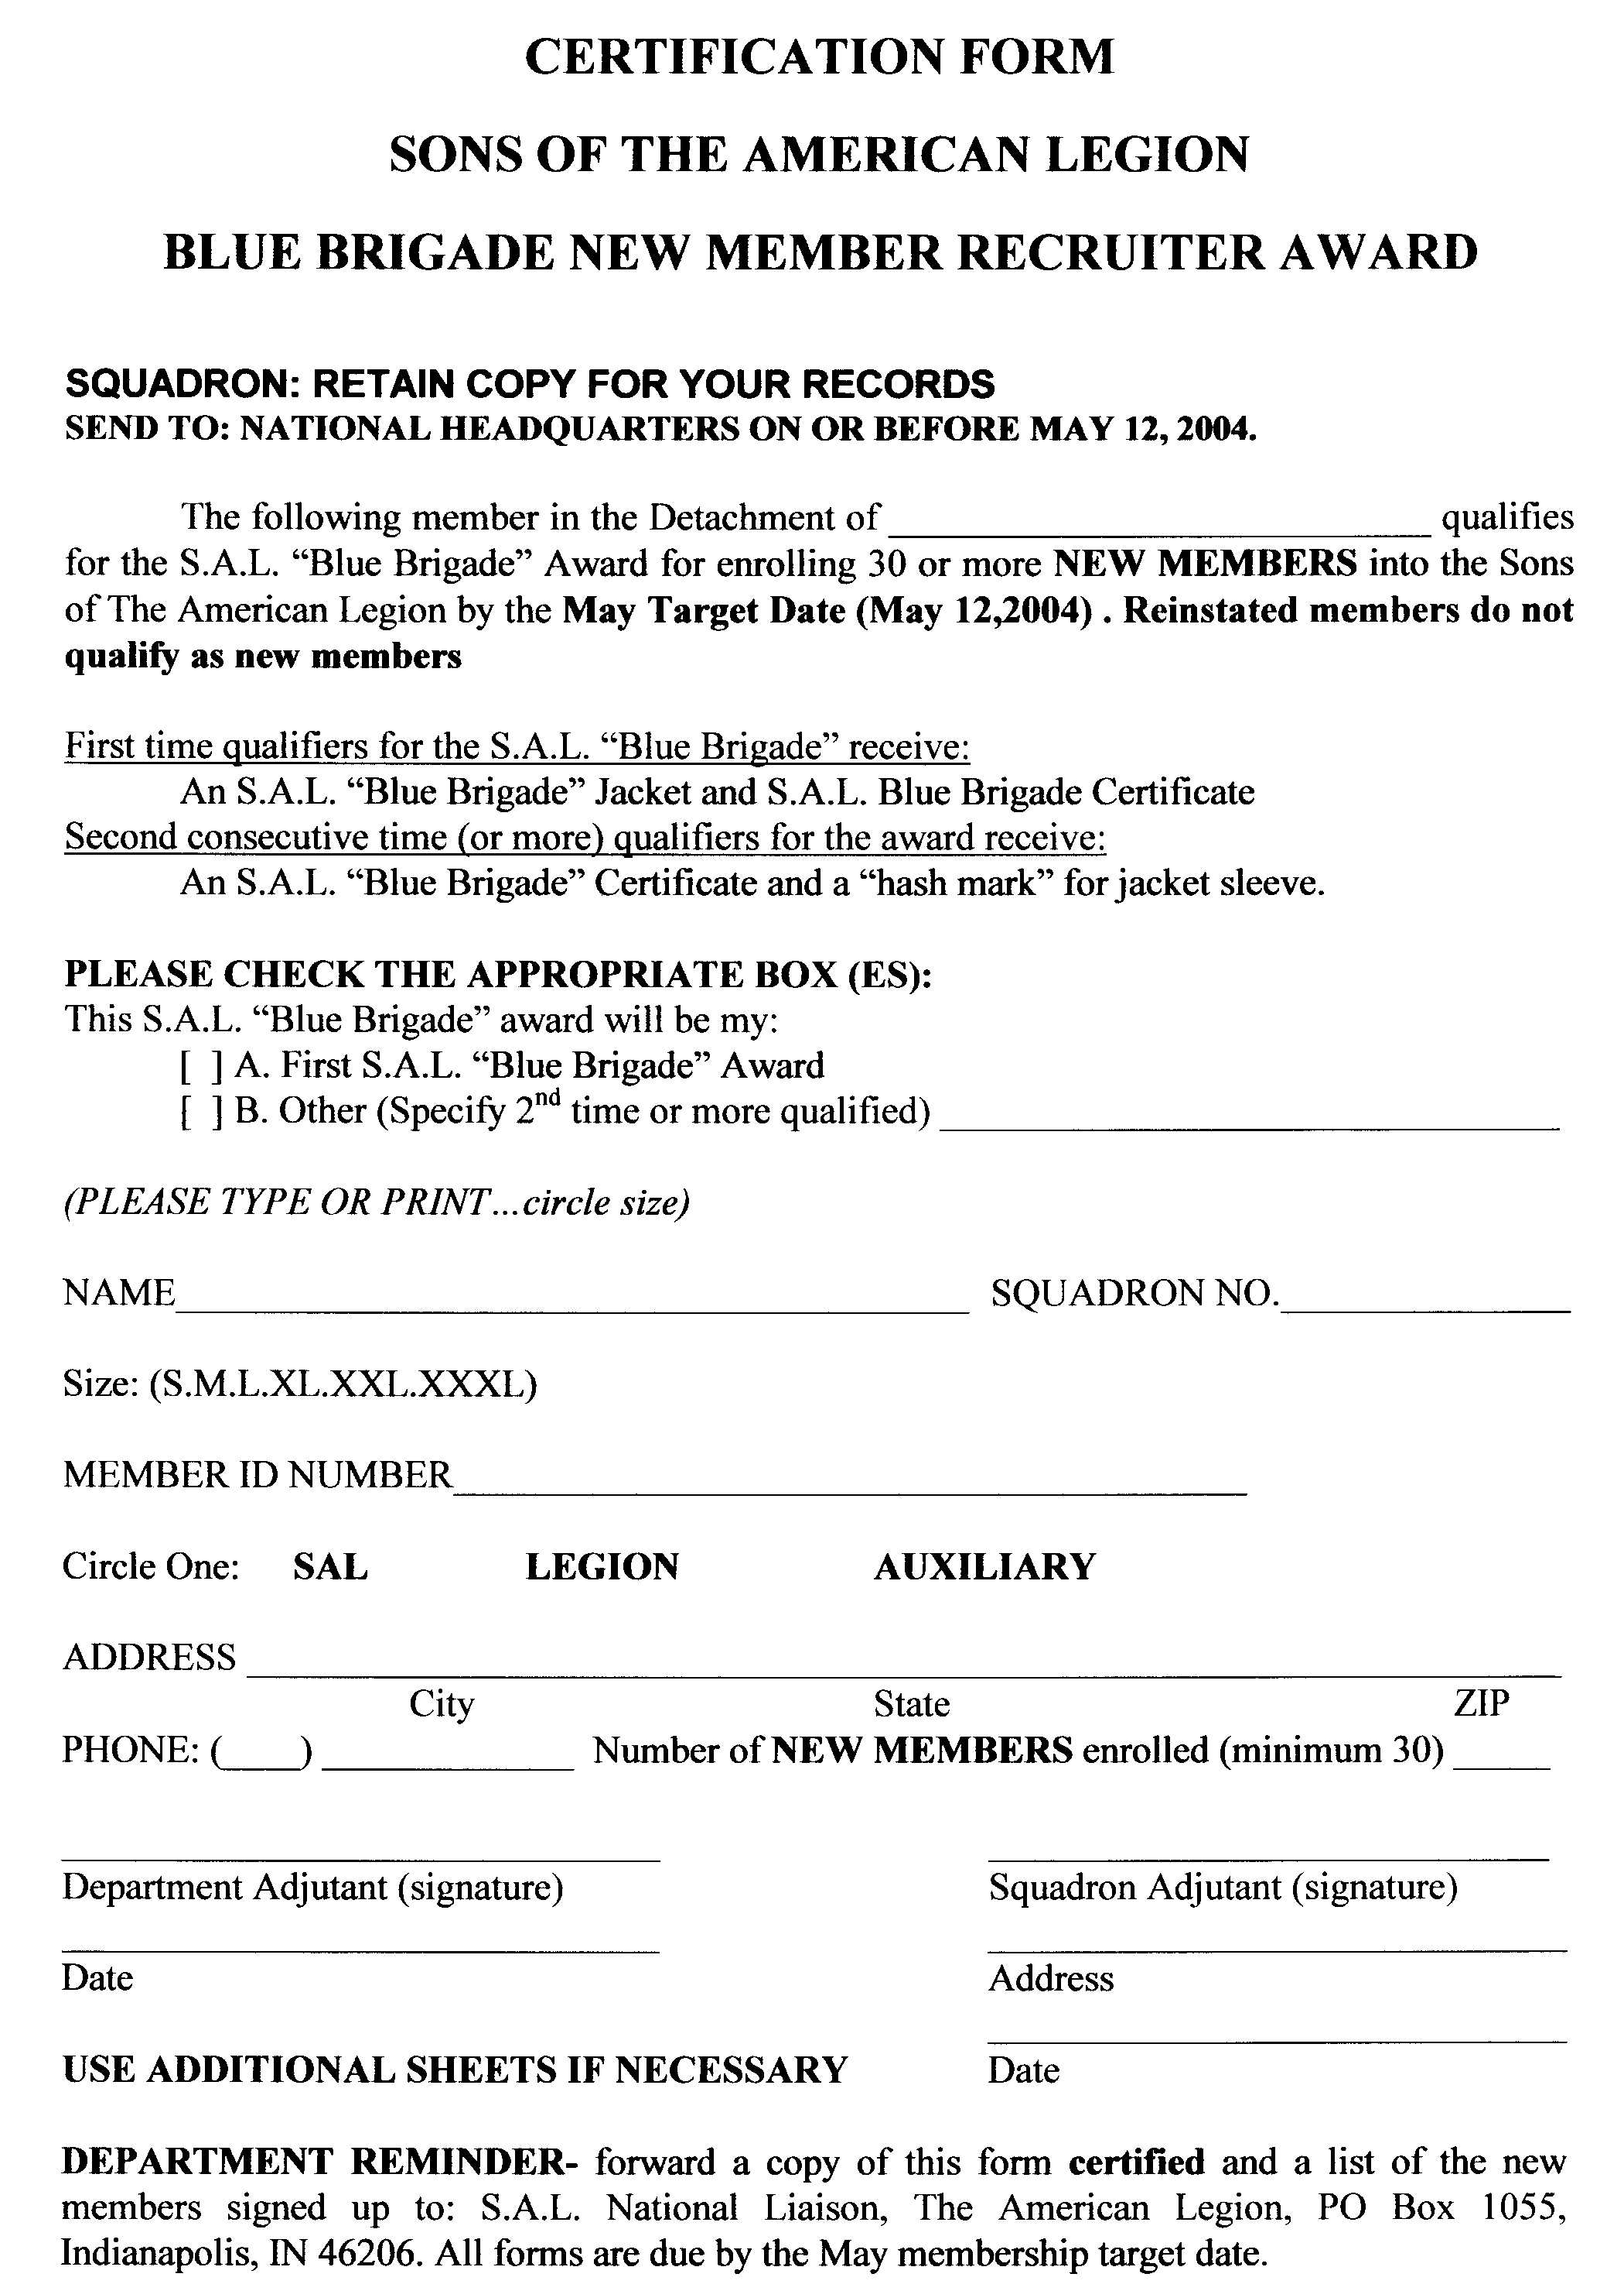
Blue Brigade
Recruiter
Award
Report
Form
Page 1

Slide 167
Blue Brigade
Recruiter
Award
Report
Form
Page 2

Slide 168
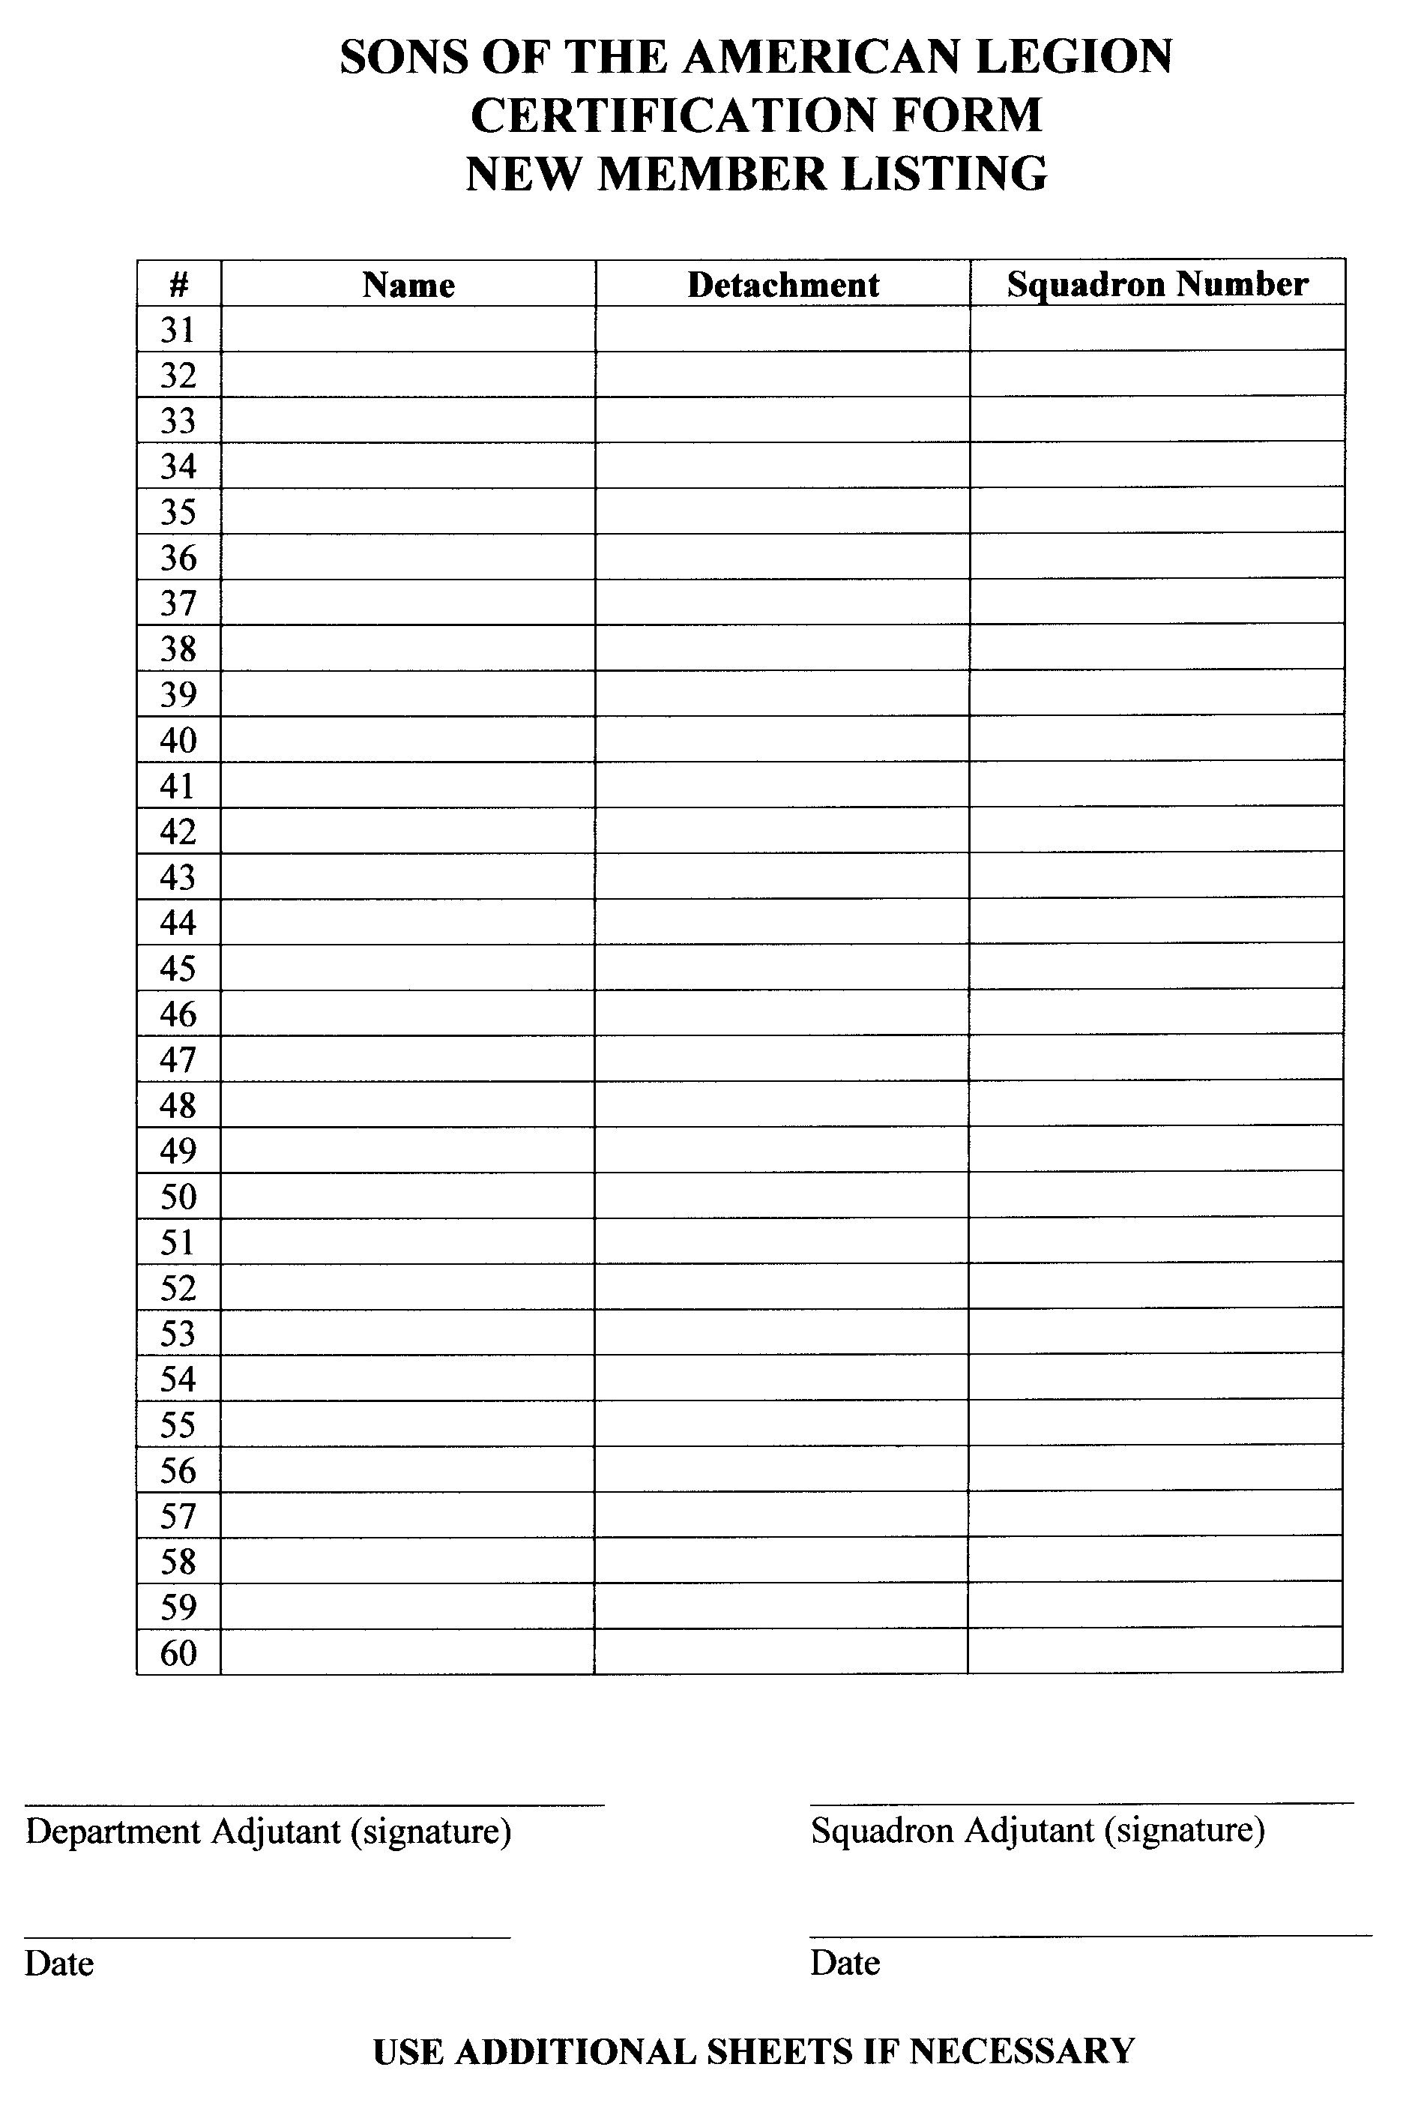
Blue Brigade
Recruiter
Award
Report
Form
Page 3

Slide 169
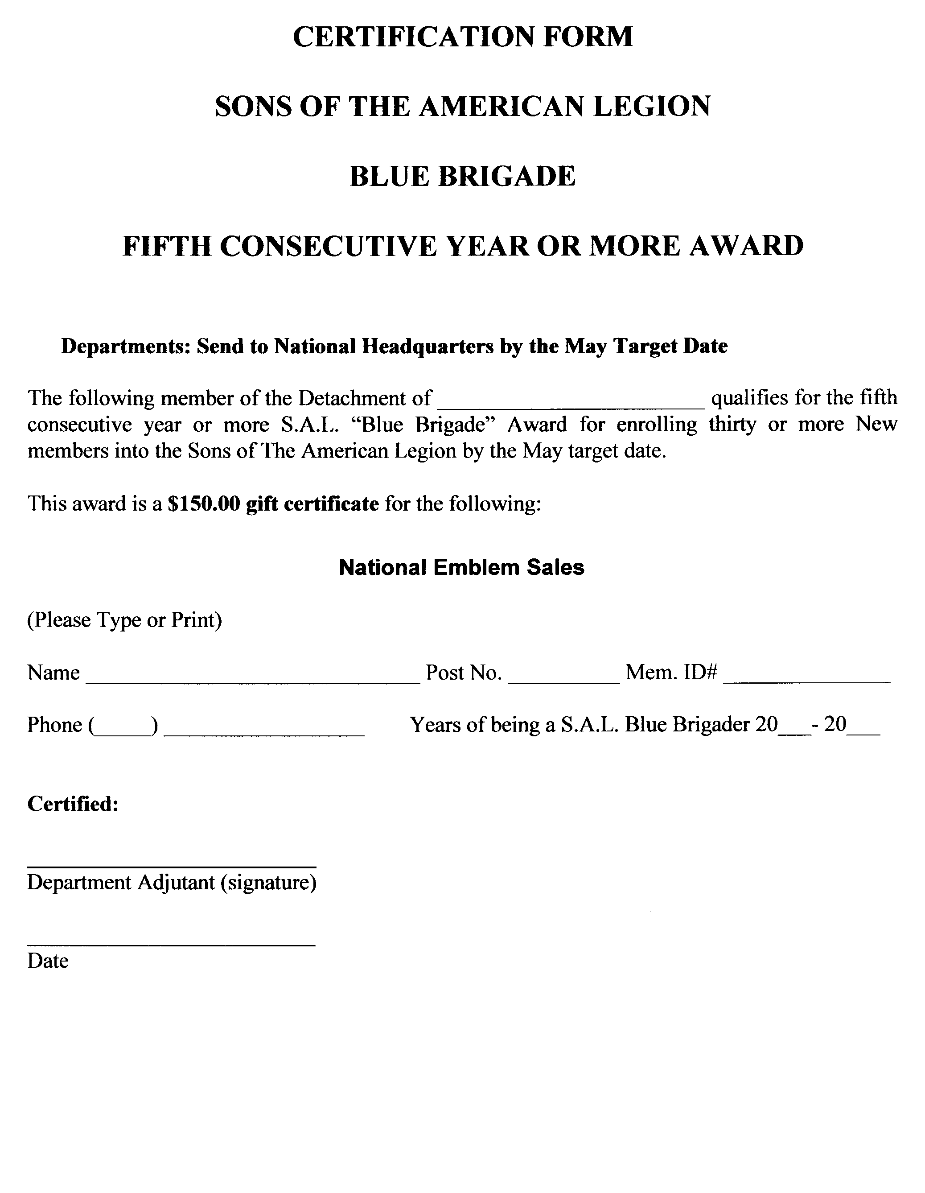
Blue Brigade
Recruiter
Award
Report
Form
Page 4

Slide 170
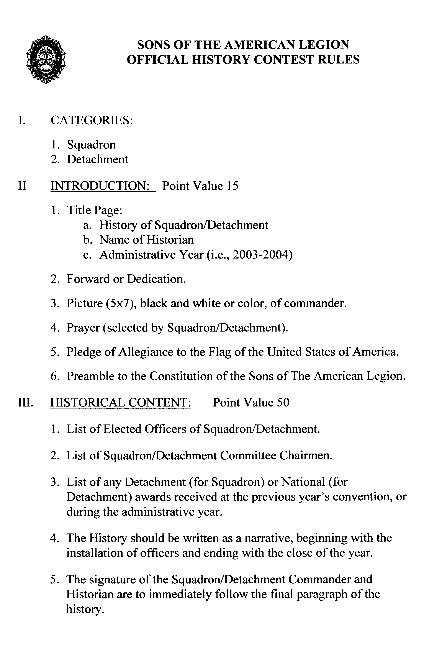
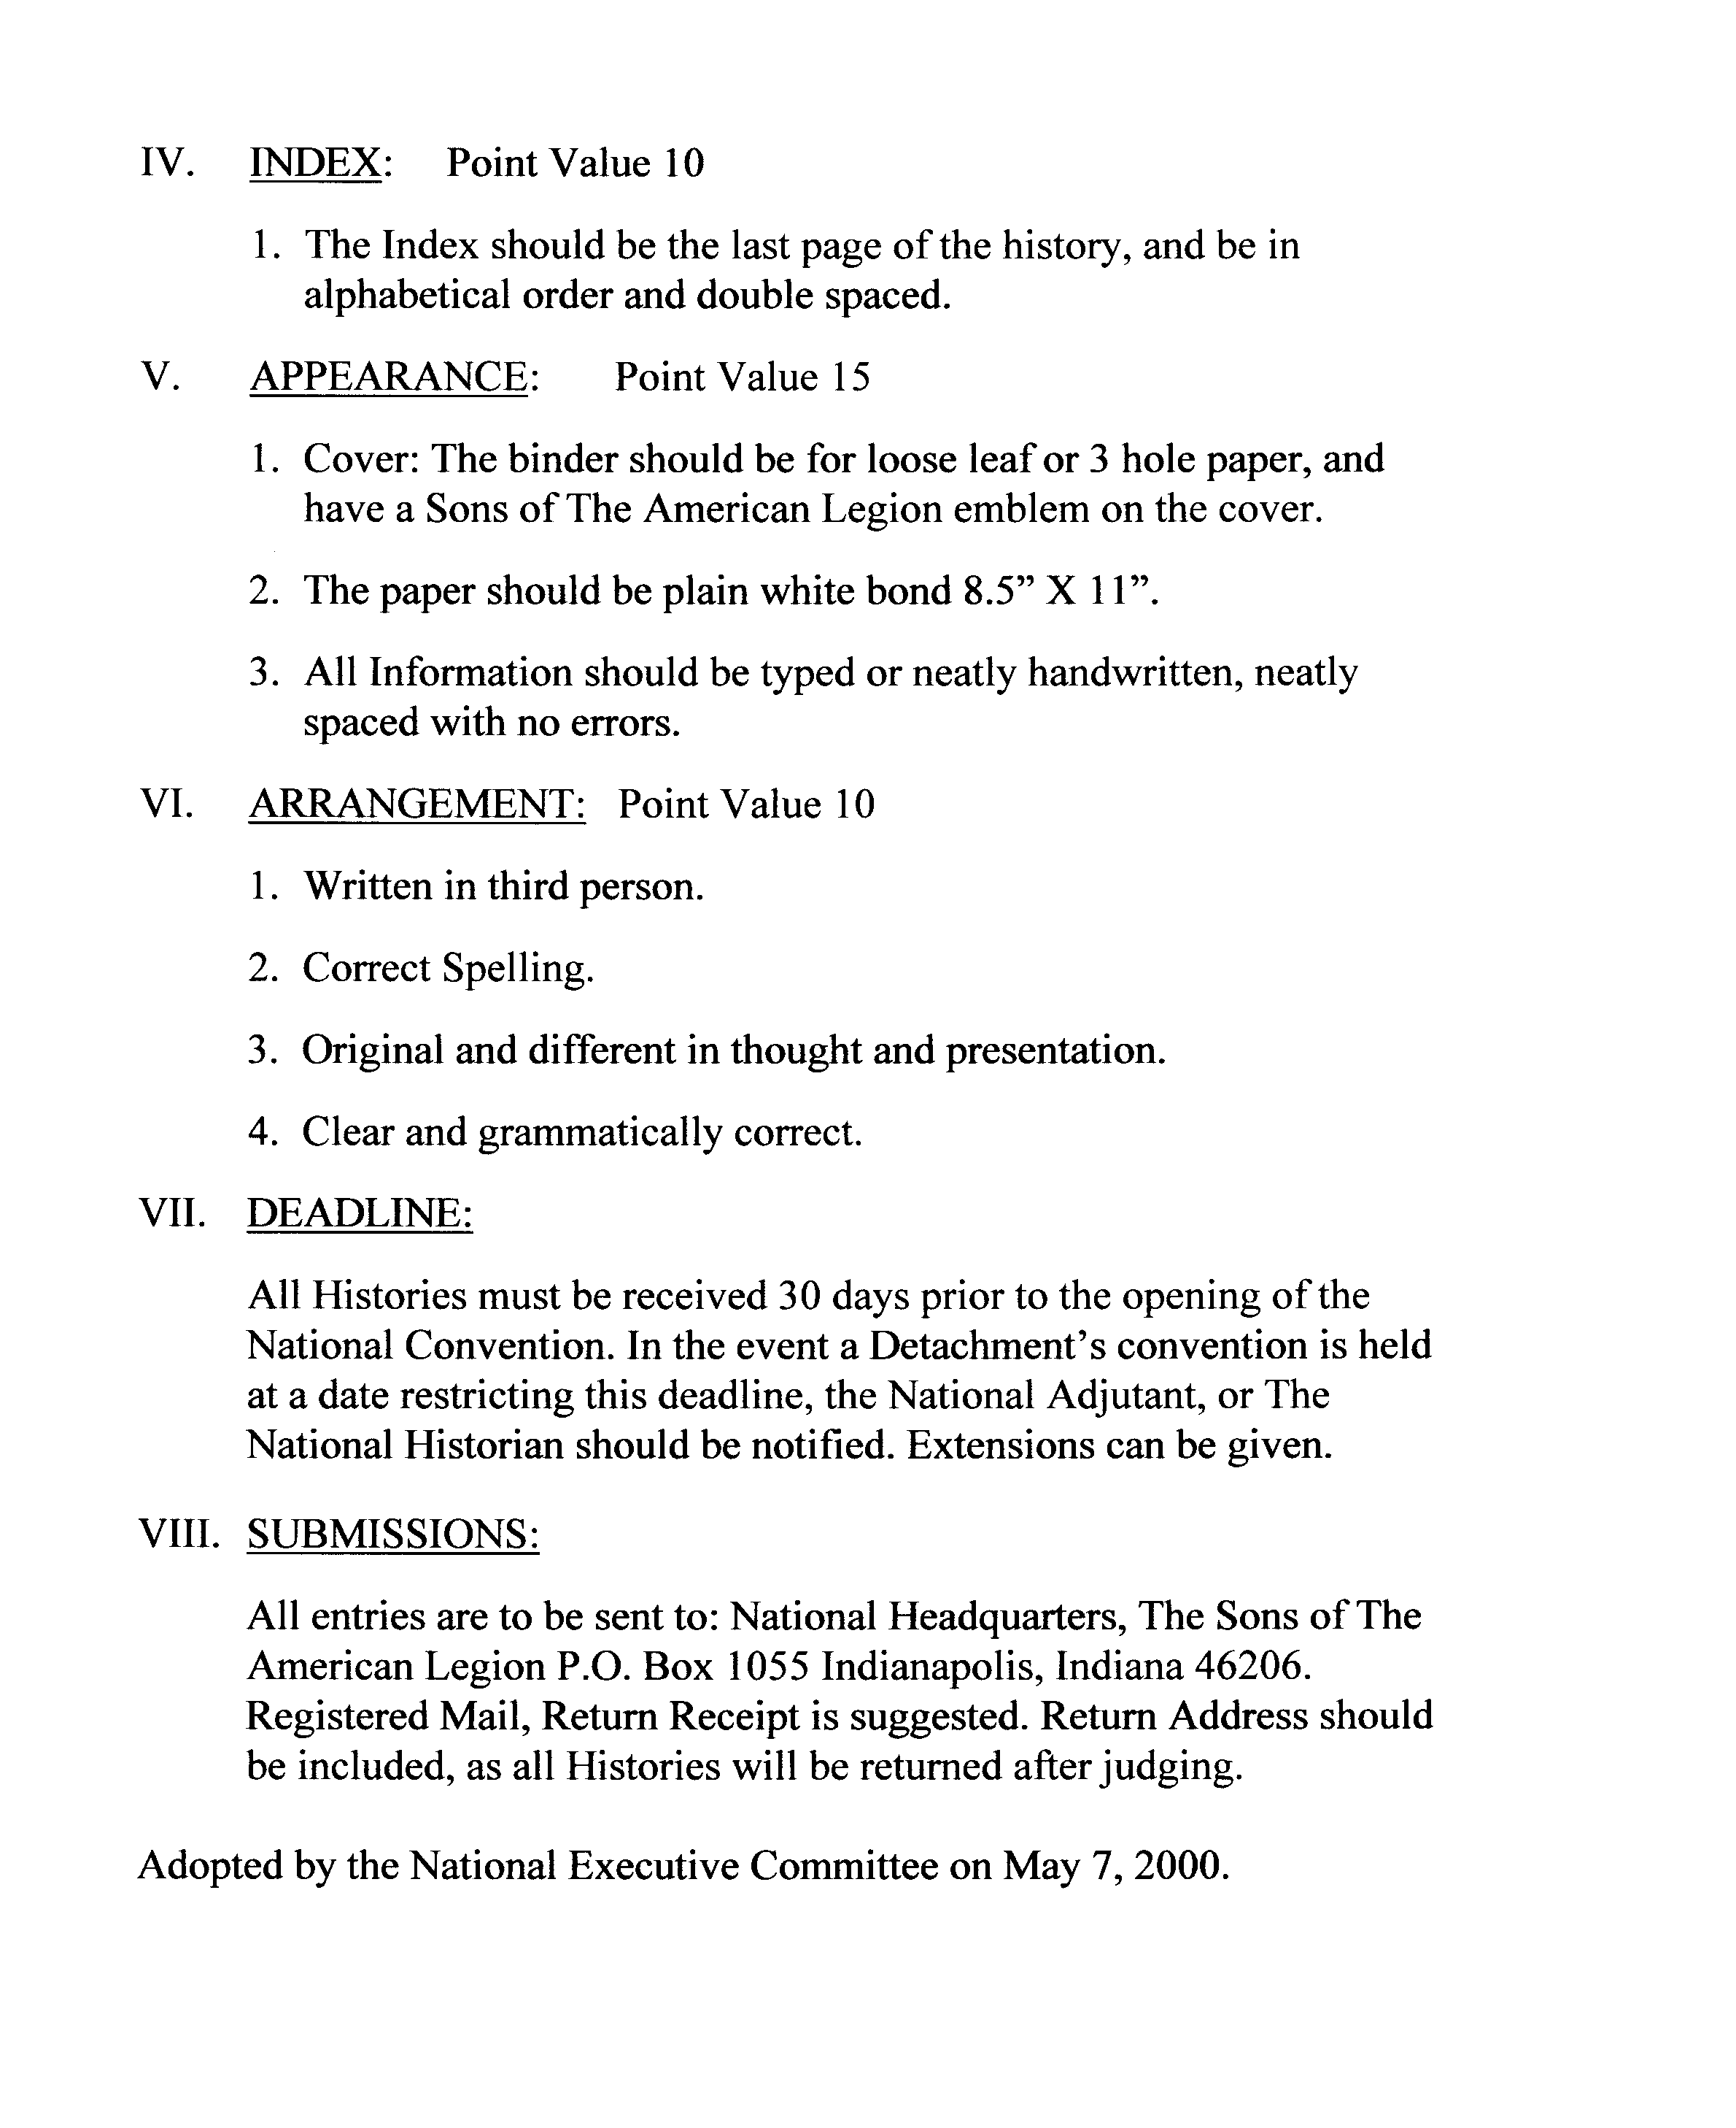

Slide 171
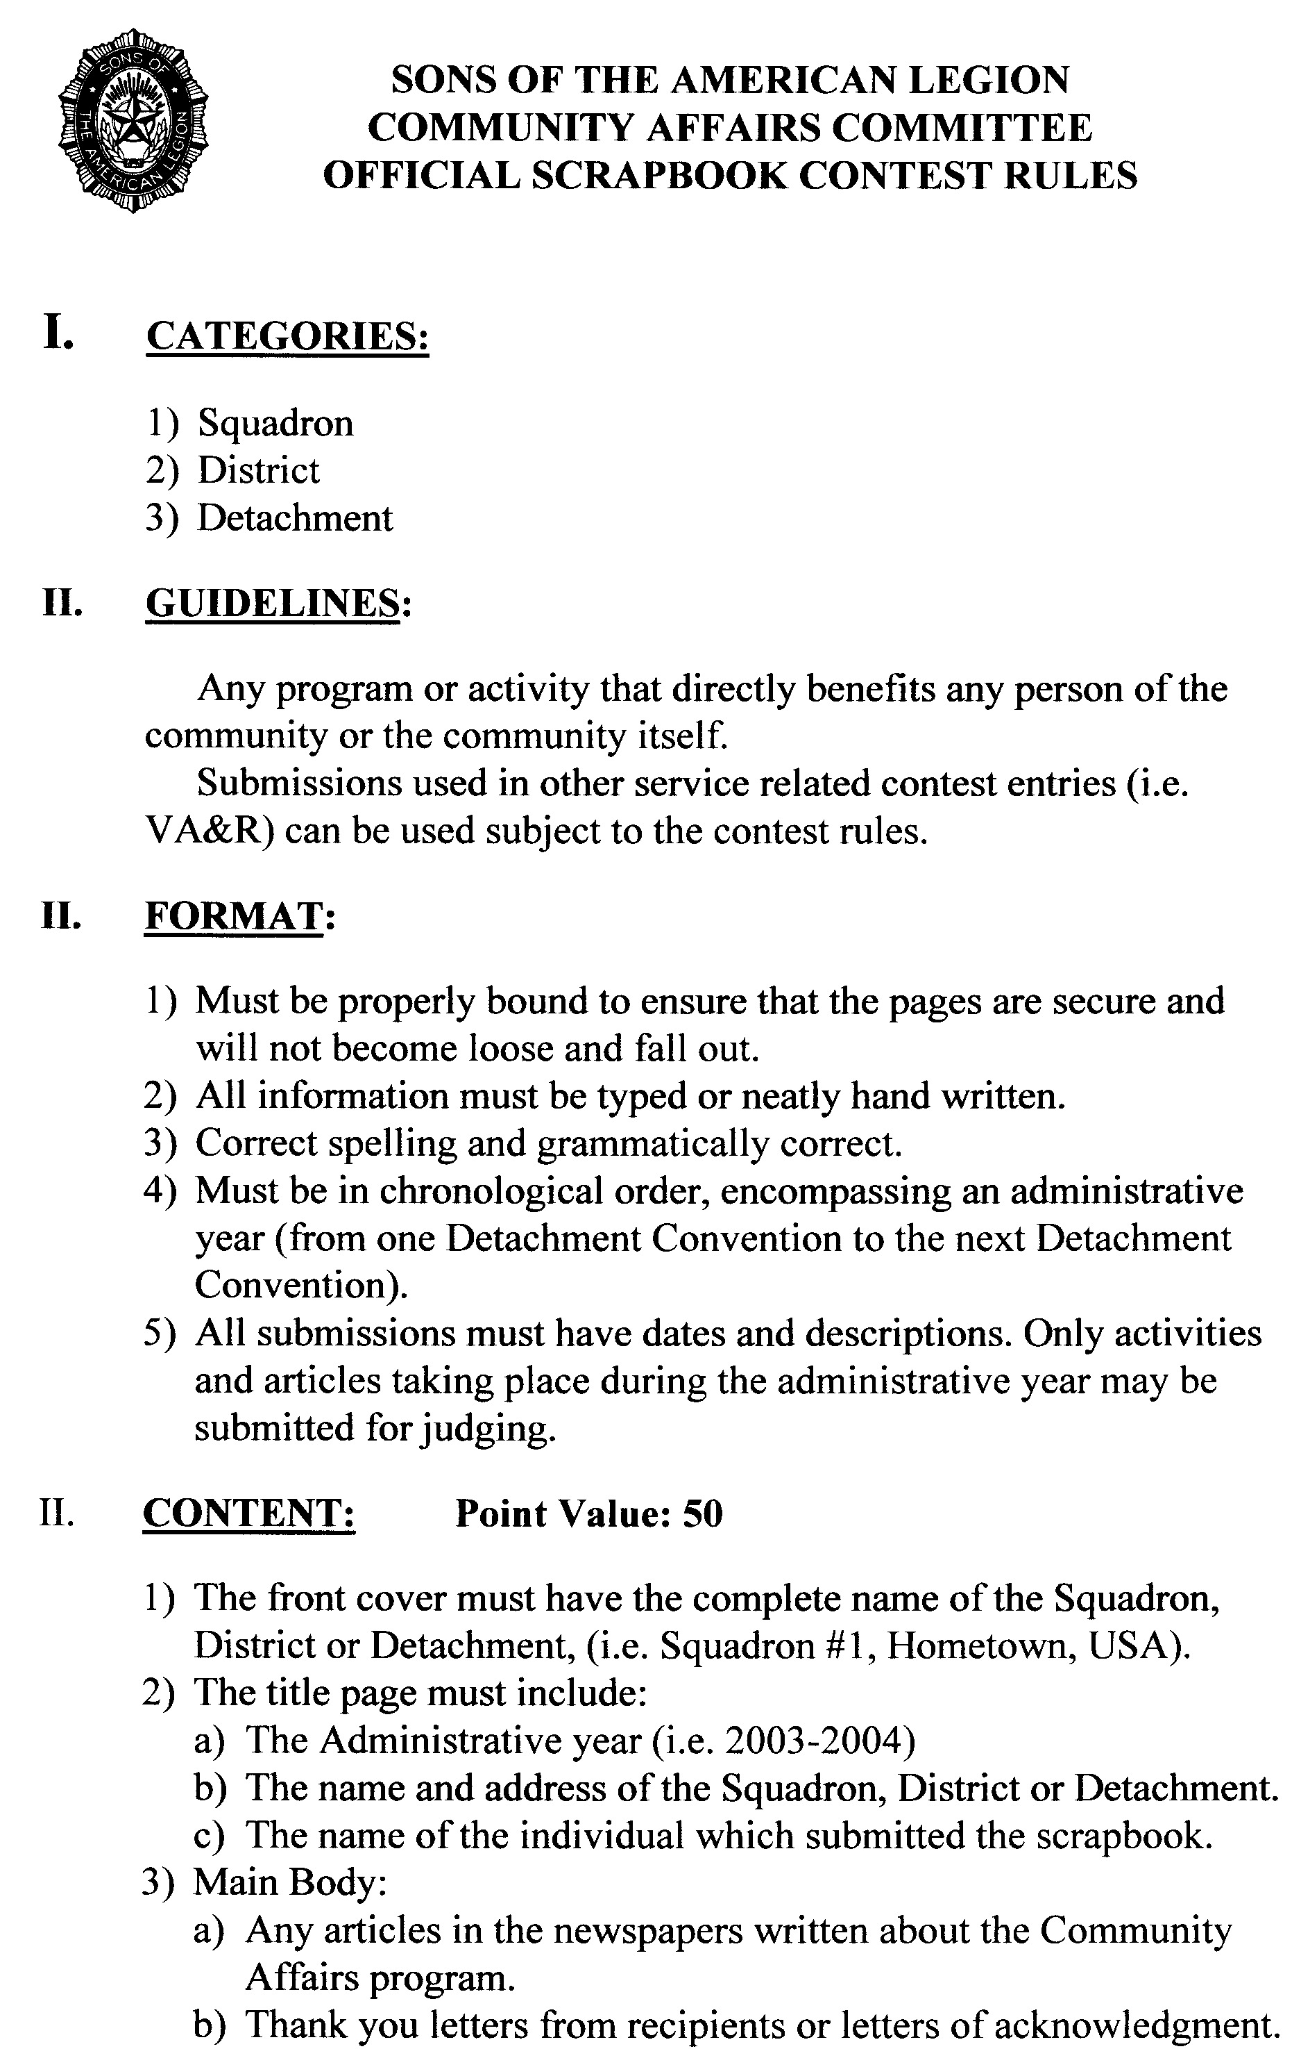
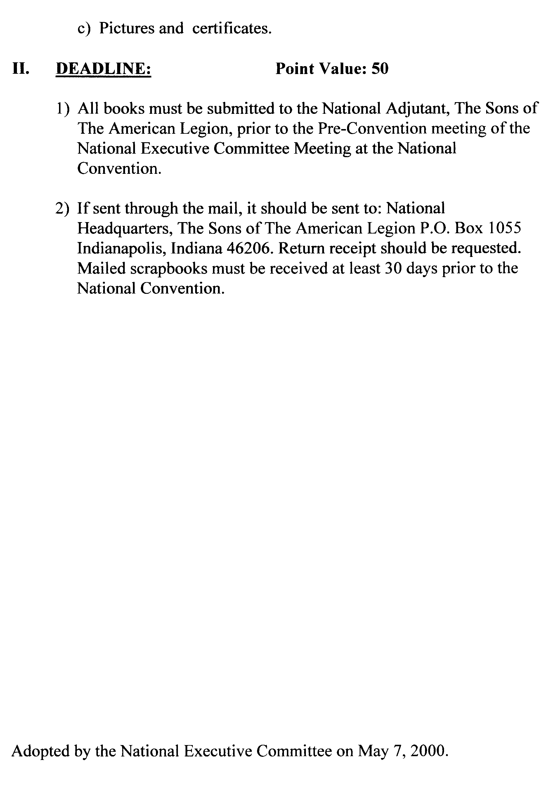

Slide 172
S.A.L.
Membership
Application

Slide 173
Squadron Forms
Certification of Squadron Officers
Per Capita Transmittal
Membership Record Card
Member Data Form (Transfers)
SAL Membership Application
Blue Brigade Membership Award
Birthday Data Information Form
Request for 5-Star Award Supplies

Slide 174
National Report Forms
Consolidated Report Form
Scrapbook Rules
History Book Rules
VAVS Certification Report Form

Slide 175
Detachment Convention
Yearly Meeting of the Assembly
Election of Detachment Officers
Consideration of Resolutions
Election National Convention Delegates
Yearly Reports of Detachment Officers
Yearly Reports of Committee and Commission Chairmen
Approval of Yearly Budget

Slide 176
Detachment Convention
The Assembly:
Ultimate Governing Body of each Detachment
All eligible Squadrons should Participate
Legislative Process of the Detachment

Slide 177
Detachment Convention
Squadrons must Elect and Certify their Convention Delegates
Certification must comply with Detachment Constitution and Bylaws
Delegate Strength based on Squadron Membership
Established Time and Reporting Requirements must be complied with.

