Slide 1
MyLegion.org
MY ACCOUNT
Training Guide
Released April 1, 2021
Notes:
Ask Jeff/Dave about the terms of use training documentation.
This document was created by National HQs staff and can be used for training. No names and addresses in the presentation include real data. Names and emails are fictitious and mainlining address are National Headquarters locations.
Use of data: When using the presentation do not display personal data.

Slide 2

What is MyLegion?
MyLegion is a web application designed for American Legion and Sons of the American Legion members, officers, program coordinators, and group administrators.
NEW MyLegion design released April 1, 2021
Notes:
myLegion is a web application designed for American Legion and Sons of the American Legion members, officers, program coordinators and group administrators.
On April 1st myLegion will have a new design with enhancements from what current users are familiar.
This presentation will provide information to help you know what to expect and an overview of the new myLegion interface for members and how administrative membership management and online membership processing is access for post and squadrons.

Slide 3

Why Create a MyLegion account?
One Account for ALL
AMERICAN LEGION MEMBERS
  Membership management
  Print membership card
  Provide emergency contacts
  Purchase/donation info
  Renew/auto renew
  Member-only discount codes
  Subscriptions
  Post and squadron
  membership management (administrative officers only)
SONS OF THE AMERICAN LEGION MEMBERS
Membership management
Print membership card
Provide emergency contacts
Purchase/donation info
Member only discount codes
Subscriptions
Squadron membership management
(administrative officers only)
NON-MEMBERS
  Group administrators
  Program coordinators
Notes:
American Legion members, Sons of the American Legion members can access their membership information online through myLegion. One account includes all areas of membership.
This secure site allows Legion and SAL members to view and manage their membership, print membership cards, and provide additional information not required when joining. Through your myLegion account you can also provide emergency contact information. MyLegion allows you to save credit card information for online giving or subscriptions. Dual members have one account detailing both memberships. Officers who currently use myLegion for membership management and payment processing will access their group information in their member account. Adjutants and Commanders register a myLegion account as a member and are granted addition access to membership tools in an area called MY Groups.
Non-members can also create a myLegion account with an email address. If you are not a member of TAL or SAL and assist your post with membership tools, an account can be set up and permissions to post or squadron information by the administrative officer. Program coordinators who need to set up a baseball or junior shooting sports application can also create a non-member account.

Slide 4
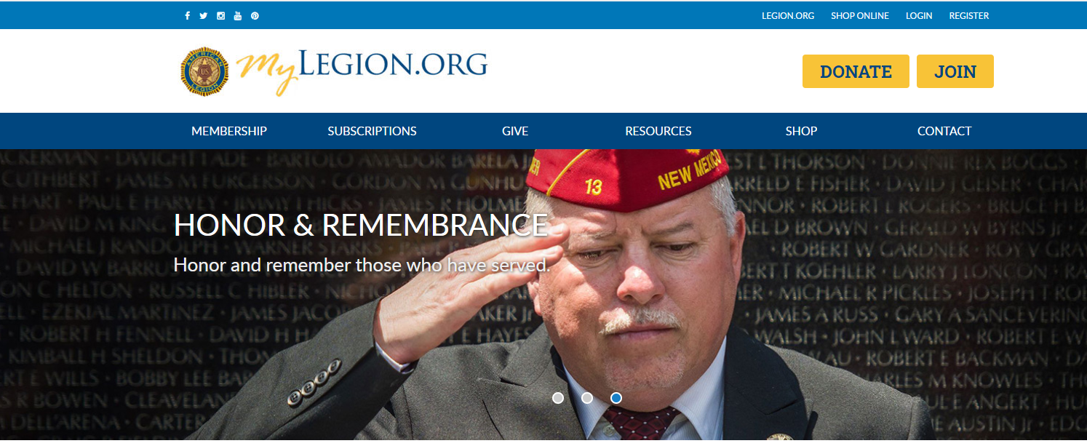
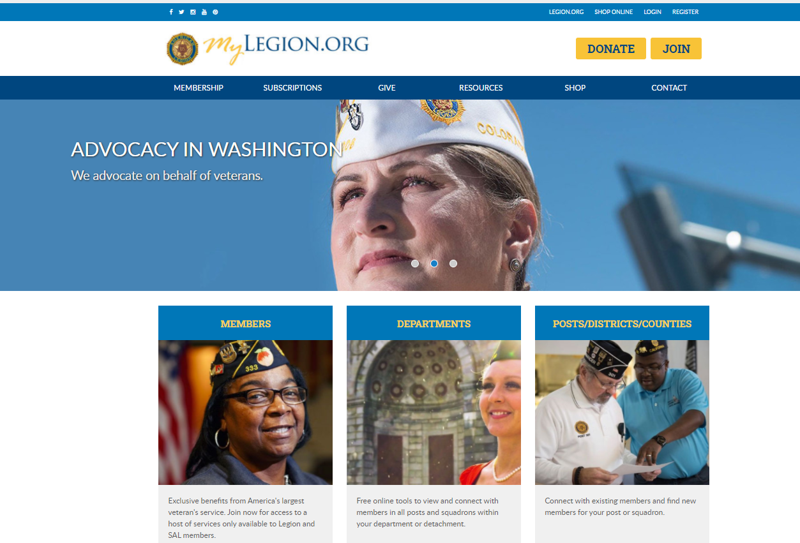
Notes:
Log in to your account at MyLegion.org. If you do not have an account. Register with the email address on your American Legion or Sons of the American Legion membership record.

Slide 5
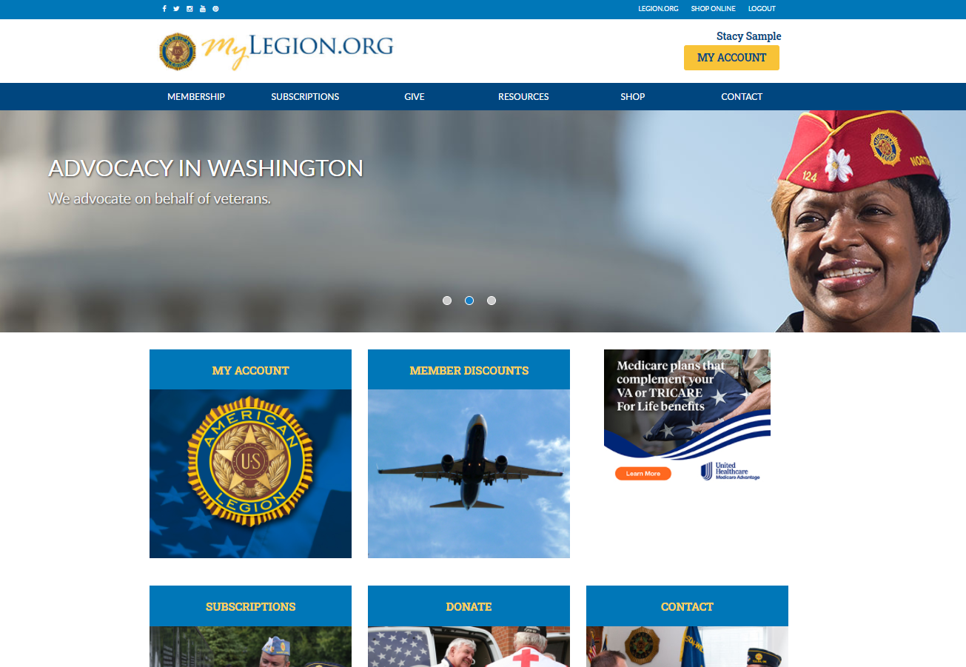
Account Home
User is logged in and viewing member home page.
Notes:
The myLegion Home page identifies the member’s name located above the MY ACCOUNT button.
It provides links to Legion.org links. Membership includes: Join, Renew and Paid Up for Life information. along with Frequently asked questions about membership eligibility. Subscriptions has online E-Newsletter options, Dispatch and Magazine subscription details. The Give menu provides multiple giving opportunities. Resources helps you find a post or service officer with User Help documentation. Shop takes you to National Emblem Sales, and Contact directs you to your National HQ directory.
For your convenience there are also Topic Tiles to direct you to My Account, Member Discounts, Subscriptions, Donation page and Contact information.
MY ACCOUNT provides information on your account on file at national headquarters. The first part of this presentation focuses on individual member profiles. We will review management tools available to all Legion and SAL member accounts. The later portion of this presentation will introduce the administrative officer area.
Click on MY ACCOUNT to open your My Account window.

Slide 6
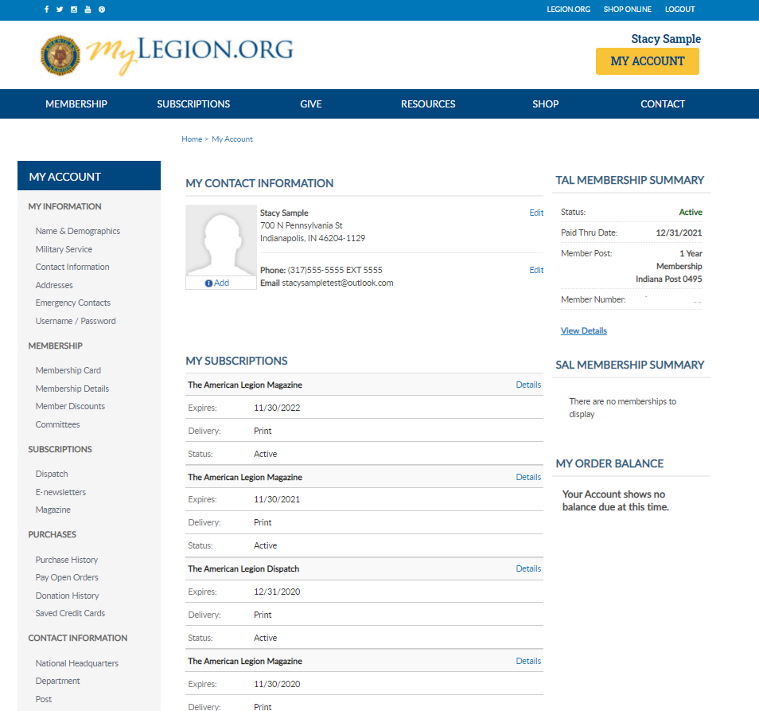
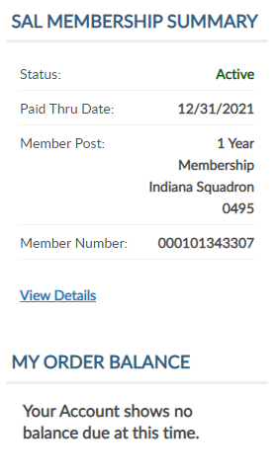
My Account
Notes:
During registration, the email verified will add your information to your account. My Account displays information on record at National Headquarters for both American Legion and Sons of The American Legion memberships.
If you register an account and the My Account page does not display your membership details, contact your department or national HQs to verify your main email address.
This member is a Dual Member. MEMBERSHIP DETAILS display for both TAL and SAL. Updating information in My Account updates both memberships.
MY CONTACT INFORMATION lists the main address phone number and email address.
MY SUBSCRIPTIONS provides details for online subscriptions
Members that have both Legion and Squadron memberships can view both membership details including status, paid through date, member type, post/squadron and membership number in MEMBERSHIP SUMMARYS. Dual members will have only one ID#.
MY ORDER BALANCE currently displays Legion dues when you become eligible for renewal. The amount due displays with a quick link to pay with a credit card.
RENEW OPTIONS are only available for Legion members. Renew Now allows you to renew dues online and set up for auto renewal.
MY INFORMATION provides additional information on your membership record. This area allows you manage your record.
MEMBERSHIP includes links to print your membership card, both Legion and SAL, membership details, auto renew maintenance , links to member discounts, and allow you to view any leadership positions.
SUBSCRIPTIONS provides information about subscribing to The American Legion Dispatch, manage online subscriptions and view TAL digital Magazine.
PURCHASE INFORMATION is where you can view your payment history for membership dues and donations. Future enhancements will include purchases from National Emblem Sales. Donation History and Saved Credit Card information.
CONTATACT INFORMATION for your National and Department Headquarters and Post/Squadron is also located in MY Account.

Slide 7
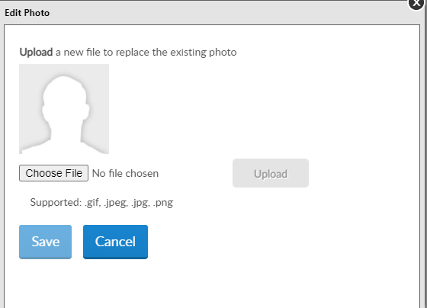
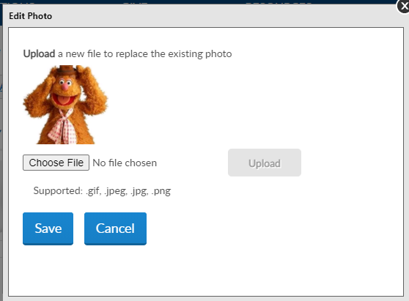
Manage Your Account
MY CONTACT INFORMATION
Add photo
Click the “Add” link on the image box in MY CONTACT INFORMATION
“Choose File” to browse the photo to upload
“Upload” A snapshot of the image selected displays to preview.
“Save”
Notes:
My Contact information displays the main address, phone and email on record. Main contact information is used as the primary contact for membership subscriptions, renewal notices, and all correspondence via email or US mail.
A new feature allows you to upload a photo that displays on your profile. The photo uploaded can be seen by your leadership groups: Post, Squadron, County, District, Department, Detachment and National staff.
To add a photo to your account, click the “Add” link on the image box in MY CONTACT INFORMATION, “Choose File” to browse the photo, and click “Upload”. A snapshot of the image selected displays to preview. Select “Save” to add the photo to your profile.

Slide 8
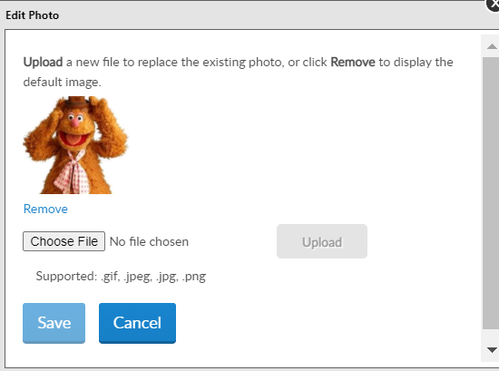
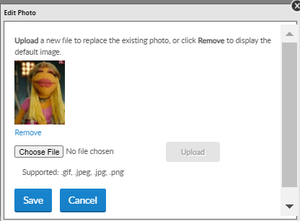
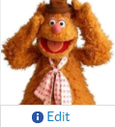
Manage Your Account
MY CONTACT INFORMATION
Edit photo
Click the “Edit” link on the image box in MY CONTACT INFORMATION
“Choose File” to browse the photo to upload
“Upload” A snapshot of the image selected displays to replace the existing photo
“Save”
Notes:
To replace the photo click the “Edit” link on the image box in MY CONTACT INFORMATION, “Choose File” to browse the photo and click “Upload”. A snapshot of the image selected displays to preview. Select “Save” to add the photo to your profile. The image will replace the existing image.

Slide 9

Manage Your Account
MY CONTACT INFORMATION
Remove photo
1236789
Click the “Edit” link on the image box in MY CONTACT INFORMATION
“Remove”
Notes:
Remove the photo through “Edit” and select “Remove”.

Slide 10
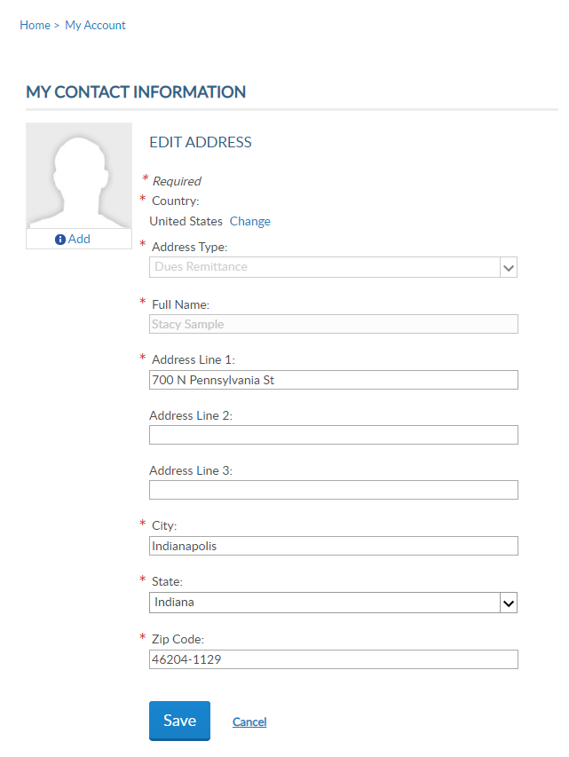
Manage Your Account
MY CONTACT INFORMATION
Edit Main Address
Notes:
To update your main address, click Edit in MY CONTACT INFORMATION. Enter new address and “Save”.

Slide 11
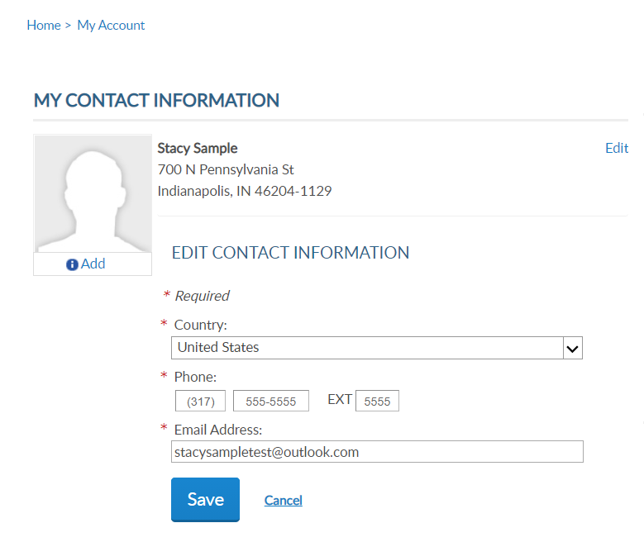
Manage Your Account
MY CONTACT INFORMATION
Edit Main Phone and Email
Notes:
Phone number and Email can also be updated in MY CONTACT INFORMATION.
Information in this area is listed as your main contact and is listed on membership rosters, reports, directories and used for all correspondence. Updating the main email address also updates your account profile email.

Slide 12
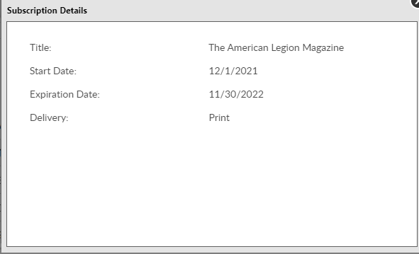
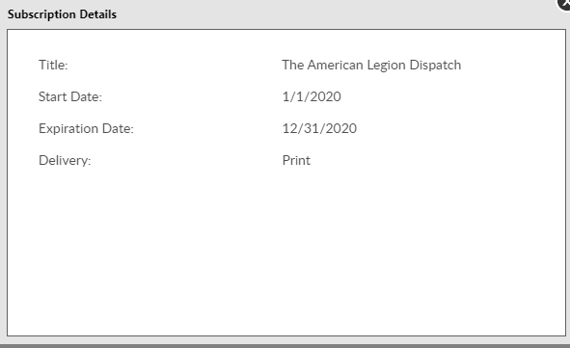
Subscription Details
Notes:
My Subscriptions displays subscription details including title, start and expiration dates, and delivery.

Slide 13
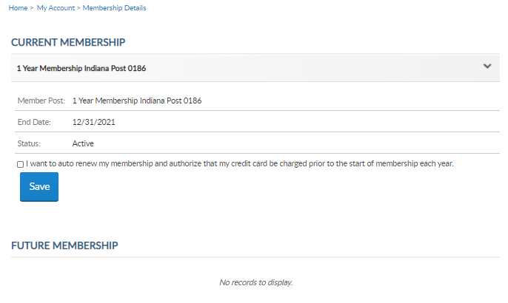
Membership Summary
View Details
Notes:
Membership summaries detail members status, paid through date, member type, post, squadron and member ID#.
Dual members with both Legion and SAL membership now have the same ID#. If you are a current Legion member, your ID# will remain the same and also become your SAL ID.
Legion members eligible for renewal are provided a quick link to renew. Through this renewal process you can also set up auto renewal with a saved credit card. Setting up auto renew authorizes the subscriptions CC on file to be charged prior to the start of the membership term each year. Online renewal at this time is only available for Legion members. However, SAL online processing will be included in future enhancements.

Slide 14
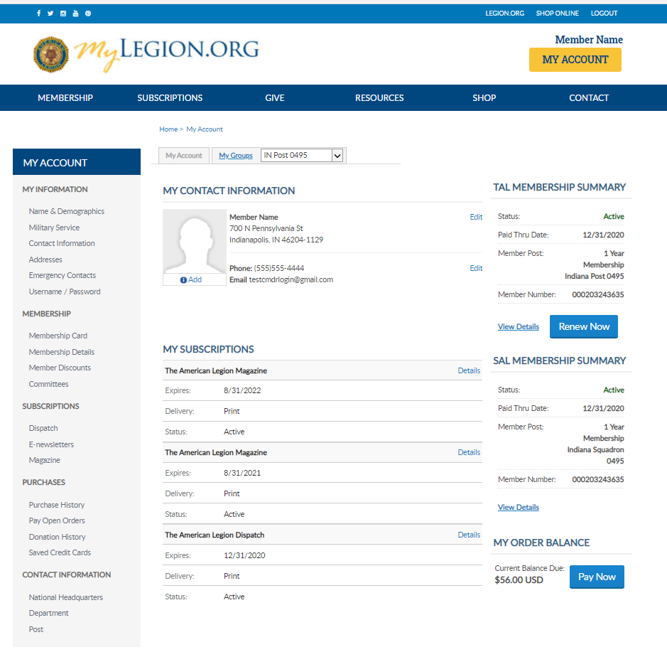
Auto Renewal
TAL MEMBERSHIP SUMMARY
Setup Auto Renewal
Select “View Details” in TAL MEMBERSHIP SUMMARY or
“Renew Now”
Check “I want to Auto Renew”
Click link to “Provide Credit Card”
Enter CC information and
“Add New Card
Return to My Account Member Details
Check the box for Auto Renew
7. “Save”
Notes:
Legion members can add a credit card to their account to automatically renew their membership annually. Online renewal is only available for Legion members. Future enhancements will include online renewal for members of the Sons of the American Legion.

Slide 15
Manage Your Account
TAL MEMBERSHIP SUMMARY
Setup Auto Renewal
Notes:
Membership details has a checkbox to add auto renew the beginning of each membership year.
Members set up for auto renewal will have their credit cards charged by the 2nd week of July annually. The American Legion’s membership campaign is from July 1 – June 30.

Slide 16
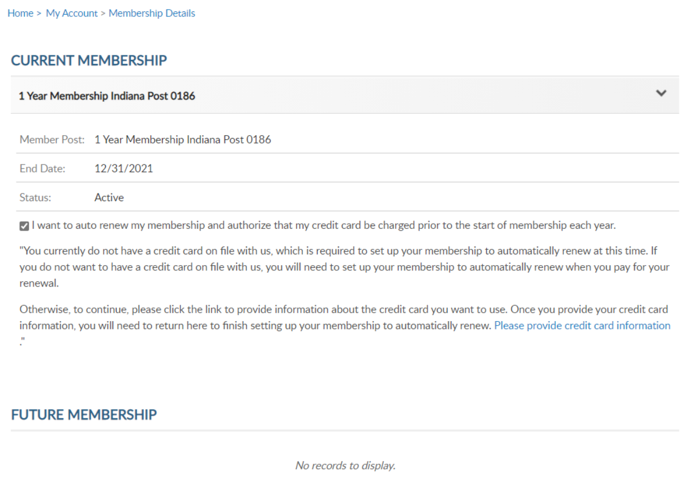
Manage Your Account
TAL MEMBERSHIP SUMMARY
Setup Auto Renewal
Provide Credit Card
Notes:
Checking the box gives you a link to set up your credit card information if you do not already have on saved.

Slide 17
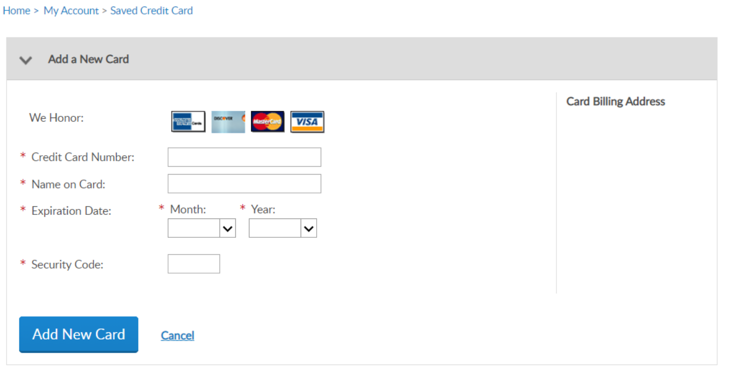
Manage Your Account
TAL MEMBERSHIP SUMMARY
Setup Auto Renewal
Add New Card
Notes:
Enter your credit card information and “Add New Card”

Slide 18
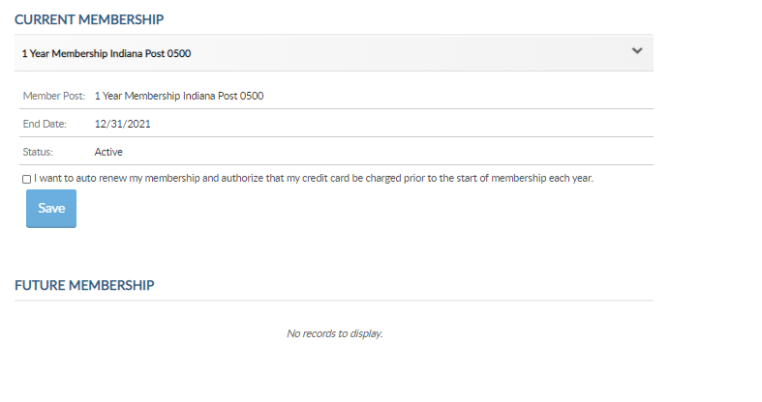
Manage Your Account
TAL MEMBERSHIP SUMMARY
Setup Auto Renewal
Notes:
Return to member details and check the box now that credit card information has been saved.

Slide 19
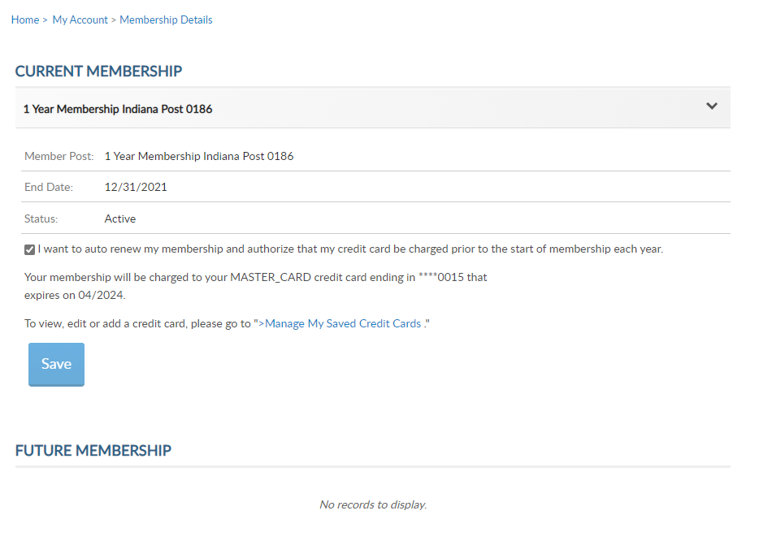
Manage Your Account
TAL MEMBERSHIP SUMMARY
Setup Auto Renewal
Notes:
Checking the box describes the credit card number that will be charged with your next renewal. Select “Save” to save your future renewal.
To add or edit credit card information click on “Manage My Saved Credit Cards”.

Slide 20
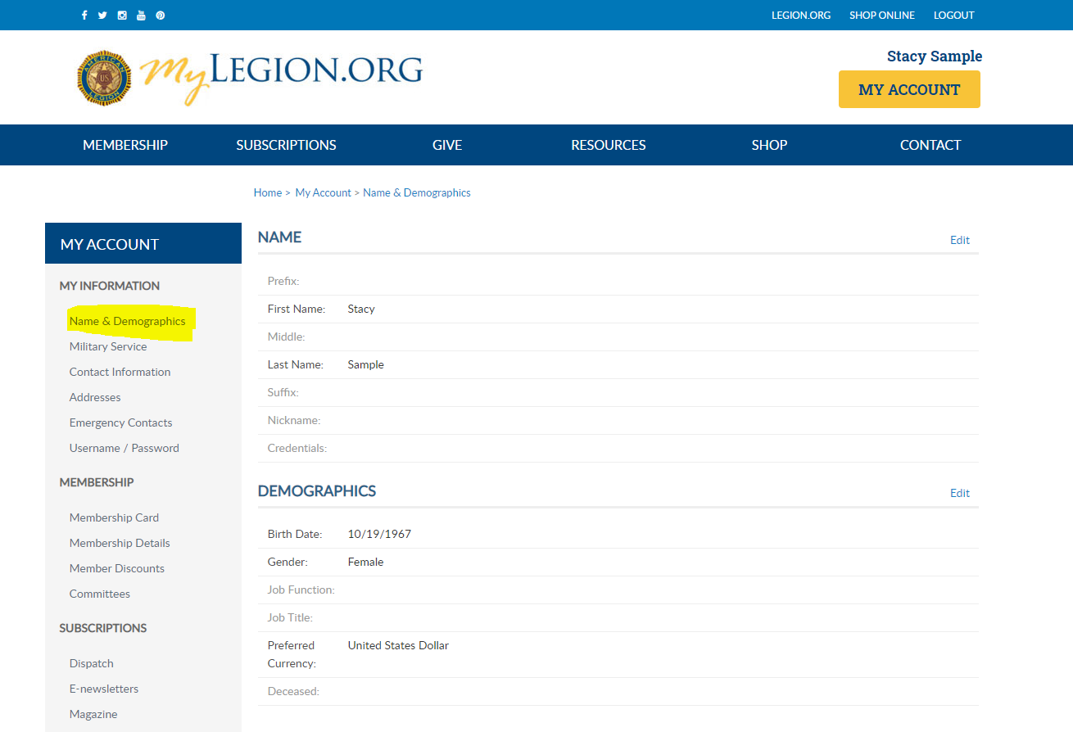
Notes:
The My Account page allows you to add, update and delete demographic information on your record.

Slide 21
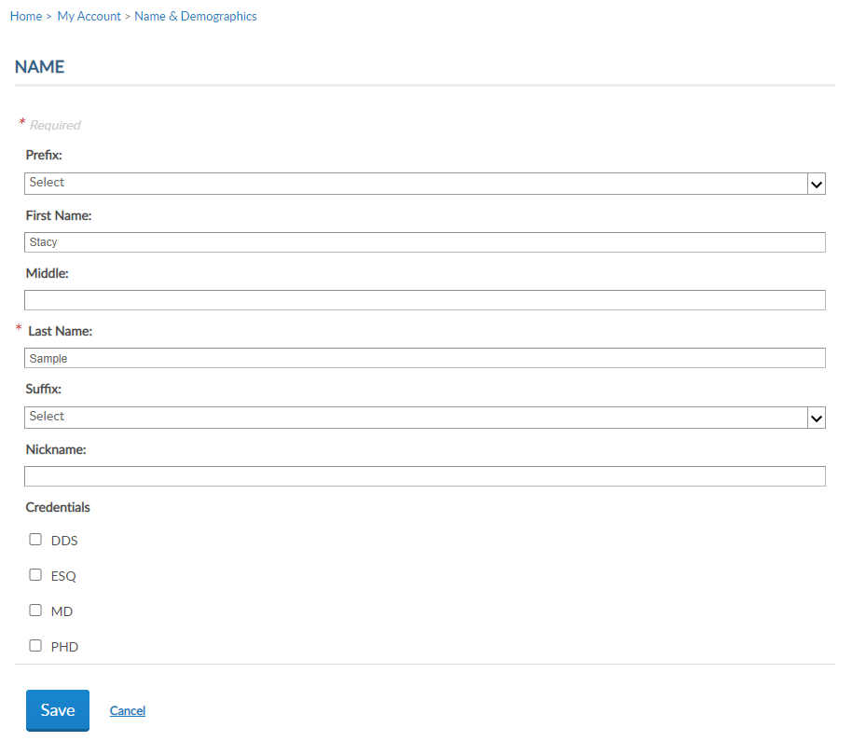
Manage Your Account
NAME AND DEMOGRAPHICS
Edit Name
Notes:
Name “edit” updates your name, including nickname, suffix, prefix and credentials such as DDS, ESQ, MD or PHD.

Slide 22
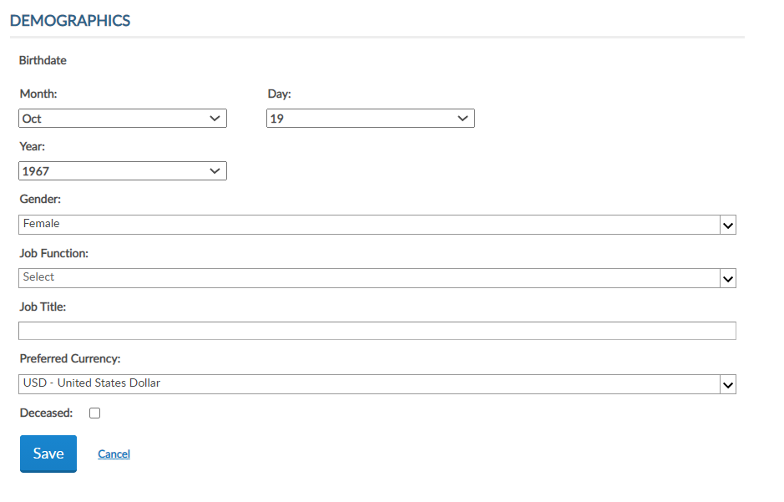
Manage Your Account
NAME AND DEMOGRAPHICS
Edit Demographics
Notes:
Demographics include date of birth, race/ethnic identity, gender, job function, job title and preferred currency.

Slide 23
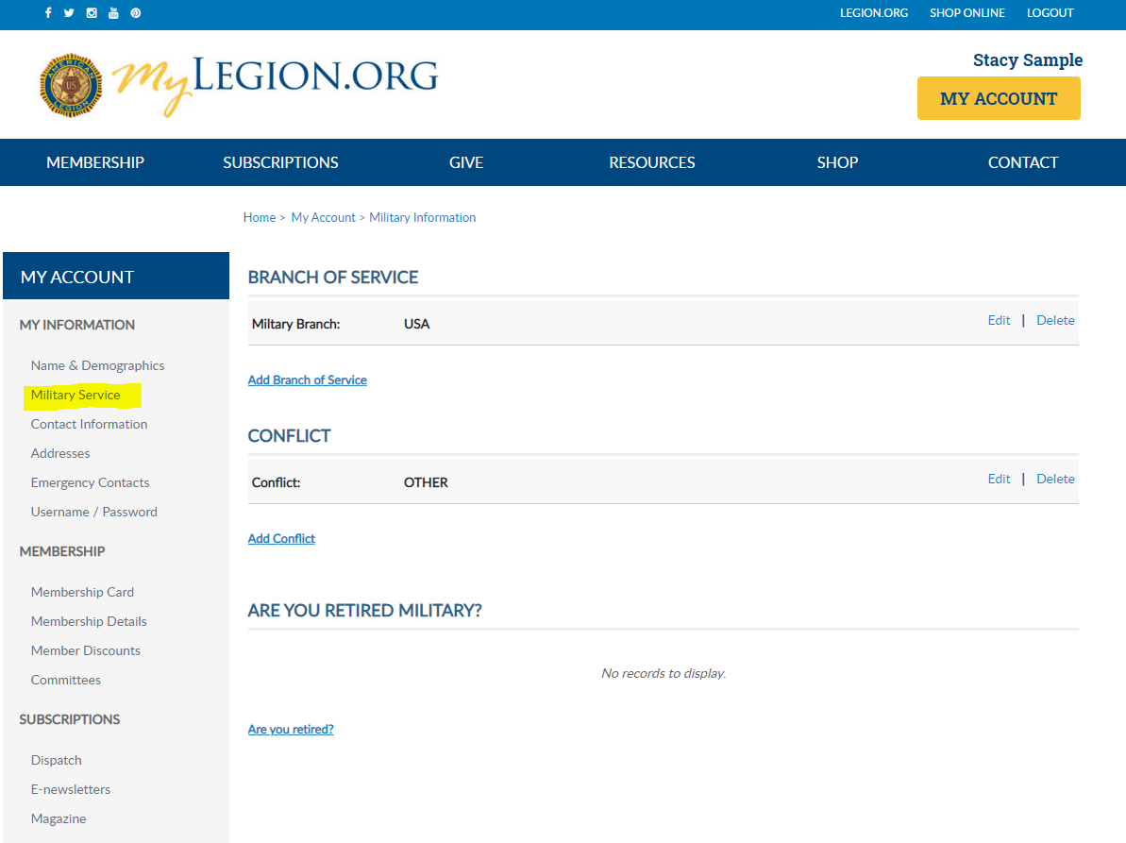
Notes:
Military service. Add, ,update, or delete the branch of service or conflict. Served in more that one branch or conflict? You can now provide that additional information.
Are you retired military? Record that on your record. Let your leadership know your retired.

Slide 24
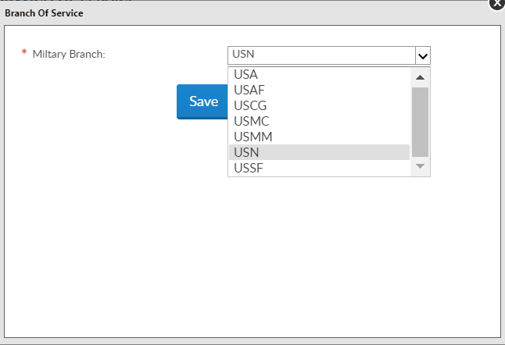
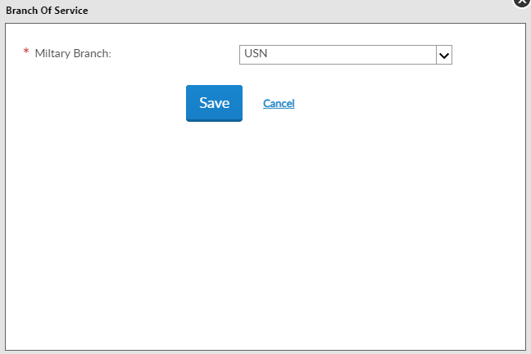
Manage Your Account
MILITARY INFORMATION
Edit Branch
Notes:
More that one branch of service can be recorded.
Options for branch of service include: USA, USAF, USCG, USMC, USMM, USN AND USSF.

Slide 25
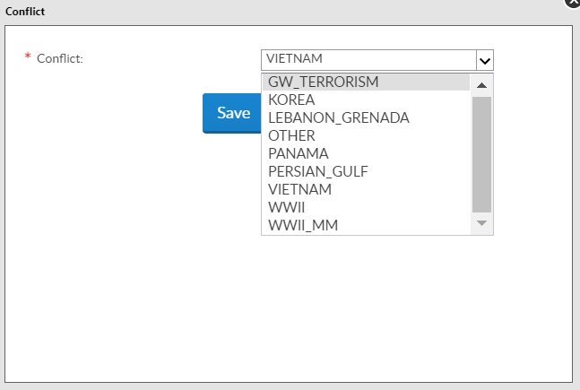
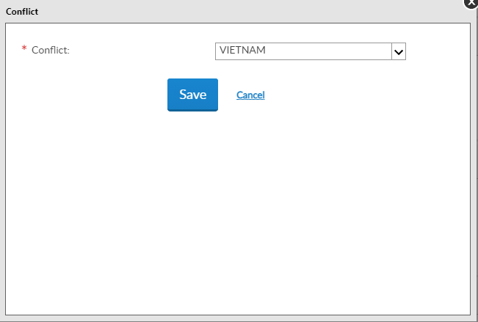
Manage Your Account
MILITARY INFORMATION
Edit Military Conflict
Notes:
You can also have more than one conflict listed on your account. Leadership rosters and reports will include the oldest conflict.

Slide 26
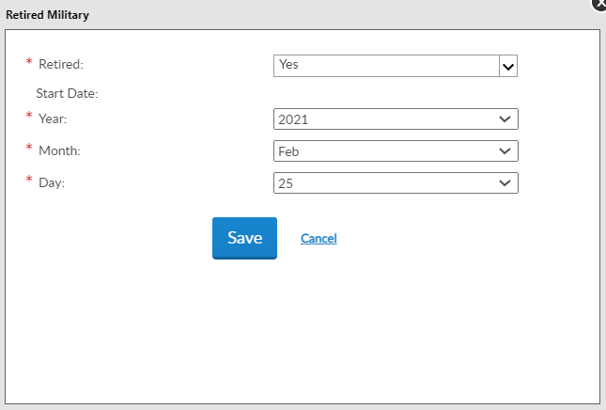
Manage Your Account
MILITARY INFORMATION
Retired Military
Notes:
New to myLegion is retirement information.

Slide 27
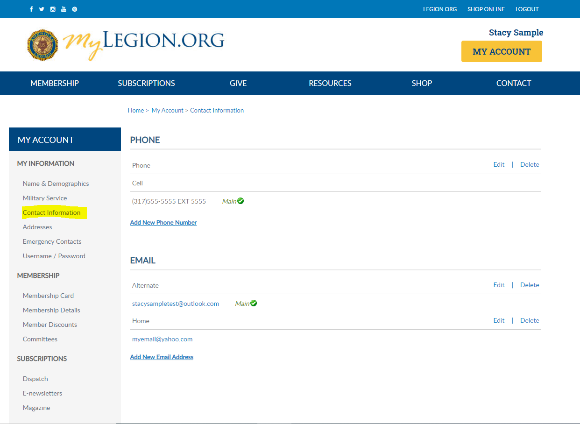
Notes:
Phone and Email is located in Contact Information.
Only one main contact can be on file for address, phone and email.

Slide 28
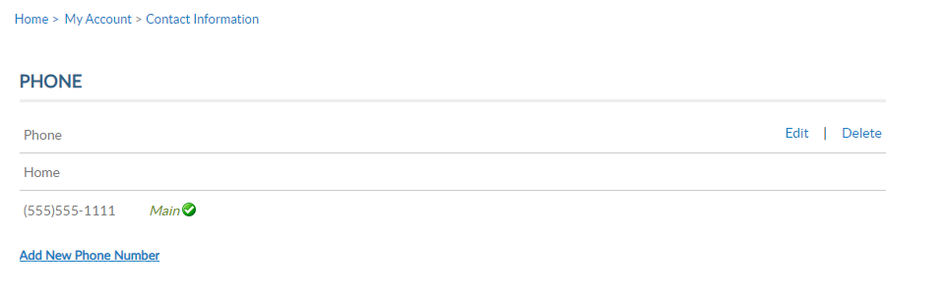
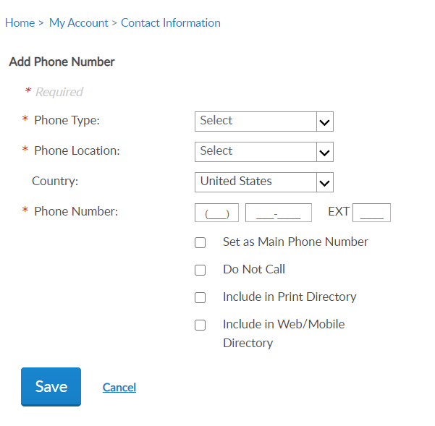
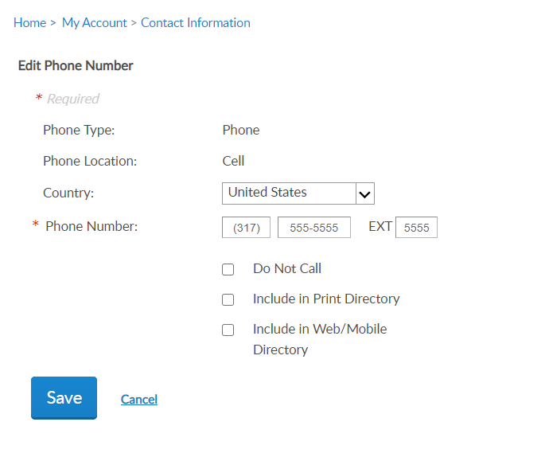
Manage Your Account
MY INFORMATION
Phone
Notes:
Using the Add, Edit or Delete links, update the phone number, phone preferences and “Save”.

Slide 29
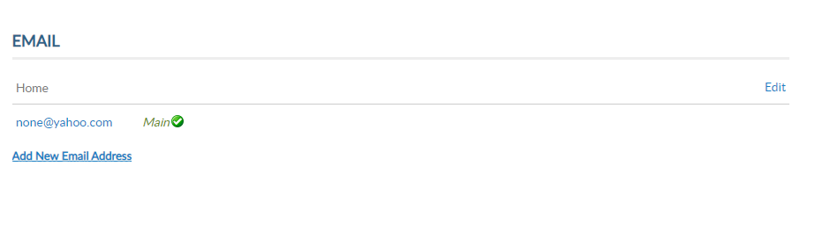
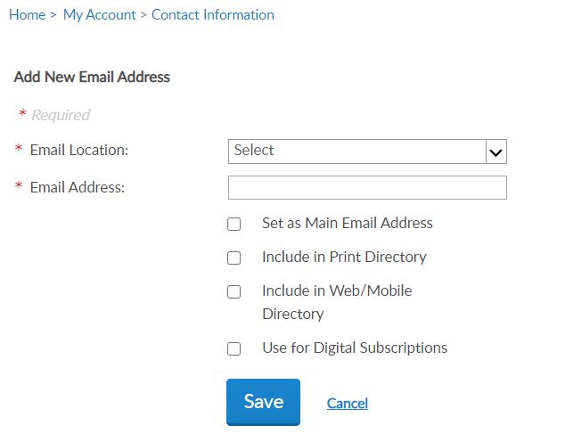
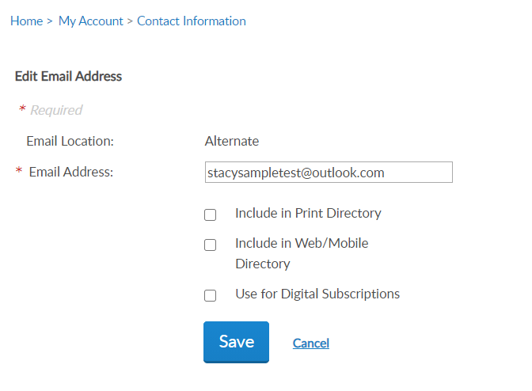
Manage Your Account
MY INFORMATION
Email
Notes:
The email set as “main email” is associated with your profile. The main email displays in MY CONTACT INFORMATION and Username/Password profile. It is also the email used for account username and password reset links.

Slide 30
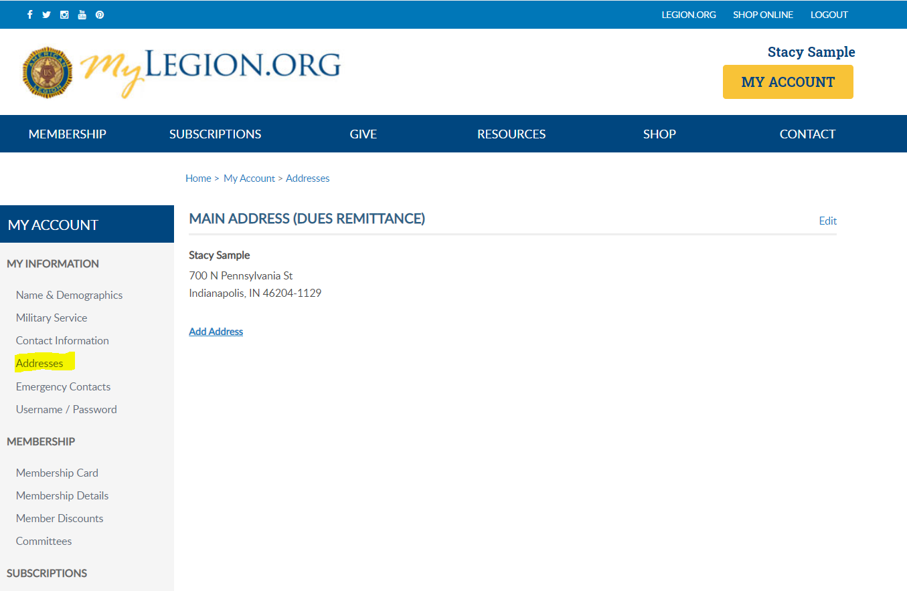
Notes:
Addresses allows you to add an alternate address and set address preferences. Information set as Main is the primary contact information. National HQs, Department HQs and other American Legion and Sons of the American Legion leadership use main contact information for mail, phone and email correspondence.

Slide 31
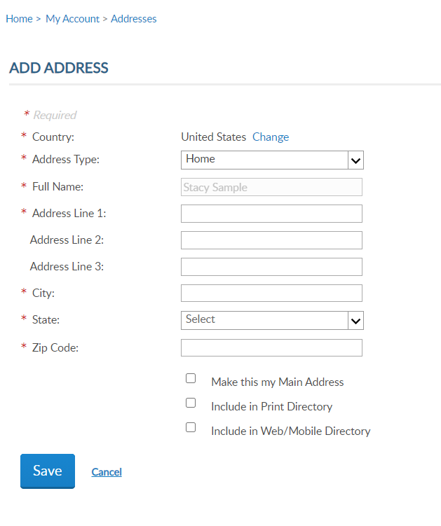
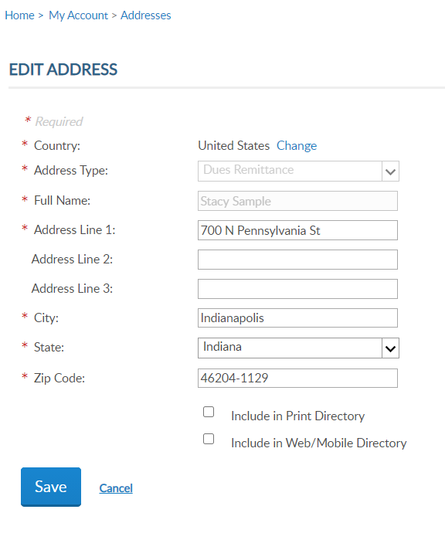
Manage Your Account
MY INFORMATION
Addresses
Notes:
Checking “Include in Print Directory” agrees your contact information can be included in directories that may be published by National, Department and Local leadership. All membership information is provided to your leadership with the directive the data can only be used only for Legion or Sons of the American Legion purposes.
Only one main contact can be on file. Adding an address with the Main Address preference will replace the existing main address.

Slide 32
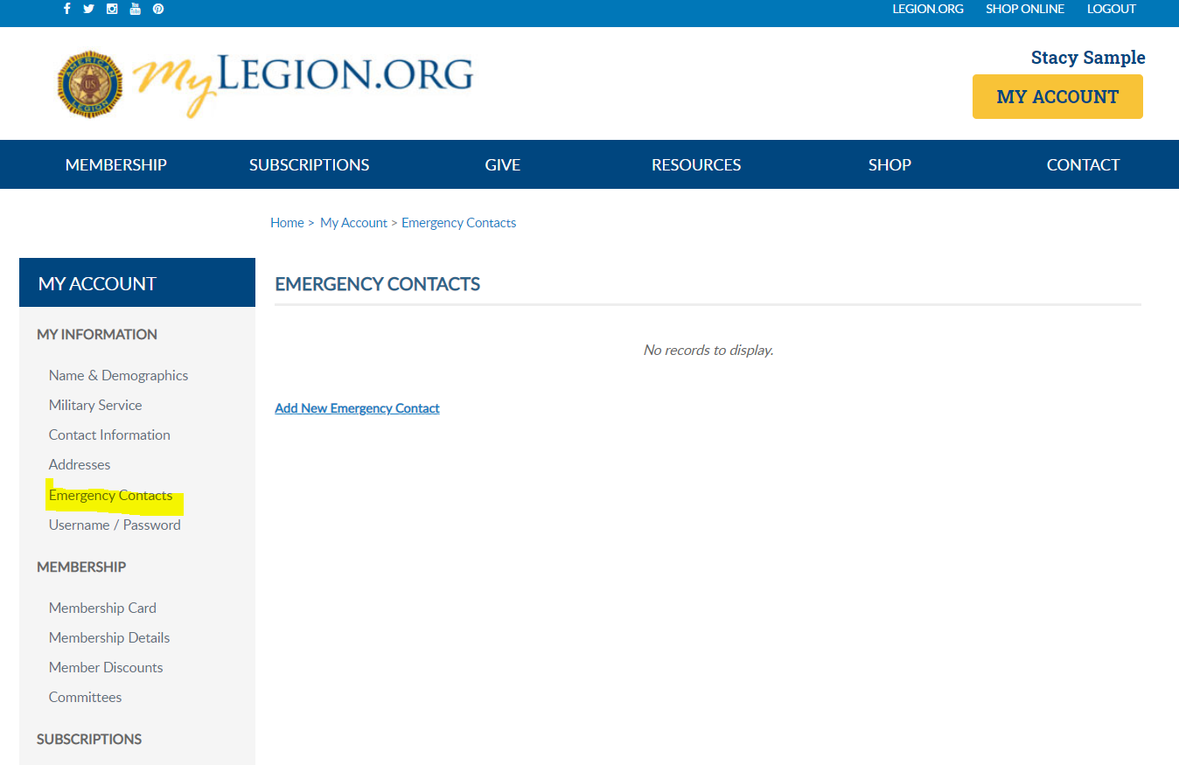
Notes:
Emergency Contacts is a new feature. Add an emergency contact to your account.

Slide 33
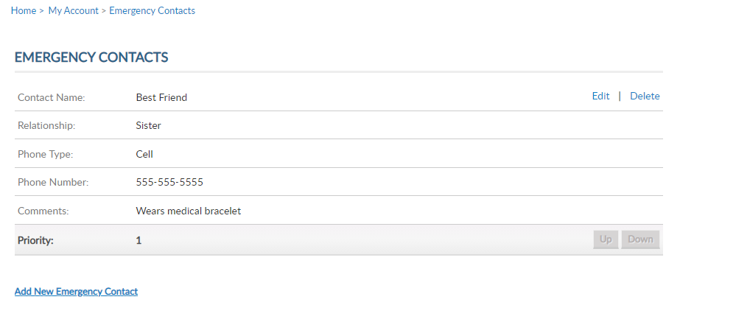
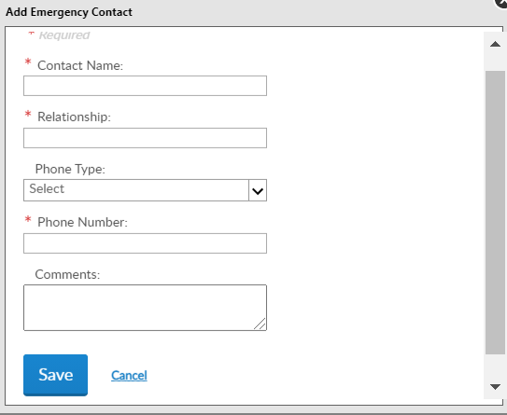
Manage Your Account
MY INFORMATION
Add Emergency Contacts
Notes:
This information is available to your leadership and can be useful if participating at an American Legion event, conference or convention.

Slide 34
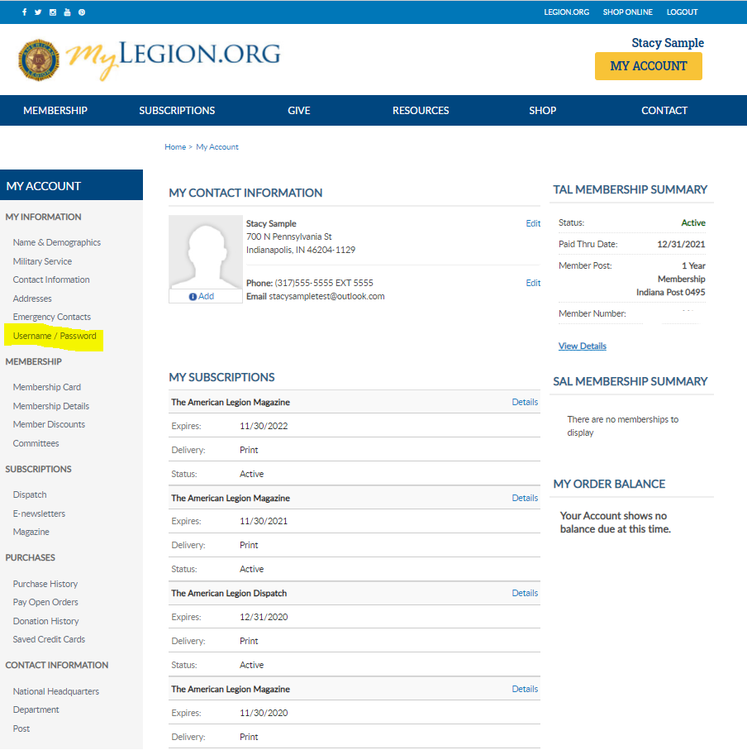
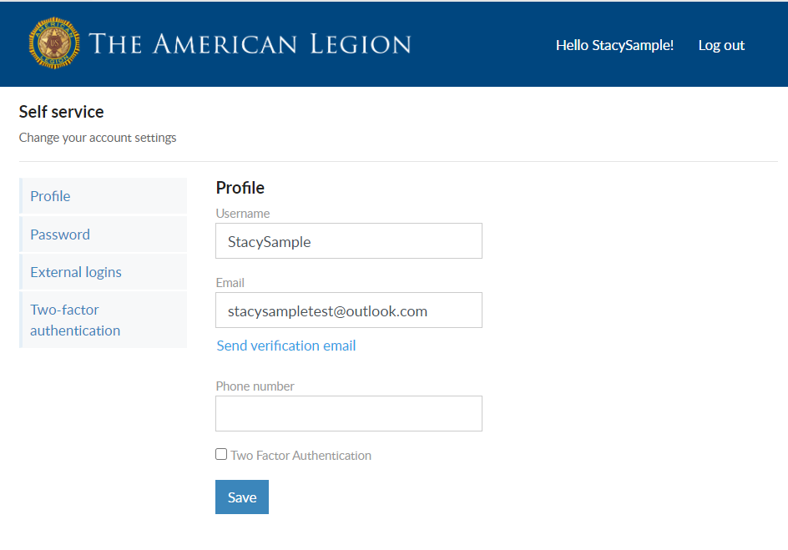
Manage Your Account
MY INFORMATION
Username/Password – Self-service Window
Notes:
To update account login credentials, go to Username/Password. This link opens a self-service window that shows your current username and main email associated with your account.

Slide 35
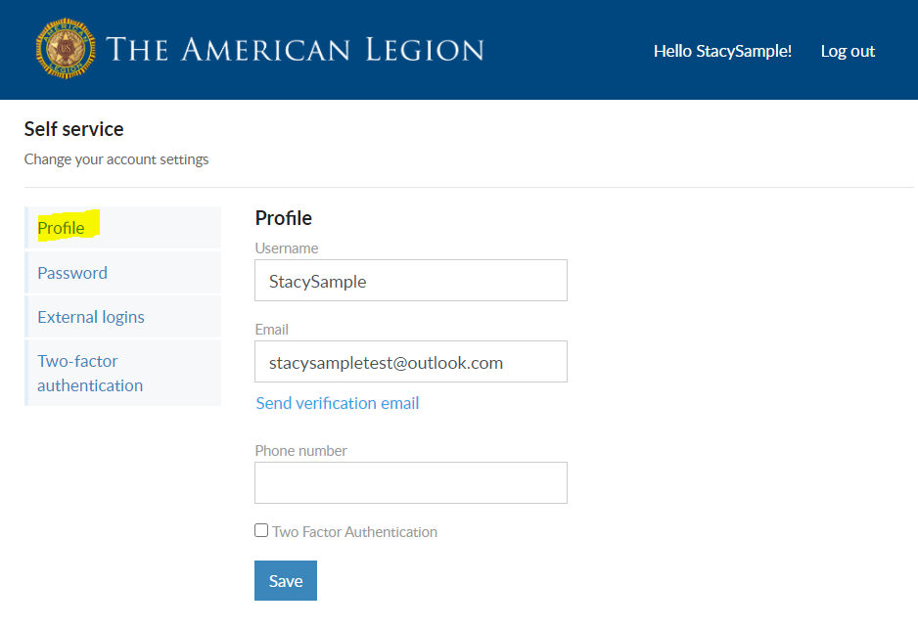
Manage Your Account
MY INFORMATION
Update Username
Notes:
To update your login credentials, enter the new information and Save.
The username does not have to be an email address. However, the email address listed in the self-service window is the main email on record and updates your contact information. Updating the email in Username/Password will direct all future forgot username and passwords to this email.

Slide 36
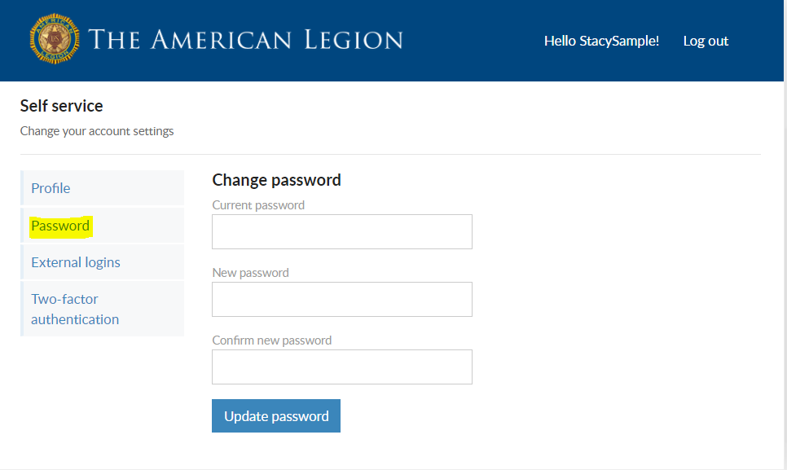
Manage Your Account
MY INFORMATION
Update Password
Notes:
To update your password in the self-service window you must know your current password. If you have logged in with a saved password and do not know it, you can log out and request a one-time password. This will email you a password reset link.
If you have your current password, enter it with the new password and click ‘Update Password’.

Slide 37
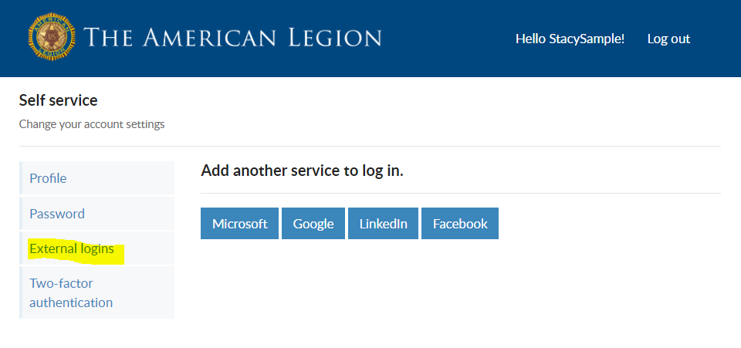
Manage Your Account
MY INFORMATION
External Login
Notes:
Like many other web applications, myLegion users can log in using other online identities as a single sign on process. Allowing fewer passwords to remember.

Slide 38
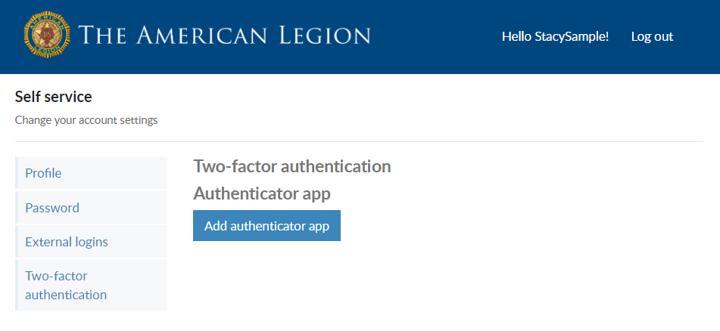
Manage Your Account
MY INFORMATION
Two-factor Authentication
Notes:
Two-factor authentication is an extra layer of security to ensure that you're the only person who can access your account, even if someone knows your password. This extra security measure requires you to verify your identity using a randomized code we'll send you each time you attempt to log in.

Slide 39
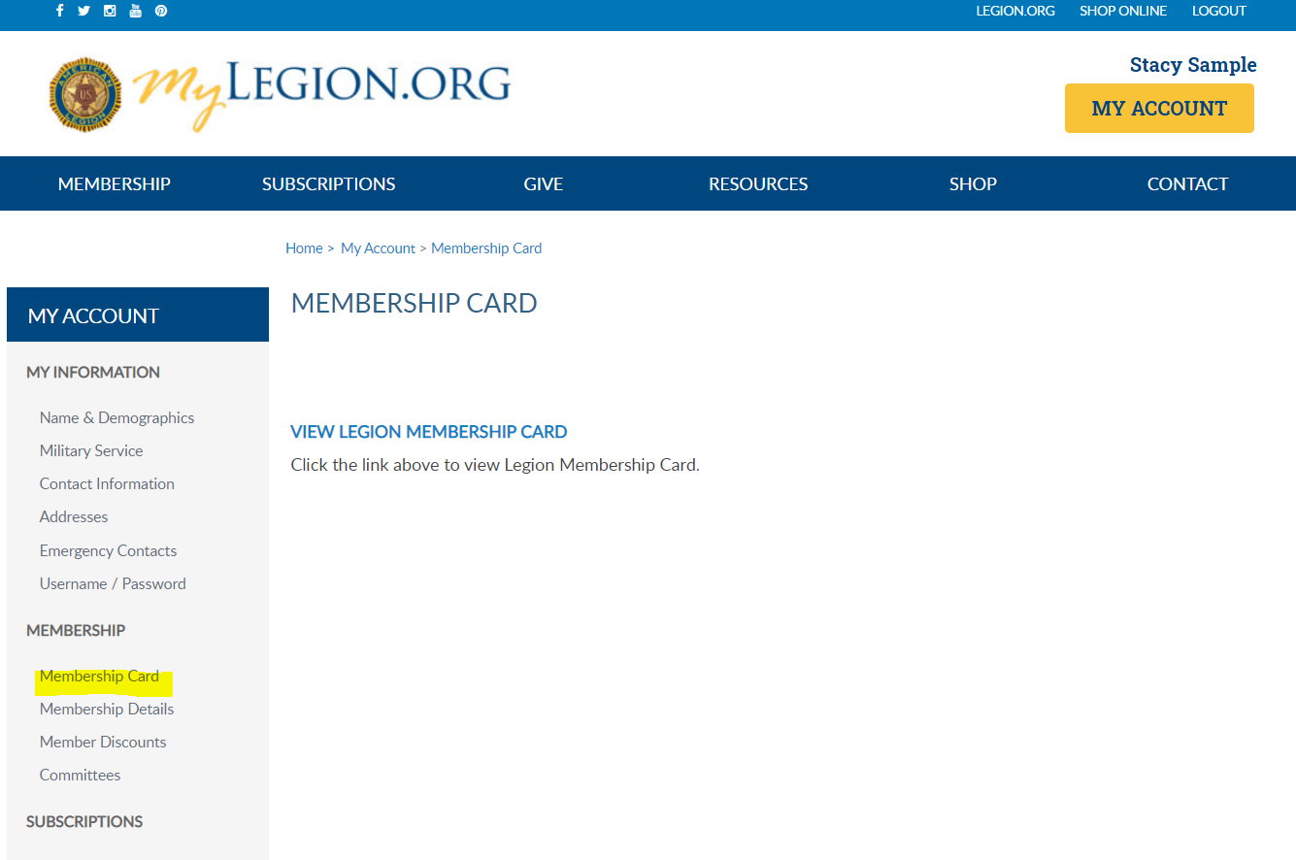
Notes:
The membership area lets members print their membership cards.

Slide 40
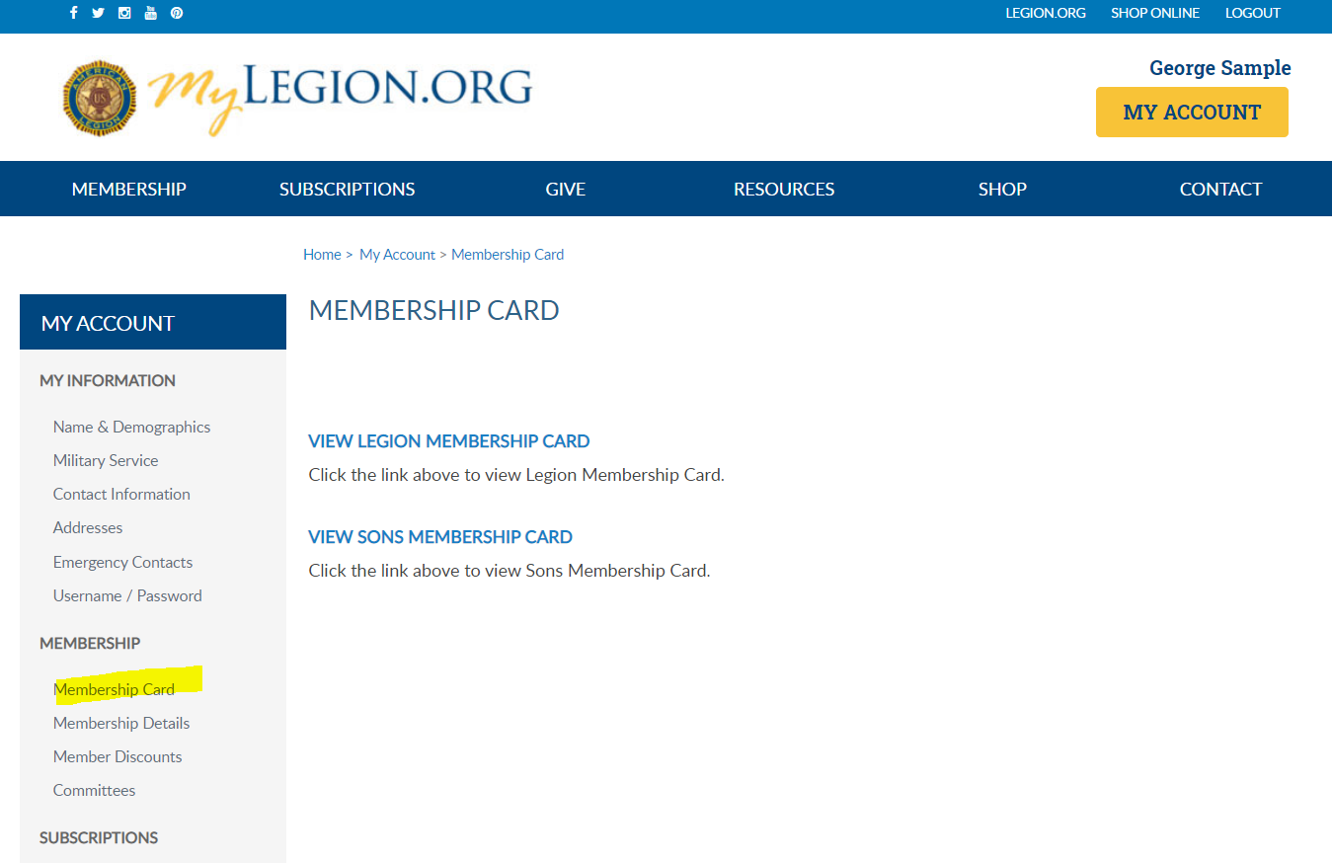
Notes:
If a member is a dual member, both Legion and SAL cards can be printed. Only current membership cards are available. If you do not have a link to print your card, you first need to pay current dues. Once dues are paid, the card is available to print.

Slide 41

Notes:
In membership details members can view current memberships and future memberships. The member detail includes your post or squadron state and number, membership end date, and current status.

Slide 42

Membership Details
Notes:
Legion members can add a credit card to their account and set up auto renew and check the box authorizing auto renewal to be charged to the saved credit card in July every year. To update credit card information click Manage My Saved Credit Cards or use “Saved Credit Cards” from the left menu.
To cancel auto renew, uncheck the box.

Slide 43

Notes:
The American Legion offers exclusive discount programs for members of The American Legion and Sons of the American Legion. Discount provider information and codes are only available in myLegion.org member accounts.

Slide 44

Notes:
Discount codes are found only when logged into myLegion. Select the area of interest to view provider contact information and exclusive discount codes.

Slide 45

Notes:
Any offices maintained by Department and National HQs are located in Committees. The page lists any past, future and current positions on file. The positions displayed in this area are post, county, district, state, and national leadership positions reported to National HQ. All leadership positions are reported through your department headquarters. If you have held a position that is not listed, contact your department headquarters. Only department and national staff can update officer and committee positions.
This member is a post commander. Post adjutants and commanders have a My Groups menu. My Groups is the administrative side of myLegion. Learn more about managing membership information for your post, squadron, county and district at legion.org/training/trainingtuesdays.

Slide 46

Notes:
Dispatch is an American Legion National Headquarters monthly print newsletter that provides post, district and department leaders with news relevant to membership, post activities and national American Legion news. Complimentary copies of Dispatch are provided to department leadership, district commanders and post adjutants, and committee/commission chairpersons.
There is a monthly Digital Dispatch e-newsletter sent directly to subscribers’ email inboxes. The e-newsletter features headlines with clickable links to the full stories on the Digital Dispatch web page, www.legion.org/dispatch.

Slide 47

Notes:
E-newsletters allows you to opt in or out of online subscriptions. To add or modify online subscriptions go to Edit.

Slide 48

E-newsletters Opt In/Out
Notes:
Check the box to select your subscription, or check the box next to E-newsletters to select all. Unless specified these subscriptions will be emailed to the main email address on file.
You can request online newsletters to be sent to a different email. Set up a 2nd email address through Contact Information. Return to opt in and out from E-newsletters. Check the subscription and assign the alternate email address. Save changes and return to home page.

Slide 49



Notes:
Members receive a 12-month free subscription to The American Legion Magazine. This publication has gone digital. Current and past issues are located your My Account subscriptions menu.
Expired members will receive an Access Denied message. Access to online magazine requires active American Legion, Sons of the American Legion membership, or paid subscription.

Slide 50


Notes:
The purchase history shows history of payments made for renewals and donations.

Slide 51

Notes:
Pay Open Orders is the same as what displays in MY ORDER BALANCE. The amount due includes post dues for your renewal. Online renewal for SAL members is not available at this time. National is in the process of collecting data to activate this feature in the future.

Slide 52

Notes:
Donation history records all online and mailed in giving. A date range search assists as you review your giving to American Legion programs and charities.

Slide 53

Notes:
Saved credit cards allows you to store payment information for future renewals and donations.
Credit card information can be maintained through myLegion in the Saved Cred Card area. Add, update or remove the credit card when needed.

Slide 54

Contact Information
Notes:
Find contact information for your National, Department and Post in contact information.

Slide 55
000111222333
Notes:
Both the myLegion home page and the My Account page, at the top of the page, have areas for Membership, Subscriptions, Giving, Resources, Shop National Emblem Sales and Contact information.
Legion.org is a public page and selecting options from this menu exits your myLegion account.

Slide 56

Notes:
Online help is available from the Resources Menu.

Slide 57

NEW
Notes:
Step by step instructions for both member management and officer tools are located this area for members and administrative officers to assist with processing membership, managing member profile information, creating reports and more.

Slide 58
MyLegion
User Help Documentation
legion.org/training/myLegion
Notes:
Need help with myLegion? Go to legion.org/training/mylegion to view help documentation on myLegion tools.

Slide 59
mylegion@legion.org
800.433.3318
Notes:
Your National support staff is available Monday through Friday, 8-4:30pm Eastern.

