Slide 1
Wynola Water District Board of Directors Meeting April 8, 2023 9:00 a.m.
Santa Ysabel Nature Center
22135 CA – 79 Santa Ysabel CA 92070

Slide 2
Call to Order
Roll Call of Board of Directors
Additions to Agenda

Slide 3
4. Approval of meeting minutes of March 11, 2023

Slide 4
5. Public Comments: Opportunity for members of the public to address the Board on matters within the Board’s jurisdiction. Person’s addressing the Board are requested to state their name and address for the record.

Slide 5
6. Treasurer’s Report: Brenden Kelso

Slide 6
7. Office Manager’s Report:
Karen Kincaid

Slide 7
Old Business:
Report by the Board President (this will include the actions taken to date since the last board meeting on March 11, 2022.)

Slide 8
Old Business:
Report from WWD Water Operator Buddy Seifert regarding system status, flushing schedule, well closure process, water treatment system and ongoing maintenance needs of the District.

Slide 9
New Business:
none

Slide 10
10. Motion to adjourn
Next Meeting: May 13, 2023 (2nd Saturday of the month)
9:00 a.m. Santa Ysabel Nature Center

Slide 11
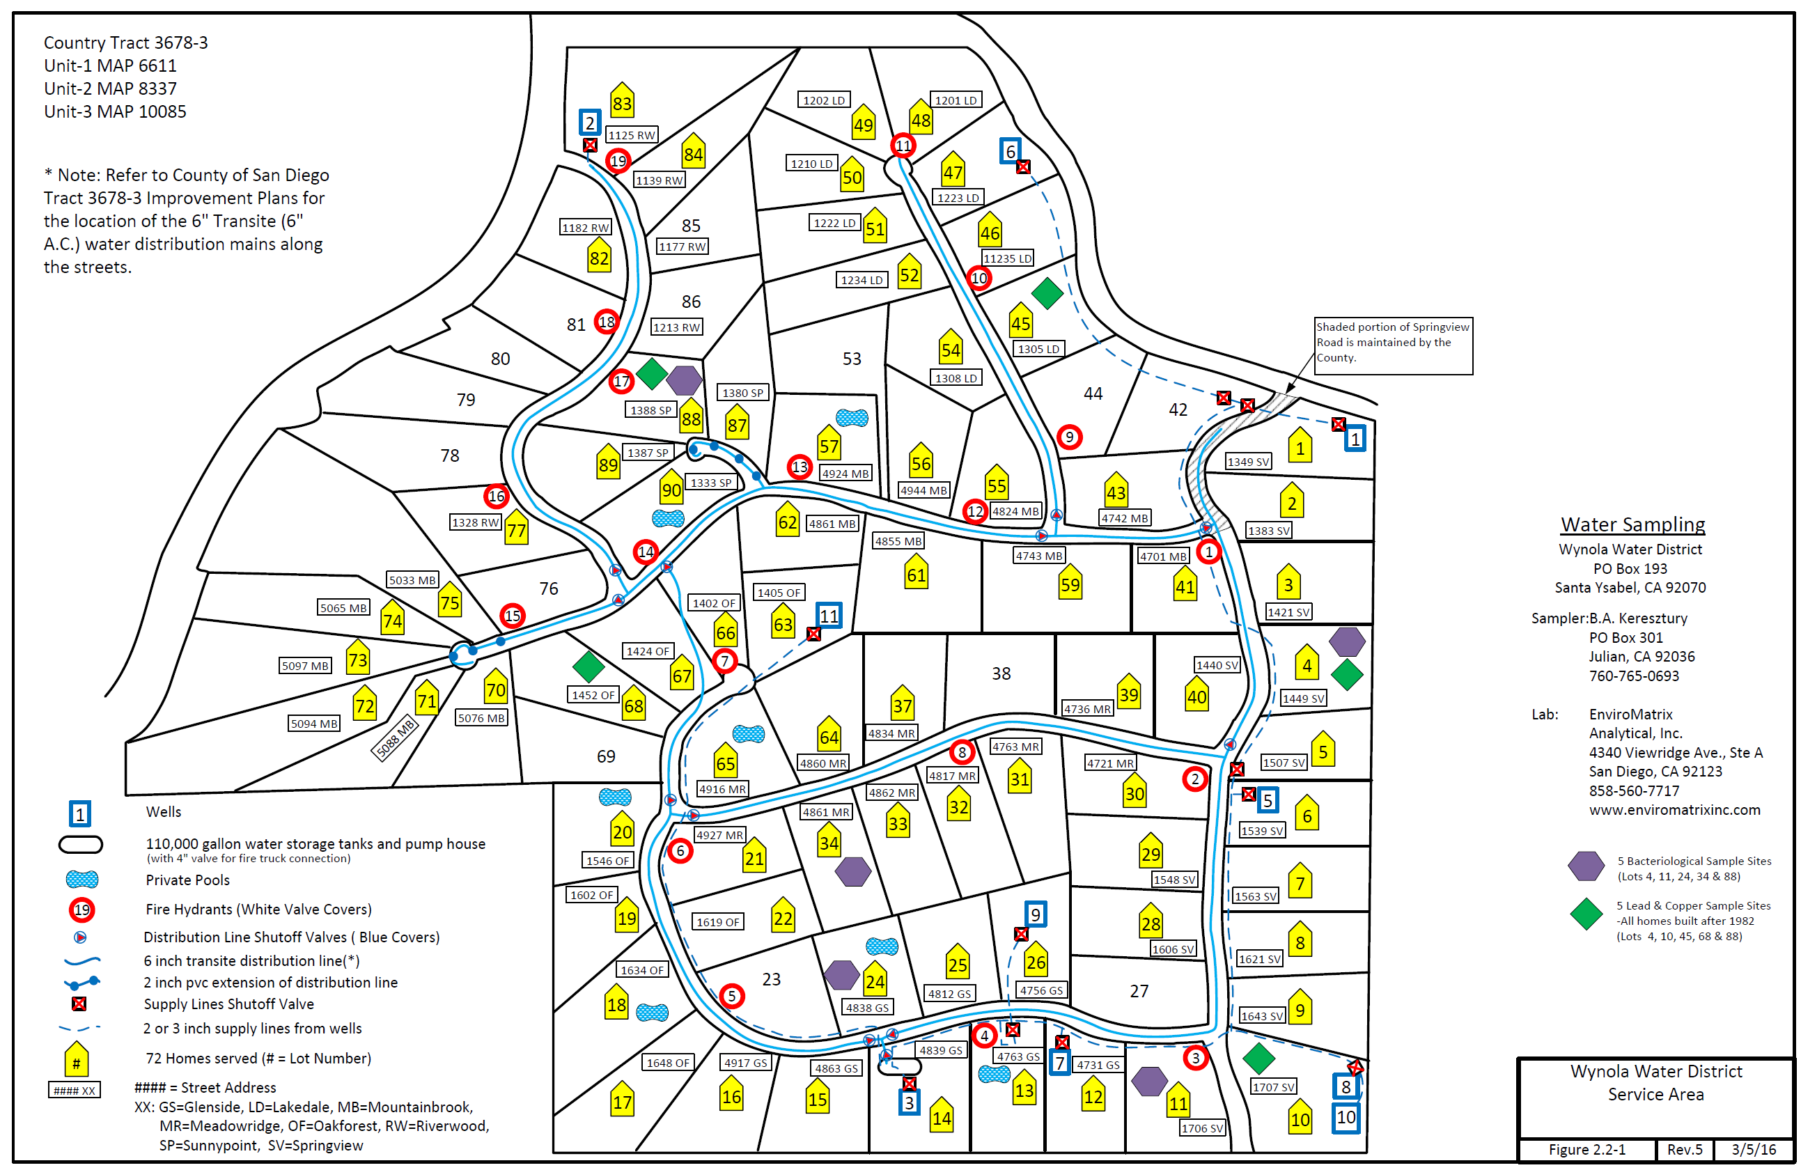

Slide 12
Wynola Water District Board of Directors Meeting April 8, 2023 9:00 a.m.
Santa Ysabel Nature Center
22135 CA – 79 Santa Ysabel CA 92070

Slide 13
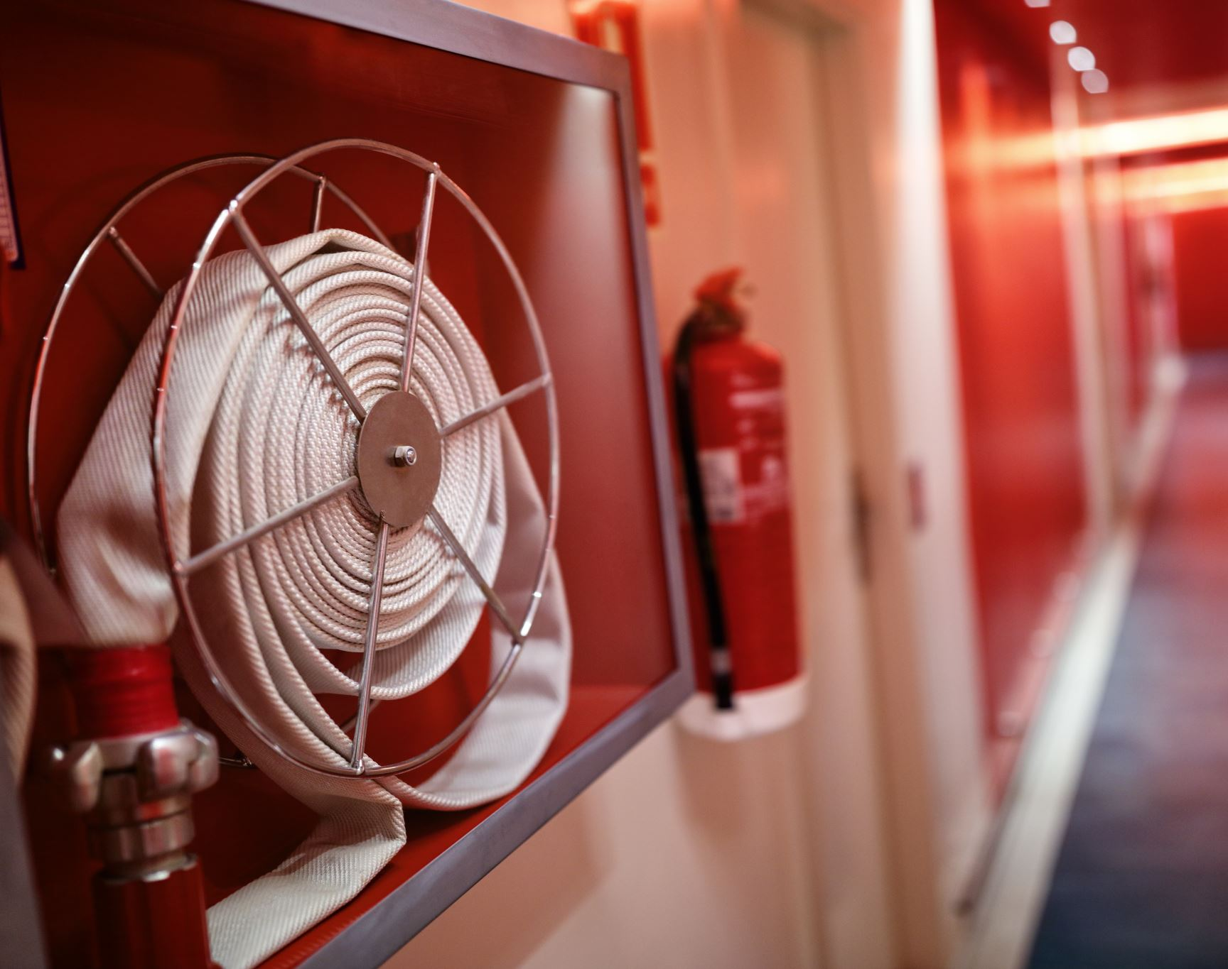
Wynola Estates Fire Safe Council Board Meeting - April 8, 2023

Slide 14
Agenda:
Call to Order
Old Business
c) New Business
d) Adjourn

