Slide 1
Wynola Water District Board of Directors Meeting January 14, 2023 9:00 a.m.
Santa Ysabel Nature Center
22135 CA – 79 Santa Ysabel CA 92070

Slide 2
Call to Order
Roll Call of Board of Directors
Additions to Agenda

Slide 3
4. Approval of meeting minutes of December 10, 2022

Slide 4
5. Public Comments: Opportunity for members of the public to address the Board on matters within the Board’s jurisdiction. Person’s addressing the Board are requested to state their name and address for the record.

Slide 5
6. Treasurer’s Report: Bonni Cogan

Slide 6
7. Office Manager’s Report:
Karen Kincaid

Slide 7
Old Business:
Report by the Board President (this will include the actions taken to date since the last board meeting on December 10, 2022.)
a.
b.

Slide 8
Old Business:
Report from WWD Water Operator Buddy Seifert regarding system status, flushing schedule, well closure process, water treatment system and ongoing maintenance needs of the District.

Slide 9
New Business:
a. Consideration of filling one (1) vacancy of the Board of Directors (Cogan): Consideration of Appointment of Board Member (Seat 4) for 2022-2026
b. One application received by deadline: Brenden Kelso
c. Accepting nominations from the floor, any member of the public interested in appointment to state their name, address, and reasons why they would like to serve the Wynola Water District Board of Directors
d. Board to interview candidate(s), deliberate, and either continue the vacancy to the next meeting or vote on candidates as interviewed

Slide 10
10. Motion to adjourn
Next Meeting: February 11, 2023 (2nd Saturday of the month)
9:00 a.m. Santa Ysabel Nature Center

Slide 11
Wynola Water District Board of Directors Meeting January 14, 2023 9:00 a.m.
Santa Ysabel Nature Center
22135 CA – 79 Santa Ysabel CA 92070

Slide 12
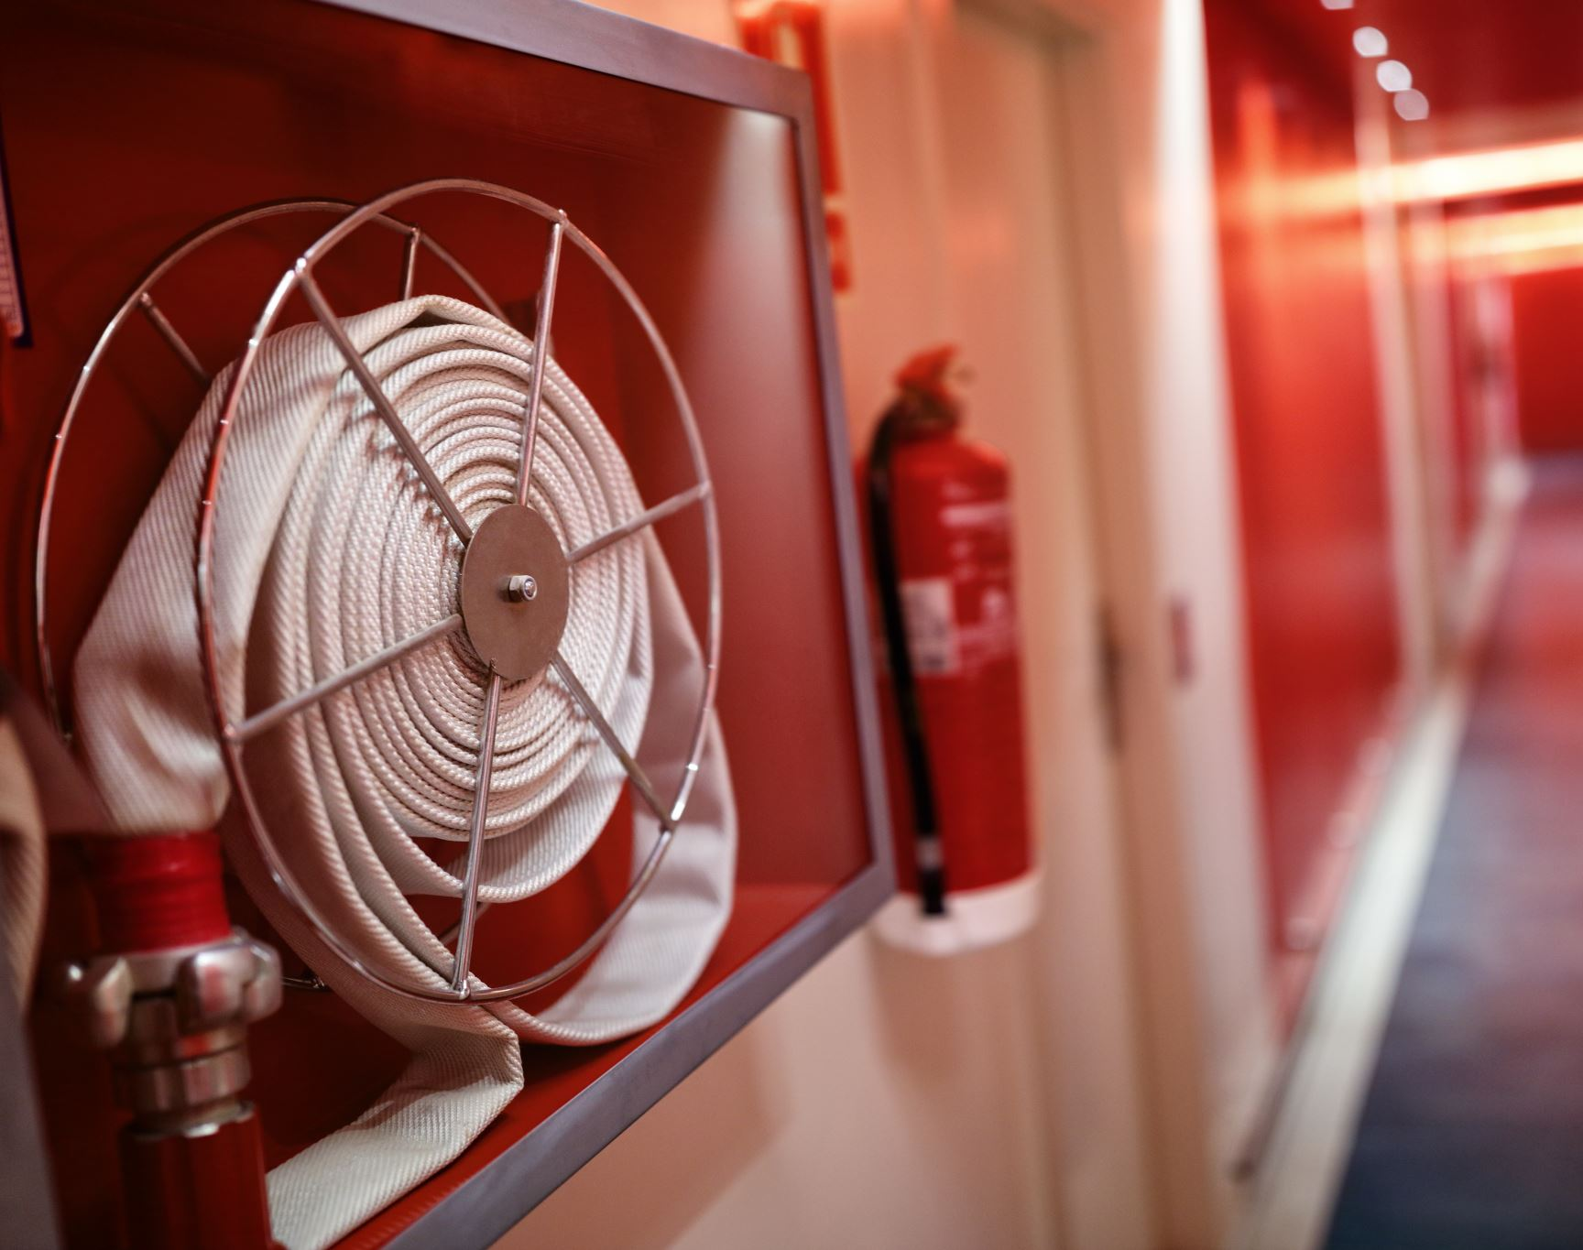
Wynola Estates Fire Safe Council Board Meeting - January 14, 2023

Slide 13
Agenda:
Call to Order
Old Business
c) New Business
Gus Calderon, Fire Watch guest speaker
d) Adjourn

