Slide 1
Blue Water Academy
2018 Admission in Progress
-Apply for Form 1-6 Places-
Chinhoyi

Slide 2
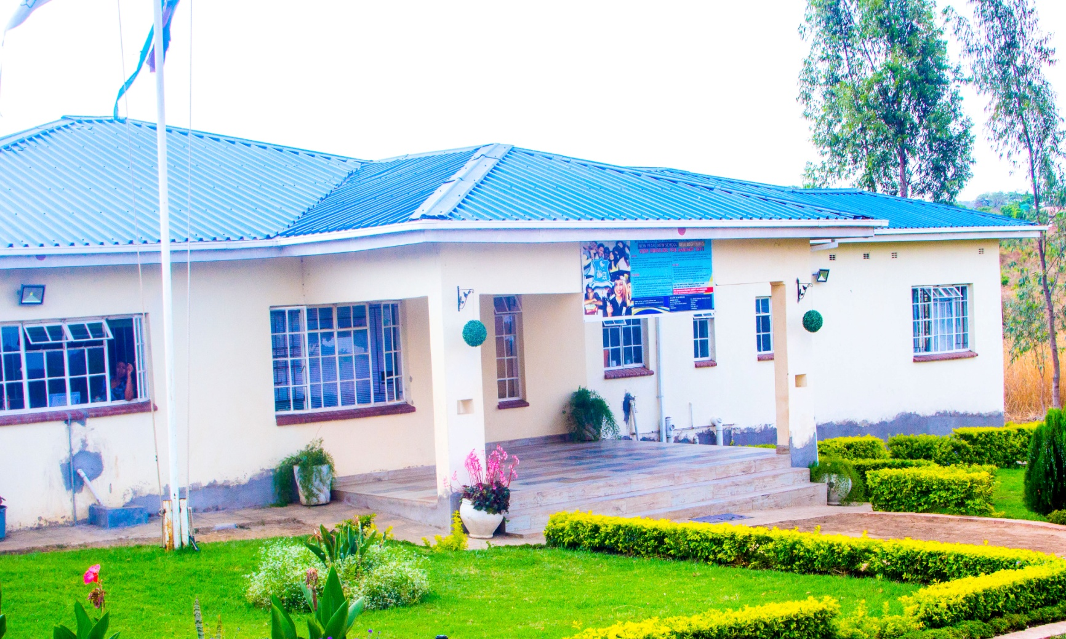
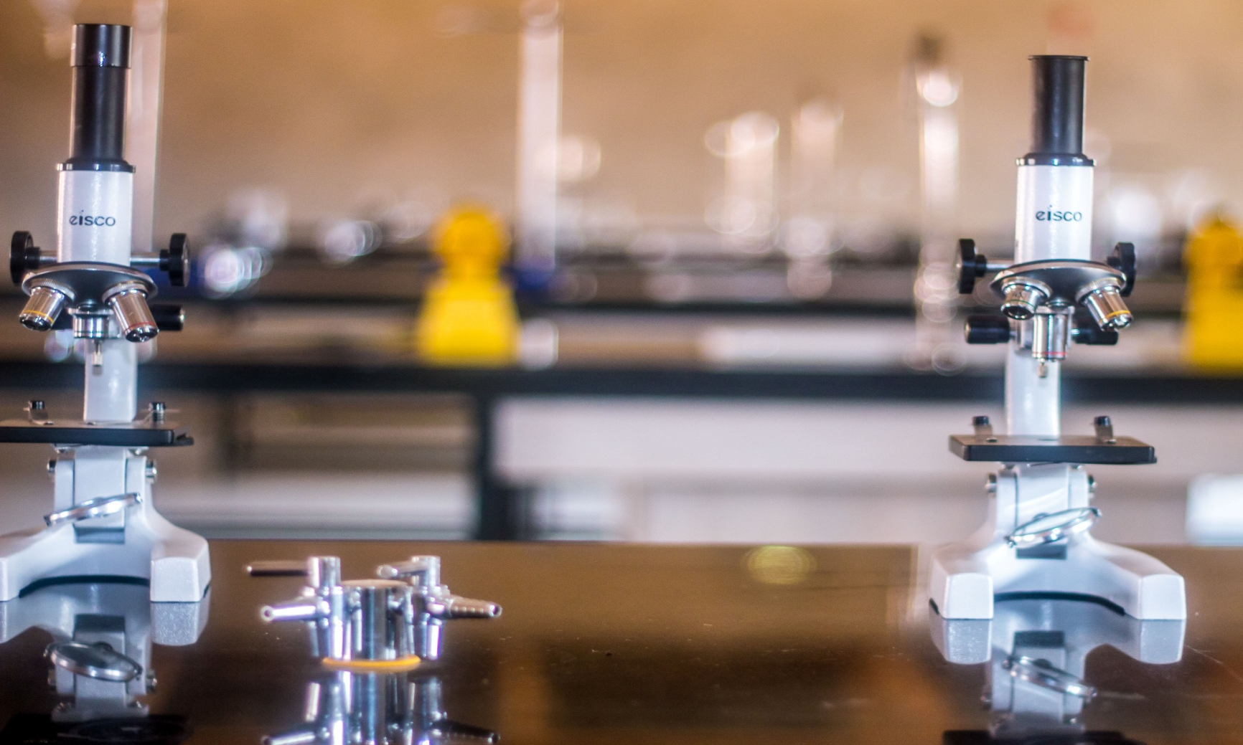
School at a Glance

Slide 3
Blue Water Academy Offers
Form 1-6 places
Day and Boarding School
O & A-Level
Zimsec and Cambridge
Excellent Learning Resources
Excellent Learning Environment
Quality Education

Slide 4
For Further Information contact
Blue Water Academy
VISIT our website at www.bluwateracademy.com
or
email us at info@bluawatercademy.com
Blue Water Academy
Chinhoyi Campus:
Stand No. 10854,
P.O Box 112,
Mapako, Chinhoyi
Telephone
0778240701 I 0732240701 I 0715240701
Email and Website
info@bluwateracademy.com
www.bluwateracademy.com

