Slide 1

Administrative Welcome &
MCHD’s Culture
Jeff R. Turner, FACHE
Chief Executive Officer
Notes:
Smile!
Welcome the new employees and thank them from coming.
Log-in by sharing a common experience (weather, current event, etc.)
Ask who has already started working? Under what division are they working (COO, CNO, CFO, MNRC)? Try to tailor presentation examples to majority of those in orientation.

Slide 2
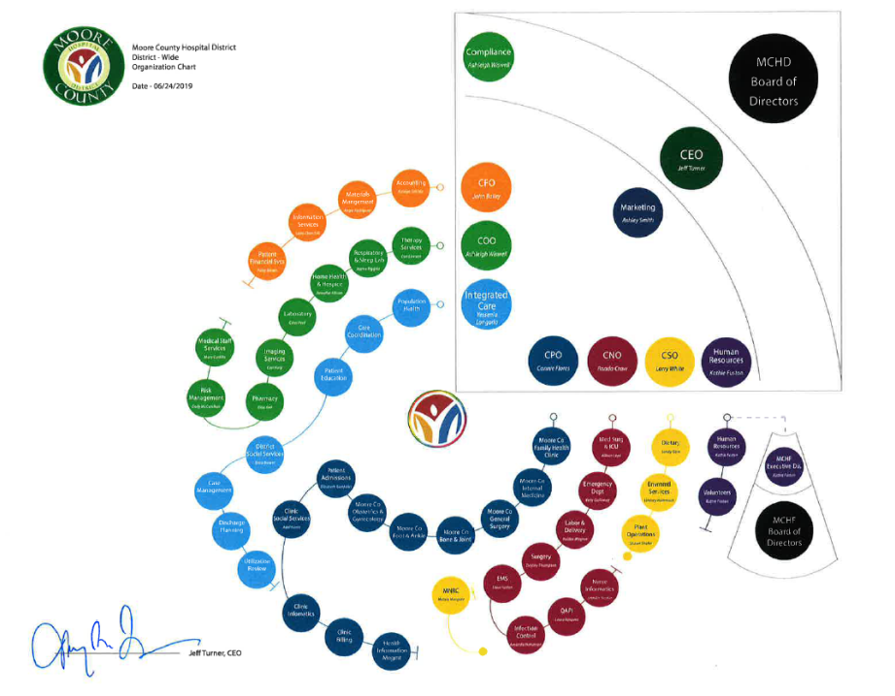


Slide 3
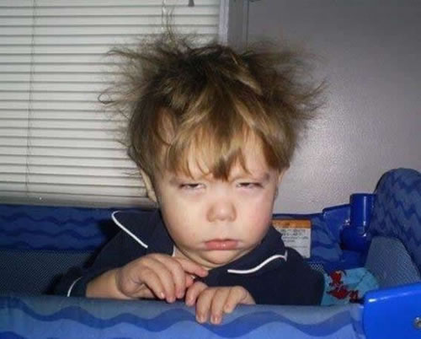

Slide 4




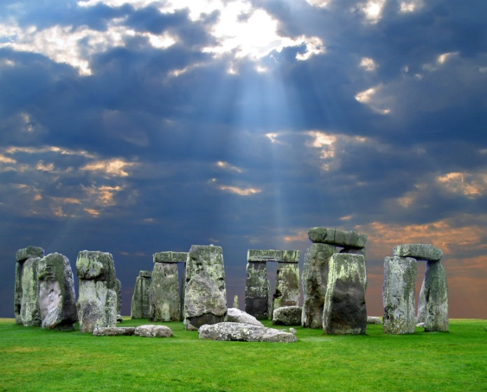

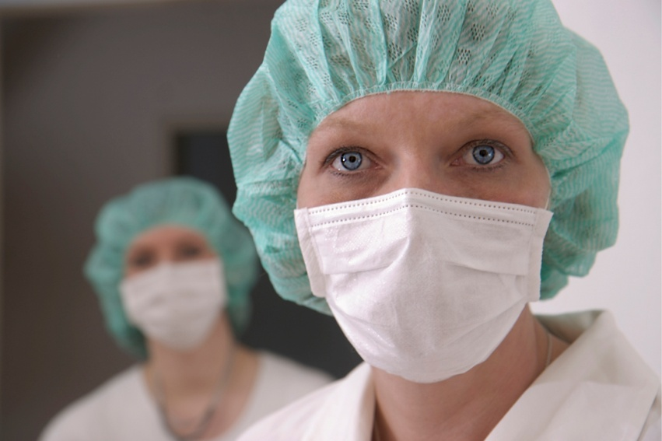
What is Culture?

Slide 5
What is Organizational Culture?
Culture – a shared system of beliefs, values, and norms about the way the organization functions.
All organizations have a culture
  Successful organizations
  Unsuccessful organizations
Consistency is the Core of Culture

Slide 6
Consistency is the Core of Culture
An organization’s culture is measured by the degree to which behaviors are shared; that is, the consistency by which behaviors occur.
What are some common traits of great organizational cultures?
What are the names of some organizations (of any industry) that you think are great or have a strong organizational culture? Explain your response.

Slide 7









“GREAT” Companies
Notes:
Show question but not sub-points. Get NEO’s to participate. Tell personal stories of “great”.
3 Degrees: when choosing healthcare, local or (1) Amarillo, (2) Dallas, San Antonio, Houston, or (3) Mayo/John Hopkins?

Slide 8
Experiencing Culture
In healthcare, patients/customers perceive an organization’s culture through their experience:
  What does MCHD look like, feel like, sound like?
  How friendly are our employees? How do we dress, speak, relate to each other and patients?
  How responsive are we?
  Do we have the best technology? Are needed items available?
All of these questions (and more) give customers a sense of our culture.

Slide 9
Codifying Culture
How do organizations define their cultures?
  Mission and Vision Statements
  Bylaws, Policies and Procedures
  Strategic Plans
  Standards of Behavior

Slide 10

MCHD Mission
The mission of Moore County Hospital District is to improve the health status of the people of the District and surrounding rural communities by providing quality and compassionate care while maintaining the fiscal integrity of the institution.
What words from our Mission Statement stand out as being key to our desired culture?

Slide 11

MCHD Vision
MCHD will be the healthcare organization of choice.
Quality: Ensure that MCHD’s clinical outcomes meet or exceed National Benchmarks for each service line.
Service: Provide exceptional customer service to all we serve.
Employees: Be a great place for employees to work.
Growth: Constantly seek new and innovative ways to grow MCHD.
Finance: Manage resources to ensure the long-term viability of MCHD.
Community: Be recognized as a community leader.

Slide 12
MCHD Vision
We refer to
these as Pillars
MCHD will be the healthcare organization of choice.
Quality: Ensure that MCHD’s clinical outcomes meet or exceed National Benchmarks for each service line.
Service: Provide exceptional customer service to all we serve.
Employees: Be a great place for employees to work.
Growth: Constantly seek new and innovative ways to grow MCHD.
Finance: Manage resources to ensure the long-term viability of MCHD.
Community: Be recognized as a community leader.

Slide 13
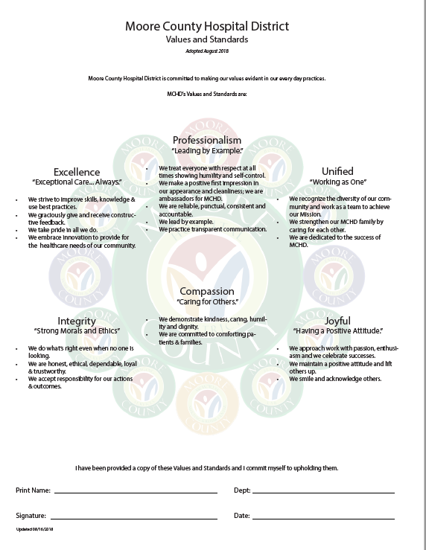
MCHD’s Standards of Excellence

Slide 14
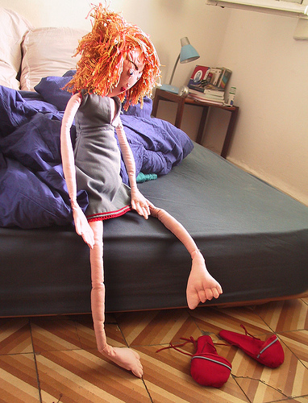


“GREAT” Companies are Full of People Just Like You
Notes:
Show question but not sub-points. Get NEO’s to participate. Tell personal stories of “great”.
3 Degrees: when choosing healthcare, local or (1) Amarillo, (2) Dallas, San Antonio, Houston, or (3) Mayo/John Hopkins?

Slide 15

How do they do become the best?

Slide 16
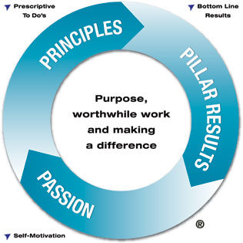
Healthcare Flywheel
The Healthcare Flywheel shows how organizations can create momentum for change by engaging the passion of their employees to apply prescriptive actions of service and operational excellence to achieve bottom-line results.

Slide 17
Nine Key Principles
Commit to Excellence
Measure the Important Things
Build a Culture of Service
Create and Develop Leaders
Focus on Employee Engagement
Build Individual Accountability
Align Behaviors with Goals and Values
Communicate at All Levels
Recognize and Reward Success

Slide 18
Prescriptive Behaviors
Culture of Service: AIDET, Patient Rounding, Discharge/Post-visit Phone Calls
Create and Develop Leaders, Build Individual Accountability & Align Behaviors with Goals and Values: High/Solid/Low Performers, Leadership Development Institutes (Quarterly), Leadership University, Objective Leadership Evaluations (LEM)
Focus on Employee Engagement: Rounding (Sr. Leader, Employee, Physician), Peer Interviewing and 30/90 Day Post-hire Interviews, 18-month Survey and Action Plans
Communicate at All Levels: Weekly Exec Ops Meeting, Monthly Leadership Meeting, Rounding, Quarterly Town Hall Meetings, Monthly CEO Forums, Monthly Newsletter
Reward & Recognition: Thank You Notes, Service Excellence Awards

Slide 19
Measure the Important Things
The MCHD Scorecard
Strategic Plan
Budget
Operational Decisions / Tactics

Slide 20
Defining Excellence
Excellence is when employees feel valued, physicians feel their patients are getting great care, and patients feel the service and quality they receive are extraordinary.
  At MCHD, we align all that we do with Six Pillars: People, Service, Quality, Growth, Finance, and Community.
  At MCHD, we strive to be in the top 10-percent of any measurement category.

Slide 21
Connecting to Why
Why do we expect that all Leaders and Employees consistently perform Prescriptive Behaviors?
Because evidence shows that Prescriptive Behaviors improve results; and
We expect the best. . . Consistently.
Why?
Because our customers expect it. . . Consistently.
Exceptional Care. . . Always
A challenge for you
A promise to our customers.

Slide 22
You Are MCHD
You are what people see when they arrive at MCHD.
Yours are the eyes they look into when they’re frightened and lonely.
Yours are the voices people hear in our waiting rooms and when
they try to sleep and when they try to forget their problems. You are
what they hear on their way to procedures that could affect their
destinies, and, what they hear after they return from those procedures.
Yours are the comments people hear when you think they can’t.
Yours is the intelligence and caring that people hope they’ll find at MCHD. If
you’re noisy, so is MCHD. If you’re rude, so is MCHD. And if
you’re wonderful – so is MCHD.
No visitors, no patients can ever know the real you, the you that you
know is there – unless you let them see it. All they can know is what they
see and hear and experience.
And so MCHD has a stake in your attitude and in the collective attitudes of
everyone who works at MCHD. MCHD is judged by your
performance. MCHD is the care you give, the attention you pay, the
courtesies you extend.

