Slide 1
HUMAN TRAFFICKING
Erica Taylor, LMSW
Social Worker

Slide 2
National Human Trafficking Hotline
1-888-373-7888
Text “BE FREE” to 233733

Slide 3

What is Human Trafficking?
As defined by the United States Department of Justice (2021), “human trafficking is a crime that involves exploiting a person for labor, services, or commercial sex.”
The Trafficking Victims Protection Act of 2000 (3 P’s)

Slide 4
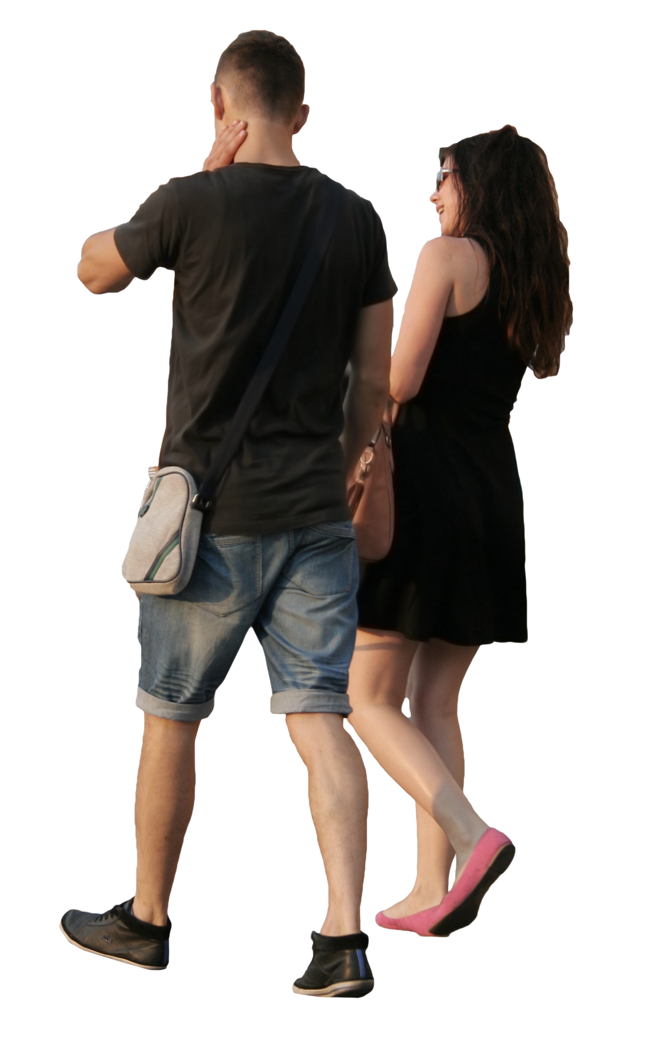
Two types of Human Trafficking:
1. Sex Trafficking
“Sex trafficking in which a commercial sex act is induced by force, fraud, or coercion, or in which the person induced to perform such act has not attained 18 years of age” (United States DOJ, 2021).
2. Labor Trafficking
“The recruitment, harboring, transportation, provision, or obtaining of a person for labor or services, through the use of force, fraud or coercion for the purpose of subjection to involuntary servitude, peonage, debt bondage, or slavery” (United States DOJ, 2021)
This Photo by Unknown Author is licensed under CC BY-NC

Slide 5
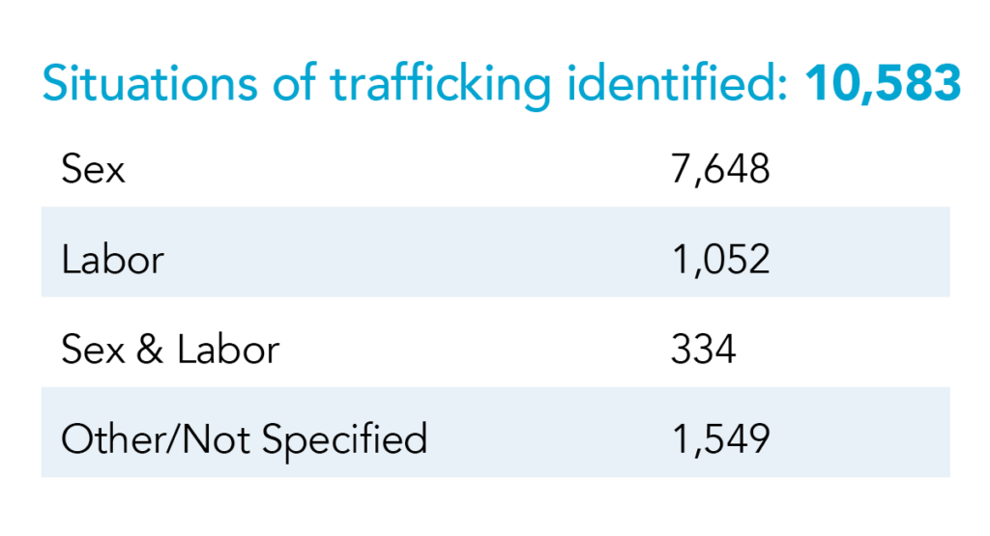
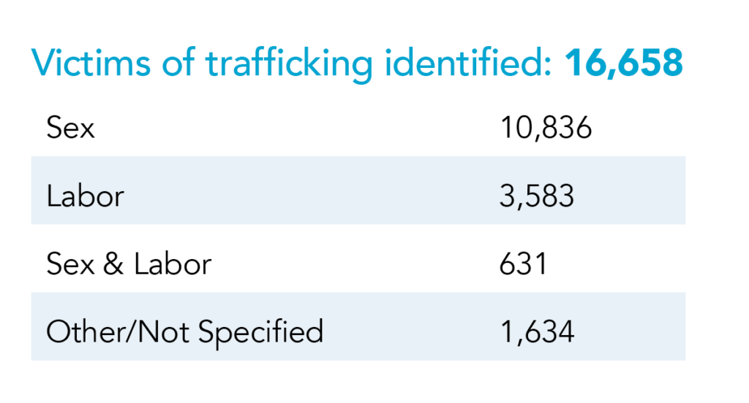
2020-2021 Statistics

Slide 6
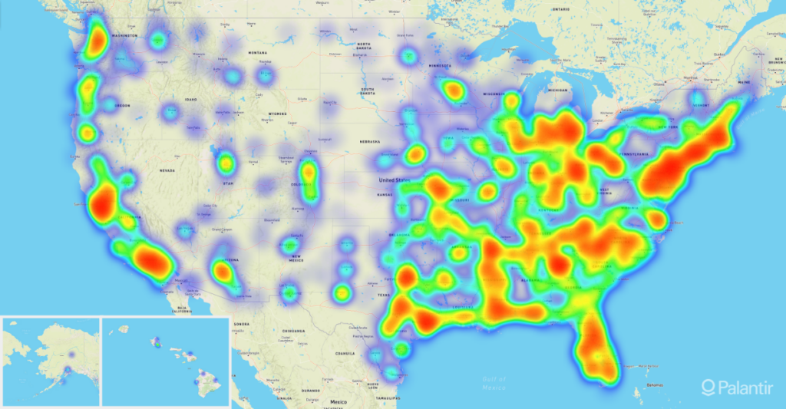

Slide 7


Slide 8
1. All human trafficking involves commercial sex.
Notes:
Poll Title: All human trafficking involves commercial sex.
https://www.polleverywhere.com/multiple_choice_polls/mjI3ppSbZytaCnEc05d0h

Slide 9

All human trafficking involves commercial sex.
All commercial sex involving a minor is legally considered human trafficking.
Commercial sex involving an adult is human trafficking if the person providing commercial sex is doing so against his or her will as a result of force, fraud or coercion.

Slide 10
2. Human trafficking only happens in illegal or underground industries.
Notes:
Poll Title: Human trafficking only happens in illegal or underground industries.
https://www.polleverywhere.com/multiple_choice_polls/9hDL7w40ufKp9zBESElWJ

Slide 11
Human trafficking only happens in illegal or underground industries.
Human trafficking cases have been reported and prosecuted in industries including restaurants, cleaning services, construction, factories and more.

Slide 12
3. Only women and children can be victims/ survivors of sex trafficking.
Notes:
Poll Title: Only women and girls can be victims and survivors of sex trafficking.
https://www.polleverywhere.com/multiple_choice_polls/28ITdKEH41h4OyTw4iUzv

Slide 13
Only women and children can be victims/ survivors of sex trafficking.
One study estimates that as many as half of sex trafficking victims and survivors are male. Advocates believe that percentage may be even higher but that male victims are far less likely to be identified. LGBTQ boys and young men are seen as particularly vulnerable to trafficking.

Slide 14
4. Traffickers target victims they do not know.
Notes:
Poll Title: Traffickers target victims they don't know
https://www.polleverywhere.com/multiple_choice_polls/Q4SdldofKb6jctCdpRgtM

Slide 15
Traffickers target victims they do not know.
Many survivors have been trafficked by romantic partners, including spouses, and by family members, including parents.

Slide 16
5. People being trafficked are physically unable to leave their situations/locked in/held against their will.

Slide 17
People being trafficked are physically unable to leave their situations/locked in/held against their will.
It is mostly generated by a lack of general necessities or effective emotional and mental manipulation. Some victims have been manipulated so effectively that they are not aware they are being trafficked.

Slide 18
Someone may be experiencing labor trafficking or exploitation if they:
Feel pressured by their employer to stay in a job or situation they want to leave
Owe money to an employer or recruiter or are not being paid what they were promised or are owed
Do not have control of their passport or other identity documents
Are living and working in isolated conditions, largely cut off from interaction with others or support systems
Appear to be monitored by another person when talking or interacting with others

Slide 19
Someone may be experiencing sex trafficking if they:
Want to stop participating in commercial sex but feel scared or unable to leave the situation.
Disclose that they were reluctant to engage in commercial sex but that someone pressured them into it.
Are children who live with or are dependent on a family member with a substance use problem or who is abusive.
Have a “pimp” or “manager” in the commercial sex industry.
Have a controlling parent, guardian, romantic partner, or “sponsor” who will not allow them to meet or speak with anyone alone or who monitors their movements, spending, or communications.
Notes:
Poll Title: What have you learned about today?
https://www.polleverywhere.com/free_text_polls/iQ28SvI83CYGP2FhrCOFD

Slide 20

https://youtu.be/JJ2xCJMp7-c

Slide 21

Takeaways:
1. Trafficking = transaction.
2. We have an opportunity to make a difference every single day by looking for warning signs/signals.
3. Human trafficking does NOT equal victims in cages.

Slide 22
References
What is Human Trafficking? | National Human Trafficking Hotline
Family Support Services | Counseling, Crisis Response and Support, Prevention Services and Veterans Services (fss-ama.org)
https://polarisproject.org/
Myths & Facts | National Human Trafficking Hotline

Slide 23
National Human Trafficking Hotline
1-888-373-7888
Text: “BE FREE” to 233733

