Slide 1
TOWN HALL MEETINGS
June 2025

Slide 2
Welcome & Updates
Jeff Turner, CEO

Slide 3
Updates
Press-Ganey Employee Satisfaction Results
94th National Percentile (up from 90th Percentile in 2023)
98% of MCHD employees participated.
We will begin rolling out Departmental Results soon.
Physician Recruiting Success
Dr. Chance Pack (Family Practice) – August 2025
Dr. Shashank Singh (Nephrology) – January 2026
Dr. Khushbu Patel (Hospitalist/Intensivist) – January 2026
Dr. Samuel Addo arriving in Sept/Oct 2025

Slide 4
FY2026 Strategic Plan Highlights
Jeff Turner, CEO

Slide 5
GROWTH
Open Inpatient Dialysis Program
Physician Recruiting:
Open Moore County Nephrology (Dr. Shashank Singh)
Start Dr. Chance Pack (to replace Dr. Corbin)
Start Dr. Khushbu Patel (Employed Hospitalist)
Recruit Pediatrics (Subject to Go Forward on New MOB)(2025 Forward Thinking #2)
Develop Mental Health Community Case Management Program (2025 Forward Thinking #4)
Define Role of Clinical Psychologist (Dr. Sandra Addo-Yankah)
Begin Counselling Services
Facility Projects:
Go/No Go on New Consolidated Primary Care RHC Office Building (2025 Forward Thinking #1)
Complete Chapel, Courtyard, Cafeteria, Corridor, Patient rooms to office conversions
Equipment Upgrades

Slide 6
SERVICE & EMPLOYEES
SERVICE
Physician Engagement Survey (August 2025)
Custom Learning Systems 5-star Initiative
Clinics
ER Academy
Hospital
Nursing Home
EMPLOYEES
Workforce Development and Volunteer Opportunities
Culinary
Clinical
DISD & SISD CTE Programs
Employ CNA Instructor (Partnership with DISD)

Slide 7
QUALITY
Build an MCHD Hospitalist Group
Add Dr. Khushbu Patel in January
Look for additional hiring opportunities to include PAs/NPs
Quality Data Collection/Submission:
American Heart Association Quality Data
ACO
JBS
Clinics
Board Quality Initiatives
Sepsis
CLS ER and Clinic Data
Patient Perception
Clinical Data
NRHA/Chartis Top 100

Slide 8
FINANCE & COMMUNITY
FINANCE
Governmental Programs (CHIRP, RAPPS, QIPP, etc.)
Continue Grant Writing Capacity
COMMUNITY
Grow MCHF
2024 Harvest (Nephrology/ Dialysis)
Scholarship Luncheon
Sporting Clays
Leader Community Service Projects
Marketing Plan

Slide 9
MEDICAL STAFF
Medical Staff Development
MEC Leadership Conference
Conduct Physician Engagement Survey (August 2025)
Deploy Chief Medical Officer Role
Implement Electronic Credentialing Software System

Slide 10
Empower Visits
Amy Davis, Director HR

Slide 11
457b Supplemental Retirement
Full Time employees are eligible to sign up
Does NOT have an employer match
Retirement Plan Advisor will be here June 26th
Sign up in HR for a time to speak with him

Slide 12
CAHPS Consumer Assessment of Healthcare Providers & Services
Ashley Smith

Slide 13
What are CAHPS?
Surveys given to our patients about the care we give them
Scored by “consistency” or “affirmation”
Always / Sometimes / Never
Yes, Definitely / Yes, Probably / No, Definitely
Administered by third party vendors
Survey Solutions - Mail/ Email / Text surveys:
Inpatient (Med Surg, Intermediate Care, Women’s Services), Surgery, ED, Clinics
Wellsky - Mailed (only) surveys:
Hospice

Slide 14
Why are they important?
Our results are published for the public to see
Our results affect how we are rated by CMS and other agencies
Star Rating
Reimbursements
They tell us what our patients think about the care that we provide to them
They allow us to hold ourselves accountable, be better, and to provide our patients Exceptional Care Always.

Slide 15
How to Read CAHPS
Remember these terms
Raw Score
Top Box
Percentile

Slide 16
How to Read CAHPS
Raw Score
Percentage of patients who gave the best possible score “Top Box” for that question
Top Box can be “Always”, “Yes, Definitely”, “Yes”, “9 or 10”
Example:
100 people take the survey
90 people give you the “Top Box Score”
YOUR RAW SCORE is 90.00

Slide 17
How to Read CAHPS
Percentile
Your Percentile is how you score compared to other hospitals
Raw scores are compared and hospitals are ranked
An easy way to remember percentiles is”
If you are in the 99th percentile, you scored better than 99% of the database

Slide 18
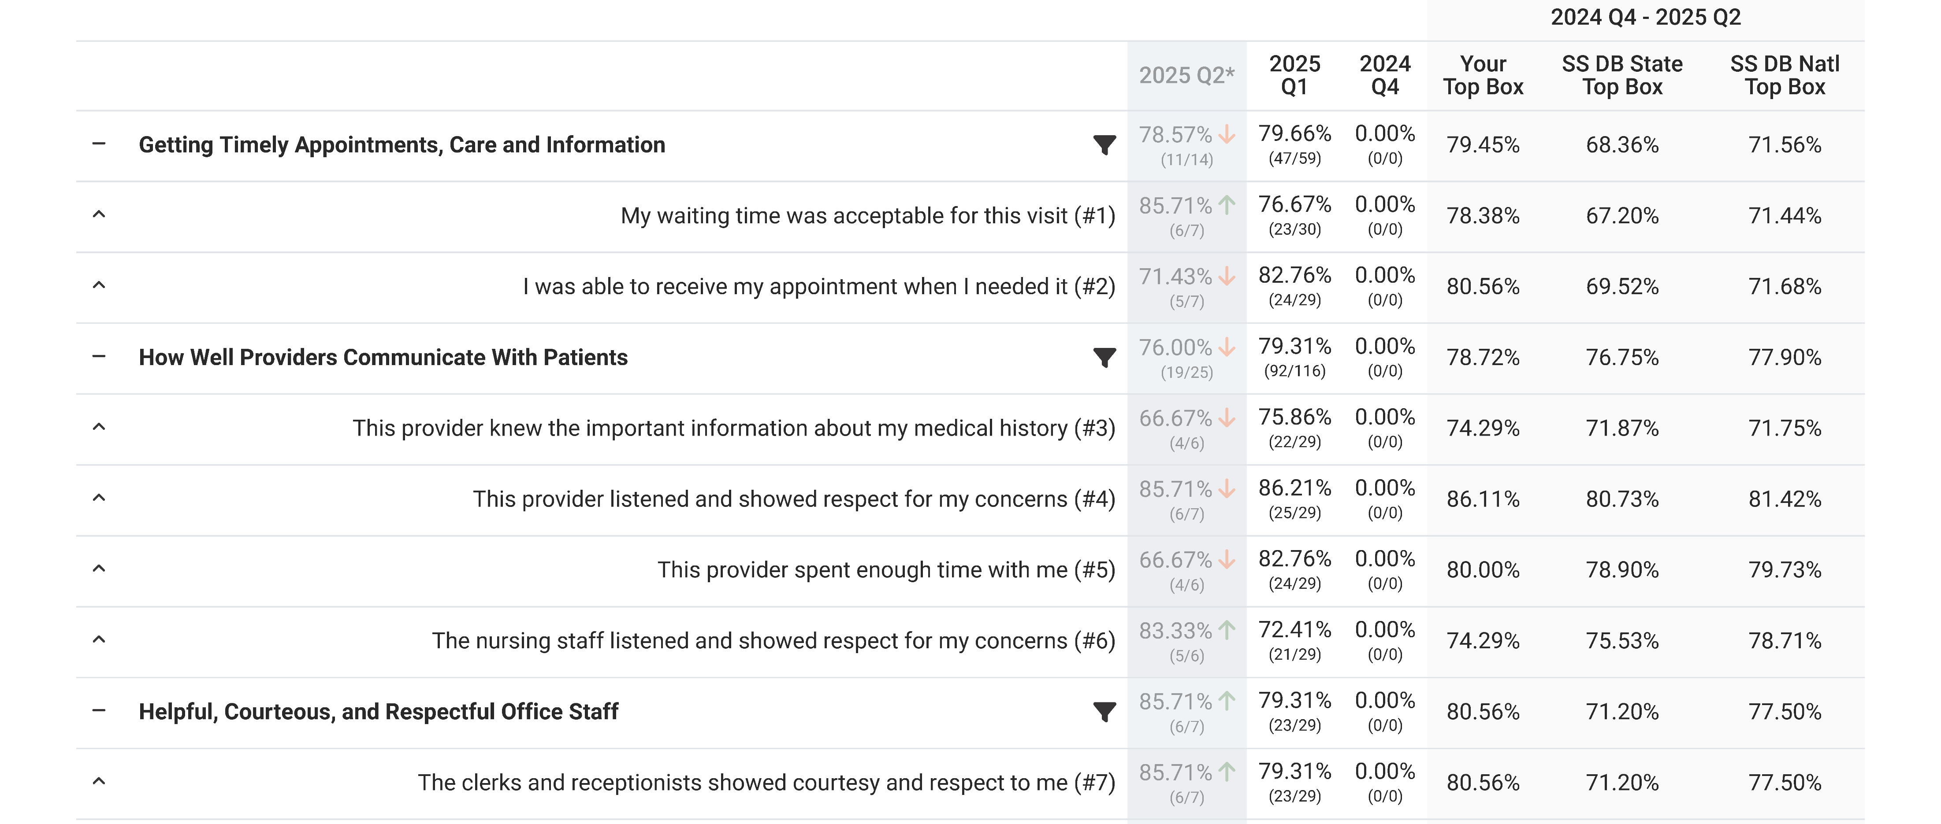

Slide 20
Questions?
Need help? Call Ashley at 1302

Slide 21
Month of Giving

Slide 22
Month of Giving Olympics

Slide 23
Month of Giving Olympics
Teams of five (5) compete for the Gold!
The team that crushes the team-only challenge, wins:
8 Hours of PTO per member
$100 Visa Gift Card per member
A team-only luncheon at your restaurant of choice
(within reason…)
Every fundraiser is a competition with a prize
Everyone can participate in the fundraisers, but only teams can win prizes.

Slide 24
The Fundraisers
Donor Levels
Makes up 90% of what is raised overall
From $5/month up to 2% of your salary *or* choose your own donation
Choose where your money goes
Payroll deducted over 26 pay periods
Apparel Sales
Baked Potato Sale
Silent Auction
Raffle (Lawn Games)

Slide 25
The Fundraisers
Baked Goods Sale
BINGO Games
Teams Only Scavenger Hunt
Flash Sale
All fundraisers have the option of cash/check, charge, and up to six pay periods of payroll deduct

Slide 26
Month of Giving Olympics
This year is about team effort, creativity, and having fun
No luck involved this year
Teams are in complete control of their points
Put in the effort and see the results
Get your team together, give your team an epic name, and register with Ashley Smith
BY WEDNESDAY, JUNE 25TH
Prepare for a month of fun!

Slide 27
QUESTIONS? COMMENTS?

