Slide 1
Antimicrobial Stewardship
For New Employees
Elise Heil, RPh
Director of Pharmacy

Slide 2
objectives
Define antimicrobial stewardship and its benefits
Discuss the four moments of antibiotic decision making
Differentiate between bacterial and viral infections
Review antimicrobial stewardship in practice

Slide 3
definitions
Stewardship – the conducting, supervising or managing of something. Especially: the careful and responsible management of something entrusted to one’s care
Antimicrobial Resistance - the capacity of a species or strain of microorganism to survive exposure to a toxic agent (such as a drug) formerly effective against it
Merriam-Webster Dictionary

Slide 4

Benefits of stewardship
Reduce secondary infections
Improve patient outcomes
Support
Infection Control
Minimize antibiotic resistance
Reduce healthcare
costs
Minimize toxicity & adverse effects
Notes:
Mention C. diff

Slide 5
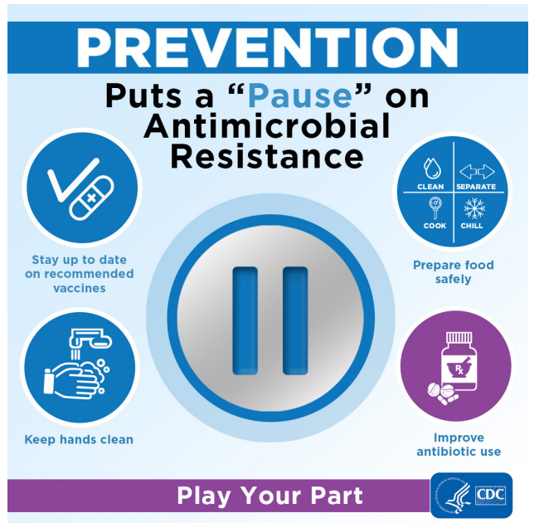
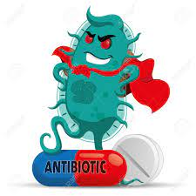
Preventing resistance
“Superbugs”
Stock.adobe.com
https://www.cdc.gov/drugresistance/pdf/USAAW-2022-toolkit-508.pdf

Slide 6
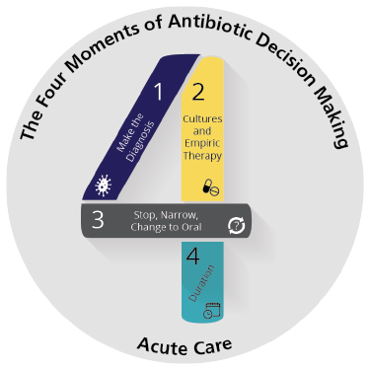
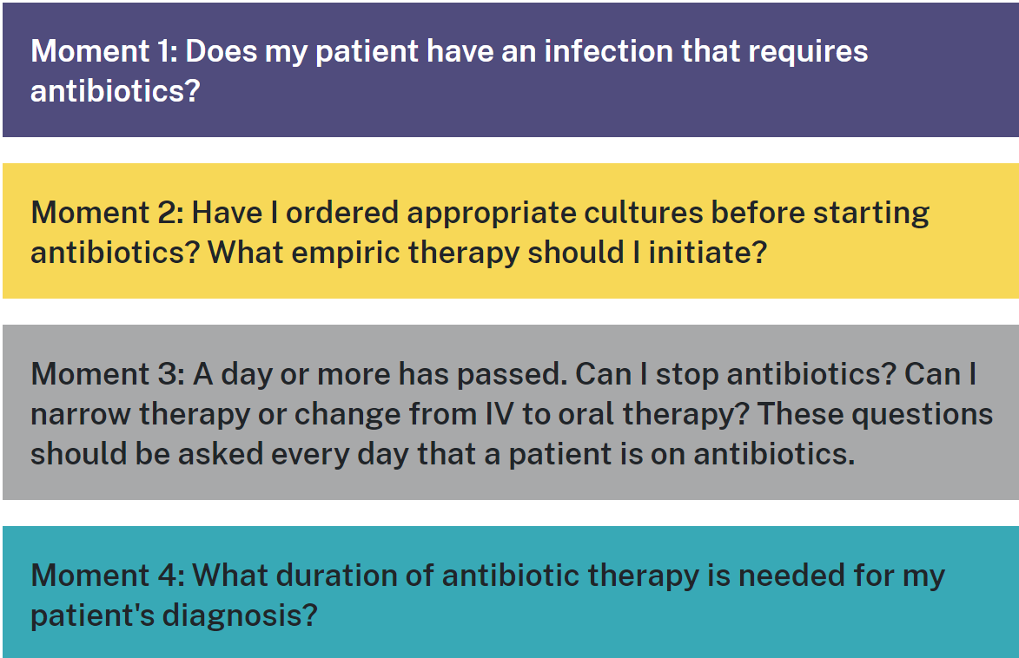
The four moments
https://www.ahrq.gov/antibiotic-use/acute-care/four-moments/index.html

Slide 7
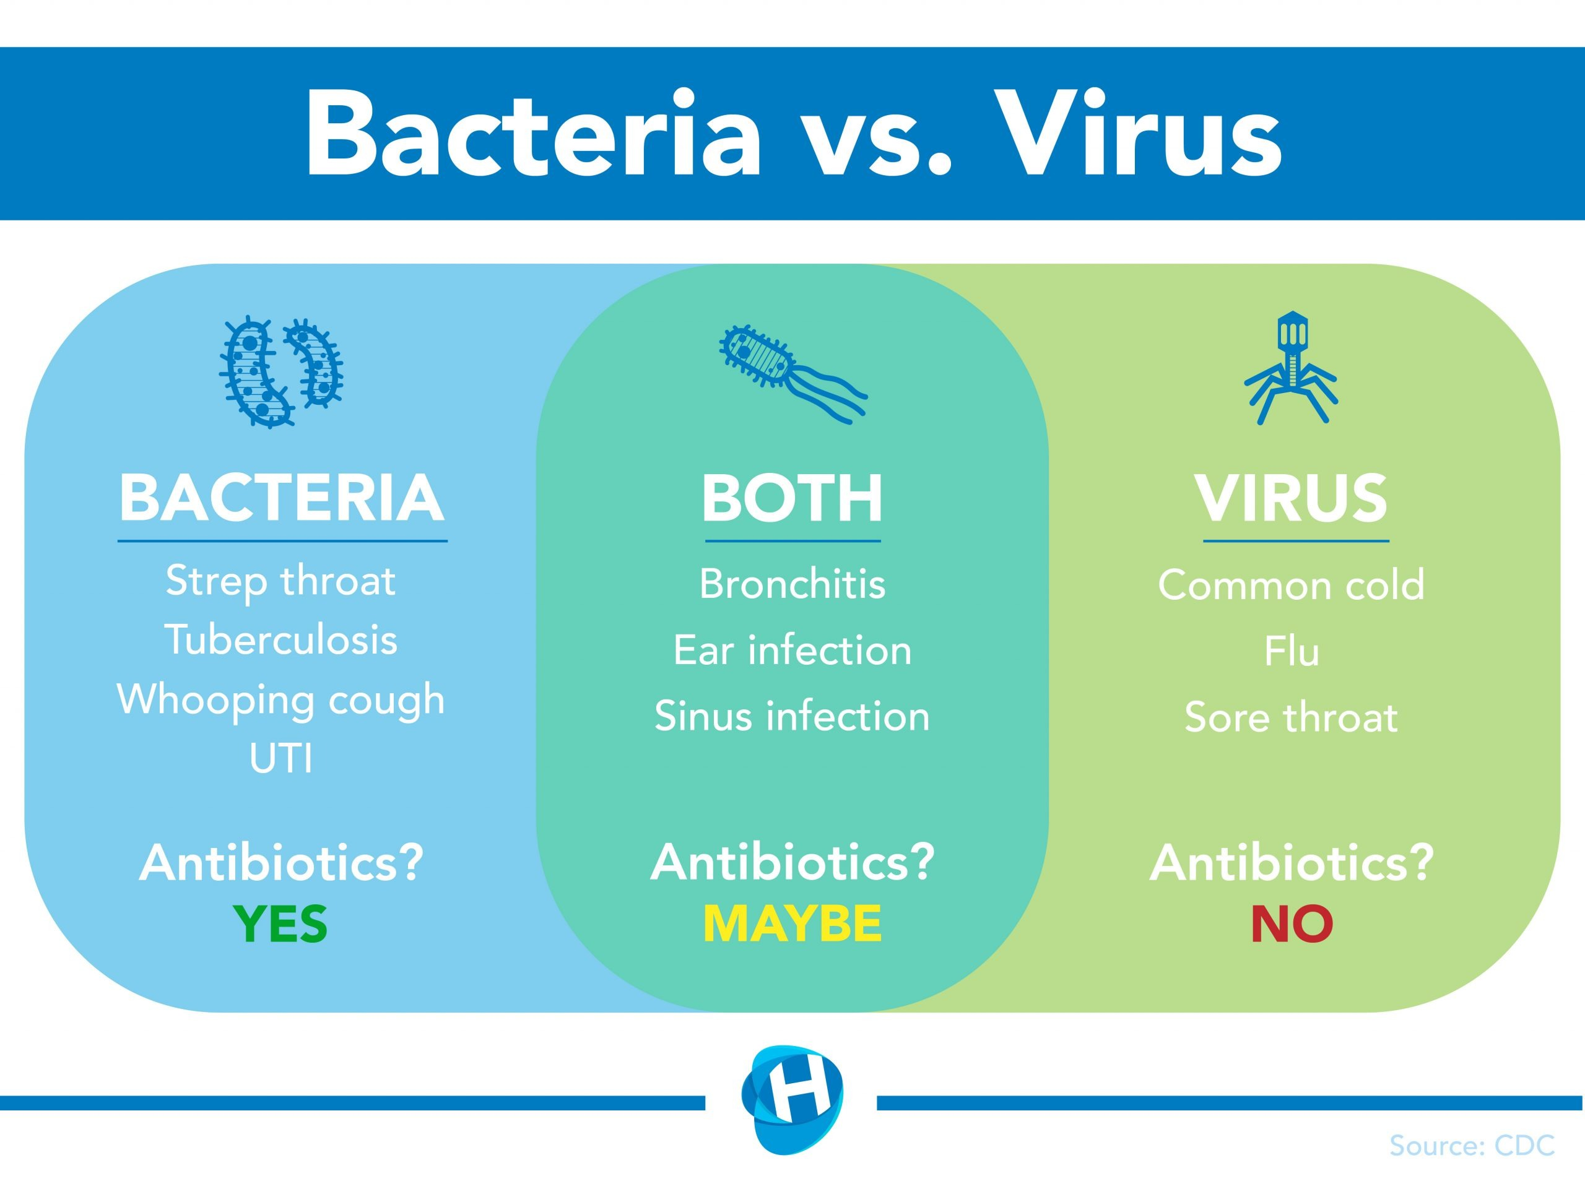
Bacteria vs virus
Bacterial infection clues:
Symptoms greater than 10-14 days
Fever worsens after several days
Pain/redness in affected site
Discolored sputum or pus
Positive cultures or PCR
Risk factors present
Examples:
  Immune suppression
  Recent surgery
  Unprotected sex
  Undercooked or contaminated food
Pneumonia, meningitis,
diarrhea
COVID-19
STI
STI – sexually transmitted infection

Slide 8
Signs of serious infection
Not all signs may be present in an infection.
Temp greater than 38◦C or less than 36◦C
Heart Rate greater than 100
Respiratory Rate greater than 20
WBC
Greater than 12,000 or less than 4,000 cells/mm3
Greater than 10% bands
Hypotension
SBP less than 90 mmHg
Procalcitonin greater than 0.5 ng/mL
+ Culture Result or PCR
Polymerase chain reaction or similar rapid molecular diagnostic test

Slide 9
Stages of infection
1
Early infection – first few days. May be clinically unstable.
2
Day 4 -6 of infection. Stabilizing.
Causative organism usually identified.
3
Day 7 forward.
If infection treated appropriately, vital signs and WBC are normal, fever resolved
Leukocytosis and neutropenia
Vital signs and diagnostic tests may be abnormal
Best time for Antimicrobial Streamlining
Clinical signs improving: WBC transitioning back to normal, afebrile.
Potential for Antimicrobial Streamlining

Slide 10
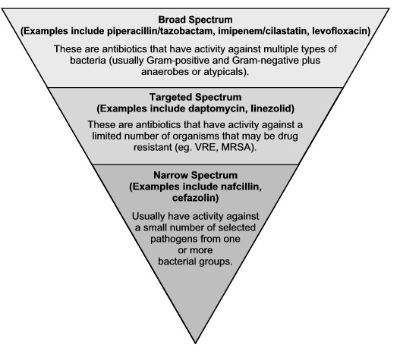
Antimicrobial Streamlining
Converting from broad spectrum therapy, which cover multiple types of bacteria, to narrow spectrum which targets a specific organism
Also known as De-escalation
This is a key component of Antibiotic Stewardship

Slide 11
Stewardship in practice
Monitor:
Clinical Response
Culture & Sensitivity
Rapid PCR Results
Interventions
Change antimicrobial therapy
Reduce number of antibiotics
Discontinue therapy

Slide 12

summary
Antimicrobial stewardship is important to reduce antimicrobial resistance, improve patient outcomes and reduce healthcare costs.
Streamlining interventions include changing antibiotics to more narrow therapy, reducing the number of antibiotics and discontinuing them when appropriate.
Differentiating between bacterial and viral infections helps us determine which patients would most benefit from antibiotics.
Questions about this information may be directed to your Antimicrobial Stewardship Team – Elise Heil RPh, Director of Pharmacy and Amanda Hokanson, MSN,BSN, RN, Infection Control, Employee Health, Eduction.

Slide 13
Last Updated November 2023

