Slide 1
Women Empowerment Agricultural Project (WEAP) report and future plans
Funding Proposal for £5,000
Empowering Women through Sustainable Agriculture in Gabon

Slide 2
Problem statement
Gabonese women disproportionately suffer from poverty compared to their Gabonese male counterparts. According to the United Nations Women Count for Gabon, 3% of employed women in Gabon live below the international poverty line compared to 1.3% of employed men. Additionally, 28.5% of women in Gabon above the age of 15 are unemployed, which is 14.1% higher than the unemployment rate for men.

Slide 3
Problem statement
Gabon is very dependent on food imports with a very significant weight (80%) of imports in food consumption. Imports are increasing sharply at an average of + 11% per year. The principal subsistence crops are plantains, cassava, and maize.
.

Slide 4
Problem Statement
- Women face barriers in agriculture, including limited land, resources, and market access.
- These challenges perpetuate poverty, food insecurity, and gender inequality.
- WEAP addresses these challenges by equipping women with skills, resources, and market access.

Slide 5
Our Experimental phase
Our agricultural project, aimed at empowering unemployed Gabonese women, recently completed its experimental phase. This initiative was launched with a £600 donation to test its feasibility and impact. While the project showcased significant potential, several challenges limited its success during the trial phase.
Firstly, we lacked proper training in land preparation, which affected the smooth growth of crops. The financial constraints also posed difficulties, as the budget did not allow for consistent visits to the field, located in a remote area, to ensure regular watering of the plants. Additionally, the absence of a marketing strategy meant we were unprepared to effectively sell the harvested produce.

Slide 6
Experimental phase
Despite these limitations, the project yielded positive outcomes. During the experiment, we cultivated relationships with potential buyers who expressed interest in purchasing future crops. We also identified individuals and organizations willing to provide training for the women, addressing the skill gap. Most importantly, the women involved demonstrated enthusiasm for the work, and the daily wages they received had a meaningful impact on their lives.
This experience has been invaluable in laying the groundwork for refining and expanding the project. Moving forward, we are confident that with enhanced training, better logistical planning, and a structured marketing strategy, this initiative can achieve its goal of empowering women and fostering economic growth.

Slide 7
Experimental phase
We used a donation of £600
Number of women: 4 women
1/ first clean-up: cut tall grass and trees over 2 days by men. cost: £70
2/ second cleaning: thorough cleaning, 4 days *4women*£6 = £96
3/ Purchase of seeds: £40
4/ planting: women for 3 days, cost: £72
5/ transport : £74
6/ Harvest 2 days: £48
Land hire: £200

Slide 8
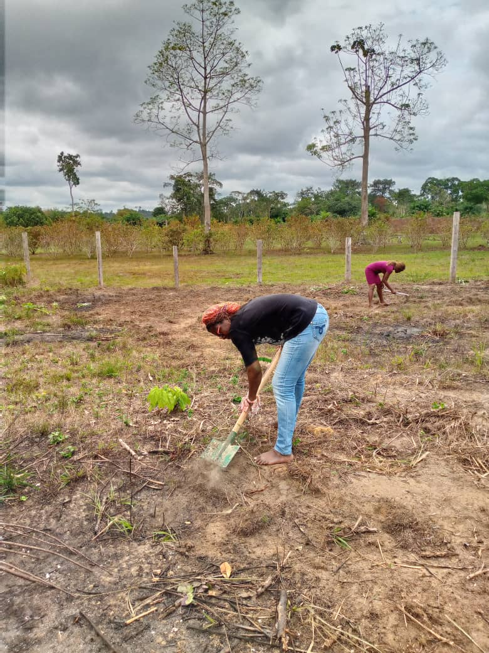
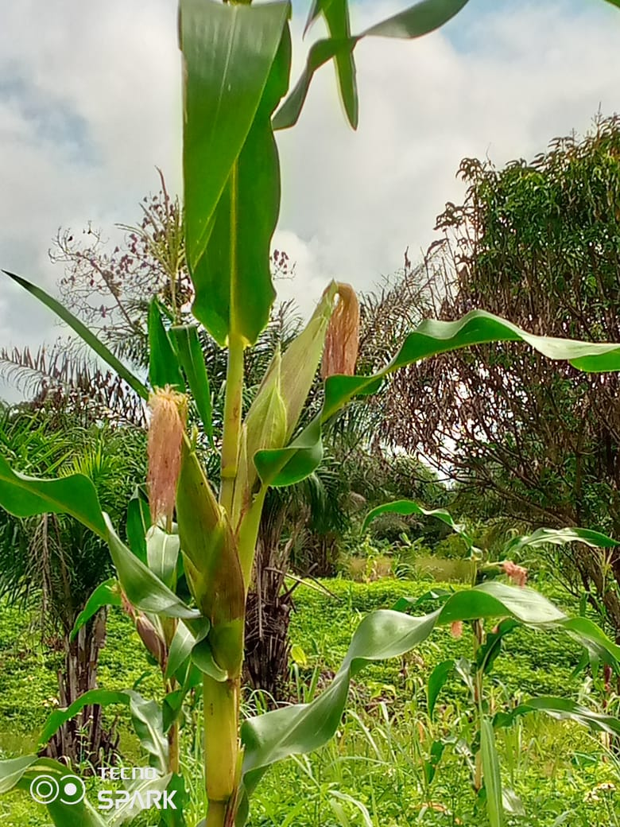
Our experimental phase

Slide 9
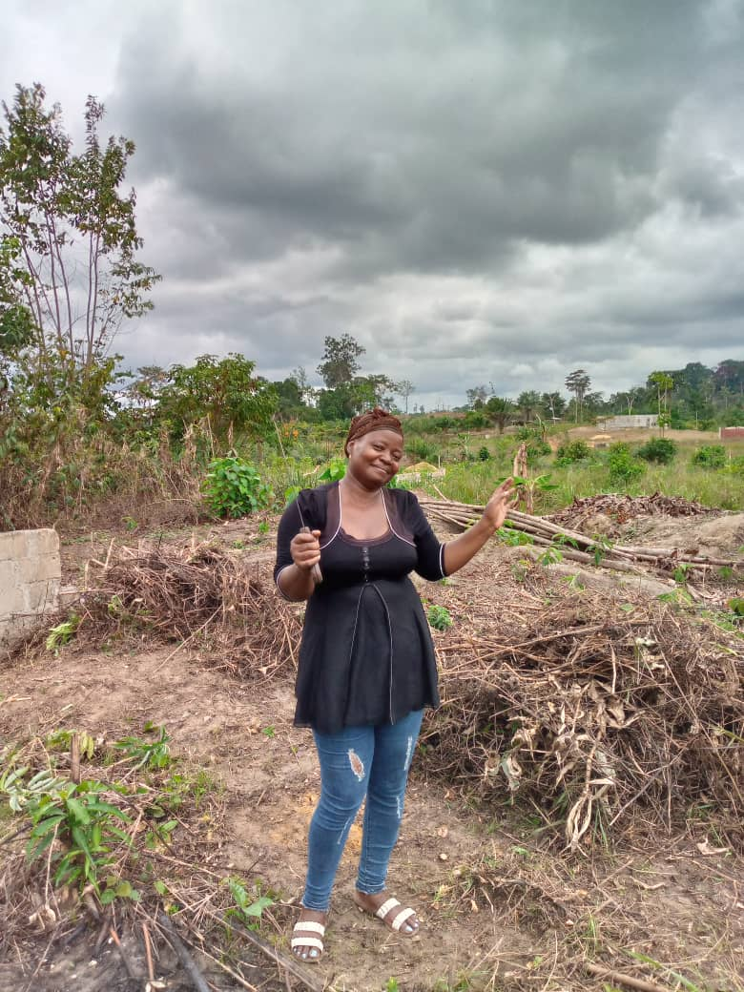
Testimonial
My name is Nadège Mouti, and I am both mother and father to my five children. Life has not been easy, especially without a stable job. Providing for my family felt impossible—until Tatiana introduced us to this incredible NGO project.
Thanks to VOW, I was given the opportunity to earn a daily wage, ensuring that my children could eat well. I can’t express how much that meant to me. Before this, I didn’t even have the money to buy medicine when my youngest fell ill with the flu. But because of VOW, I was able to afford the care my child needed.
This program isn’t just about work—it’s about survival, dignity, and hope. As long as I don’t have a steady job, I will continue to be part of this initiative. It has changed my life, and with your support, it can change many more

Slide 10
Future plans
The Women Empowerment Agricultural Project (WEAP) aims to empower 15 women in Gabon in 2025 through sustainable agriculture. By providing training, resources, and market access, WEAP enhances food security, improves incomes, and fosters economic development. This £5,000 proposal covers land, stipends, inputs, and market linkage, creating a scalable model for empowerment.

Slide 11
Objectives
1. Empower 15 women through agricultural skills and resources.
2. Cultivate 1 acre of land for high-demand crops.
3. Enhance household incomes and community food security.

Slide 12
Project Activities
1. Training and Capacity Building: Hands-on farming and financial literacy training.
2. Resource Provision: Seeds, fertilizers, and tools.
3. Land Preparation and Planting: Hire and prepare 1 acre of land.
4. Market Linkage: Facilitate access to profitable markets.
5. Monitoring and Evaluation: Document progress and lessons.

Slide 13
Budget Breakdown
1. Land Hire: £400
2. Stipends for Participants: £2,700 (£6/day for 15 women, 30 days)
3. Agricultural Inputs: £900
4. Training Costs: £600
5. Market Access Support: £300
6. Monitoring and Evaluation: £100
Total: £5,000

Slide 14
Expected Outcomes
- Economic Empowerment: Increased incomes for 15 women and their families.
- Enhanced Food Security: Improved availability of nutritious food.
- Sustainability: Establish a replicable model for women-led agriculture.

Slide 15
Project Timeline
Month 1: Project Planning
Month 2: Training Sessions and Land Preparation
Months 2-3: Planting Activities
Months 3-6: Crop Management
Months 6-7: Harvest and Market Access
Month 8: Evaluation and Reporting

Slide 16
Sustainability and Scalability
- Reinvestment Model: Profits reinvested into subsequent cycles.
- Scaling Potential: Documenting the model for replication in other regions.

Slide 17
Conclusion and Contact
The Women Empowerment Agricultural Project will empower women, improve food security, and drive rural economic development. Your support of £5,000 will lay the foundation for this transformative initiative.

