Slide 1
Responsible Coaching Movement
Facilitated by: Shelley Coolidge, ChPC Manager Professional Coaching

Slide 2
Agenda
Objective of RCM.
What is the Responsible Coaching Movement?
Why is RCM important?
Where do I start?
Organizational risk audit
RCM elements
Tools and resources
(definitions, audit, implementation, intervention)
5. Next steps.

Slide 3
Purpose and Importance
Notes:
What is the purpose for the RCM
Why is it important?
Who benefits from implementing RCM?

Slide 4
Responsible Coaching Movement
Call to Action - the Pledge
Objective = keep sport healthy and safer
Federally funded sport organizations must take all necessary measures to create a workplace free from harassment, abuse or discrimination
Notes:
Objective – to keep sport heathy and safer!
Call to Action – for all sport organizations in Canada to take the pledge and make a statement that everyone is working together to make the sport system safer.
Who benefits – all participants, volunteers and employees as well as the sport system in Canada.

Slide 5
Responsible Coaching Movement
Phase 2 – led by CCES
1) Social Media Policy
2) Parent Tools
3) On-going Education
Concepts embedded in core NCCP training
Notes:
Currently being developed by CCES.
The majority of Canadian Sport NSO’s have implemented the Rule of Two into all of their coach to athlete and staff to athlete communication.
Copy in relevant staff in communication.
Parent Tools – Currently referring groups back to the CCES Ride Home Campaign – additional resources still tbd from CCES.
- Kids Help Phone resource is valuable share here as well as the Canadian Centre for Child Protection as a resource.
On-going education – Current revision cycle for NCCP is taking into consideration core concepts of RCM

Slide 6
Why is RCM important?

Slide 7
Why should you be a part of this?
2019 Minister of Sport and National Safe Sport Task Force declared “It is time for a new normal!’
Sports have a legal and ethical responsibility to mitigate risk for athletes, especially minors
RCM is a proactive means to act and communicate your commitment to addressing key areas of risk
The Canadian Sport Policy 2012 recommended the principle of “values-based” be integrated into all sport-related policies and programs.
Notes:
What has happened
Safe Sport Summits:
12 Jurisdictions
1 National
NSO Taskforce:
Recommend criteria that the Minister will mandate
Development of a Safe Sport Task Force
Safe Sport Task Force
Current focus:
What sports are offering
What training should be part of mandate

Slide 8
Age of Protection: When does it rise to 18 years old?
Canadian Centre for Child protection states
For all children 12 – 17:
If the other person is in a position of trust or authority over the child (e.g. a coach, teacher, etc.), the child is dependent on the other person or the relationship is exploitative of the child, the child is NOT able to give consent, making sexual activity in the context of such relationships illegal.
To protect the inherent vulnerability of child from power or other imbalance.
Notes:
ADD – every Coach is in a position of power!
Really important:
Org responsible to educate your coaches that they are in a position of power!
Tool – to deal with this – Sport Organizations need to make this legislation part of their organization on boarding training for coaches of all ages (16+)
Add to Employment agreement with their coaches that they employ!
* See HR notes for detail…

Slide 9
Age of Consent (from Canadian Centre for Child Protection)
Child’s Age | Can Child Consent?
Under 12 | NO; No person under 12 is able to consent to sexual activity under any circumstance.
12 or 13 | SOMETIMES; if age difference is < 2 years and the child is able to give consent*
14 or 15 | SOMETIMES; if age difference is < 5 years* (No power relationships)
16 years + | YES; BUT exceptions. (No power relationships)
18 years old | Age of protection in Canada is generally 16 years old, but the Criminal Code increases that age to 18 in the context of certain relationships.
Notes:
This is the law in Canada – violation of Age of Consent – has been a driver to a leading reason why protection of children and the vulnerable sector for RCM have been a priority!
Other professions in Canada have a cooling off period prior to a person being able to engage in a relationship with another individual
Ie College of Psychology – cooling off period / University setting – Gretchen Kerr
What is the age of protection in your region? Are your coaches aware of the POWER DYNAMICS in addition to AGE OF CONSENT?

Slide 10
Vicarious Liability
COACH & VOLUNTEER
PTSO
NSO
LSO/CSO
ATHLETE
Notes:
Vicarious Liability - Legal Opinion Summary for CAC– Gowling LLB. (See slide 10)
Indirect risk = organization being held responsible for the misconduct of another party because of the relationship that exists between them.
National Sport Organizations can be held responsible for the misconduct of coaches because of the relationship that exists between them. Case law has also shown vicarious liability based upon volunteer actions. Damages awarded for abuse of vulnerable victims are on the rise.
Failure to take steps to prevent sexual abuse from occurring may lead to vicarious liability. Sport organizations without proper protocols in place may provide an environment in which certain individuals in a position of power (coaches) may have the opportunity to be alone with young athletes.
Organizations must take steps to avoid potential risks to the community. This requirement becomes increasingly important if similar organizations are moving towards best practices that have been shown to reduce risks.
The Responsible Coaching Movement provides leadership in best practices.

Slide 11
What are the elements of RCM
Notes:
What are the elements of RCM
What does a Sport need to do to implement the program?
What does a Sport need to do to start?
What tools are available?

Slide 12
Bridge Gap from Crisis Response to Crisis-free Culture
Implementation
Rule of Two
Screening and
Education
Ongoing Education and Training
Organizational Audit of Policy and Practice
Where is your organization?
Education for Change
Sustainable
Change
Modified from USOC Safe Sport
Notes:
Where are you as an organization?
Still learning x 6
Exploring options - n/a
Taken RCM pledge – x 8 (48 of 66 NSO’s have taken the pledge)
Implementation – x 10
Sustainable change – x 6 (vball, gymnastics, golf, hockey, basketball, swimming)
Purpose of Audit!
* for an organization to recognize where they are and move to sustainable change-
***determine a realistic process for creating change based on their individual state of readiness, to be successful in the long-term.
To begin, you need to evaluate where you are --
We see this all the time in the news: there’s some community crisis, and people leap to action. That’s necessary, but the longer effort is more critical.
The system needs change, and that takes time and mindfulness.
We are seeking to build upon the education and awareness activities to move the needle toward creating a positive culture of Safe Sport as we bridge the gap between crisis response to crisis-free culture.
Recognition of the systemic problem. All youth activities have had to see abuse as a reality, and this topic has entered our conversations about effective youth serving organizations. system of our membership - enabling abusers to fly under the radar and gain access to kids.
Education and awareness: Provide them with facts and stories. Safe Sport as a good and necessary part of the sport experience. Members have recently been asking for a new kind of educational resource—one that can be used to address common, less severe breaks in culture, which tells us that people are wanting to intervene before a crisis occurs.
Tools and motivation: Once people are aware and have education about the underlying issues, we want to equip them with tools and empower them to find the motivation to use them. Tools such as intervention strategies, policies, resources to point to when issues come up. Motivation means that people are not waiting for a crisis to use the tools—issues are talked about in a preventative way and interventions are staged early.
This all leads to local-level sustainability, where change effort is now owned and maintained by the local community. The system is reset to mitigate risks, empower members, and report successes and problems in the long-term.

Slide 13
RCM Implementation Checklist | Level of organizational risk increases the longer it takes to implement change
Levels of Risk | Low Risk | Medium | High Risk
Risk Considerations | Policies and Practices to be implemented
1. Policies | Code of Conduct; Rule of Two; Travel Policy; Coach, Parent, Athlete Agreements
2. Background Screening | As level of risk increases, intensity of screening needs to increase.
3. Implementation of Rule of Two | As ability to implement Rule of Two increases, Background Screening requirement more closely aligns with position being screened for.
4. Certification & Training | Additional ways organizations can move toward protecting their athletes in addition to Rule of Two.
Education & Awareness
Practices
Notes:
USE WITH HANDOUT TO GUIDE WORK ON AUDIT CHECKLIST
*if the audit checklist for implementation isn’t available, use this slide.
Chart provides examples of types of policies and procedures organizations should be implementing over a 3 year time period based on their initial capacity to implement Rule of Two. The levels of risk relate to exposure of minor athletes. As level of risk increases, intensity of background screening increases.
So, an organization that has no ability to implement the Rule of Two in Year 1 falls in the red (high risk) column of the background screening matrix regardless of the position being screened for. As they increase the implementation of the Rule of Two, the Background screening requirement more closely aligns with the position being screened for.
The intent of this matrix is to demonstrate there are ways organizations can move towards protecting their athletes as they look for ways to implement the Rule of Two.
Rule of Two will not be going away so organizations need to think creatively in how they can implement it over time.
Organization Implementation Checklist
PTSO’s
RCM Pledge
PTSO’s at AGM engage clubs in discussions on the RCM or through Webinar Meetings
PTSO Conducts audit of internal practices
Code of Conduct
Provincial Team Coach/ Athlete Agreements
Policies and Procedures
PTSO presents on findings and GAPS
PSO hosts facilitated workshop for LSO’s

Slide 14
Background Screening

Slide 15
Background Screening Tools may include::
The
Person
Role
Clarity
Reference checks
Specific training relative to needs
Vulnerable Sector Checks (VSS, VSV, VSC) – RCMP or Local Police
Criminal Record Checks
Screening Process
may vary depending on position
CJMRC
Comprehensive Job Postings and Job Descriptions
Interviews – right questions
Evaluation and on-going supervision
https://www.sterlingtalentsolutions.ca
E-PIC
Youth – additional reference checks vs criminal record check
Notes:
Background screening – includes JD’s right through to evaluation and ongoing supervision and feedback!
PRC’s / CRC’s etc = Background screening is equally as important because it sends a message.
Note though that somebody has to do something and have been caught and charged!
Numerous sports
1 VSV (VSS) Vulnerable Sector Screening
2. Self Disclosure form
3. Every 2 – 3 years an up to date Enhanced Police Check from Sterling Talent Management
Or provincially recommended organizations.

Slide 16
Background Screening Matrix - handout
 | Level 1 - "Low Risk" |  |  | Level 2 - "Medium Risk" |  |  | Level 3 - "High Risk"
 | Non-Volunteer Parents | Youth Volunteers | Occasional Volunteers | Assistant Coaches | Volunteer Head Coaches | Directors | Paid Head Coaches | Travel Team Coaches | Team Managers
Application Form |  | ü | ü | ü | ü | ü | ü | ü | ü
One Letter of Reference |  |  | ü | ü | ü | ü
Two Letters of Reference |  | ü |  |  |  |  | ü | ü | ü
Position Briefing / Orientation | ü | ü | ü | ü | ü | ü | ü | ü | ü
Driver's Abstract (if requested) |  |  |  | ü | ü | ü | ü | ü
Screening Disclosure Form |  | ü | ü | ü | ü | ü | ü | ü | ü
Criminal Record Check (E-PIC) |  |  |  | ü | ü | ü | ü | ü | ü
Vulnerable Sector Verification (VSV) |  |  |  |  |  |  | ü | ü | ü
 | Level 1 - "Low Risk" - Individuals involved in low risk assignments who are not in a supervisory role, not directing others, not involved with financial/cash management, and/or do not have access to minors or people with a disability |  |  | Level 2 - "Medium Risk" - Individuals involved in medium risk assignments who may be in a supervisory role, may direct others, may be involved with financial/cash management, and/or who may have limited access to minors or people with a disability |  |  | Level 3 - "High Risk" - Individuals involved in high risk assignments who occupy positions of trust and/or authority, have a supervisory role, direct others, are involved with financial/cash management, and who have access to minors or people with a disability
Notes:
This chart provides examples of the varying degrees to which Background screening may be implemented depending on the risk level of the position. This will also be influenced by the degree to which organizations are able to implement the Rule of Two.

Slide 17
Rule of Two

Slide 18
Purpose of Rule of Two
To protect minor athletes and coaches in potentially vulnerable situations by ensuring more than one adult is present
Gold Standard
*Exceptions for Emergency Situations
2 Certified and Screened Coaches
1+ Athlete
2 Trained Screened Coaches
1+ Athlete
1 Trained Coach
1 Screened Adult
1+ Athlete
Transparent (Open & Observable)
Authorized
Accountable
1 Coach
2 Athletes
1 Coach
1 Athlete
Notes:
Value of the Rule of Two is that it protects the Minor athlete as well as the quality coaches that we have in our program.
In sport we must move from the Red Zone toward the Gold Standard.
The reality right now is that Coaches currently may be in training or trained.
We need to move coaches toward Certification in their stream where available.
If your organizations coaches are minors – consideration should be given to bringing in a screened adult team manager for meetings with athletes and holding all meetings in a Transparent (open and observable) environment.
Stopping extended periods of access is a priority
In isolated locations (ie chair lift is okay; fairway okay); ski storage shack is not
Emergent situations – emergent care is the first priority!
Engage parents – ie tail gunners, screened parent volunteers
Screened community elders
Chartered Professional Coaches are Certifies, have criminal record checks and references from

Slide 19
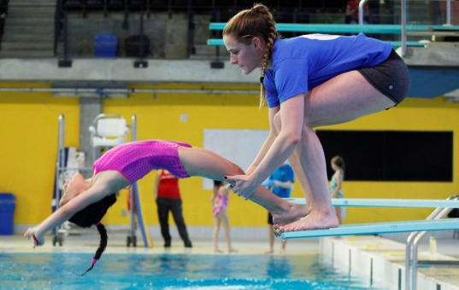
Rule of Two Defined
The Rule of two is #1 deterrent, in addition to screening, that protects a child and a coach
There will be two screened and NCCP trained or certified coaches with an athlete, especially a minor athlete, when in a potentially vulnerable situation. If screened and NCCP trained or certified coaches are not available, a screened staff, volunteer, parent, or adult can be recruited.
Any vulnerable situation one-on-one interaction off the field of play between a coach and an athlete must take place within earshot and view of the second coach, with the exception of medical emergencies.
More information on a safe and inclusive environment: http://cces.ca/gender-inclusivity
Notes:
R of 2 = # 1 Deterrent protecting child and coach.
Language needs to be adapted:
1 notion that the ultimate goal is too difficult to implement
2 technology and rule of two eg. Always a cc line; always a screen shot of texts; always disable one on one communication; use team snap.
Moving to Gold Standard - In all instances, one coach/volunteer must reflect the genders of the athletes participating or be of an appropriate identity in relation to the athlete(s).
Organizations are encouraged to ensure that those individuals in supervisory roles are appropriate for, and acceptable to, the individual athlete. Further information on creating a safe and inclusive environment can be found at http://cces.ca/gender-inclusivity

Slide 20
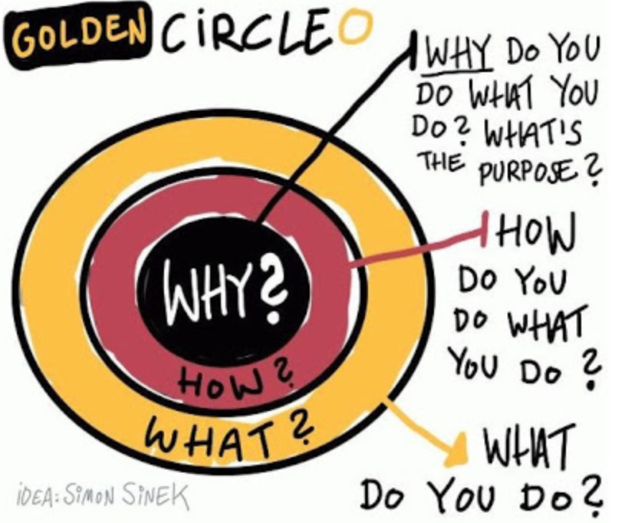
Professional Coach – ChPC Value Proposition
Elevating coaching standards for the public at all levels in all sports
The Chartered Professional Coach™ (or ChPC™) is the recognizable designation in Canada that provides a credential both for coaches starting their career and for experienced coaches throughout their career.
Based on National Coaching Certification Program (NCCP) & the Registered Coach™ license
Endorsed by Sport Canada and major sports organizations
Delivered by NCCP instructors and accredited post-secondary coaching programs
Setting the standard of excellence in coaching ethics, knowledge, and experience
Professional designation in all coaching contexts: Community, Instruction, and Competition.
Professional standards: The ChPC designation tells employers, sports organizations, and the public a coach commits to set standards, has been screened and has completed the required education and training to coach safely and effectively.
Professional community: The ChPC community is focused on improving skills and safety.

Slide 21
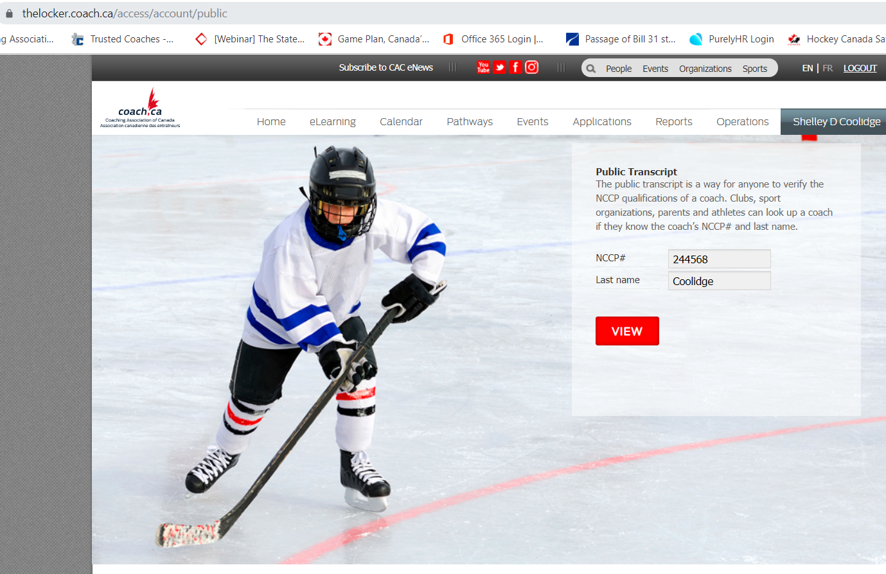
Using locker to assist organizations with verification
Verify your coaches training, certification and / or professional status using coach.ca Public Transcript

Slide 22
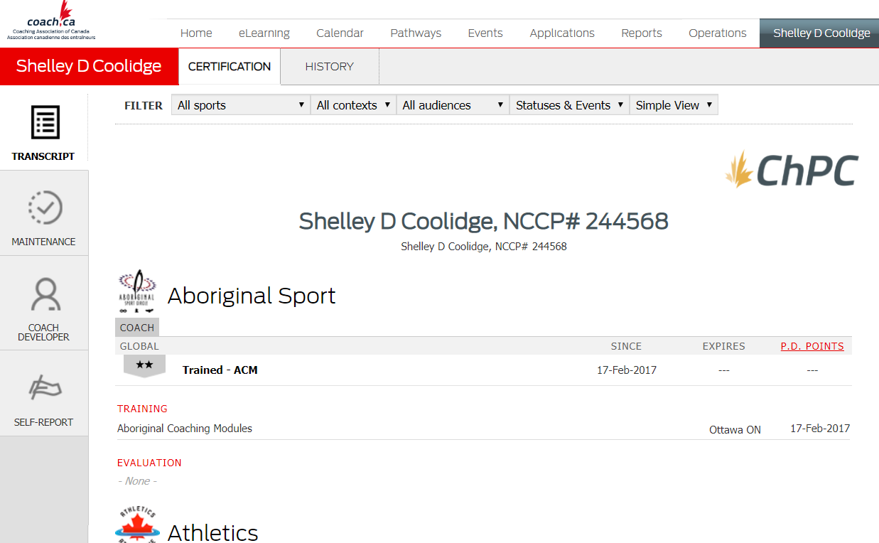
Using locker to assist organizations with verification
Using coach.ca Public Transcript
If a Professional Coach is in good standing you will see either “ChPC” or “Registered” on their transcript:
a current police record check,
had two references vouch for character and experience and
have signed off on the Coaching Association of Canada Code of Conduct

Slide 23
Rule of Two - Implementation Challenge
Obstacles to implementation
1. What challenges do we face as coaches trying to implement the rule of 2 – what is most at risk for you?
2 minutes:
Potential solutions
2. Identify potential solutions in your context to mitigate the risk?
8 minutes:
Notes:
Discussion or On-line Menti if time? Can also consider having this conversation at the end of the presentation.
2 minutes of Obstacles
8 minutes of Solution finding
Convenience and lack of numbers
Funding the 2nd appropriate person
Parents drop and go – not always involved
Parent expectations
Capacity to screen
Obstacles Screening
Resources / Costs
Gender of coaches – having male and female
Mandatory certification
Sport size ratio of coaches to athletes
Time required to get certified and trained @multiple sessions
Impromptu needs of young athletes – bathrooms
Funding – prohibitive of 2 trained/ certified coaches per team
Team travel arrangements
Resistance to changing current practices from members and families
Amount of time being demanded of volunteers for courses
Capacity – coach/volunteer capacity.
Supports based on org. size.
Nature of instruction (traditional coaching)
Communication / marketing capacity
Educational pieces
1-2 quick wins, immediate steps or ways to implement safer sport.
Provincial teams to showcase how to model behaviours
Partner with other associations to implement
Link to this info to website
Policies – enhance by having Province engage with Sport Law Group to have generic policies that is implementable
Engage parents - Welcome and invite parents to stay, hold a meeting outlining expectations
Put Rule of Two poster on websites, posters, give to athletes, etc to be more visible always to everyone.
Safety tax to help offset costs
Inform clubs/parents/athletes to just get a second person of any kind
Screening judges/officials to increase the pool of screened pool of people.
Could help by developing policy templates, pay and lead public awareness campaigns
Provincial team to showcase
Clear rules across all sports
Tools to assist with ongoing monitoring

Slide 24
Rule of Two Implementation Challenge Discussion
Number of volunteers in the system
The geography of our province and the ability to reach rural coaches and the ability to move coaches to “Certified”
Financial resources – to develop and implement safe sport and the Rule of 2.
Ability to get the message out to the public
Challenges with record check screening, especially for sports wanting vulnerable sector and the amount of time it takes
Club turnover and risk – vicarious liability
Partnership with schools and municipalities
Young coaches – below 18
Getting to “gold standard” is this attainable? How do we help Coaches move to “Certified”?
Who does the work?
Notes:
Discussion or On-line Menti if time? Can also consider having this conversation at the end of the presentation.
2 minutes of Obstacles
8 minutes of Solution finding
Convenience and lack of numbers
Funding the 2nd appropriate person
Parents drop and go – not always involved
Parent expectations
Capacity to screen
Obstacles Screening
Resources / Costs
Gender of coaches – having male and female
Mandatory certification
Sport size ratio of coaches to athletes
Time required to get certified and trained @multiple sessions
Impromptu needs of young athletes – bathrooms
Funding – prohibitive of 2 trained/ certified coaches per team
Team travel arrangements
Resistance to changing current practices from members and families
Amount of time being demanded of volunteers for courses
Capacity – coach/volunteer capacity.
Supports based on org. size.
Nature of instruction (traditional coaching)
Communication / marketing capacity
Educational pieces

Slide 25
Rule of 2 – Risk Solution Implementation Discussion
Cultural shift, a new normal, target small prioritized steps
Aim for Gold Standard for highest risk athletes and situations
Outline of responsibilities at each level of sport including providing clear coaching roles
Funding to support implementation of safe sport principles
Develop and share resources – reduce work on volunteers (work, material, time, etc)
Training is free in NL so train and work to move more coaches to Certified
Educate using the screening checklist so individuals understand levels of screening needed for people to be qualified as “Screened”
Provide guidelines for travel
$ to travel when 1 athlete qualifies – pair up with other clubs on-site or add a safe sport tax (Skate Canada) to fund. require parents to go?
Meet athletes in an open and observable environment – coffee shop vs behind closed doors
Provide incentives for coaches that move to Certification, work with School sport for credit, provide opportunity to record hours logged
Need more police departments offering on-line Vulnerable Sector checks in addition to Sterling Talent Managements E-PIC
More blended learning opportunities in addition to face to face; develop NL facilitator training
Create on-line training about what RCM is and for sessions that support coaches outside the metro area
Develop more Coach development sessions and parent information sessions along with player development camps
Notes:
1-2 quick wins, immediate steps or ways to implement safer sport.
Provincial teams to showcase how to model behaviours
Partner with other associations to implement
Link to this info to website
Policies – enhance by having Province engage with Sport Law Group to have generic policies that is implementable
Engage parents - Welcome and invite parents to stay, hold a meeting outlining expectations
Put Rule of Two poster on websites, posters, give to athletes, etc to be more visible always to everyone.
Safety tax to help offset costs
Inform clubs/parents/athletes to just get a second person of any kind
Screening judges/officials to increase the pool of screened pool of people.
Could help by developing policy templates, pay and lead public awareness campaigns
Provincial team to showcase
Clear rules across all sports
Tools to assist with ongoing monitoring

Slide 26
Education
Ethics & Respect Training

Slide 28
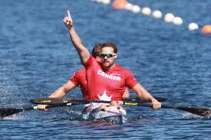
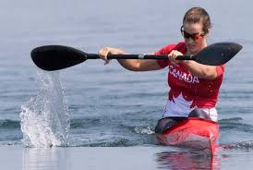
Ethics and Respect Training
Increasing coaches’ ethical conduct and ethical behaviour toward athletes requires that coaches be trained to understand what it means to act ethically.
Mobilizing the bystander to act rather than relying on just changing behaviors'.
“see something, say something!”

Slide 29
NCCP Make Ethical Decisions
Updated content with new scenarios
MED reflects:
current initiatives and resources: RCM, Canadian Centre for Child Protection
ethical / legal situations coaches face more often
Stronger emphasis and increased information on legal obligations of coach:
Liability
Vicarious liability
How to handle legal situations, with or without children
Videos to help support scenarios

Slide 30
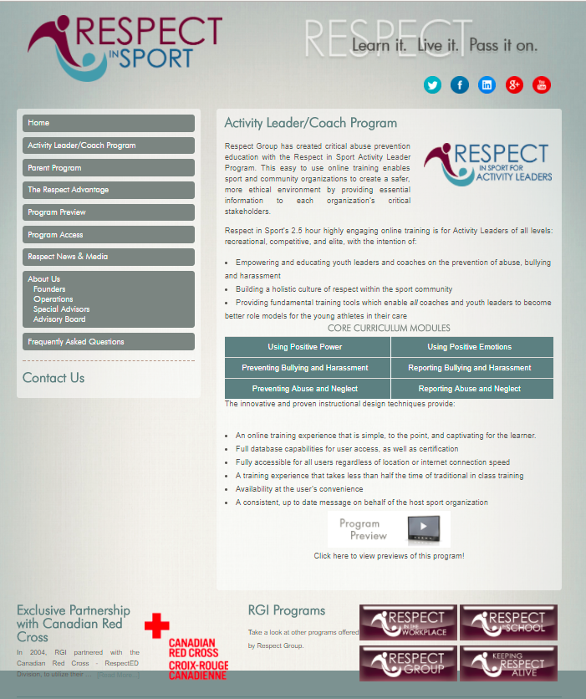
Ongoing Learning - Examples Respect Group
Respect Training:
Important training tool to:
better understand and recognize maltreatment, and abuse in sport
to better understand current issues in Sport
Recognized in your NCCP Locker
If certified you will receive 3 PD points towards Maintenance of Certification

Slide 31
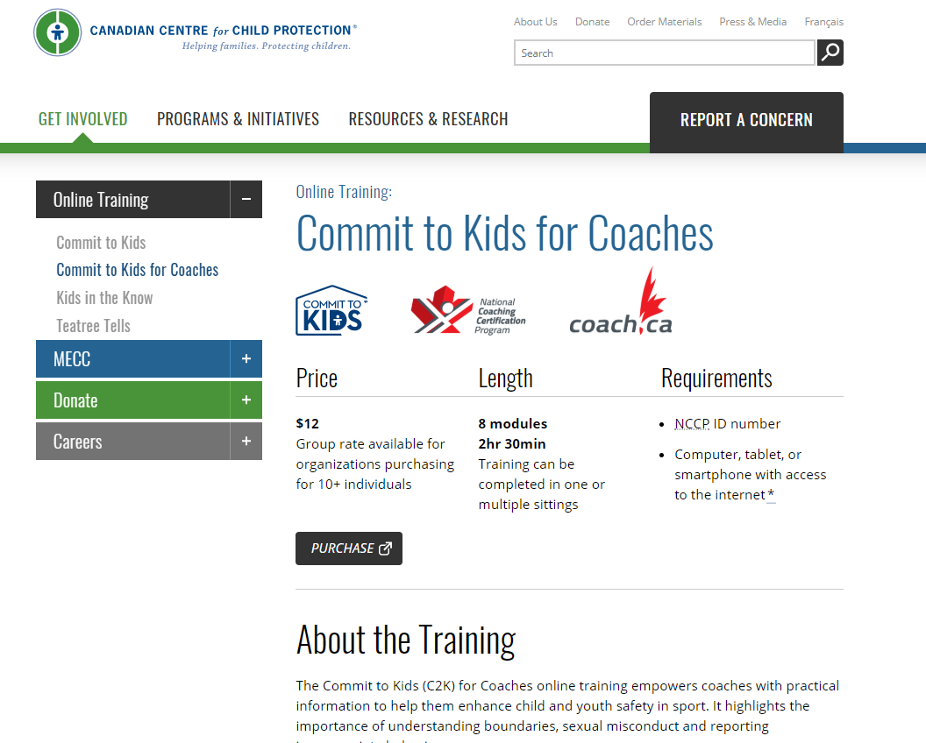
Canadian Centre for Child Protection
Commit to Kids for Coaches
Training focuses on the Process of Grooming
Recognition of Misconduct
Provides thresholds and tips for reporting
Guidelines of proactive conduct
Recognized in your NCCP Locker
If certified you will receive 3 PD Points towards Maintenance of Certification
Notes:
Better messaging

Slide 32
Checklists, Tools and Resources Coach.ca
Notes:
Move to new space
CAC Responsible Coaching Webpage and YouTube Video Support for NSO’s, PTCR’s, PSO’s and LSO’s to use as needed to get the RCM Message out to our Coaches.

Slide 33
CAC Partnership with Kids Help Phone
five-year partnership
broaden valuable support services and resources to young people within the sport community in Canada

Slide 34
Canadian Sport HELPline
1 888 837 7678

Slide 35
Moving forward with implementation
Identify 1 -2 quick wins, immediate steps or ways to implement safe sport.
2. While the system is being developed, what 1 – 2 supports do your need to enhance your capacity to deliver safe sport?

Slide 36
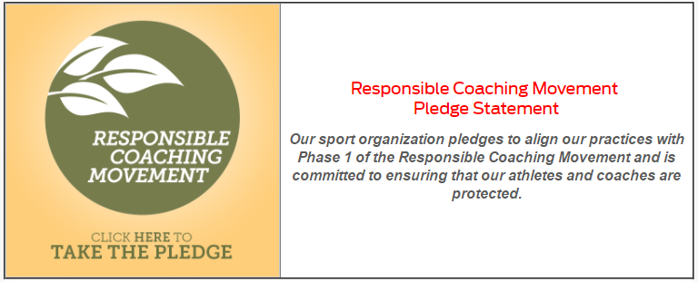
RCM Take The Pledge! Déclarer votre engagement!

Slide 37
Thank you!
Shelley Coolidge
Manager Professional Coaching Services
613-235-5000, 2387 scoolidge@coach.ca | www.coach.ca
Chris Wellsman
Coordinator Educational Partnerships and Professional Coaching Services
613-235-5000, 2355 cwellsman@coach.ca | www.coach.ca

