Slide 1
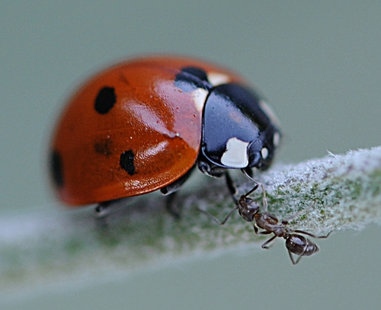
Welcome to the world of…
INSECTS!

Slide 2
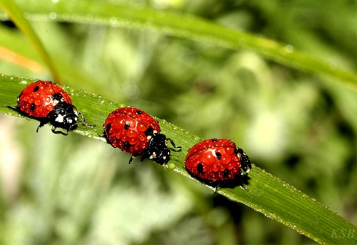
Ladybugs are insects.

Slide 3
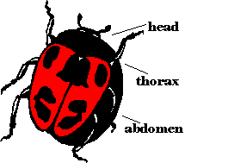
Ladybugs have 3 body parts: head, thorax, and abdomen.

Slide 4
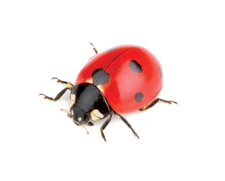
Ladybugs have 6 legs.

Slide 5
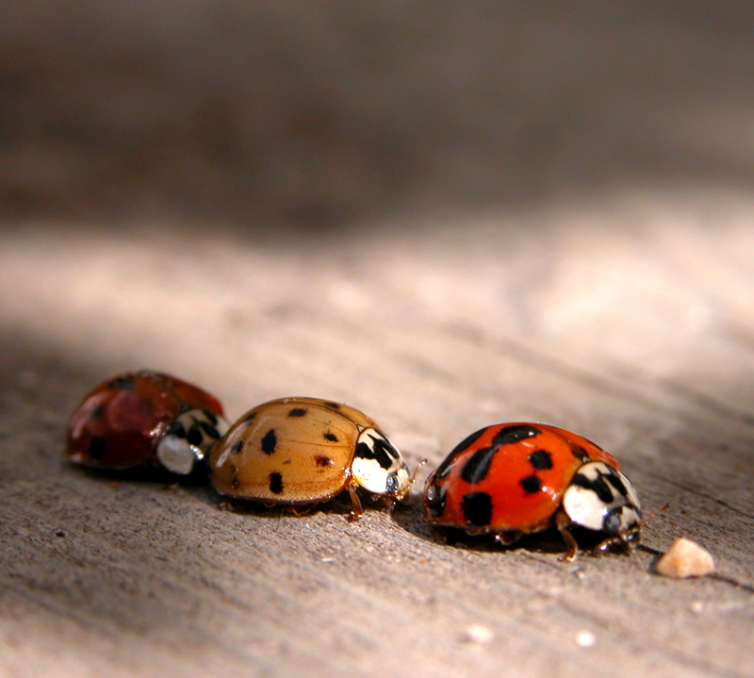
Ladybugs are round with spots.

Slide 6
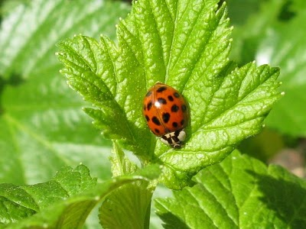
Ladybugs have markings that say, “Don’t eat me!”

Slide 7
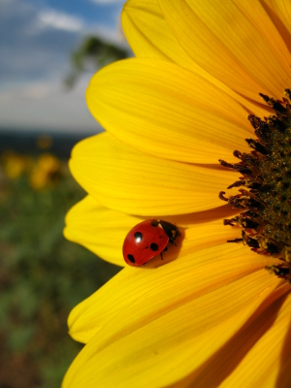
Ladybugs live in forests, fields, and gardens.

Slide 8
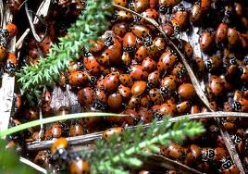
Ladybugs hibernate in large groups.

Slide 9
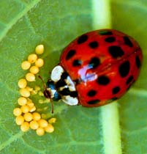
Ladybugs lay eggs on leaves.

Slide 10
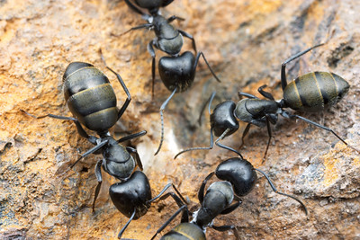
Ants are insects.

Slide 11
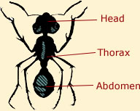
Ladybugs have 3 body parts: head, thorax, and abdomen.

Slide 12
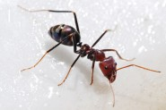
Ants have 6 legs.

Slide 13
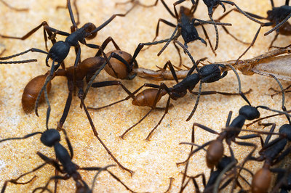
Ants are black and brown.

Slide 14
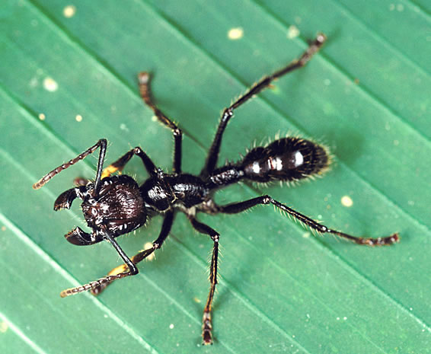
Ants stay safe with their strong jaws.

Slide 15
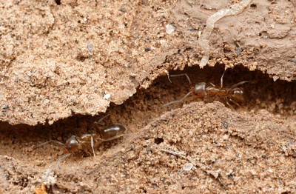
Ants live in underground nests.

Slide 16
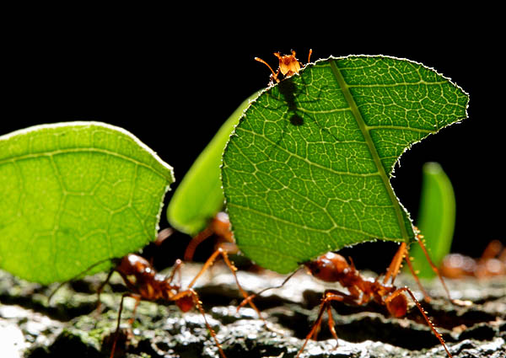
Ants live and work in large groups called colonies.

Slide 17
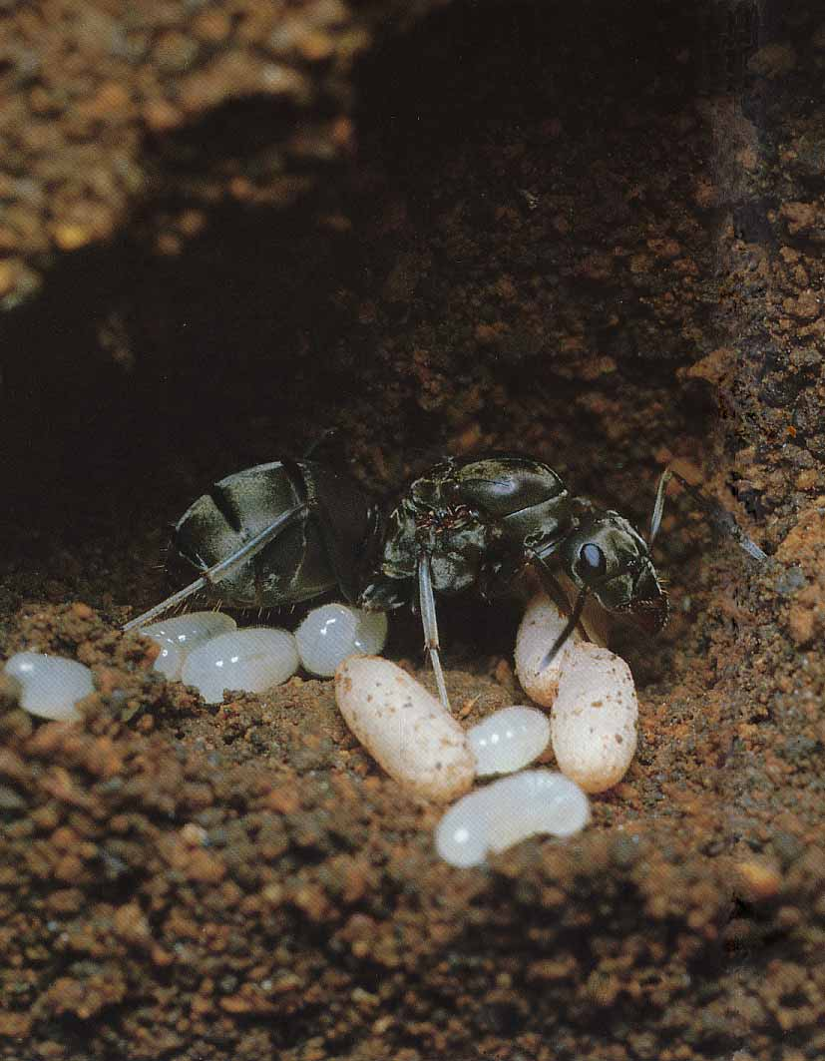
Ants lay eggs underground.

Slide 18
We read so many facts!
THINK…
How are the insects DIFFERENT?
How are the insects the SAME?
ladybugs
ants

