Slide 1
The Mental Game of Investing

Slide 2
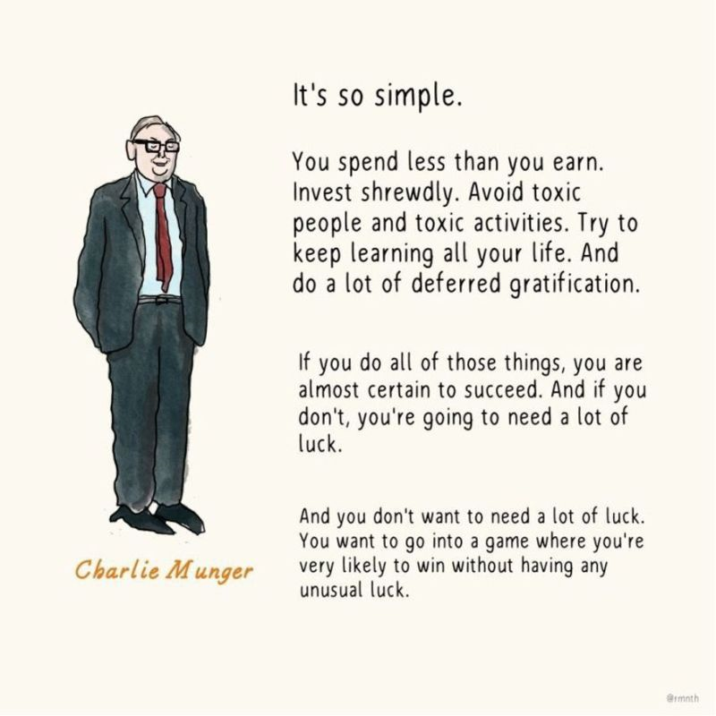
“Charlie Munger once said deferring gratification gives him so much gratification that he’s not sure he’s actually deferring it.”

Slide 3
“Probably the silliest stuff we’ve seen taught at major business schools has been in the investment area. It is astounding how they’ve focused on one fad after another in finance theory, and it’s usually been very mathematically based … Investing is really not that complicated. I would have two courses: one on how to value a business, and another on how to think about markets. If people grasped the basic principles in those two courses, they would be far better off than if they were exposed to a lot of things like modern portfolio theory or options pricing. Who needs options pricing to be an investor?
…If you buy businesses for less than they’re worth, you’re going to make money. And if you know the difference between the businesses that you can value and the ones you can’t, you’re going to make money. But they’ve tried to make it a lot more difficult. That’s what the high priests in any particular arena do; they have to convince the laity that the priests need to be listened to.”

Slide 4
Rinse and repeat framework
Each and every day we are on the hunt for new ideas and we must approach those ideas with clear eyes.

Slide 5
Empty your mind
In an article my father wrote in 1971 about his art of Jeet Kune Do, he started off with a Zen parable to prepare the reader to keep an open mind, as what he was about to go on to say was extremely unorthodox for fighting arts of the time.
He wrote, “A learned man once went to a Zen master to inquire about Zen. As the master talked, the learned man would frequently interrupt him with remarks like, ‘oh yes, we have that too,’ and so forth. Finally, the Zen master stopped talking and began to serve tea to the learned man. However, he kept pouring and the tea cup overflowed. “Enough, no more can go into the cup,” the learned man interrupted. “Indeed, I see,” answered the Zen master. “If you do not first empty your cup, how can you taste my cup of tea?”
The “learned” man can’t truly take in anything that the Zen master is saying because he is simultaneously comparing and judging the information against his own. In other words, he’s not really listening. His mind, his cup, is too full of his own point of view, measuring and evaluating everything the master has to say, to let anything else in. In overflowing the cup, the master shows the man how he must let go of that which he already thinks he knows. He must empty his cup in order to really listen and take in new information.
The “Be Water” quote begins with the prompt “empty your mind.” The first request is perhaps the most important one in our process because it sets us up for everything that comes next.
My father believed that this act of leaving behind the burdens of one’s preconceived opinions and conclusions had, in itself, a liberating power. In fact, if this step is the only one you actively work on for a while, you will expand your life considerably.

Slide 6
Finding neutrality
Emptiness, in these first discussions on the mind, means a state of openness and neutrality. When your mind is crowded with thoughts and information about all the things you’ve learned and how you feel about them, there isn’t room for much else. You’ve given up access to new possibilities and points of view. You’ve limited yourself. In order to learn new information, we must first make room to let that information in.
Emptying your mind does not mean forgetting everything you’ve ever learned, or giving up everything you believe. What it means is that you should try to meet each conversation, each interaction, and each experience with a willingness to consider something new without the burden of your judgment in the process. You must give up everything you think you know, and believe, for just an instant, in order to fully experience that in which you are encountering in the present moment. Make room for the possibility that maybe you don’t already know all of what you believe to be true; that what you believe is, in fact, a working process – capable of changing and evolving as you learn and grow.
It is under these conditions that you may discover something that you never thought was possible.
In fact, my father suggests that predetermined and unquestioned preferences are minds’ worst disease. Stand at the neutral point between negative and positive, he wrote. No longer directing one’s mind to anything. Emptiness is that which stands right in the middle of this and that; never before or against. The struggle between for and against is the mind’s worst disease. Do not like or dislike and all will then be clear.

Slide 7
No expectations investing
Consider how much influence your preferences and beliefs have on you in every moment of every day. As we go through our day, we are expert evidence collectors – so much so that we should all have our own CSI show. Because of our beliefs and our preferences, we walk around collecting the evidence of our experiences to bolster our beliefs. If I walk into a party with a sense of dread, then I am subconsciously looking for evidence of that dread to prove myself right. And it may be true that there are things to dread at the party, but because I’m on high alert for all the dreadfulness, I will conveniently find it and not see anything that might be enjoyable or fun. We’re always looking to be proved right. And when we have a need to be right, we will only accept that which substantiates our point of view.
But what if you went into that party with no expectations; no sense of dread and no expectation of having the time of your life. Then the party just is what it is. You can assess for yourself later what parts of it you really enjoyed and what parts you didn’t. You met each moment of the party as it occurred. No stress. Your full attention is on the party without having to constantly check with yourself if you’re having a good enough time. Neutral. Present. Empty.
Of course, when it comes to functions we may or may not want to attend, the stakes aren’t so high. But what about when it comes to more charged and serious topics? What about difficult life choices that need to be made? Or, making judgments between people who might be good for us versus bad influences? If we are never for or against anything, how do we make decisions?

Slide 8
Choiceless Awareness
Remember the on-guard position: our poised and ready posture in the face of any situation. Let’s consider that the mental version of our opening stance on life should be this of poised neutrality. What we are trying to cultivate is what my father called “the ability to see purely.” Pure seeing means to try, as much as possible, not to project ones’ preferences or opinions on to something in the process of experiencing it so that what you encounter is the “truth”; the reality of things as they are in their objective totality.
Instead of weighing everything as good or bad, right or wrong, as it is happening, become a fully sensing organism; so that you may see and encounter the experience with your whole being. If you focus too much on the mind and its preconceived ideas and assessments, you are holding part of yourself separate from the totality of the experience. But if you can pause, and allow yourself to sense everything, perhaps you will experience something new or a richer version of something you already know. It is to see things as they are and not become attached to anything.
Scratch away all the dirt our being has accumulated and reveal reality in its isness; in its nakedness. Drop the burden of your preconceived conclusions and open yourself to everything and everyone ahead. Be a calm beholder of what is happening around you. You simply see, and in this seeing, the whole is presented and not the partial.
This is a process my father called “choiceless awareness.”
The idea is to have awareness of all that is happening around you, and within you, without judging it, without making a choice or creating a story about it, while maintaining full awareness of it. See it purely for what it is. Experience it fully so that you can have a total experience rather than a partial and, therefore, limited one.
Notes:
Not only do you have to get the strategy right, you must also understand your process so well that it literally becomes second nature (subconscious thinking). If you get to the plate and you’re thinking about the mechanics of your swing, it’s too late. You’re not going to be focused on purely seeing the ball. Likewise, if you’re working through an investment thesis and you get to the “know what?” Or, “where you do I go from here?” you’re in trouble because you’re no longer a fully sensing organism engulfed in understanding the company. You to nail down the process so that you don’t think about it when in combat.

Slide 9
Absence of thought
Absence of thought means not to be carried away by your thoughts in the process of thinking them. In other words, don’t get stuck on a particular thought and spin around it obsessively to the detriment of all the other sensory input that passes through your perception in the moment.
  Now is the time for growth stocks …
When this happens, you are no longer present. You are trapped in a box, and you are no longer seeing purely. And you are certainly not having a non-judgmental awareness of the whole situation.
As my father said, “I must give up my desire to force, direct, strangle the world outside of me, and within me, in order to be completely open, responsible, aware, alive.” This is often called to ‘make oneself empty,’ which does not mean something negative, but means the openness to receive. From this place, we can make the decisions we need to, while understanding ourselves and what might truly be in line with our soul. We will also have more compassion and acceptance of what is. From this place, we have so much more possibility.

Slide 10
‘Make oneself empty’
Agents, who manage money for others, worry that acting boldly will expose them to the risk of being fired by their employers or terminated by their clients. Thus, they moderate their actions, doing only that which is considered prudent and uncontroversial. That’s the tendency that caused John Maynard Keynes to observe: worldly wisdom teaches that is better for reputation to fail conventionally than to succeed unconventionally. But that tendency introduces an important conundrum. If you’re unwilling to take a position so bold that it can embarrass you if it fails, it’s correspondingly impossible to take a position that can make a real difference if it works out well. Great investors are able to follow up their intellectual conclusions with action. In short, they dare to be great.
Within professional investing, most people learn, in craft-like form, some particular style of investing and then never change. They buy low price-to-earnings (P/E) stocks, or leading tech names, or whatever. They build that craft and then never change. Or, change only marginally. In contrast, Warren Buffett consistently took new approaches, decade after decade, so that it was impossible to predict what he might do next. You could not have predicted his 1970s franchise-orientation from his original strict value bet. You could not have predicted his 1980s consumer products orientation at above-market average P/Es from his previous approaches. His ability to change, and to do it successfully, could be a book onto itself. When most people attempt to evolve as he has, they fail. Mr. Buffett didn’t fail, my father believed, because he never lost sight of who he was. He always remained true to himself.
It is that part about Mr. Buffett; his knack for evolving consistently with his values and past, doing the next thing unfathomed, that my father most admired. Moving forward, unfettered by the past restraints, utterance, convention, or pride.
It goes back to Mr. Buffett’s core values; he always knows exactly who he is and what he is about.

Slide 11
Redefining true intelligence

Slide 12
I truly believe intelligence is embodied. It’s not something that’s just cognitive.
  I’m continually learning to feel what an embodied sensation feels like when I’m making an investment decision.
  There is a feeling I have. It’s in different places in the body; this is of a high-quality decision.
  That comes with time. It’s hard to transfer that knowledge cognitively to someone; it comes with time. It comes with experience. And you can apply that to anything. You can apply it to sports.
  You’re talking to an athlete at the highest caliber and you ask them what it feels like when they’re on that court. It’s the finals, or championship. It’s an embodied feeling that we’re operating from.

Slide 13
Living in a question
Are you converging on an answer or living in a question?
  I think about a question as kind of a wave function. You don’t want to collapse the wave function with an answer. You want the wave function to be open.
  You want to be curious. You want to be testing. That’s why the idea of a hypothesis is the right kind of feeling – this is something that the weight of the evidence suggests today, let’s see what the weight of the evidence suggests tomorrow.
  So everything is kind of this wave function where we’re just on a railroad of curiosity, of question-asking.
Let’s continue to ask deeper questions.
  But we need a force function, oftentimes, for better questions.
  All of us get stasis when we’re not asking deeper, harder questions.
  But should we go to Mars? I don’t know, but I know the force function of trying to do it. That question asking, that material science that’s required; there’s so much discovery that will happen through that force function that we will evolve as a species.
  I see this across many, many different systems where the forcing function of writing a book, writing an annual letter, of creating a challenge to nurture new habits – the forcing function opens up a whole new level of learning, of discovery, of insight.

Slide 14
And then what?

Slide 15
Establishing Proper Goals
We aim to achieve returns of 15-20% on an annualized basis, while limiting the risk of permanent loss.

Slide 16
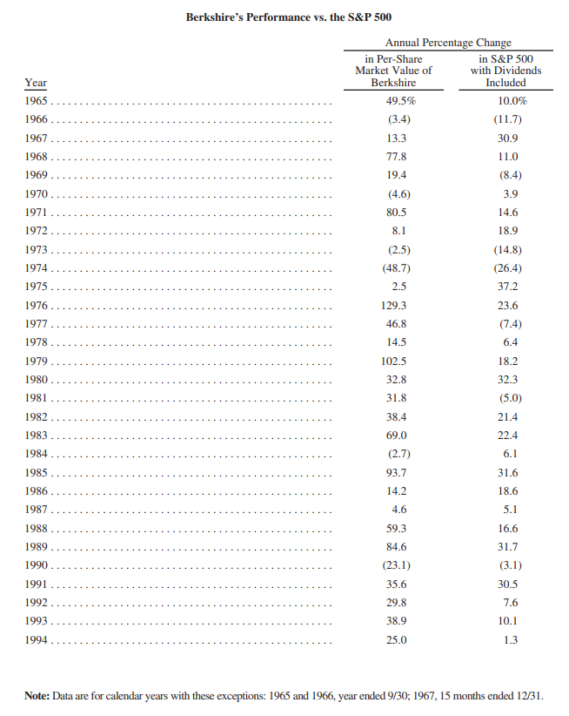
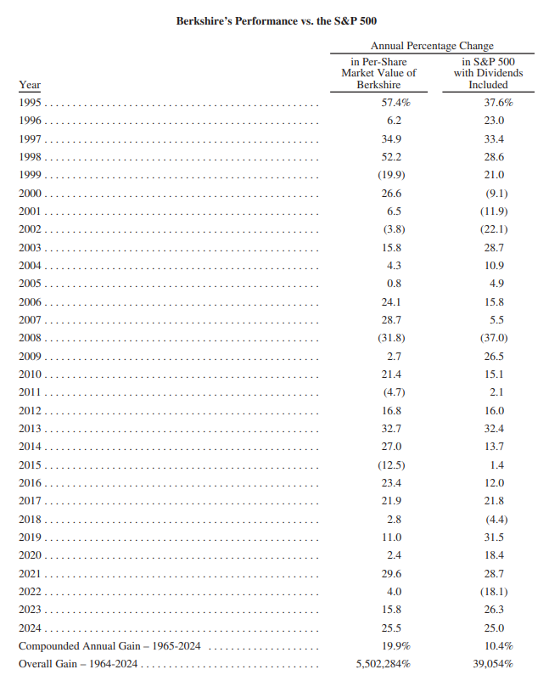

Slide 17
The Compound Effect - Goals
As I mentioned before, the Compound Effect is always working, and it will always take you somewhere. The question is, where? You can harness this relentless force and have it carry you to new heights. But you must know where you want to go. What goals, dreams, and destinations do you desire?
When I attended the funeral of Paul J. Meyer, another mentor of mine, I was reminded of the richness and diversity of his life. He achieved, experienced, and contributed more than dozens of people combined. His obituary made me reassess the quantity and size of the goals I set for myself. If Paul were here, he would tell us, “If you are not making the progress that you would like to make and are capable of making, it is simply because your goals are not clearly defined.” One of Paul’s most memorable quotes reminds us of the importance of goals: “Whatever you vividly imagine, ardently desire, sincerely believe, and enthusiastically act upon … must inevitably come to pass!”
Something almost magical happens when you organize and focus your creative power on a well-defined target, I’ve seen this time and again: the highest achievers in the world have all succeeded because they mapped out their visions. The person who has a clear, compelling, and white-hot burning why will always defeat even the best of the best at doing the how.

Slide 18
The Compound Effect - Goals
You only see, experience, and get what you look for. If you don’t know what to look for, you certainly won’t get it. By our very nature, we are goal-seeking creatures. Our brain is always trying to align our outer world with what we’re seeing and expecting in our inner world. So, when you instruct your brain to look for the things you want, you will begin to see them. In fact, the object of your desire has probably always existed around you, but your mind and eyes weren’t open to “seeing” it.
We are bombarded with billions of sensory (visual, audio, physical) bites of information each day. To keep ourselves from going insane, we ignore 99.9 percent of them, only really seeing, hearing, or experiencing those upon which our mind focuses. This is why, when you “think” something, it appears that you are miraculously drawing it into your life. In reality, you’re now just seeing what was already there. You are truly “attracting” it into your life. It wasn’t there before or accessible to you until your thoughts focused and directed your mind to see it.
Make sense? This isn’t mysterious at all. It’s actually quite logical. Now, with this new perception, whatever your mind is thinking internally is what it will focus on and all of a sudden “see” within that 99.9 percent of remaining space.
When you define your goals, you give your brain something new to look for and focus on. It’s as if you’re giving your mind a new set of eyes through which to see all the people, circumstances, conversations, resources, ideas, and creativity surrounding you. With this new perspective (an inner itinerary), your mind proceeds to match up on the outside what you want most on the inside – your goal. It’s that simple. The difference in how you experience the world and draw ideas, people, and opportunities into your life after you have clearly defined your goals is profound.
In one of my interviews with Brian Tracy, he put it this way: “Top people have very clear goals. They know who they are and they know what they want. They write it down and they make plans for its accomplishment. Unsuccessful people carry their goals around in their head like marbles rattling around in a can, and we say a goal that is not in writing is merely a fantasy. And everybody has fantasies, but those fantasies are like bullets with no powder in the cartridge. People go through life shooting blanks without written goals – and that’s the starting point.”

Slide 19
Our “Scoreboard” Goal
1) achieving annualized returns of 15 – 20%
Why?
  1) process – the evolution of our own investment process that leads us to identify outsized investment opportunities and capitalize on them
  2) culture - a firm set of values and operating principles that guide us in the right direction
  3) identify outlier talent – partnering with high-quality talent that share our business philosophy and ethics (“just makes sense”)
  4) mental game – relentless continuing efforts, attitudes and actions that prepare us for the unknown future and allow us to win under a variety of market conditions (“the right temperament”)
2) while limiting the risk of permanent loss (it’s what we’ve programmed ourselves to do – Rule #1)
How?
  1) intent - we simply try to be consistently not stupid (long-term advantage)
  2) discipline – before looking at what can go right, we must thoroughly think about what can go wrong
  3) focus – quality information from intensively researching stocks and industries (taking in a lot of information, but acting only on a rare occasion)

Slide 20
Einstein’s five ascending levels of intellect:
1) smart
2) intelligent
3) brilliant
4) genius
5) simple
Our fund is primarily based on two key premises:
1) it’s better to be invested alongside a counterparty where their ENTIRE success or failure is based on how well they invest client money.
2) In the accounting world, if you’re 10 percent better than the partner sitting next to you, maybe you could make 10 percent more money. In the investing world, if you’re 10 percent better, that’s the difference between having a very, very successful career and being average and being replaced with an index fund.

Slide 21
Pursuing our human potential
“Like it or not, life is a game. Whoever denies that truth, whoever simply refuses to play, gets left on the sidelines, and I didn’t want that. More than anything, that was the thing I did not want.” – Phil Knight
How can we craft an investment strategy that withstands multiple decades and compounds capital at an above-average rate of return?
  In a very real sense, all that counts is the ability to play the game tomorrow
    Persistent Incremental Progress Eternally Repeated – the definition of compound interest, cadence of learning
    Delayed gratification / Long-Term Focus – be the example. You want excellence and excellence is not going to come in a day, but you just keep going every day.
    I want to spend all of my time doing something I love and doing it with people I love – construct your life in a way that’s true to who you are.
  Life is about doubles: given X runway, how many doubles can we rack up?
If you were teaching an investment class to a group of college students, who would you invite to come speak to them?
  Two things: they’ve had Extraordinary success + they’re Extraordinary people. That’s the bar.
  It’s the same try we try to invest in. We want to invest in businesses that are trying to make the world a better place.

Slide 22
Competitive Advantage #1 - willing to do what others aren’t
Sometimes I thought the secret of Pre’s appeal was his passion. He didn’t care if he died crossing the finish line, so long as he crossed first. No matter what Bowerman told him, no matter what his body told him, Pre refused to slow down, ease off. He pushed himself to the brink and beyond. This was often a counterproductive strategy, and sometimes it was plainly stupid, and occasionally it was suicidal. But it was always uplifting for the crowd. No matter the sport – no matter the human endeavor, really – total effort will win people’s hearts.
And at Blue Ribbon, of course, we were preparing to put our money where our emotions were. We understood that Pre couldn’t switch shoes right before the trials. He was used to his Adidas. But in time, we were certain, he’d be a Nike athlete, and perhaps the paradigmatic Nike athlete.
For eleven laps they ran a half stride apart. With the crowd now roaring, frothing, shrieking, the two men entered the final lap. It felt like a boxing match. It felt like a joust. It felt like a bullfight, and we were down to that moment of truth – death hanging in the air. Pre reached down, found another level – we saw him do it. He opened up a yard lead, then two, then five. We saw Young grimacing and we knew that he could not, would not, catch Pre. I told myself, Don’t forget this. Do not forget. I told myself there was much to be learned from such a display of passion, whether you were running a mile or a company.
We’d compete as if our lives depended on it.
Because they did.
Certainly not Pre. “Sure there will be a lot of pressure,” he told Sports Illustrated. “And a lot of us will be facing more experienced competitors, and maybe we don’t have any right to win. But all I know is if I go out and bust my gut until I black out and somebody still beats me, and if I have made that guy reach down and use everything he has and then more, why then it just proves that on that day he’s a better man than I.”

Slide 23
Competitive Advantage #2 - quality work for people that I love
I told Warren: “Both you and Charlie are such good judges of humans and human nature, were you always that good at figuring people out?” He says to me, “Mohnish, you’re mistaken. I am useless at figuring people out. If you put me in a cocktail party with 100 people, and you gave me five or ten minutes to meet each person, I could tell you 3 or 4 people are exceptional. And I could tell you 3 or 4 people you want nothing to do with. And the remaining 92, I would have no opinion on, because there’s not enough time to figure them out.” But he also said, “Look, what you do in life is those three or four people who are exceptional, you bring them into your inner circle. And obviously, the 3 or 4 people who are not the great humans, you’re not going to have anything to do with them. But the third thing you do is you treat the 92 just like the useless humans.” He says, “be a harsh grader. When you have friendships, and when you have people you work with and peers and all of that, there’s a gravitational pull. If you hang out with people better than you, you’re going to get better. If you hang out with people who are worse than you, you’re going to get worse.” He said that “one of the things most humans are not willing to do is; loyalties get in the way for them. They may have a friend who’s kind of weird or quirky, or has ethical issues, but they’ve had a long friendship. So they’ll keep that person going with them. That has detrimental impacts. So basically, I really took that to heart and I said that I’m really going to try to see if I can focus on the great relationships. The great people.
Now, it’s unfair, because you’re treating the unknown the same as the useless people. But that’s the way life is. I think that sometimes you have to make these difficult choices. Because if you don’t do that, then the impact of that is significantly negative.
Adam Grant wrote this wonderful book Give and Take. He categorizes people in three buckets: the givers, the takers, and the matchers. Now, the takers you don’t want to have anything to do with. They’re just going to want to extract whatever they can from you; they’re just not people you want to have in your life. The givers are people who are selflessly trying to help the planet, not really concerned about what comes back to them. Those are the ones you want to be with. And then the matchers, they’re kind of doing math in their headers: “Oh, Sean did this for me so I’m going to do something similar for him.” So even the matchers aren’t that great. So what you really want to do is you want to seek out the givers. And more important than that, you want to be a giver.
The interesting thing that he pointed out in the book is that when you’re a giver, the universe conspires to help you. And Warren and Charlie are great examples of givers. Everyone is trying to help them, in any way they can. The funny thing is that the matchers, who are trying to do this equalization, they end up losing. The best way to get the most is not ask for anything. It will all come to you. So these are wonderful models to incorporate.

Slide 24
Competitive Advantage #3 – harnessing the power of compound interest

Slide 25
Competitive Advantage #5 – Competitive perseverance
WB: “Advanced math is of no use in the investment process. An understanding of mathematical relationships, an ability to quantify – a numeracy – that’s generally helpful in investments; something that tells you when things make sense or don’t make sense, or how an item in one area relates to something someplace else. But that doesn’t really require any great mathematical ability. It really requires sort of a mathematical awareness and a numeracy … Charlie and I, when we read about one business, we’re always thinking of it against a screen of dozens of businesses – it’s just sort of automatic – but that’s just like a scout in baseball thinking about one baseball player against an alternative. You only have a given number on the squad, one guy may be a little faster, one guy can hit a little better, that sort of thing. And always in your mind, you are prioritizing and selecting in some manner. My own feeling about the best way to apply that is just to read everything in sight. If you’re reading a few hundred annual reports a year, and you’ve read Graham, Fisher, and a few things, you’ll soon see whether it falls into place or not.”

Slide 26
Competitive Advantage #6 – ability to turn on a dime

Slide 27
Operating Principles
Have faith in yourself, but also have faith in faith. Not faith as others define it. Faith as you define it. Faith as faith defines itself in your heart.

Slide 28
Starting a fund (fund structure)
I thought of investing as a hobby; I didn’t even think of it as a fund. But I want to do it in a format that works for me. So, I loved the Buffett partnerships where he didn’t charge management fees, he only charged performance fees.
So a normal hedge fund would be a 2 and 20 structure. They would take 2% of assets as a management fee for breathing, every year, and then 20% of the profits. So, if a hedge fund has $1 billion under management. The general partners would take $20 million a year for breathing, and then if it went up 10%; they would take $100 million, for example, on the $1 billion, they’d take another $20 million on that. So basically what would happen is the investor who put up the money on a 10% return gets a 6% return. Below the S&P because of all of these frictional costs. So Buffett had run his partnership by saying that there’s no management fee, the first 6% returns go to you, and above that, I’ll take 1/4th and you take 3/4th’s. So, the same situation, if the fund is up 10%, in Buffett’s case, the first $60 goes to the investor’s, and the remaining $40 million is split. So it becomes $10 million to him, $30 million to the investors. And you’re paying for performance. If he’s not up that much you don’t pay anything. So I like that structure. They really didn’t care what structure it was. So Pabrai Funds really started in 1999 as a hobby with me and my buddies. I had $13 million on the side, which was my main focus. And I said, “yeah, there’s another $1 million here; it’s okay. If I find something I can buy for both.” It makes no difference.

Slide 29
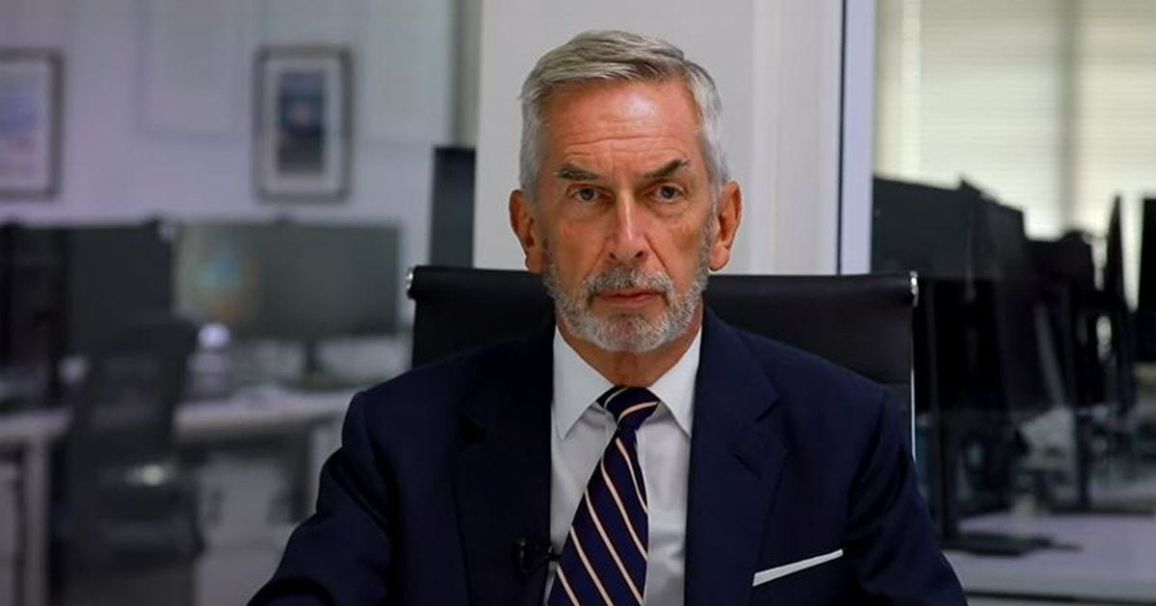

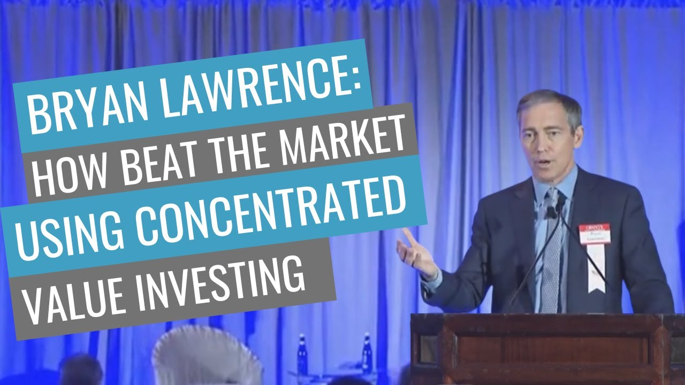


Slide 30
Investment Philosophy
We will be successful not by outsmarting the other players, but by trying to be consistently not stupid

Slide 31
Investment Philosophy
1) More often than not, we stick to our discipline (bread and butter – concentrated value investing), but we refuse to settle for mediocre returns
  When it comes down to it, we keep our eye on the ball of achieving high returns for our partners. This is best accomplished through investing in companies with high returns on capital at reasonable prices.
  Markets are dynamic – we must adapt and recommit to our process when necessary

Slide 32
WB: “We basically look for companies where we think we could understand what the future will look like in five, ten, or fifteen years. That doesn’t mean we calculate it to four decimal places – but we need to have a feel for it, and we know our limitations. We stay away from a lot of things … We just keep reading and thinking and looking at things that come along; as Charlie describes it, comparing Opportunity A with Opportunity B. When we were capital-constrained, we usually had to sell something if we were going to buy something else. And that always makes for an interesting challenge, when you’re measuring something you hold against something that has come along, to see which is more attractive. We probably leaned very much toward things where we felt we were certain to get a decent result, as opposed to where we were hopeful of getting a brilliant result. We went with our instincts and kept putting one foot in front of the other.”
CM: “We had some good fortune. Warren says he was lucky to find GEICO, but not every twenty-year-old was going down to Washington, DC, and knocking on the doors of empty buildings to try and find something out that he was curious about. So we also made our own luck by being curious and seeking wisdom – and we certainly recommend that to anybody else. There’s nothing that produces wisdom more thoroughly than really getting your own nose whacked hard when you make a mistake – and we had a fair amount of that, didn’t we?”
WB: “We had plenty. We thought we knew the department store business in Baltimore (w/ Hoschild-Kohn) and we thought we knew about the trading stamp business (w/ Blue Chip Stamps). We’ve had a lot of experience with bad businesses, and that really makes you appreciate a good business. To some extent, it sharpens your ability to make distinctions between the good ones and bad ones. And we’ve had a lot of fun along the way. That helps too. If you enjoy what you’re doing, you are likely to get a better result than if you go to work with your teeth clenched every morning.”

