Slide 1
Value to price
The rebel allocator lessons

Slide 2
The state of yarak
Upfront: training a hawk would take a big commitment
To get the most out of your bird, you have to keep it at the perfect weight; not sitting there fat and happy, but enough energy in the tank
At this state, the bird has incredible clarity, energy and singularity of purpose toward its most important objective: hunting
It’s called yarak – nothing can prevent that bird from tearing its prey to shreds
Personal Finance: Pay Yourself first
Here’s what you do: take money out of your account every month in an automated way to save for the future; Live on what’s ever left
Key Idea: Pay yourself first before you pay everyone else
Get creative to make ends meet and not dip into your savings
You create an artificial hunger, this state of yarak in yourself; you become the bird that has to hunt

Slide 3


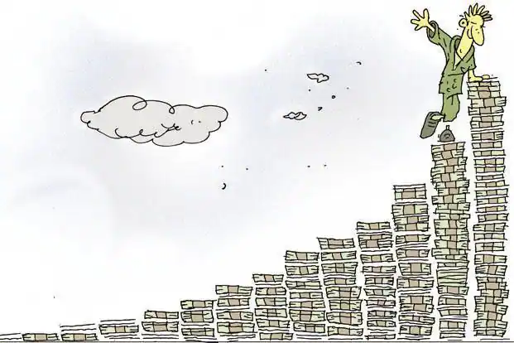
Compounding
Recipe: constantly spend less than you earn
Automatically tuck away ten percent of whatever you make
You don’t even have to be an investment genius with that ten – if you pull the time lever
Constant improvement is the only way to succeed
Success is a few simple disciplines, practiced daily
You’re either getting slightly better or worse every single day; there’s no stasis
A one percent change is barely noticeable in isolation

Slide 4
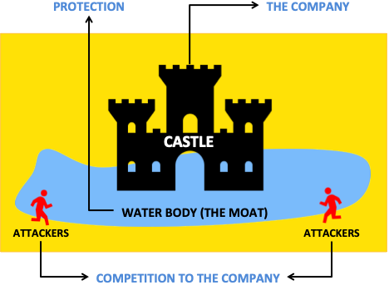
Every day, in countless ways, the competitive position of each of our businesses grows either weaker or stronger. If we are delighting customers, eliminating unnecessary costs and improving our products and services, we gain strength. But if we treat customers with indifference or tolerate bloat, our businesses will wither. On a daily basis, the effects of our actions are imperceptible; cumulatively, through, their consequences are enormous. When our long-term competitive position improves as a result of these almost unnoticeable actions, we describe the phenomenon as “widening the moat.”
– Warren Buffett
Business is very competitive, and the difference between Hall of Fame and the graveyard can be remarkably thin.

Slide 5
THE IRON LAW OF ECONOMIC SURVIVAL
Cost
Price
Value
In order for a business to thrive, the value delivered to the customer, V, has to be greater than the price the customer is charged, P, which has to be greater than the cost of that good or service, C.

Slide 6
Deeper dive on C, P, V
1) What does cost actually mean here?
Every cost should be included in the C number. The more comprehensive your list, the better your calculation of true economic cost.
2) The price you receive for selling something
It’s helpful to look at the price through different time periods
Newspaper subscription: that first month’s price, one transaction, wouldn’t tell the whole story
Often it is better to look at the customer’s lifetime relationships to determine costs and prices
If you have more than five competitors in your fishbowl, don’t expect to be able to control the price of anything
In the long run, a mature market becomes a two-horse race
3) the value of something always depends on your individual context
We all have wants and needs at different times. They vary w/ the condition you’re experiencing
If you’re drowning in a river, a glass of water isn’t much of use. If you’re stranded in the desert, it’s almost infinitely valuable to you
Every human has a list buried in their head that’s the order of their wants and needs at that given moment
The list usually changes slowly

Slide 7
Railroad
Plan: spend six billion dollars to redo the highway track from London to paris
Cut thirty minutes off a four-hour journey
Less time on the train is a good thing, right?
Or, spend six million dollars to add tv sets into every seat and also provide passengers with free movies
Spend 1/1,000th of the original price and make the ride feel even shorter than the thirty minute proposed reduction
Don’t be an engineer. Think! What would make the customer more happy?
Takeaway:
Perceived value is based on what the individual customer feels and experiences
The people closest to the customer probably have the best gauge on how to fix a problem or what might delight the customer

Slide 8
Customer Feels Cheated
- The customer doesn’t think they’re getting their money’s worth.
- It’s an opportunity for other businesses to come steal that unhappy customer.
- Eventually that person will find a way to stop paying for the product.
Cost
Value
Price

Slide 9
Next Stop: Bankruptcy
- The consumer is delighted but you can’t stay in business.
- It’s only a matter of time before you run out of money.
Price
Value
Cost

Slide 10
Profit = Price – Cost
___
_____
______
________
Profit
Cost
Price
Value
- Every company has to eventually make a profit to stay in business.

Slide 11
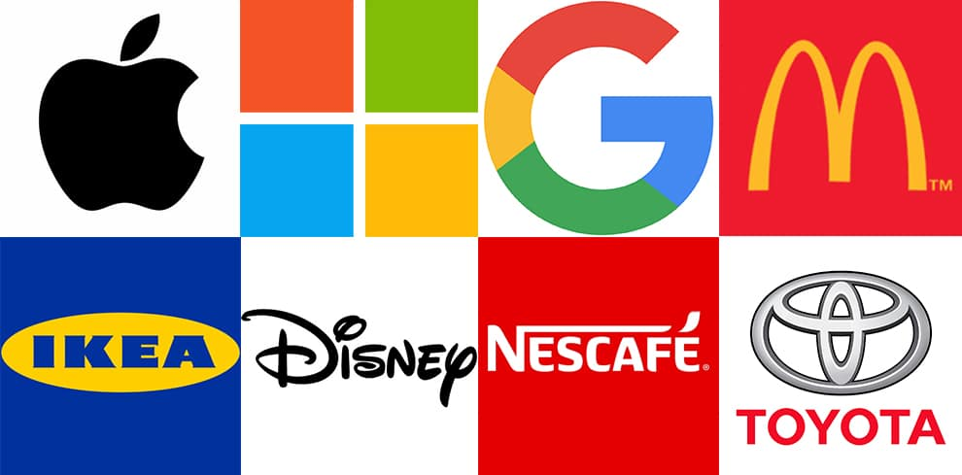
Bringing It All Together
- There’s a piggybank in your customers’ minds. With every interaction, you’re either making a deposit or taking a withdrawal.
- The contents of the piggybank is a measurement of your brand.
___
___
- The extra bit of surprise value that the customer feels they got compared to the price they paid.
_____
_____
______
______
________
________
Profit
Brand
- There are three ways to make the brand triangle bigger.
- 1) be the cheapest
- 2) be the most convenient
- 3) be the best
Cost
Price
Value
Notes:
Consumer Surplus – let’s avoid academic jargon

Slide 12
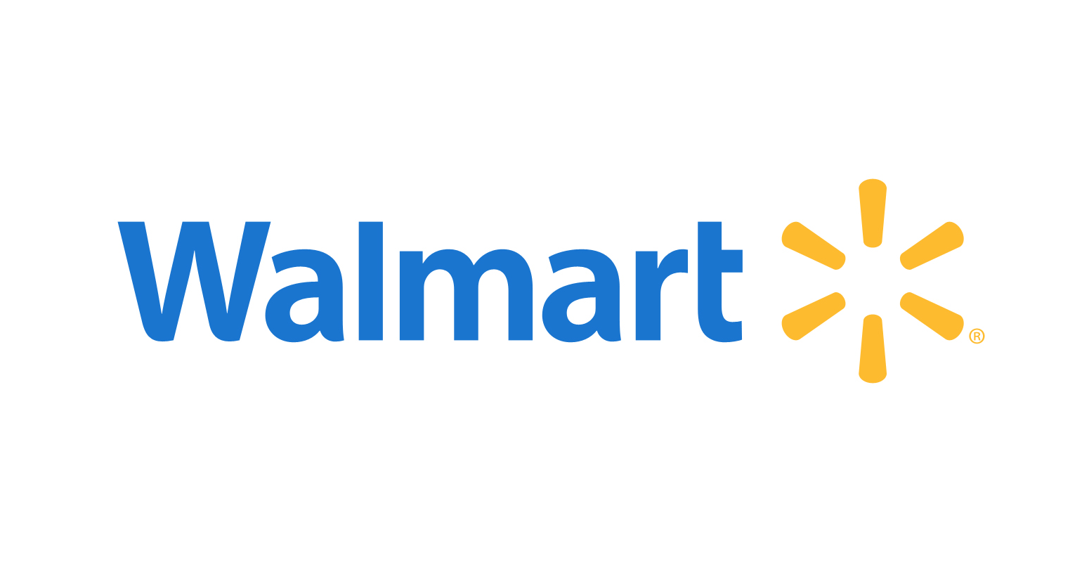
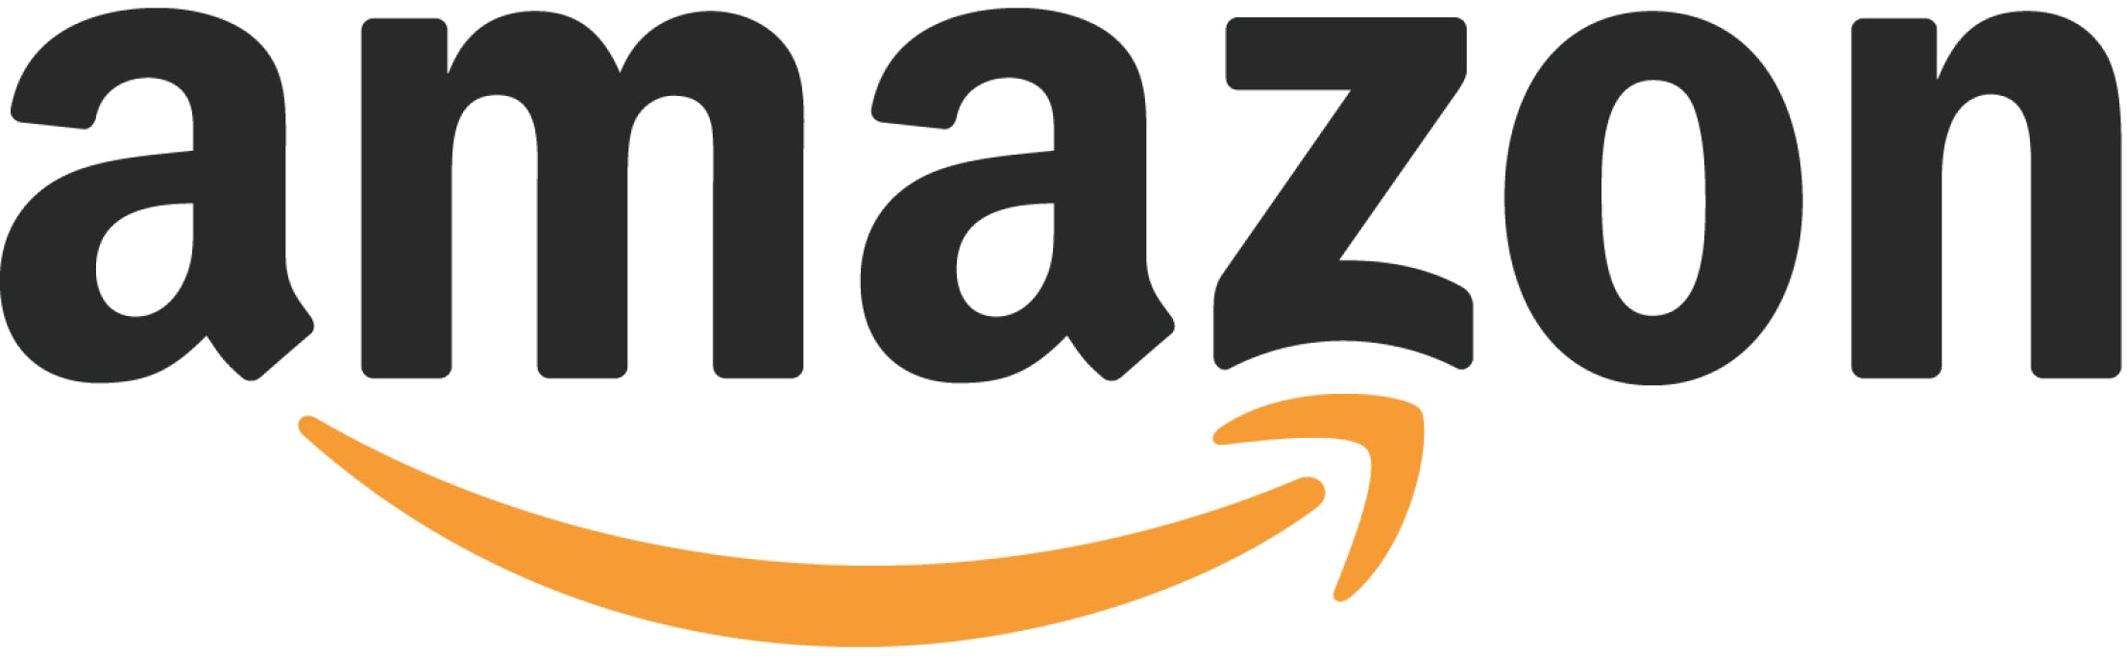
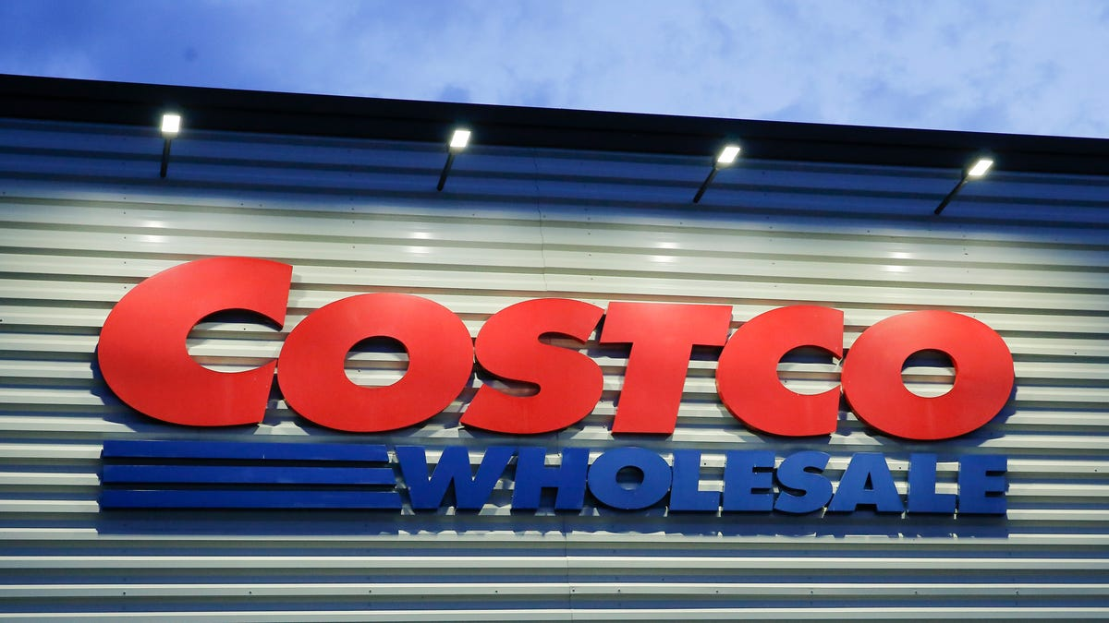
The dynamics of capitalism guarantee that competitors will repeatedly assault any business ‘castle’ that is earning high returns. Therefore a formidable barrier such as a company’s being the low-cost producer (GEICO, Costco) or possessing a powerful world-wide brand (Coca-Cola, Gillette, American Express) is essential for sustained success.
- Warren Buffett

Slide 13
Economics of a commodity business
QOTD: If you wanted to, could you raise prices and not lose customers?
If you can answer yes, you probably have a differentiated product
If you can answer no, you’re in a commodity business
There’s nothing wrong w/ providing a commodity, but it Changes what you should focus on
They know They can’t do much to change value and price, so you become demons on lowering costs…
Take Kansas basketball – they have a great offense. They space the floor well, move without the ball, and have terrific shooters. If they were a business they’d be a differentiated product.
Other teams focus on playing great defense. In business, defense is like being the low cost producer.
It doesn’t mean you can completely abandon one in favor of the other, but you have to decide where to direct your focus
More businesses are providing a commodity than they realize
It’s very hard to create and maintain a differentiated product for a long time.
EOTD: You either have to be the lowest cost producer or build up a brand that lets you charge more if you want to earn higher returns.
Notes:
Does every player on your team know your strategy?

Slide 14
Cootie Burger economics
It appears hamburgers are a commodity; you can get a pretty good burger at a lot of different places
“Because of that we are relentless with managing our costs. IT’s our primary area of focus.”
“But we also strive to differentiate ourselves with a great customer experience.”
The Customer’s experience is always right
“We do think there are some costs we incur that move the value straw enough to justify the resources.”
None of this is strictly black and white

Slide 15
Technology changing the landscape
With all of the new technology coming out all the time, how do you know if what you plan on delivering to customers will even move their Value straw?
The answer is, you never really know for sure
Often, the customer can’t even articulate the value they’re feeling because it’s happening at deeply subconscious levels.
Clues:
First, remember that technology is just a tool to accomplish a human want or need.
Read up on Maslow’s Hierarchy: we have basic needs like food, shelter, clothing, connection, meaning, contribution.
How we get our needs met will change based on the tools and technology of our time.
Second, in general the longer we humans have been using a particular technology, the longer we are likely to continue using it in the future.
There’s a persistence

Slide 16
Little Profit, Lots of Brand
Profit
Brand
Cost
Price
Value
- When the Price straw is near the Cost straw, there isn’t much profit, but there’s a lot of brand.

Slide 17
Little Profit, Lots of Brand
- You can either access the value quickly in the form of profits, which are readily available to you, or you can store it away for later use in the minds of your customers as brand.
- The more profit a company generates, the more attention they draw to themselves.
Profit
Brand
Cost
Price
Value

Slide 18
Managing cash flow
Think of cash as the oxygen of a business.
During normal times when cash is plentiful, it’s easy to ignore and take for granted
But when it’s suddenly missing, it’s hard to think about much else
#1thing that trips up small business owners:
‘I’m selling more everyday, why is there no money in the bank?”
Here’s what’s going on:
You collect cash from your customers. You use cash to pay your vendors for inventory and employees for labor.
Some businesses are able to collect cash from their customers very early, well before they have to make other payments.
So there’s always money in the bank to meet their expenses.
The more you grow, the more cash builds up.
This is an easier business to run from a cash flow standpoint
Bad cash flow business: You have to pay everyone before the customer pays you.
As that kind of business grows, it requires more and more cash to keep things running
Cash flow requirements don’t make a business good or bad necessarily. Plenty of solid, profitable businesses have poor cash characteristics. You just have to know what kind of business you’re in so you don’t get surprised and caught short.
It helps to be conservative!!!

Slide 19
The individual, the family, the kingdom
You can use the same straws (C, P, V, P, B) to look at a business on a per unit basis at the individual transaction level.
Say a customer buying one Hamburger:
You can look at it on the single store level in the cost of one Cootie unit selling five hundred thousand hamburgers per year
Or you can also look at the entire cootie enterprise selling hundreds of millions of hamburgers across the whole system
Same store sales (any retail store)
There are certain costs you pay every day whether you have one customer or one thousand.
These are your ‘Fixed Costs.’ Think cost of the building, the electricity, the parking lot.
If we spread these costs across more customers, we actually lower the cost on a per-individual basis.
This is referred to as operational leverage or economies of scale
You’re increasing your profitability w/ every burger you sell.
That gives you the option to collect more profit by leaving price where it is, or lower your prices to bank that value as brand in your customers’ minds.
Kingdom level:
The costs at headquarters are like the fixed cost of the four walls of a restaurant at the single store level.
You can spread them out and dilute them across a larger number of burgers at the kingdom level
Notes:
You have to understand the nature of the business in order to figure out what the important metrics are. For retail, it’s same store sales.

Slide 20
Operational Leverage / Economies of Scale
Cootie Burger – Same Store Sales
- If growing, you’re increasing your profitability with every burger you sell or …
- If declining, your fixed costs now have to be spread over a smaller pool of customers, so they go up on a per-customer basis.
- You not only lose the margin of the additional burger you might have sold. You accelerate toward declining profitability with each tick down in same store sales. (double-edged sword)
Profit
Brand
Cost
Value
Price

Slide 21
Network Effects
Cootie Burger – Network Effects
- It has to do with human psychology and how our brains work.
- We evolved in tribes and the default is to look at what the group is doing to see what’s right and safe. So if you came into a busy Cootie Burger, each customer and burger sold would be social proof that this is a good, safe place to eat.
- What’s interesting about humans is that expectations can affect your perceived experience. We’re talking literally how your brain interprets the electrical signals from the taste buds in your tongue.
- If you had been primed to expect a great meal: the cleanliness of the restaurant, smiling faces, it’s likely you’d report it tasting better than if you ate by yourself in a dim, dirty shack. So for Cootie, each hamburger sold might subtly bump up the Value for every customer.
- Key Conclusion: value is subjective in each customer’s mind
Profit
Brand
Cost
Price
Value
- Each unit you add at the individual level increases the value for everyone at the global network.
- So you bump up everyone’s Value straw at a faster rate than the costs grow.

Slide 24
The trifecta
1) “While deals often fail in practice, they never fail in projections.”
2) “The higher return a business earns on the capital that is invested in the business, the more cash it is producing and the more value is being created.”
3) “Growth can destroy value if it requires cash inputs in the early years of a project or enterprise that exceed the discounted value of cash flow that those assets will generate in later years. Growth is simply a component – usually a plus, sometimes a minus – in the value equation.”

Slide 25
Return on Invested Capital
Return on Invested Capital: for every dollar that’s put into the business for operations, how much comes out?
If you put a dollar into a business, and it throws off Fifty cents, your ROIC is 50 percent
Any particular year is not how I like to think about it though. In spite of our desire for order, business usually doesn’t map well to one trip around the sun
ROIC of strategies
Many companies will measure the ROIC of individual projects, which probably makes more sense than any given year.
But at cootie … we measure the ROIC of strategies
A strategy is a bigger goal we’re trying to accomplish as a team. If you recall our previous conversations, a good strategy for us involves finding ways to better delight our customers or lower our costs. There are usually several projects that make up a strategy. Like a bundle.

Slide 26
Strategies vs projects
We prefer to assess and fund strategies and not individual projects for several reasons.
First, we’re aiming to succeed in the long term. A strategy is inherently more long term focused than a single project
There are important human dynamics to consider. Don’t forget that it’s people who are coming up with these ideas. It’s easy to fudge the projections on individual projects and make the numbers work. Not due to any maleficence – it could be they’re simply enthusiastic. Humans tend to be overconfident and extrapolate in straight upward lines when they get excited.
The projects never fail to show a profit
My view is that it’s harder to overestimate an entire strategy. So thinking in strategies keeps the numbers more honest and your team pulling in the same direction.
Here’s another takeaway: Thinking in strategies can open your eyes to new paths in the forest. Sometimes a great idea is staring you right in the face and you don’t see it until you look at your bigger strategy.

Slide 27
Cootie strategy
WE have a strategy to lower the cost of testing restaurant locations
We have to determine where people want to eat our hamburgers. And any costs we can save figuring that out are meaningful. Those saved resources mean we have more left to test other projects and fund other strategies to lower costs or wow our customers.
When we first started out, it was based on my gut feelings of different locations and communities.
We got better by funding a project to measure traffic patterns to make better decisions
Then we had an idea where we could use food trucks to test out a location in small scale to see if our brand of burgers and shakes would be popular in an area.
A food truck costs about $60,000 to outfit.
One of our restaurants is around $1.5 million to build.
Granted, it’s not a perfect correlation that a successful truck test will become a good permanent location. But A new truck is less than five percent the cost of a restaurant, and we can keep reusing the trucks
Our errors show up as bad returns on invested capital

Slide 28
“But a positive or negative ROIC is a huge deal when you look at the entire capitalistic ecosystem. Misallocation is bad for the company because we have less profits to reinvest. Where’s the internal eighty percent of funding going to come from? It’s bad for customers because we built in a location no one really wanted. It’s bad for the environment because we wasted materials and energy for a building that will likely be torn down. It’s bad for society because not making progress is a waste of everyone’s time and talent.”

Slide 29
Higher returns on capital mean more value is being created. Not just for the business or investors, but for the whole ecosystem.
“I know it sounds like hyperbole, but good business decisions can positively impact us more than nearly anything else.”
Not all growth is good
There is a strange fascination with growth
Maybe a better term for growth would simply be “more.” If you’re doing something right, more is good. But if you’re doing something wrong, more is definitely not what you want.
Return on invested capital can serve as the gauge that tells you if you’re doing something right or wrong
Are you giving the consumer something they value and are you delivering it in a cost effective manner?

Slide 30
Charles atlas’s exercise program
Imagine the bench press: During my atlas training, I learned you need to use proper form to avoid injury.
Before you load up the bar with heavy weights, you must have your form correct, usually through practice with lighter weights.
In this analogy, your return on invested capital is your form.
It shows you how well your product or service fits with what consumers want.
Only after you have proper form as demonstrated through sufficient returns should you attempt to add the extra plates of growth and scale up.
If you attempt growth without showing adequate returns on capital, you wind up destroying value and risking business injury, even death.

Slide 31
Improving ROIc at cootie
For a long time, we kept everything in-house by building and running our own restaurants
Buy the land, put up a structure, add all of the restaurant equipment – requires a lot of money to grow, which keeps you expanding slowly
How can we get better returns on our capital? – Where was our organization able to create the most value for our customers, all while consuming the least resources?
It’s a fool’s errand to believe that you can be good at everything
‘We shined when it come to sourcing quality ingredients, crafting an enjoyable customer experience, and strict attention to detail in operations.’
Let others help with the real estate side of the equation – Franchising – take out the low three percent return on real estate
Make more money with less invested capital through franchising – invested capital goes into designing better systems and building our brand (not buying real estate)

Slide 32
“All financial assets can be made economic equals: It applies to outlays for farms, oil royalties, bonds, stocks, lottery tickets, and manufacturing plants. And neither the advent of the steam engine, the harnessing of electricity nor the creation of the automobile changed the formula one iota – nor will the Internet. Just insert the correct numbers, and you can rank the attractiveness of all possible uses of capital throughout the universe.” – Warren Buffett
“In the real world, you uncover an opportunity, and then you compare other opportunities with that. And you only invest in the most attractive opportunities. That’s your opportunity cost. That’s how we make all of our decisions.” – Charlie Munger

Slide 33
Profitable expansion at cootie
Everything moves in cycles:
growth, eventual decay, cleansing tear down, repeat.
When an area is particularly rough, we’re able to acquire properties for very low prices. The buildings and services like water and electricity are often still in decent shape.
The low price today makes sense – who wants to buy in this shabby state? – you couldn’t get much cash flow from this property as it exists right now
Here’s the hard part of the strategy: we have to wait!
It make take over ten years of just sitting on the property doing nothing but paying property taxes
The wheels of progress turn imperceptibly slowly. But eventually a rough neighborhood gets cleaned up.
We then have a location in a hot area, and we paid a favorable price for the real estate
Now we have a material advantage over our competitors for a long stretch
Most CEOs are measured by the quarter; it’s very difficult to be that patient
It can really cloud a decision-maker’s thinking when there’s a shot clock

Slide 34
Patience
Here’s the lesson I want you to take away from the humble pine cone:
Patience may be the least-exploited advantage in the game.
Cootie in the 1980s:
We weren’t building anything. Our competitors had bid up the price of land, raw materials, and construction labor to the point where new buildings were very expensive and it was hard to see how we’d make our money back.
I’ve noticed that when there’s a lot of easy money sloshing around, the returns on capital start to suffer.
Instead of borrowing, we ended up accumulating a lot of cash through operations and just sitting on it.
What’s the alternative? Do something that didn’t make sense, just to be like everyone else?

Slide 35
Business is cyclical in nature
- “These companies borrowed a lot of money to build new stores. They got ahead of themselves with how much restaurant space consumers really wanted. They got ahead of themselves with how much restaurant space consumers really wanted. It’s simple economics: any time you have too much supply, prices start dropping. All the projections on how they were going to pay back that debt went sour because they couldn’t get the prices they needed due to overcapacity. Boom is followed by bust, surely as night follows day. “
- “Businesses in industries with both substantial overcapacity and a ‘commodity’ product are prime candidates for profit troubles. Over-capacity may eventually self-correct, either as capacity shrinks or demand expands. Unfortunately for the participants, such corrections are long delayed. When the finally occur, the rebound to prosperity frequently produces a pervasive enthusiasm for expansion that, within a few years, again creates over-capacity and a new profitless environment. In other words, nothing fails like success.”
Idea: There’s really no such thing as a bad asset. Just paying the wrong price for that asset.”

Slide 36
Business is Cyclical in nature
- “Sort of. We weren’t being contrary for no reason though. Their zagging just made no sense to me. There’s an ebb and flow that’s woven into the very fabric of capitalism. People who forget cyclicality are bound to be hurt by the bust, whereas we were able to benefit. Every bubble forces you to make a choice: do you want to look like a fool during the build up as you’re missing out? Or would you rather look like a fool after it bursts? There’s no getting around looking foolish. But you do get to decide the time frame. I call it ‘The Bubble Ultimatum.’”

Slide 37
Eight ways of expansion at Cootie Burger
“Here’s the quiz question: How many different options does Cootie to have to create a roof over a customer’s heads?” “I can think of at least eight ways.”
1) we could buy a fresh plot of land like this one and build on it immediately
2) we could buy land by itself and wait to eventually put a building on it
3) we could technically buy a building and store it somewhere before we have the land, like a manufactured home
4) you could buy an existing building and convert it to a cootie burger
5) you could buy a competitor’s chain and convert all of its restaurants into Cootie burgers
6) we could calculate how much a publicly-traded competitor is selling for on a per-restaurant basis and buy partial ownership in their stock
7) you can buy back your own stock, which in a way is purchasing some of your own roofs back from your business partners
8) often the smartest thing to do is nothing.

Slide 38
The secret to good capital allocation
Capital allocation is hard:
Perhaps, but it’s not so bad once you have the menu laid out in front of you
All you have to do is evaluate each idea and decide on the most logical choice.
This is the secret to good capital allocation: have a lot of options and pick the best one.
You want to cast the net wide when you’re measuring all of your choices against each other. It’s the missed opportunities right in front of your face that really hurt.
Why Mr. Buffett doesn’t stress about not having a long term plan: at every juncture, he’s looking at his various investment options and trying to pick the smartest one. Even if the answer is to wait for a better menu. How can you make too many plans if you don’t know what opportunities the future holds? You’re limiting yourself by pre-deciding today what the best option is ten years from now.

Slide 40
“Start with the customer and work backwards.”
Cootie: Eleven-star experience exercise
What would you expect a six-star experience to be like?
How about a seven-star experience?
Finally, what would an

Slide 41
Paradox of choice
Why doesn’t Cootie have a bigger menu?
If you’re trying to deliver maximum value to Cootie burger customers, shouldn’t you offer more than just burgers, fries and shakes?
If you gave customers more choices, they could pick what they wanted and would maximize their subjective experience.
Paradox of choice
Humans aren’t always logical. Our brains evolved for survival, not necessarily logic.
People end up less happy with their final choice because it seems like they gave up too many other great options to choose just one.
“we’re doing our customers a favor. We’re make their choices more manageable.”
There are some good business reasons to have a simplified menu: it makes managing inventory much easier. You don’t have to throw away spoiling food because people didn’t want chicken sandwiches that week for some reason. Throwing away food In the restaurant business is akin to throwing away money.
It also simplifies our operations. You don’t have to train employees on how to make ten different items. They make fewer mistakes, and new hires get up to speed faster.
Most importantly: “There’s a glitch in the human mind: if you only offer one or two things, people assume you do those few things very well. Maybe even the best.”
The important point is people can only remember so many things about your business. They’re busy living their lives. You want to make it easy and unambiguous for them to form associations about what you’re good at.
Unique Selling proposition: Could your customers explain in ten seconds what makes you so great?
We do burgers, fries, and shakes at Cootie. Full stop. We happen to focus on quality and provide great service. Because we don’t offer anything else, it’s very clear what you’re going to get when you visit. People know what to expect, which is comforting. So when one of their friends asks where’s a great place to get a burger, we own that space in their mind and they reflexively think of us. That becomes a form of advertising.”
Due to the brand that you’ve built through so many customer interactions – that fat you have stored in your customers’ minds.
That’s exactly why over-delivering on value is such an important goal for us. Someone sharing the best place to get a burger with a friend is worth how many TV or radio advertising spots?

Slide 42
Bringing customer’s in
“let’s think a little more broadly. One of the most important expenses any business has is the cost to find customers and get them in the door.”
In business school, they probably called it ‘customer acquisition cost.’
Cootie could invest in radio advertising to get people to come eat our burgers. We could advertise on billboards. Or skywriting. Or on the internet. Each medium has a certain cost and expected return in traffic, though it’s usually very difficult to measure that return.
There’s nothing wrong with traditional advertising; we use it at cootie. We just happen to believe focusing on a stellar in-store experience and viral word-of-mouth are more effective for us.
What’s really nice is that if a customer refers us to a friend, they’re basically making a public proclamation that they like eating at our restaurant. People have a strong internal desire to appear consistent with what they say to their friends. So by making the referral, they reinforce their own good feelings and commitment to liking Cootie.
When a customer refers a friend, they’re almost referring themselves all over again.

Slide 43
Advertising has two functions
Make people aware of the product, and shift out that v straw and increase the perceived value a customer experiences.
If you can nudge V out farther than the cost required, I’d consider that to be a sound strategic expense.
At cootie we happen to focus on quality ingredients and a great customer experience, but that doesn’t mean it’s the only way.
Gatorade dramatically increased the perceived value of their drinks in your friend’s mind through their association with Michael Jordan
If your business focuses on discovering and expanding on those ways through imagining eleven-star experiences, you have a good shot at making your customers feel great – which is the whole point of business.

Slide 45
How a deal gets financed
The first choice is to use cash you have in the bank
The second is usually to issue debt to fund your acquisition
Eventually you run out of our own cash and people who are willing to loan you more money. So what does that leave you with?
Equity
The first thing you must understand is that equity –stock- is like having your own currency. If you issue shares for an acquisition, it’s like printing your own currency.
Rule of thumb: never issue shares unless you receive as much intrinsic business value as you’re giving up

Slide 46
Issuing shares
“I made an even worse mistake when I said ‘yes’ to dexter, a shoe business I bought in 1993 for $433 million in Berkshire stock (25,203 shares of A). What I had assessed as durable competitive advantage vanished within a few years. But that’s just the beginning. By using Berkshire stock, I compounded this error hugely. That move made the cost to Berkshire shareholders not $400 million, but rather $3.5 billion. In essence, I gave away 1.6% of a wonderful business – one now valued at $220 billion – to buy a wonderful business.” – Warren Buffett
You should always ask yourself if you would sell one hundred percent of your business on the same basis as you’re considering issuing equity?
If you issue shares for less than intrinsic business value, you are harming your current family of shareholders
If you are able to issue shares at above intrinsic value, you might actually be benefitting them.

Slide 47
Farm example
Say you’re in charge of your family’s 100 acre farm
You decide to merge your farm with your neighbor’s fifty acre farm into an equal partnership.
You are now in charge of 150 acres, which is nice to talk about at bbqs, but your family’s ownership of land and the crop yield has actually gone down by twenty-five acres.
You’re now in charge of 150 acres, but are you really much of a hero?
You should always ask yourself if you would sell one hundred percent of your business on the same basis as you’re considering issuing equity?
If you’re able to use your stock that’s priced at twice what you know it’s worth to acquire a company for half what it’s worth, it doesn’t take a genius to figure out you stand to add a lot of value for your shareholders. That’d be the equivalent of using fifty of your family’s acres to acquire 100 of your neighbor’s acres.

Slide 48
Motivations for doing a deal
Wrong reasons for doing a deal
Thrill of action – to be in the game, to make something happen, even if it is stupid
Humans have a tendency to follow leaders who are bold
Size, status, and ego
BBQ factor – being able to bring to your friends and family at the BBQ
Telling them how you’re a big shot who runs a large company with more revenue, more employees, more assets, more complexity.
General overconfidence
If you’ve had some recent success, you might think you’re on a hot streak.
Overconfidence can show up in something as simple as lofty expectations about what the two companies will look like when combined into one (Synergies)

Slide 49
Acquisition common sense
Cootie making an acquisition
“Ask yourself, Is it a better deal to get the roof through acquisition or potentially building it yourself?”
Never participate in auctions
Obvious cost synergies
Two types of synergies: Revenue (rarely real) and Cost (often real)
Cut non-strategic expenses to improve profitability
Margin of safety
When engineers build a bridge that’s rated for 10,000 pounds, they only let trucks that weight up to 5,000 pounds use it.
What if I’m wrong on what I think the business is worth?
CEOs are herd animals
They travel in packs and emulate each other, including when it comes to M&A
There’s a first-mover advantage to being early in the cycle because there are more higher quality targets, fewer competitors, and usually lower valuations early on. Beware buying anything late in the cycle when everyone wants in.

Slide 51
“In allocating Berkshire’s capital, we ask three questions: Should we keep the capital or pay it out to shareholders? If pay it out, then you have to decide whether to repurchase shares or issue a dividend. To decide whether to retain the capital, we have to answer the question: do we create more than $1 of value for every dollar we retain? Historically, the answer has been yes and we hope this will continue to be the case in the future but it’s not certain. If we decide to retain and invest the capital, then we ask, ‘What is the risk?’, and seek to do the most intelligent thing we can find. The cost of a deal is relative to the cost of the second best deal.”
- Legally, there isn’t a big difference in terms. But I purposely refer to Cootie shareholders as ‘partners’ for a reason. Word choices impact our thoughts. If I think of them as my partners in the business, I make better decisions on their behalf. I serve as their fiduciary. I take full responsibility for their financial well-being with respect to our stock. I want to be an example of the good that can come from business done right.
- Owners / partnership mindset: one of the things that’s missing today in corporations is a feeling of partnership between shareholders, the board of directors, and management. If more CEOs viewed their shareholders as business partners, they’d do things a lot differently.

Slide 52
Intrinsic Value of a business
What determines the intrinsic value of a business?
Said another way, assuming you had perfect information, what would you add up to come up with a single number?
Academic perspective: “The intrinsic value is the net present value of all of the cash that can be taken out of the business during its remaining life.”
How about in plain English?
There are different future scenarios which lead to very different amounts of cash in the bank. What if there’s a recession? What if competition intensifies? What if in the case of Cootie, people stop eating hamburgers?
So the total amount of cash a business generates in its lifetime could be a lot of different numbers based on what happens in the world.
Net Present Value?
All it says is that a dollar today is worth more than a dollar tomorrow.
The higher the interest rate, the less that dollar ten years from now is worth.
So even if we had a crystal ball and knew the exact quantity of cash that we’d get out of our business from here to eternity, different interest rate assumptions would make that pile of cash worth more or less today.
Very smart people could look at the exact same set of facts and calculate two different intrinsic values based on their view of the future.
We simply provide all the facts as clearly as we can, just as we’d want to see them if the tables were turned. It’s the best we can do to be fair to our partners.

Slide 53
How an investor makes a buck
How do you make money as an investor or business owner?
When the underlying business becomes more profitable, the intrinsic value goes up and the share price tends to move upward as well.
Sometimes it can take longer than you’d ever expect for share price and intrinsic value to converge, but they eventually do.
You only get that money when you sell
The company can pay out dividends
Most executives believe that once they pay a dividend, they have to keep paying it. Maybe even increase it a little every year. They think they have to give the shareholders their allowance to keep them happy. Keep them at bay
IF you’re one of the partners in a successful business, you should want to keep as much of your money as possible invested there. That assumes the business is doing good things with the money, by which I mean earning high returns on invested capital and redeploying the money intelligently.
The same magic of compounding can happen inside a company when a high ROIC strategy has a long runway to absorb a lot of capital and keep providing high returns. It acts like a golden goose. If you’re an investor, you want management to unlock the compounding machine inside the business. Then you have to do all you can not to take any money out of it. You want to keep your money tied in this machine that feeds itself and keeps growing. Taking money out would be a terrible idea – including to pay a dividend.

Slide 54
Paying a dividend should be the last resort for a rebel allocator. It’s like a confession that they have a lack of attractive ideas. It says a lot actually: I can’t reinvest back in our business and find profitable growth. There are no acquisitions that would be productive for our partners. The price of our own stock is high enough to be inappropriate to buy back. In essence, they’re saying I can’t find anything smart to do with this money, so I’m giving it back to my partners.
In some instances, especially for an older, established company, paying a dividend could make sense. They may have a profitable business that simply can’t absorb new reinvestment. They’re out of other good opportunities and are sending the money back to owners. If that was the reasoning used, it’s very honorable to pay a dividend rather than have the hubris of reinvesting in value-destroying projects. I’d call that recommendable even. There are a lot of unforced errors made in Corporate America from trying to jam money into empire-building; self-congratulatory BBQ projects. It’s slower to grow with the mindset of a good capital allocator, which is why it’s so rare; but my belief is it’s longer lasting.

Slide 56
What is your definition of capital allocation?
At the most basic level, It’s how you decide to spend money. But it’s even deeper than that. Successful capital allocation means converting inputs like money, materials, energy, ideas, human effort, into more valuable outputs. It’s that transformation process.

