Slide 1
Children’s Corner Preschool
Preschool Expansion Aid Program
Registration Opens: January 21,2025
Registration Deadline: February 10,2025

Slide 2
What is Preschool Expansion Aid?
Money awarded to school districts to provide full day preschool to residents
Applying districts are funded annually
2025-2026 will be the 8th year Piscataway has received Preschool Expansion Aid funding from the State of New Jersey!
Provides high quality, full day preschool to 3- and 4-year-olds residing in Piscataway

Slide 3
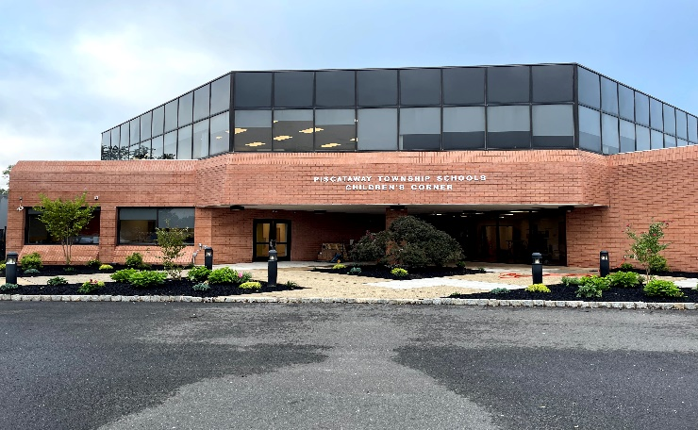
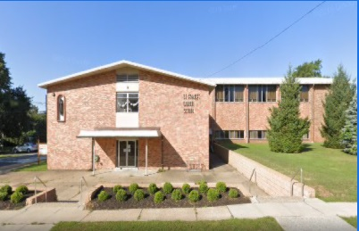
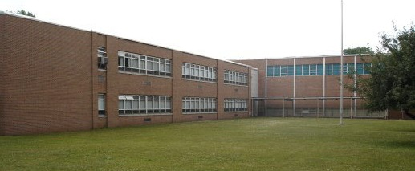
Children’s Corner Locations
Children’s Corner Preschool
275 Old New Brunswick Road Piscataway, NJ 08854
Children’s Corner River
2300 Cooper Street Piscataway, NJ 08854
Children’s Corner Pond
499 New Market Road Piscataway, NJ 08854

Slide 4
How To Qualify
You must be a resident of Piscataway
Your child must be 3 or 4 years old by October 1, 2025
Children must attend full days of school, 5 days a week (there are no part-time enrollment options)
There are a percentage of seats for families that meet financial eligibility guidelines and a percentage of seats for all families currently living in Piscataway.

Slide 5
Children’s Corner Program Information
Full Day: 8:45am – 3:00pm
Lunch program offered (fee based)
Full time nurse at all locations
Security system and safety officer at all locations
Follows Piscataway School District calendar
Extended Care available if needed (fee based)
Children’s Corner Preschool offers a high-quality early childhood education, with an ideal environment for learning that focuses on literacy, science exploration, math skills, dramatic play and music.
Bright, age-appropriate rooms, a nurturing environment, and play-based learning help children to develop the knowledge and skills they need to succeed.

Slide 6
Sample Daily Schedule
8:45 – 9:00 Free Choice
9:05 – 9:20 Opening Group
9:20 – 9:50 Gross Motor
9:50 – 11:00 Make Believe Play/Play Planning
11:00 – 11:20 Small Groups
11:20 – 11:55 Lunch
12:00 – 1:00 Rest Time
1:00 – 1:45 Free Choice Play
1:45 – 2:00 Large Group
2:00 – 2:30 Gross Motor
2:30 – 2:45 Snack
2:45 – 3:00 Closing Group

Slide 7
How to Apply Online
Visit our website at ccprek.com
Click on “Registration” then the “Register Now” link
This will direct you to the Community Pass Online Registration portal. For families needing translation, please click on “Translate: in the top left corner to translate Community Pass to over 70 different languages.
Existing Families: Children already attending Piscataway Schools
New Families use “Create Account” on the bottom of the screen

Slide 8
Community Pass
Once you are logged in, select “Browse Activities”

Slide 9
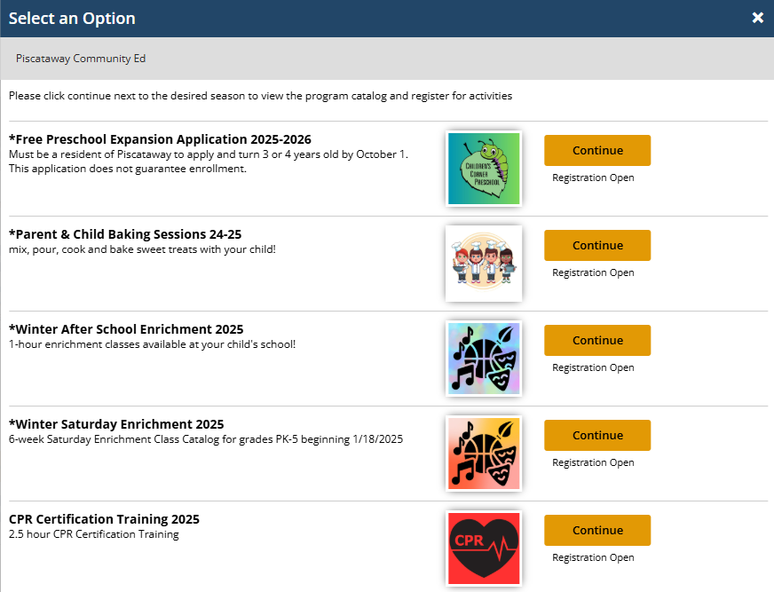
Select “Free Preschool Expansion Aid Application 2025-2026” and press “Continue”
Application

Slide 10
Application
Verify your email address and press “Continue”

Slide 11
Application
Select the Participants (your child) that you wish to complete an application for and press “Continue”

Slide 12
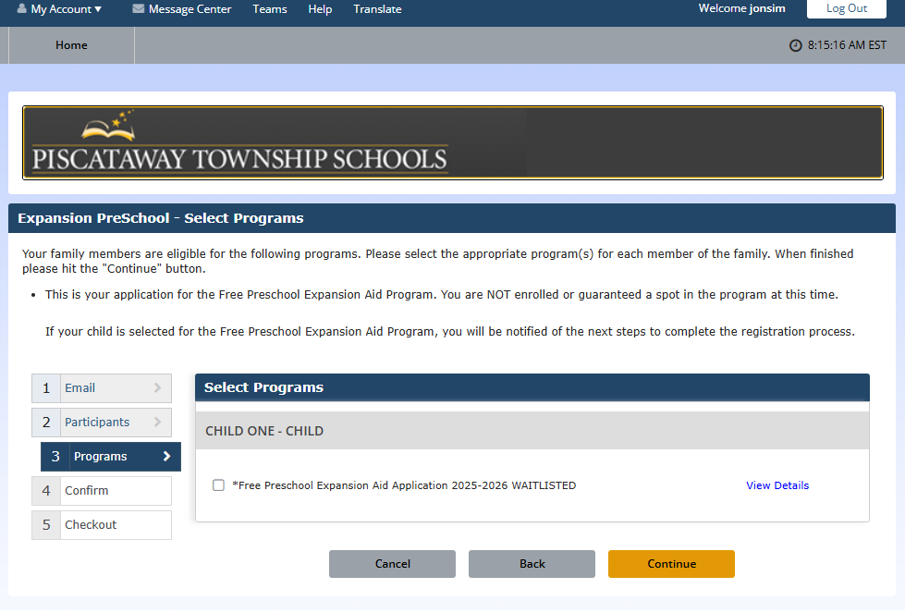
Application
Select the box for the *Free Preschool Expansion Aid Application 2024-2025 WAITLISTED and press “Continue”
* All applications are waitlisted pending review and approval*

Slide 13
Application
Answer every question on the application
The application MUST be filled out in its entirety

Slide 14
Important Information Needed for Your Application
List all children (first and last name) in the household ages 0-18.
Does anyone living in the household receive benefits from SNAP, TANF, or other programs? Check the appropriate box.
If you checked any of the first three boxes, please indicate the case number in the box provided.
Indicate the number of children living in your household. (This should match the number of names listed above)
Indicate the number of ALL adults that are living in the household
List all adults (first and last name) living in the household and their annual income.
*Use conversion chart if needed.*
7. Do you receive public assistance, alimony, child support, or retirement pension?
8. List the monthly income from the above question

Slide 15
INCOME qualifications
Income Eligibility based on:
Household Size
Household Income
All age-eligible (3 or 4 years old by 10/1/25) families are encouraged to apply regardless of income eligibility!
Notes:
Eligibility for F/R lunch is based on HH size and HH income

Slide 16
REPORTABLE INCOME
Income from work
Public assistance, child support, alimony
Pensions, Retirements, Social Security, Veteran’s benefits
All other income including unemployment and disability

Slide 17
FAQs
All financial questions must be answered.
There are a percentage of seats for families that qualify financially and a percentage of seats for all families.
A lottery will take place if more applications are received than available seats.
If your application is accepted, you will need to provide documentation for the financial information as well as proof of residency in Piscataway.

Slide 18
Additional Information
Eligibility criteria is set by the United States Department of Agriculture.
The Piscataway Township School District processes applications based on the eligibility guidelines, because of this we are unable to change or modify any rules when making a decision on your child’s application.
Notes:
Will be reviewing F/R Lunch Application which is the basis for determining eligibility in Grant Funded Preschool program
Whether eligible or not is based on guidelines set by USDA
Pway processes app based on such criteria

Slide 19
APPLICATION DEADLINE: February 10, 2025
Need help?
Email ccprek@pway.org
or
call 732-572-2289 x2017.

