Slide 1
Preschool Expansion Aid Program
Registration Opens April 5, 2021 Registration Deadline: April 23, 2021
Children’s Corner Preschool

Slide 2
What is the Preschool Expansion Aid?
Money awarded to districts to provide full day, high-quality preschool
Money is funded annually
2021-2022 will be the fourth year Piscataway has received Preschool Expansion Aid
Provide preschool to 3 and 4 year olds

Slide 3
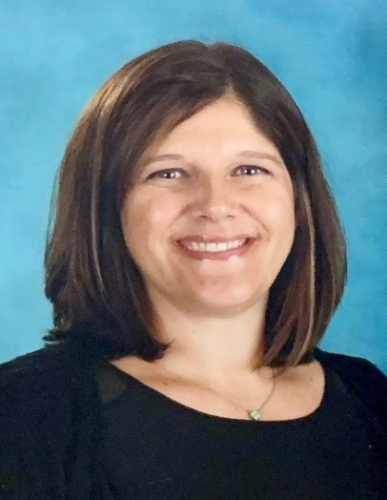
Children’s Corner Locations
Children’s Corner by the River
2300 Cooper Street Piscataway NJ
Supervisor: Jennifer Sernotti
Children’s Corner by the Pond
499 New Market Road Piscataway NJ
Supervisor: Shavonne Anderson

Slide 4
To Qualify
You must be a Piscataway Resident
Your child must be three or four years old by October 1, 2021
Children must attend 5 days a week, full days.
There are no part-time enrollment options
*Preschool spots are available to families that both qualify financially and families that do not qualify financially.

Slide 5
Children’s Corner Day
8:45 – 9:00 Free Choice
9:05 – 9:20 Opening Group
9:20 – 9:50 Gross Motor
9:50 – 11:00 – Make Believe Play/Play Planning
11:00 – 11:20 – Small Groups
11:20 – 11:55 Lunch
12:00 – 1:00 Rest Time
1:00 – 1:45 Free Choice Play
1:45 – 2:00 Large Group
2:00 – 2:30 Gross Motor
2:30 – 2:45 Snack
2:45 – 3:00 Closing Group

Slide 6
Children’s Corner Information
Full Day – 8:45am – 3:00pm
Lunch Program offered (fee based)
Full time nurse on staff
Security system and safety officer at both locations
Follows Piscataway Schools calendar
Extended Care available if needed
Children’s Corner Preschool offers a high-quality early childhood education, with an ideal environment for learning that focuses on literacy, science exploration, math skills, dramatic play and music.
Bright, age-appropriate rooms, a nurturing environment, and play-based learning help children to develop the knowledge and skills they need to succeed.

Slide 7
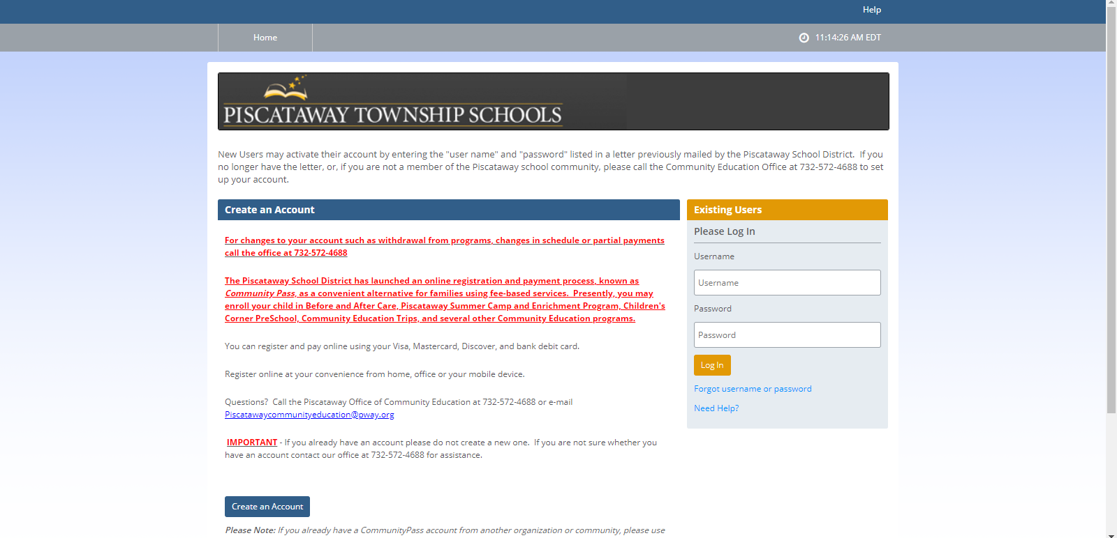
How to Apply
Visit the www.ccprek.com
Click on “Registration” then the “Register Now” link. This will take you to the Community Pass Online Registration homepage.
Existing Families: Children attending Piscataway Schools
New Families use “Create Account” on the bottom of the screen

Slide 8
Community Pass
Choose “Browse Activities”

Slide 9
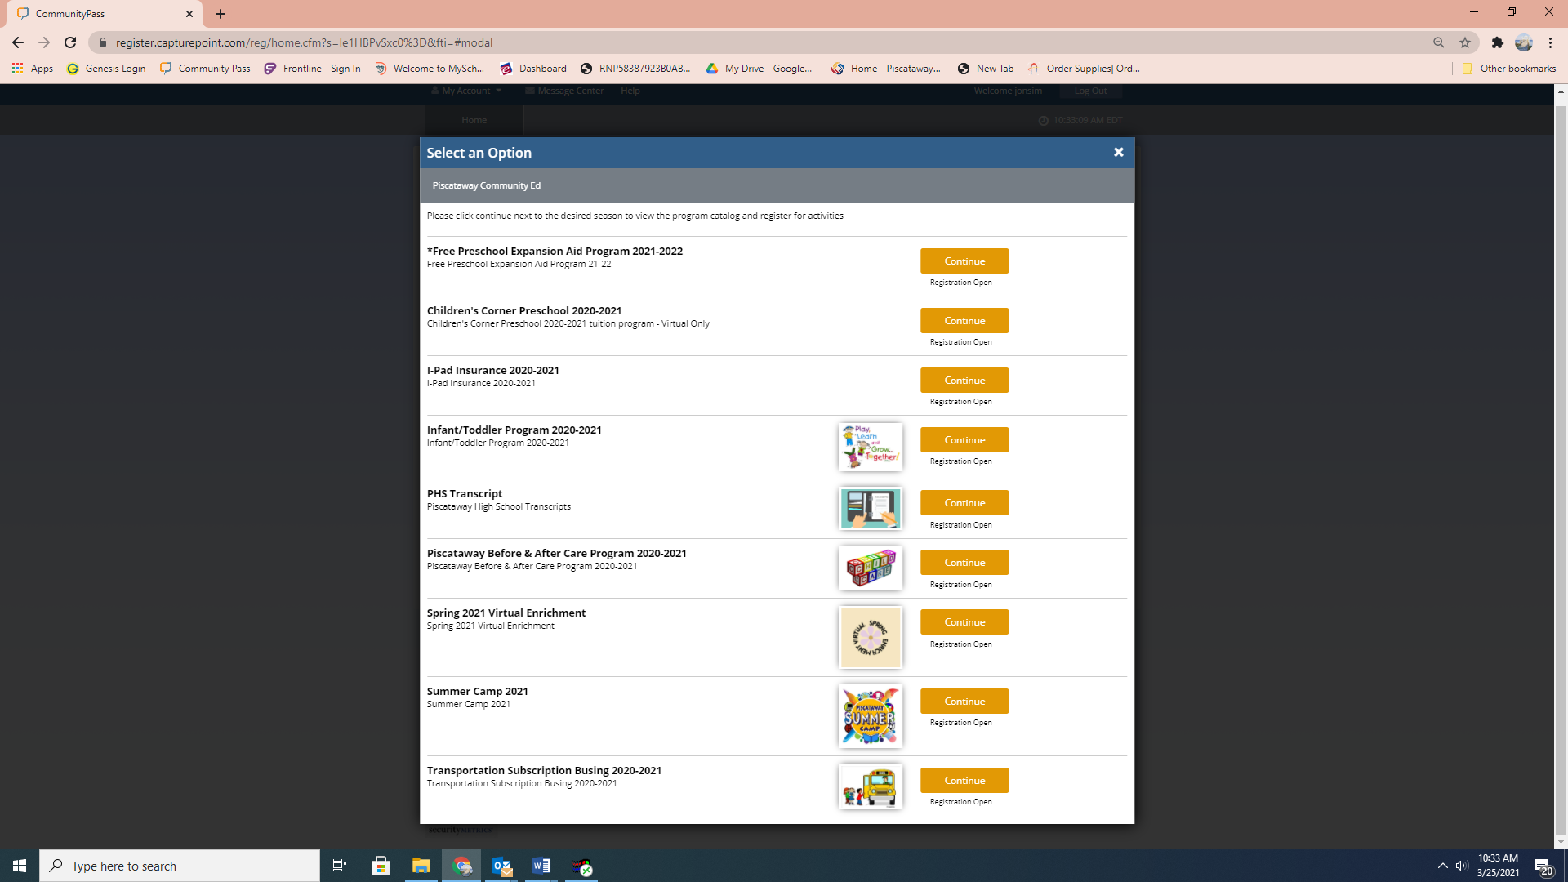
Application Cont.

Slide 10
Application Cont.
Verify your email address and click continue

Slide 11
Application
Select the Participants (child) that you wish to complete an application for the free preschool program. Press continue

Slide 12
Check the box for the *Free Preschool Expansion Aid Program 2019-2020 and press continue

Slide 13
Complete all information.
Every box must have the information typed into it.
This will include:
Language, Contact Information, Allergies, etc.

Slide 14
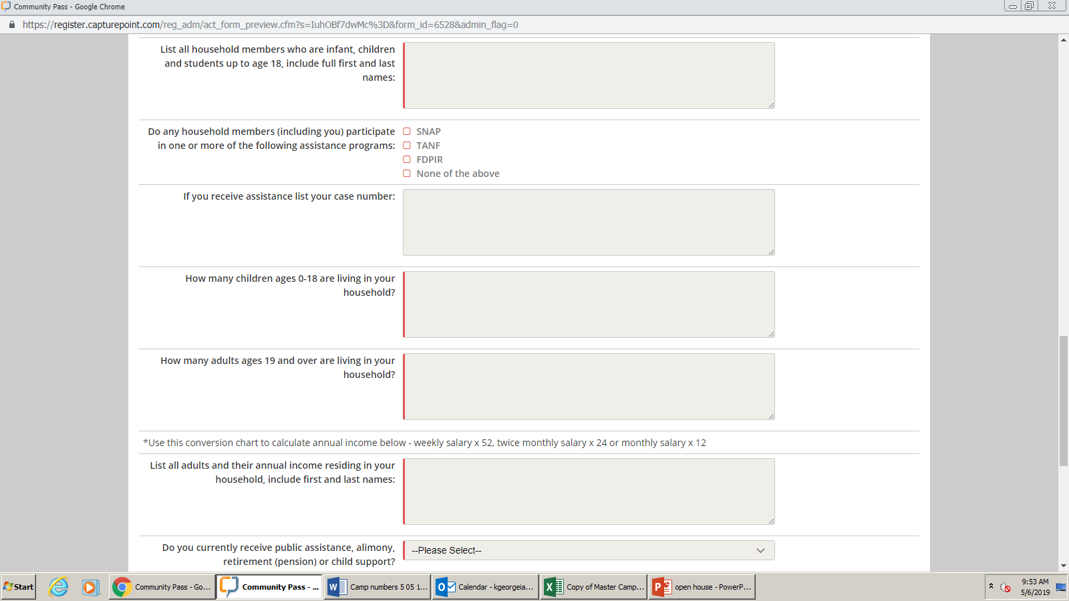
Important Part of the Application
List all children(first and last name) in the household ages 0-18.
Does anyone receive benefits from SNAP, TANF, or other programs? Check the appropriate box.
If you checked any of the first three boxes, please indicate your case number in the box provided.
Indicate the number of children living in your household.(This should match the number of names listed above).
Indicate the number of adults that are living in your household (this should include all).
List all adults(first and last name) living in your household and their annual income. *Use conversion chart if needed.*
Do you receive public assistance, alimony, child support, or retirement pension?
List the monthly income from the above question.
List the total number of people, children and adults, living in your household.

Slide 15
Questions
All financial questions must be answered.
There are a percentage of seats for families that financially qualify and a percentage of seats for all families.
A lottery will take place if more applications are received than available seats.
If your application is accepted, you will need to provide documentation for the financial information as well as residency.
Deadline: April 23, 2021

Slide 16
General Information
Eligibility criteria is set by the United States Department of Agriculture.
The Piscataway Township School District processes applications based on the eligibility guidelines, because of this we are unable to change or modify any rules when making a decision on your application.
Notes:
Will be reviewing F/R Lunch Application which is the basis for determining eligibility in Grant Funded Preschool program
Whether eligible or not is based on guidelines set by USDA
Pway processes app based on such criteria

Slide 17
INCOME APPLICATIONS
Income Eligibility based on:
Household size
Household income
ALL age-eligible Piscataway families are encouraged to apply
regardless of income!
Notes:
Eligibility for F/R lunch is based on HH size and HH income

Slide 18
REPORTABLE INCOME
Income from work
Public assistance, child support, alimony
Pensions, retirements, Social Security, Veteran’s benefits
All other income including unemployment and disability

Slide 19
**IMPORTANT NOTE**
Completion of this 2020-2021 Application for Free and Reduced Price School Meals is ONLY to determine eligibility for the 2021-2022 Grant Funded Preschool Program.
You must complete a new
2021-2022 Application for Free and Reduced Price School Meals by September 30, 2021
to determine eligibility for the Free and Reduced Lunch Program for the 2021-2022 School year.

