Slide 1
League of Women Voters
Central Yavapai County
“Election Information You Need - Your Voice, Your Vote”
E: VOTE411October 9 forum cms FINAL
Notes:
Presentation given at general public forum by LWVCYC on Saturday, October 9, 2021

Slide 2
Education Fund and VOTE411
1957, Education Fund established. The Ed Fund is a separate organization for voter registration and information to encourage the active and informed participation of citizens in government and increase understanding of major public policy issues. The Ed Fund is a 501 (c)(3).
Early 1990’s, LWVUS established a dedicated website for voter information.
2006, VOTE411.org website was established as a “one-stop-shop” for election related information. Today, VOTE411 provides both general and state-specific nonpartisan resources for the voting public.

Slide 3
VOTE411.org Wins Webby People’s Voice Award Best Government & Civil Innovation Website
May 19, 2020 – The League of Women Voters Education Fund announced VOTE411.org, its “one-stop-shop” for election information, has been named Best Government & Civil Innovation Website in the 24th Annual Webby People’s Voice Awards.
The Webby Awards, presented by the International Academy of Digital Arts and Sciences, is the leading international awards organization honoring excellence on the Internet.
“VOTE411 has set the standard for innovation and creativity on the Internet,” said Claire Graves, Executive Director of The Webby Awards. “This award is a testament to the skill, ingenuity, and vision of its creators.

Slide 4
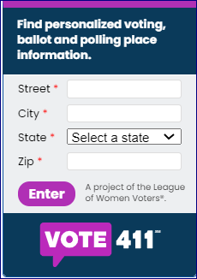
What is it?
LWVUS Web Portal for providing digital voter guides https://www.vote411.org
Voters can find information on elections, candidates, ballot measures, links to register to vote, and verify your registration
Who provides information?
State and local leagues decide the information to include on this portal, the National League reviews all material
Candidates provide information in response to league’s questionnaires
Leagues provide recorded candidate forums, debates, and town halls
Who can access VOTE411?
It is a public website, open to everyone
How is it accessed?
Use a computer, mobile device; accessible through all social media platforms
Local leagues can use QR code or widget to add to website, social media posts, newsletters, and emails
Central to voter registration, education, mobilization, and protection.

Slide 5
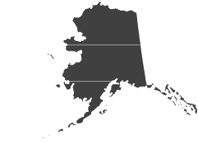
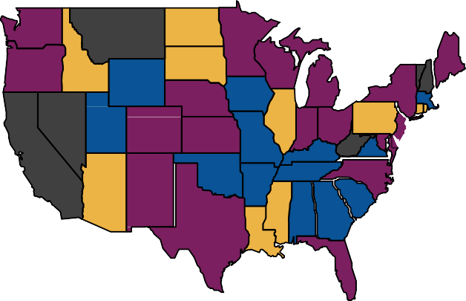
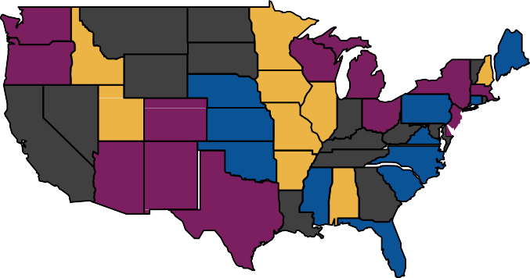
League Participation VOTE 411 Voter Guide Program
2020
Key:
1-2 local Leagues
Many Local Leagues
Entire State
No Leagues
2021 (to date)

Slide 6
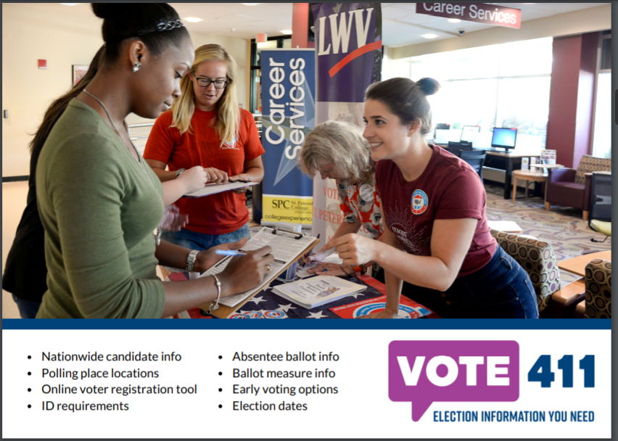
BENCHMARK - BY THE NUMBERS
2020
Served 6.1 million users
Launched Spanish website
VOTE411.org/es
450+ Leagues from 44 states
Detailed candidate information on 41,000 candidates
Candidates from 23,000 races
AZ site had ≈ 58K visitors
2021 (to date)
300+ Leagues from 31 states
Served 435,000 users
Launching new features!

Slide 7
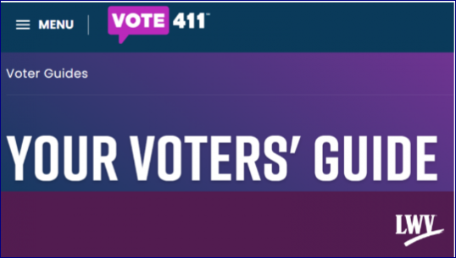
State & Local Elections and Why They Matter
State and local elections impact our daily lives in countless ways that our national elections never could, including
Directly control the budgets and policies that are key to our quality of life
Determining how much funding our schools receive
Whether we invest in employment programs
Law enforcement budgets & how we handle police conduct
Funding and maintenance of infrastructure, including roads, bridges, water systems
Funding and maintenance of cultural & community institutions like
libraries & parks
One major reason for notoriously low voter turnout for local and state elections
People don't have enough information or easy access to trusted sources
According to a study by the National Civic League, "lower turnout is frequently a result of a lack of awareness of the candidates and issues."
“Election Information You Need - Your Voice, Your Vote”

Slide 8
Licensing VOTE411
To ensure that all local leagues can participate LWVAZ purchased statewide licenses through 2023
The statewide license allows
Posting information for all Federal, state and local elections (candidates, ballot measures and key voting information) in Arizona
Ensures that all local leagues can participate without funding constraints

Slide 9
State Advocacy Committee and LWVCYC Work Together “Speaking with One Voice”
LWVAZ VOTE411 team will organize the content and uploading of information for Federal and statewide races, ballot initiatives and statewide elections information
Provide elections information from secure sites and Clean Elections Commission
LWVCYC, with guidance from state, will research local jurisdiction elections, e.g., county, city, town, special districts, school boards, others as determined by the local league
Provide election information from trusted sources
Countywide and other local elections are at the discretion of the local league
Uniformity and consistency of approach, adherence to all guidelines and protocols are critical to ensure that we are speaking with one voice
All communication with candidates is delivered through the VOTE411 portal

Slide 10
Organizing for Vote411
LWVCYC and LWVAZ
Identify trusted sources for election information, Ex: Clean Elections and Service Arizona
Develop race-specific questionnaires for candidates
To ensure questions are nonpartisan, must be approved by LWVAZ & LWVUS
Prepare analysis and information for statewide ballot measures
Update LWVCYC.org directory of local election officials
Identify and obtain other digital media that would expand education of voters, e.g., videos of LWVCYC sponsored or hosted forums, debates
Document all procedures, cite all sources

Slide 11
Organizing for Vote411 – LWVCYC Team
Candidate follow-up by local VOTE411 Team
Team members contact the candidates who have not completed the questionnaire
Critical to ensure that voters have all the information they need to make informed choices
Note: the League does not make changes to candidate responses

Slide 12
City of Prescott General Election
Election 2021 Timeline
Mon., October 4 – last day to register to vote
Wed., October 6 – in-person voting begins
Wed., October 6 – ballots mailed
Fri., October 22 – last day to request and be mailed a ballot
Tues., November 2 – last day to vote in-person
Tuesday - November 2 – Election
https://www.azcleanelections.gov/voting

Slide 14
What Questions do You have?

Slide 15
LWV Central Yavapai County
Thank You to our team:
Joyce Haas, Vivian Perry, Deb Dillon, Judy Kelch,
Bobbi Boyd, Cory Shaw, Bonnie McMinn, Greg Stein
“Election Information You Need - Your Voice, Your Vote”

Slide 16
League of Women Voters
Central Yavapai County
“Election Information You Need - Your Voice, Your Vote”

