Slide 1

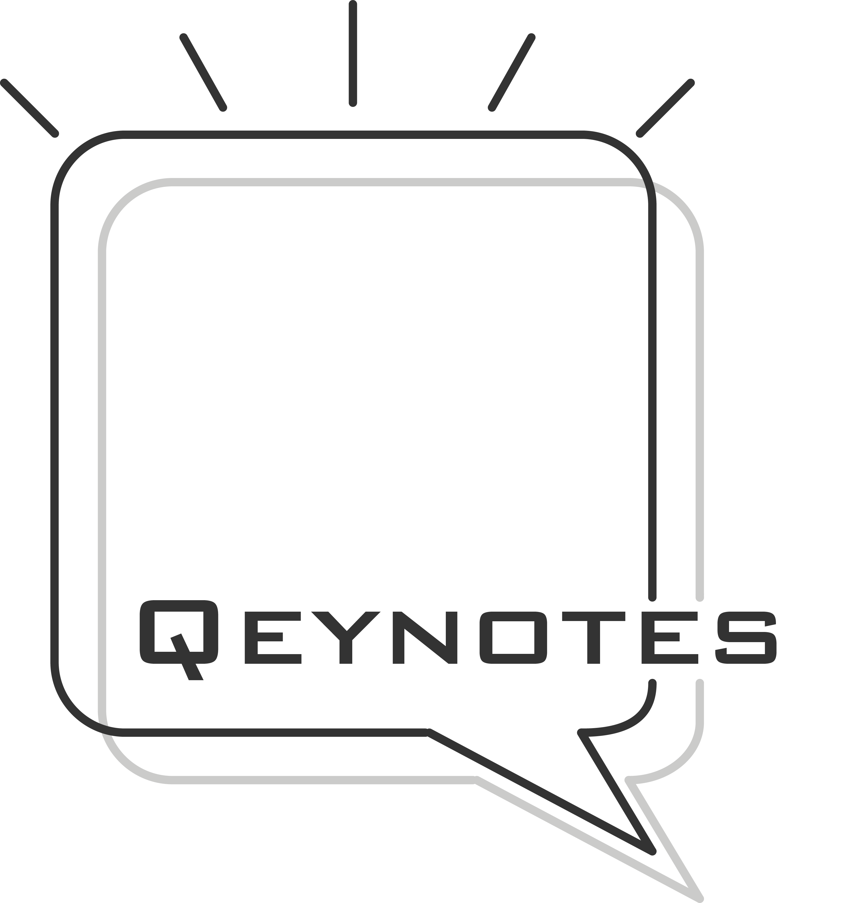
Learning library 2026
Be the Better Best

Slide 2

At Qeynotes, we believe that learning is not an event, but a continuous journey of growth. Founded with a passion for people development, we partner with organizations to unlock the full potential of their talent—empowering individuals to perform at their best and contribute meaningfully to business success.
Our vision is simple yet powerful: to help everyone be their best at work. Through thoughtfully designed workshops, Qeynotes inspires professionals to embrace a growth mindset and pursue continuous improvement.
Guided by our tagline “Be the Better Best,” we are committed to creating learning that transforms perspectives, strengthens capability, and builds a culture where growth, connection, and excellence thrive.
About Qeynotes

Slide 3


Our Solutions
  Personal Development
  Leadership Development
  Team Development
1 / 5

Slide 4

Personal Development
Embracing Change with Growth Mindset
In times of constant transformation, mindset shapes how we adapt and thrive. This course helps participants understand the principles of a growth mindset and apply them to navigate personal and organizational change.
Through exploring the change curve, learners will discover practical actions to take at each stage—turning uncertainty into opportunity and developing the resilience needed to grow through change.
This series is designed to develop interpersonal skills and self-competent.
Suitable for High Potential talents or individuals who needs to enhance personal competency for job efficiency.
Professional Workplace Communication
Strong communication is the foundation of effective leadership at every level. This course helps participants develop clarity, structure, and empathy in their business communication to enhance influence and collaboration.
By understanding how to craft messages that connect and motivate, learners will strengthen their ability to lead conversations, build trust, and create positive impact across the workplace.
From Order Takers to Trusted Advisors
Strong relationships are built on trust, understanding, and genuine care for our clients—both internal and external. This course invites participants to adopt a client-centric mindset that goes beyond service to true partnership.
Through exploring how to listen actively, understand evolving needs, and communicate with empathy, learners will discover how to build meaningful connections that create long-term value for both clients and the organization.
2 / 5

Slide 5
Personal Development (cont.)
Influencing Without Authority
True influence stems from mindset, credibility, and connection—not just position or title. This course helps participants develop the confidence and techniques to lead through influence across all levels of the organization.
By leveraging personal power, understanding others’ motivations, and applying practical strategies, learners will discover how to gain trust, build alignment, and drive positive outcomes without formal authority.
This series is designed to develop interpersonal skills and self-competent.
Suitable for High Potential talents or individuals who needs to enhance personal competency for job efficiency.
Personal Branding
Your personal brand is a key driver of career success. This course guides participants to understand how their strengths, values, and actions shape the way they are perceived in the workplace.
By aligning their brand with professional aspirations and learning practical strategies to build visibility and credibility, learners will be equipped to take ownership of their career growth and confidently position themselves for future opportunities.
Confident Voices at Every Level
Business presentation is a vital professional skill that builds credibility and influence. This course helps participants strengthen their speaking ability through practical techniques in energy control, voice modulation, sentence refinement, and non-verbal communication.
By applying storytelling methods, learners will learn to structure their messages clearly, engage their audience with confidence, and deliver presentations that convey clarity and professionalism.
3 / 5

Slide 6

Leadership Development
Core Skills for Modern Managers
This series is designed to help managers to equipped with the core skills that drives performance for results
Suitable for new managers or experienced leaders who wants to refresh their managerial skills
Effective management begins with mastering the fundamentals. This all-rounded program provides new and experienced managers with the essential knowledge and practical skills needed to lead across every stage of the employee journey—from onboarding and performance development to engagement and growth.
Participants will strengthen their ability to guide teams, make informed decisions, and create a positive, high-performing workplace culture.
From Manager to Performance Coach
High-performing teams grow under leaders who coach with clarity and care. This course helps managers adapt a growth mindset and apply practical skills to elevate performance through constructive feedback and effective coaching conversations.
Participants will learn how to guide improvement without damaging relationships, foster accountability, and adopt a growth-oriented leadership style that unlocks potential and drives sustained excellence.
Courageous Conversations for Growth
Addressing low performance is one of the most challenging yet crucial responsibilities of a manager. This course equips leaders with a step-by-step framework to conduct difficult conversations with confidence, empathy, and structure.
Participants will learn how to address issues constructively, manage emotions, and guide discussions toward clear agreements, solutions, and accountability—turning tough moments into opportunities for growth and performance improvement.
4 / 5

Slide 7

Team Development
The Power of Personality: Unlocking Team Synergy with MBTI®
These workshops uses the most popular psychometric tools as a mean to help team develop stronger collaboration and cohesiveness.
Suitable for remote teams, newly formed teams, or newly onboarded leaders who wants to understand the team and build rapport quickly
Great teamwork begins with understanding and celebrating differences. In this dynamic and interactive workshop, participants will explore their unique MBTI personality types and learn how these differences shape communication, collaboration, and decision-making.
Through engaging activities and reflections, teams will build stronger trust, enhance mutual understanding, and create a more cohesive and supportive work environment—laying the foundation for lasting team success.
Connecting Through Differences: The DiSC® way
Effective communication is the key to building strong teams and lasting partnerships. This interactive workshop uses the DiSC framework to help participants recognize their own communication style and understand how to adapt to others.
Through practical tools, group exercises, and real workplace applications, learners will develop strategies to tailor their approach, enhance collaboration, and communicate more effectively with diverse colleagues and stakeholders.
5 / 5

Slide 8
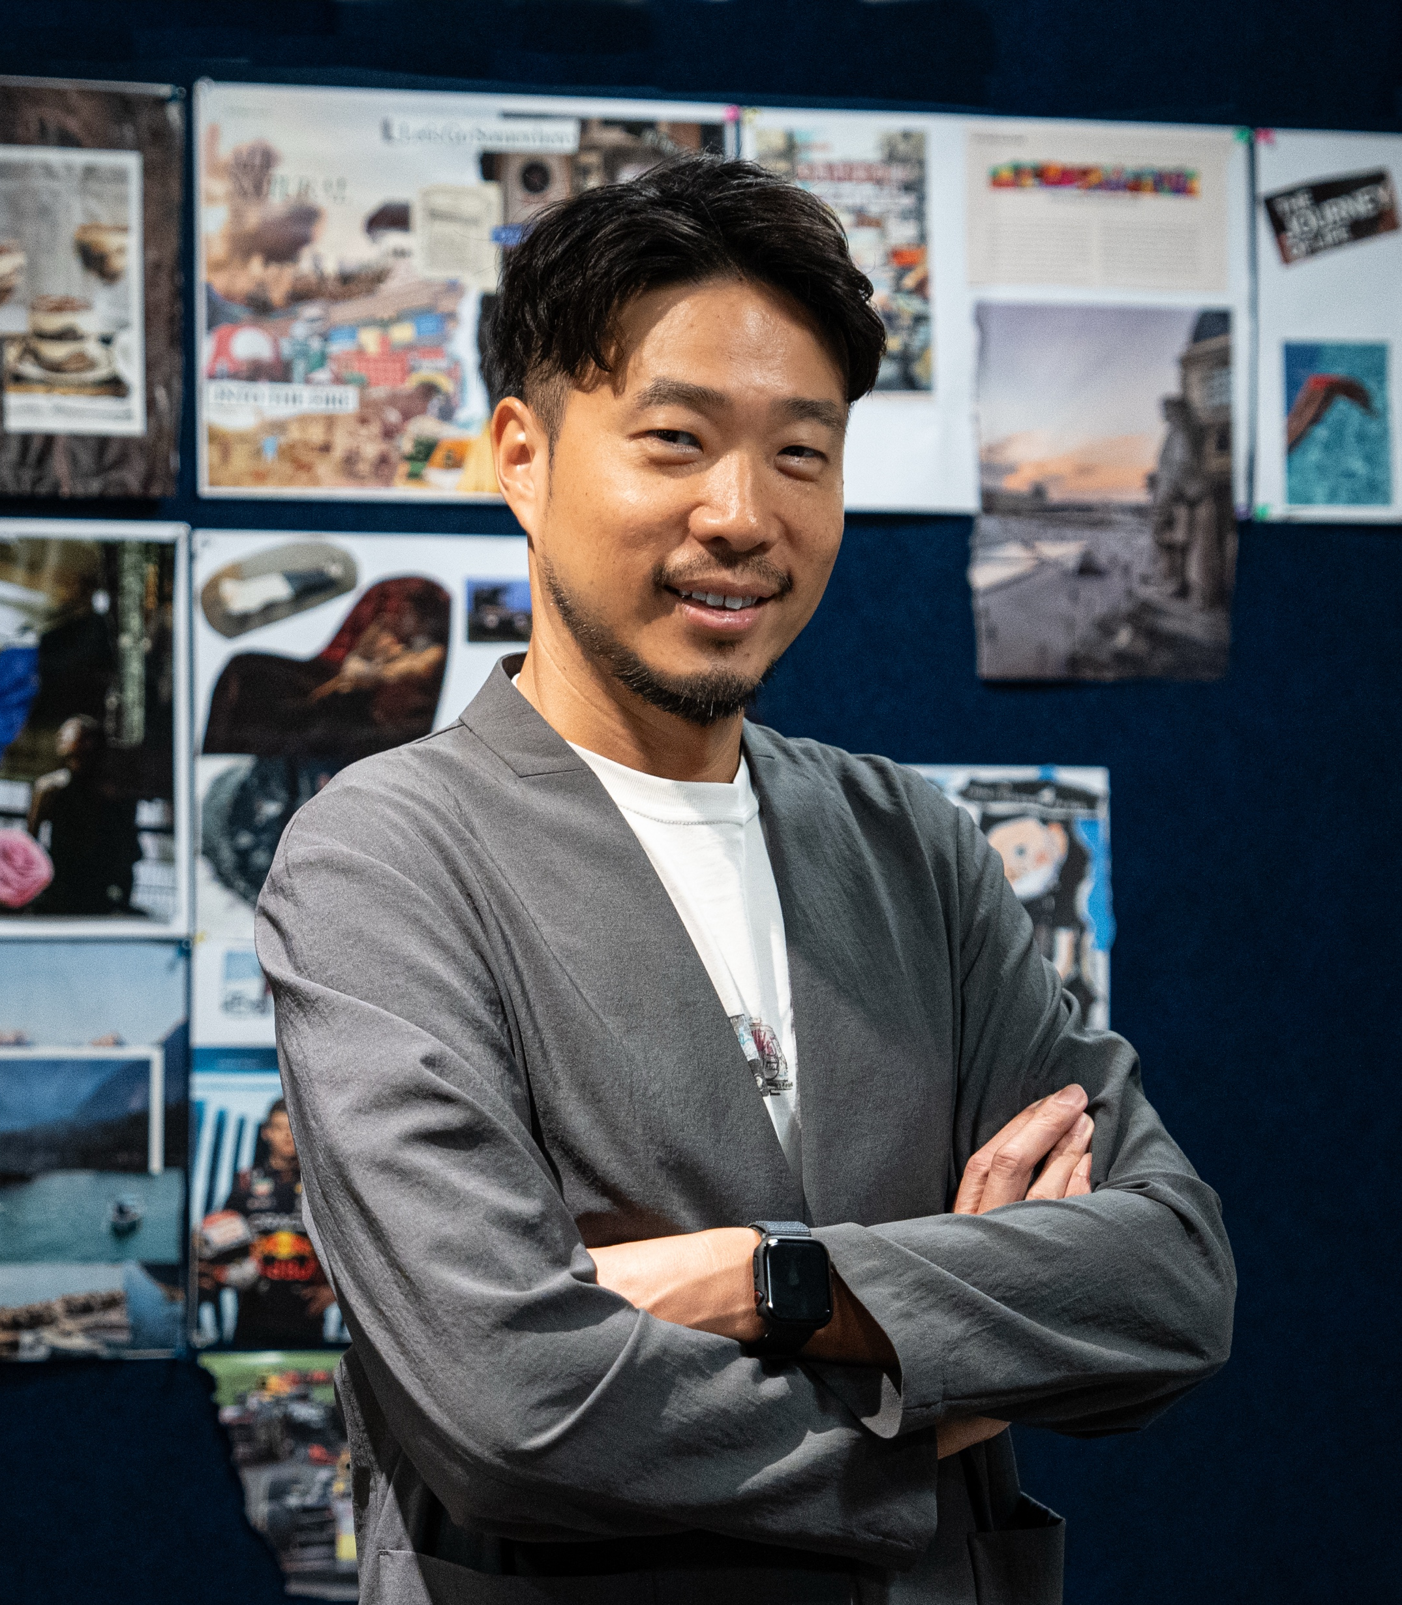
Jack Ho, Chief Consultant
Jack is a seasoned learning and development leader with a career spanning aviation, the public sector, and global banking. He has held key HR leadership roles, including Training Specialist at Cathay Pacific, Vice President of Learning and Development at DBS Bank, and Regional Head of Learning and Development at a global investment bank.
Grounded in psychology and driven by a passion for human connection, Jack believes empathy and communication are the foundations of effective leadership. He inspires professionals to develop social competence and influence—empowering them to connect authentically, lead confidently, and achieve lasting impact in the workplace.
Education and qualifications:
Bachelor of Psychology, University of British Columbia
Master in Management, University Collage Dublin
Certified Organizational Coach
Certified Behavior Consultant with DiSC®
Certified in MBTI® with Myers-Briggs
Certified Mindfulness Coach

Slide 9





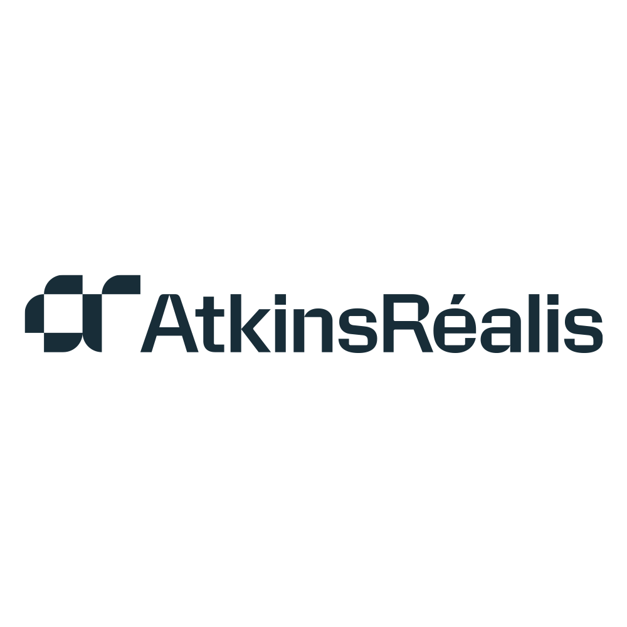






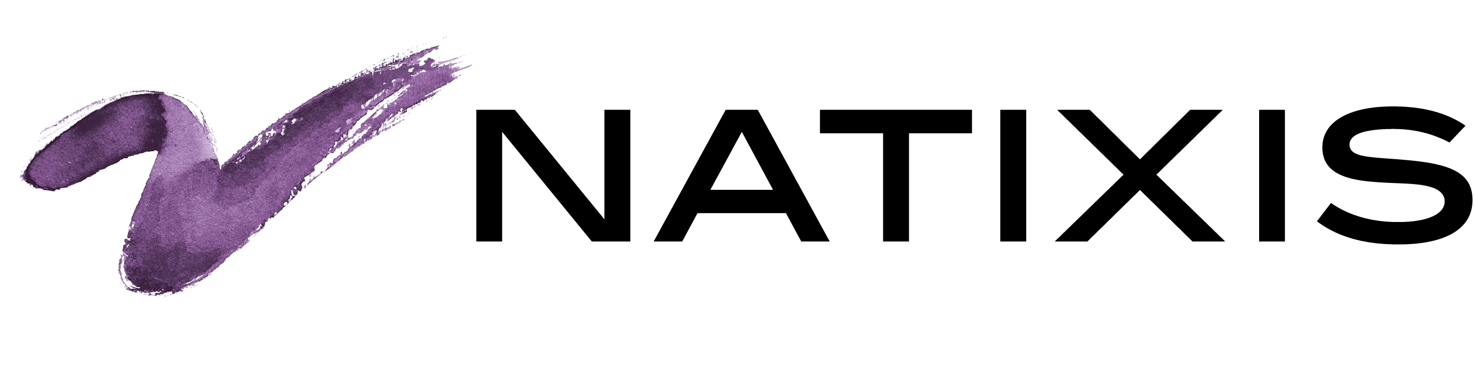











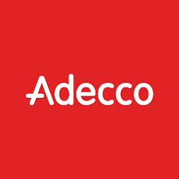









Trusted clients and past working experiences

Slide 10



Contact us
WhatsApp
94489049
Email
hello@qeynotes.com
Website
www.qeynotes.com

