Slide 1

DIAMOND HUSTLERS

Slide 2
Agenda
Meet Your Leader
About our Company
Compensation Plan
Support
First Steps
Confidence Delivery thru Consistency and Content
Resources

Slide 3
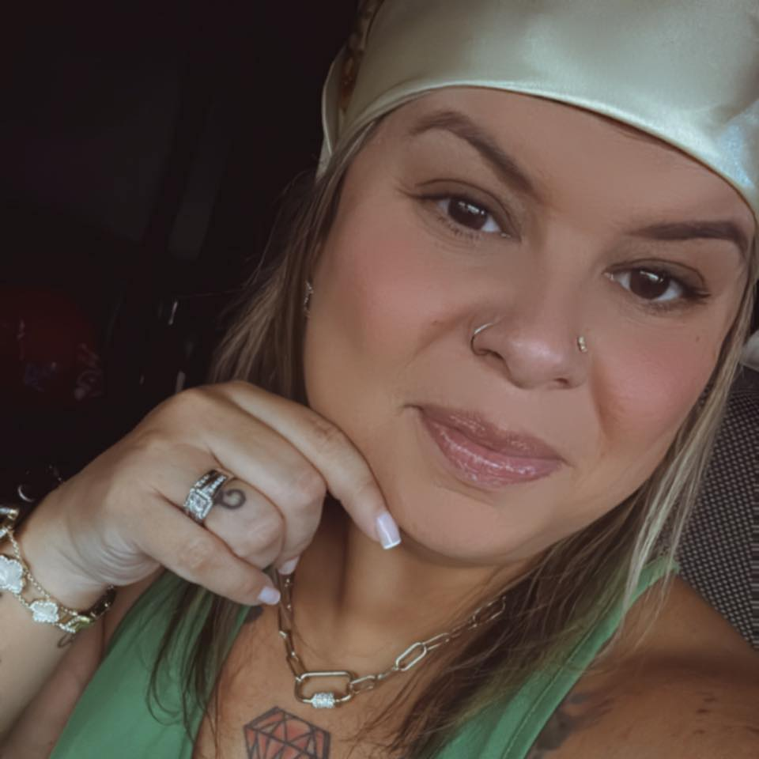
About your leader *10 years in network marketing *Mom of 3,Wife and small business owner *Leading teams since 1999 *My Passion I love to work with others to build confidence. Empowering and encouraging others to believe in them to create their success.

Slide 4

About the company
Mission, Compensation Plan, Resources

Slide 5
Mission
Transform people’s lives with products that provide wellness and economic empowerment.
Vision
Become the #1 direct-selling cosmetics company by 025. Achieve this goal by committing to the honest principles of our founder , Dr.. C. Tuna.

Slide 6
Compensation Plan
How you get paid, including bonuses.

Slide 7
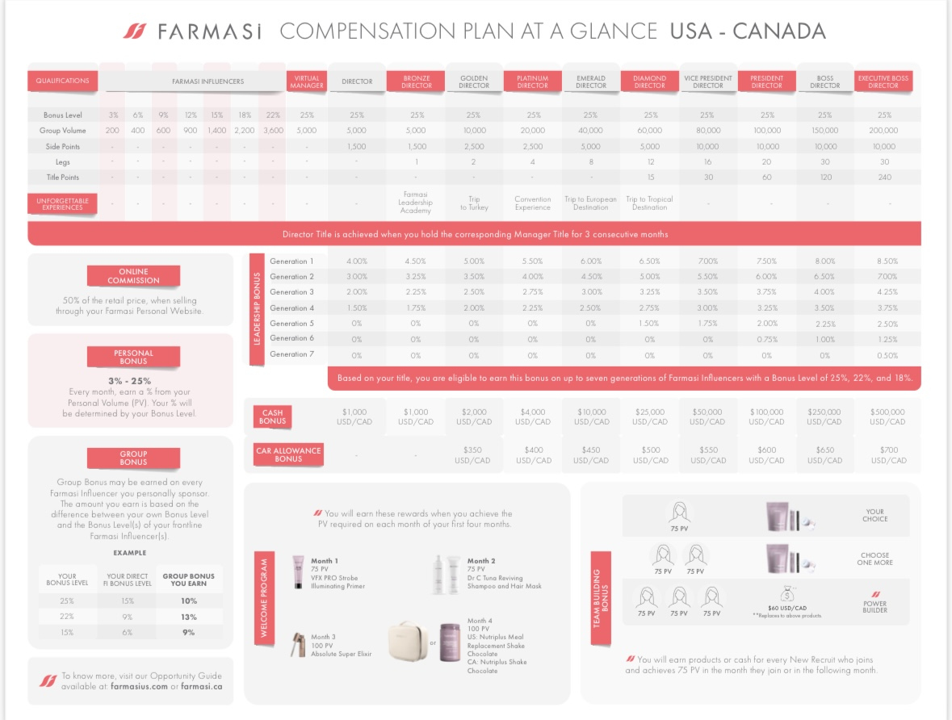
Compensation Plan
Additional info found : https://millionairemasterytraining.com/us%2Fcan-comp-plan

Slide 8
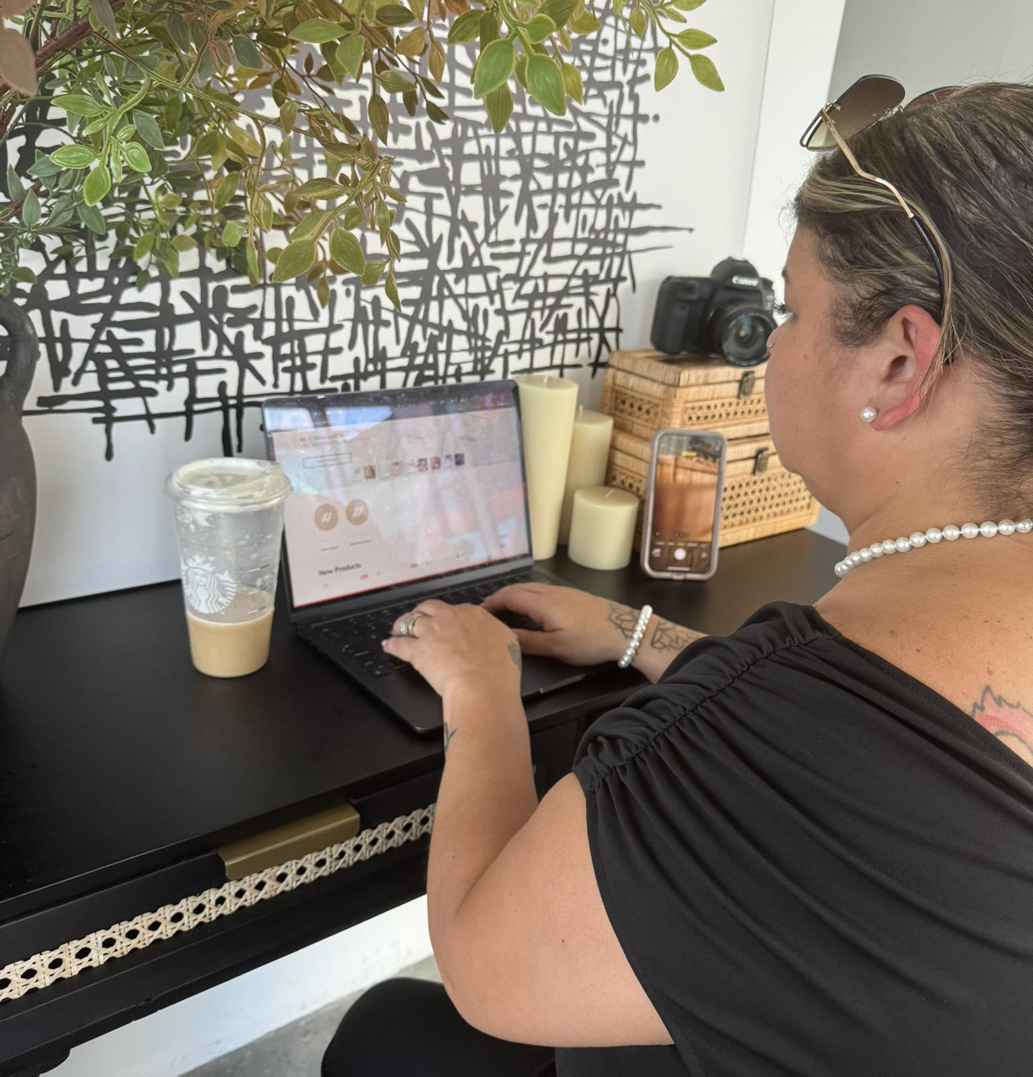
Support
💫 Welcome to the Team! We’re so excited to have you on board! You're not in this alone — we're here to guide you every step of the way.
Here’s the Support You’ll Receive:
✅ 1:1 Onboarding Support You’ll get personal guidance during your first few days so you know exactly where to start and what to focus on.
🗓️ Weekly Check-Ins We’ll meet regularly to answer questions, celebrate your wins, and help you move forward confidently
.📚 Training Library Access You'll have 24/7 access to resources, videos, and step-by-step guides to help you grow at your own pace.
💬 Team Chat Group Instant support from me and your teammates! Ask questions, share successes, or just get some motivation.
🚀 Goal Planning + Strategy Help Whether you want part-time earnings or to build a full-time income, we’ll map out a custom plan to fit your goals.
🌟 Recognition + Incentives You’ll be celebrated for your achievements and have the chance to earn fun rewards along the way! advice, a pep talk, or just someone to brainstorm with — I’m only a message away.

Slide 9
First Steps
Learn about your business. Join the areas in which you find your support team chats and group pages. Find what works best for you.
💌 You’re Never Alone!
Whether you need quick advice, a pep talk, or just someone to brainstorm with — I’m only a message away.
Task | Complete Within
Complete your onboarding checklist 📝 | First 30 days
Join our team group chat 💬 | Immediately
Set your first 30-day goal 🎯 | Immediately

Slide 10

Confident Delivery Through Consistency and being YOU
🔁 Rehearse Often • Build familiarity with your message and your purpose. • Speak naturally — not memorized.
🎯 Refine Your Style • Let your personality shine. • You will attract your audience.
🎤 Perfect the Flow • No one is Perfect be YOU • Time on content matters for views.
✅ Bottom Line: The more you are yourself, the more confident and credible you’ll sound. Show up as YOU and your message will land powerfully.

Slide 11
Resources
Resource | Location | Link
Trainings | Skool App
Corporate Page | Facebook
Team Page | Facebook

Slide 12
Growing Together is what WE do here.
Erika Polaski
352-223-6127

