Slide 1
Rogers Behavioral Health
Dual Diagnosis in Sober Housing
Ashley Podzius, Outreach Representative
Direct: 262.266.0512
Email: ashley.podzius@rogersbh.org

Slide 2
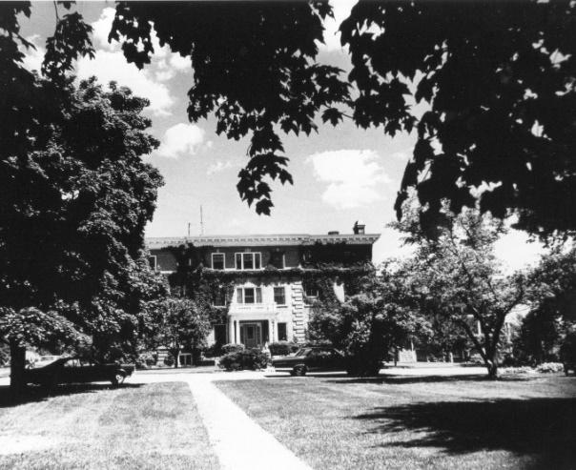
About Rogers: Who We Are
Established in 1907 as Rogers Memorial Hospital, Wisconsin’s largest private, unaffiliated, not-for-profit psychiatric and addiction treatment provider.
Joint Commission accredited.
Evidence-based care delivered by psychiatrists, general medicine physicians, psychologists, therapists and other mental health clinicians.
Offer continuum of care, right intensity of care at the right time:
Inpatient - Residential
Partial Hospitalization - Intensive Outpatient
Supportive Living

Slide 3
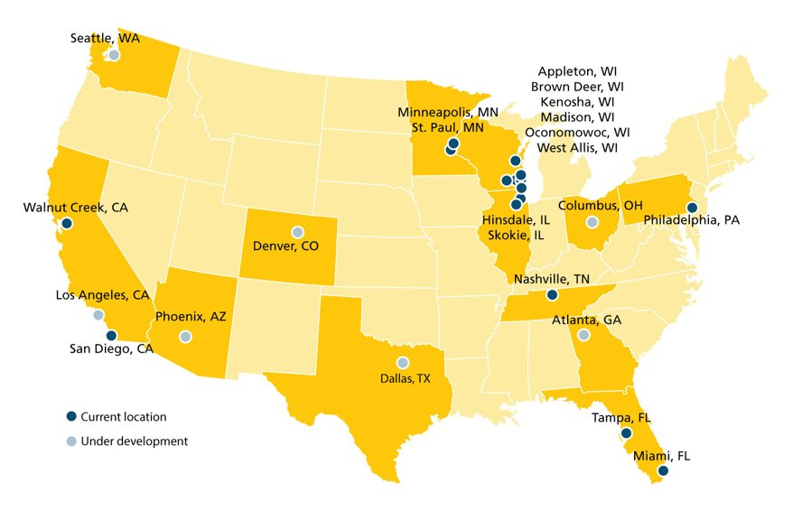
Increasing access to specialized care across the nation

Slide 4
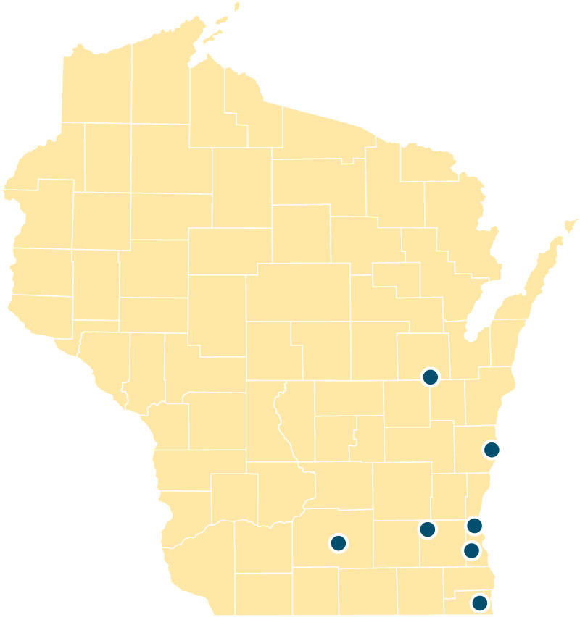
Seven Locations in Wisconsin
Appleton
PHPs and IOPs
Brown Deer
Inpatient hospital
PHPs and IOPs
Kenosha
PHPs and IOPs
Madison
PHPs and IOPs
Oconomowoc
Inpatient hospital
10 residential programs
PHPs and IOPs
West Allis
Inpatient hospital
3 residential programs
PHPs and IOPs
Sheboygan
PHPs
Supportive Living

Slide 5
Dual Diagnosis

Slide 6
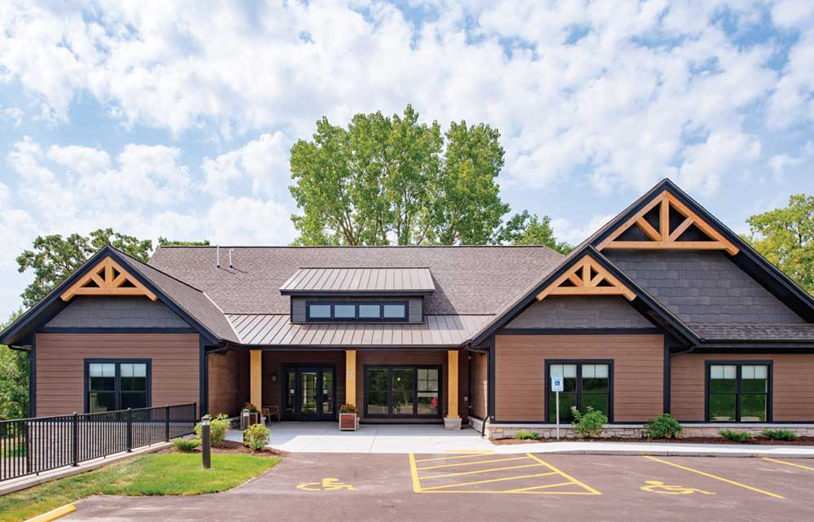
Sheboygan Tour

Slide 7
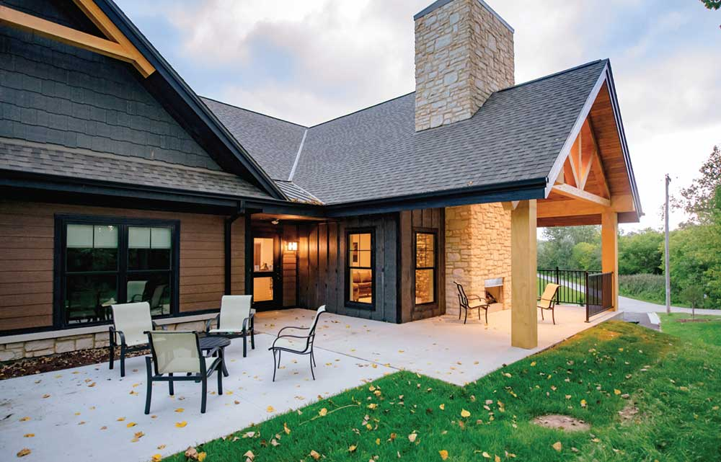
Sheboygan Tour

Slide 8
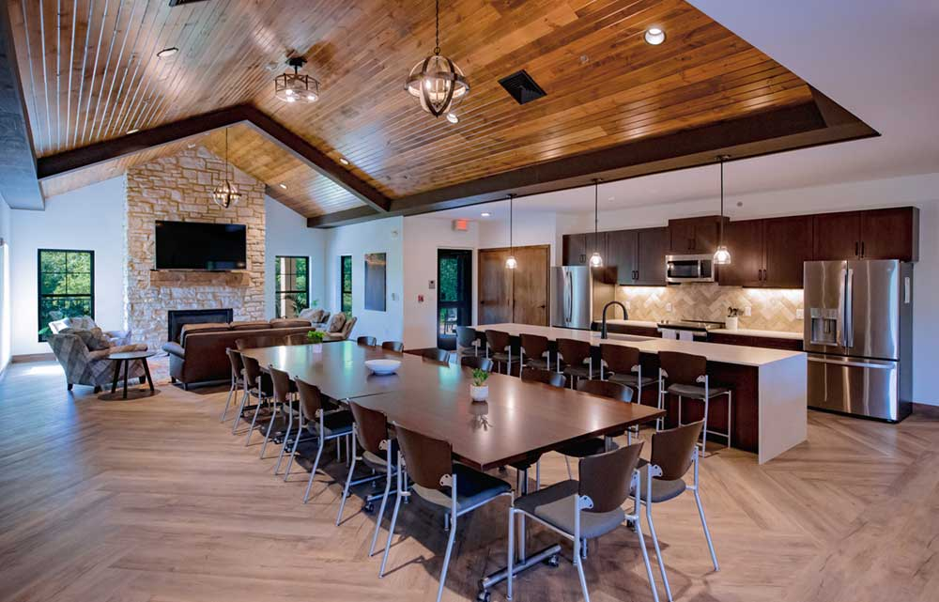
Sheboygan Tour

Slide 9
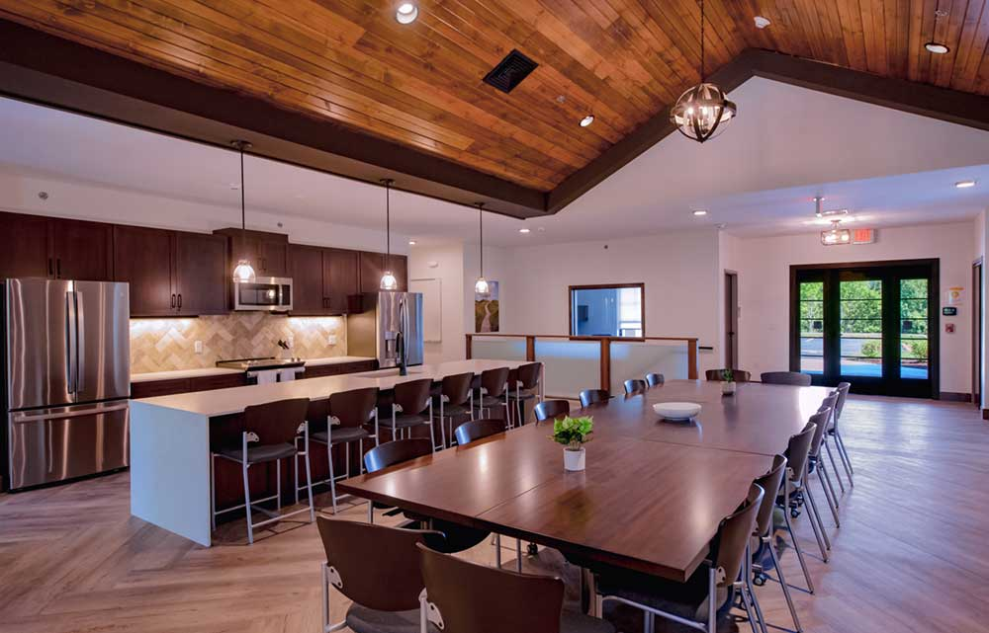
Sheboygan Tour

Slide 10
Sheboygan Tour

Slide 11
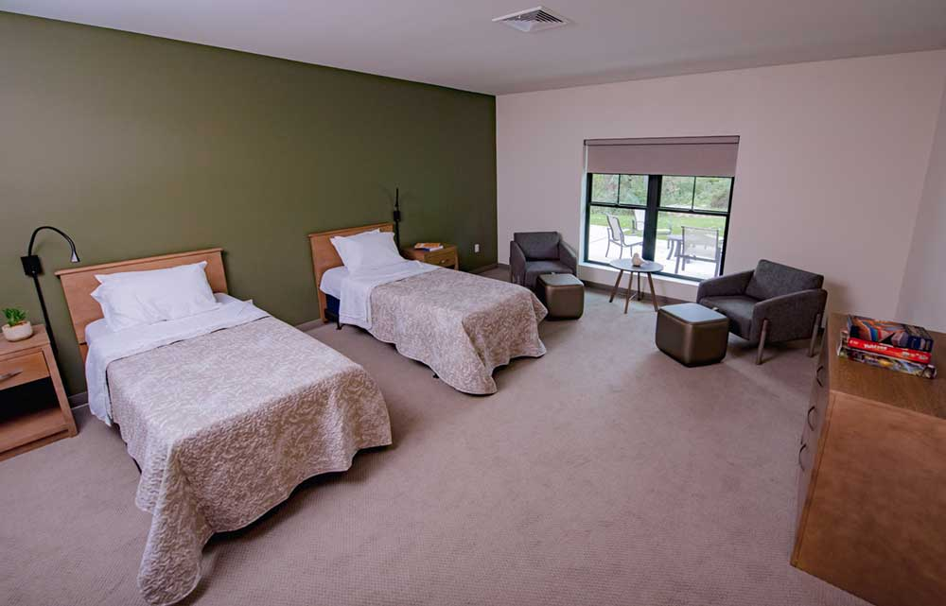
Sheboygan Tour

Slide 12
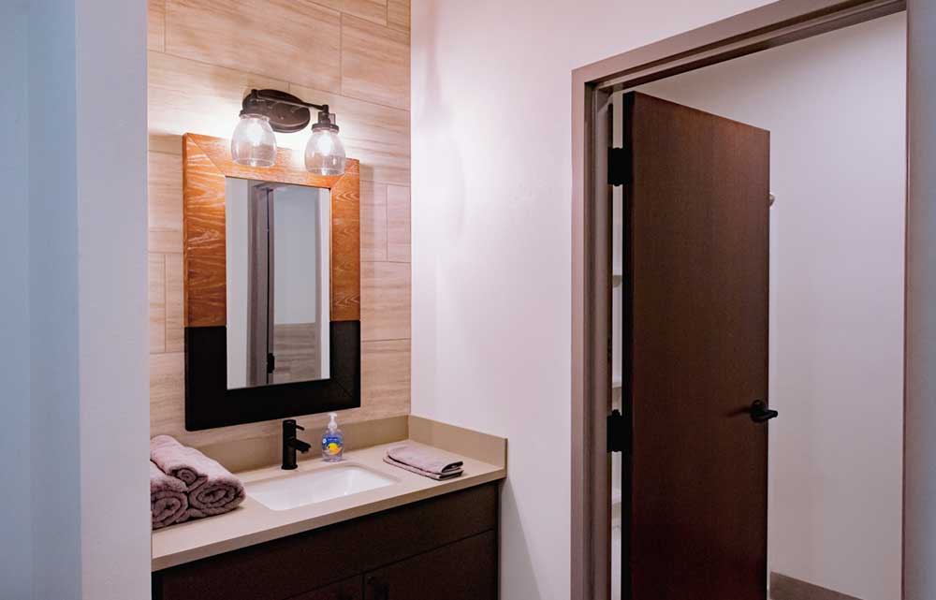
Sheboygan Tour

Slide 13
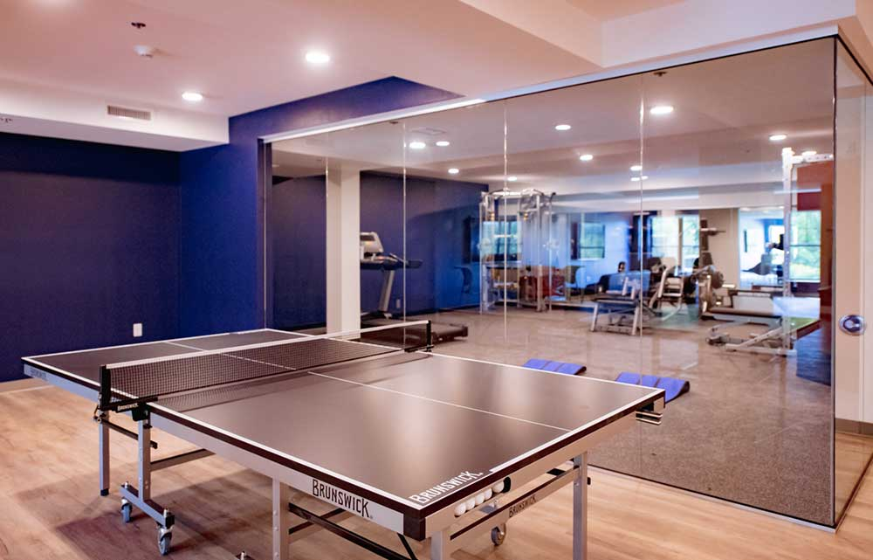
Sheboygan Tour

Slide 14
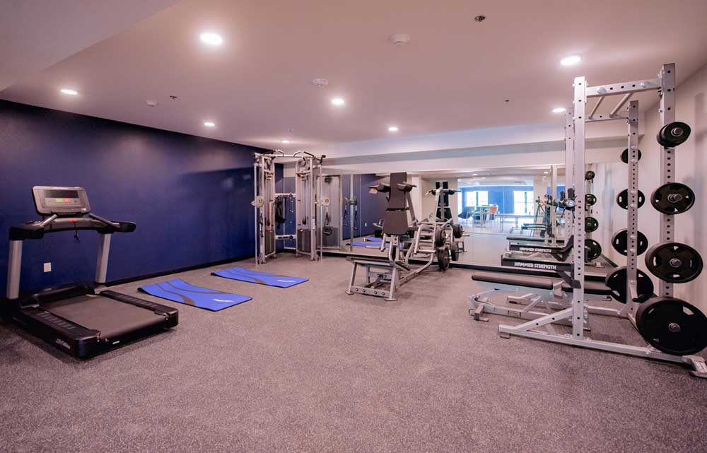
Sheboygan Tour

Slide 15
Sheboygan Tour

Slide 16
What sets us apart
Modern, state of the art, housing environment staffed 24 hours a day 7 days a week
Medication management and on-site Nurse Practitioner at the clinic
Transportation is provided for residents going off site for meetings, errands, etc. (depending on safety level)
Provides a safe space for those in recovery of the following diagnoses:
Depression
OCD
Anxiety
Substance Use
Residents are required, at this time, to program at the Rogers clinic next door to supportive living
Over 25 years of proven, evidenced based date outcomes within the Rogers system.

Slide 17
How do I refer?
Call: 888-927-2203
Admission begins with a phone call, Our staff will connect you and/or your patient with our intake team.
Intake schedules a screening.
Generally take 30 to 45 minutes
Typically over the phone. We ask about: demographic info, insurance, history and current symptoms.
Medical staff reviews screening and within 48 hours makes a program recommendation.
Intake follows up with a recommendation, insurance and deposit information.

Slide 18
Questions?
Ashley Podzius – Outreach Representative
Phone: 262-266-0512
Email: Ashley.Podzius@rogersbh.org

