Slide 1

Standards, Recovery & Quality Improvement
A Working Session to Identify Our Priorities

Slide 2

Who is in the room today?
Tell us a bit about yourself:
http://etc.ch/6S6a

Slide 3
Results
Results link: https://directpoll.com/r?XDbzPBd3ixYqg8eB1WaJCqgkAX1gCNvREgKXwcwd

Slide 4




What do we mean by Quality Improvement?
System Change through Process Improvement:
1. Walk through the process looking for areas that could be improved
2. Brainstorm solutions
3. Pick one process / solution
at a time for testing
Finish

Slide 5
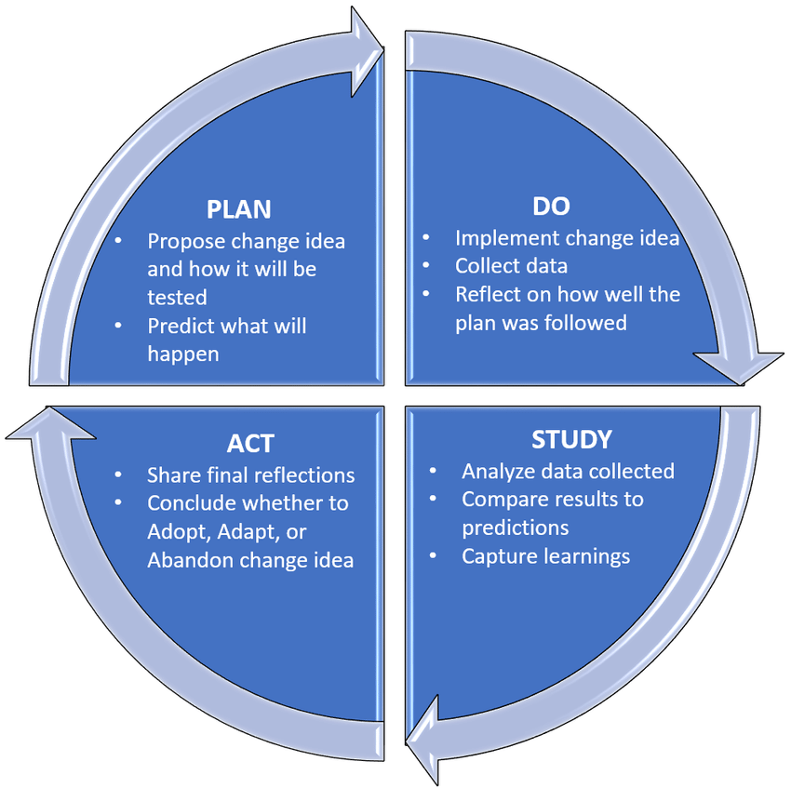
What do we mean by Quality Improvement?

Slide 6
Table Talk Topic #1
What does success look like for your recovery residence?

Slide 7
Table Talk #2
When you think about the definition of success you just discussed, whose definition is that?
What might success look like for different stakeholders?
What stakeholders have you considered and what stakeholders have you left out?

Slide 8

What standards drive success?
Choose 5 standards that you believe most drive success for recovery housing.
Voting Link: http://etc.ch/Lgix

Slide 9
RESULTS https://directpoll.com/r?XDbzPBd3ixYqg8TttPXjSiK7SYWBhsQwjBp2R7R8

Slide 10
Discussion

Slide 11
Study Cohort #1
NEXT STEPS
Create measures
Establish benchmarks
Collect QI data
Share findings
* Apricity
* Lighthouse Recovery (Horizons)
* Next Step (Pres House)
* Opportunity House (SWCAP)
* Our Dwelling Place
* WisHope

