Slide 1

Harvesting the Day

Slide 2
What are you taking away from the day?
Any new ideas?
What have you learned?
Who have you met?

Slide 3
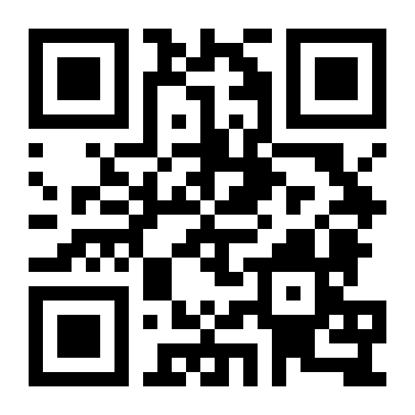
What are you interested in learning more about?
Voting Link: http://etc.ch/Hidy

Slide 4
Engage with us
Consultation
Monthly Advisory Calls
Certification
Join the Recovery & Quality Study

Slide 5
Before you go: we need your feedback

