Slide 1

Leo Club
Informational Meeting
MAY 25, 2023

Slide 2
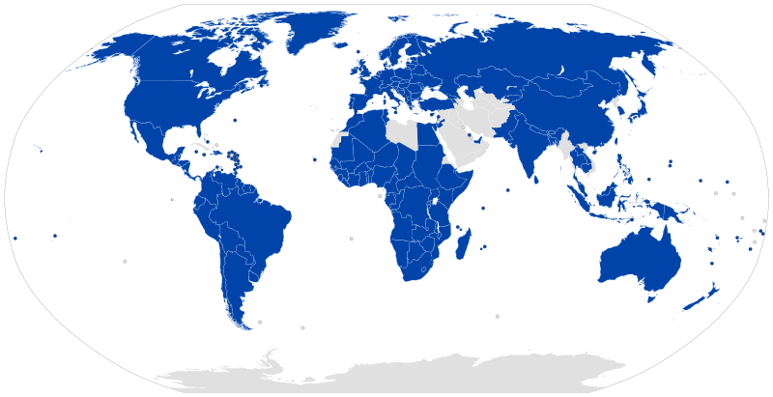
Lions Club International
Lions Club was founded in 1917 in Chicago, IL by Melvin Jones
In 1920 the first Canadian club was founded in Windsor, Canada officially making the Lions an international organization. At that time, the Lions were only active in 23 States with a total of 6,400 Members.

Slide 3
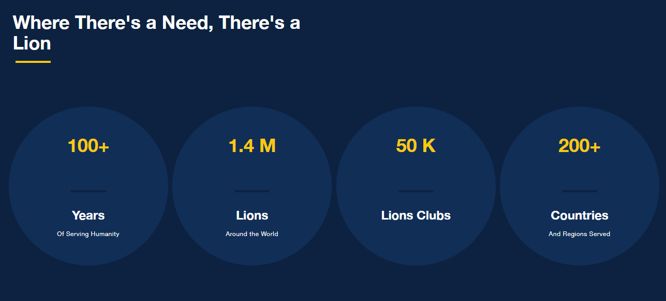
Lions Today
Today there are 1.4 million members around the world in more than 50,000 clubs in in over 200 countries around the world

Slide 4
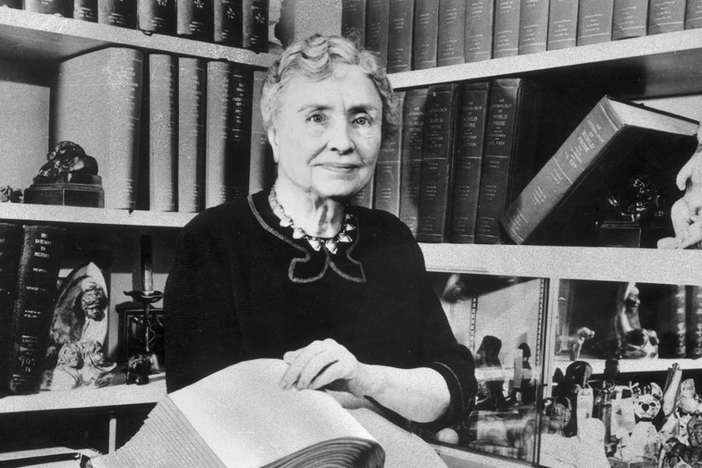
Lions Club International
In 1925 Helen Keller was invited by Lions Club International to speak to a group of Lions.
She challenged the Lions to refer to themselves as “Knights of the Blind” in a crusade against blindness.

Slide 5


Juneau Lions
The Juneau Lions club was founded in 1939 (celebrating 85 years in 2024)
Some of the ways the Lions support the Juneau area:
  Highway Cleanup – On hwy 33 from 26 to Horicon
  Local residents can borrow medical supplies from the Lions for FREE
  Paideia award ceremony highlighting academic and athletic excellence at Dodgeland
  $1000 scholarship awarded annually to a Dodgeland student
  Eye tissue and recovery supply transports for the Lions Eye Bank of Wisconsin

Slide 6
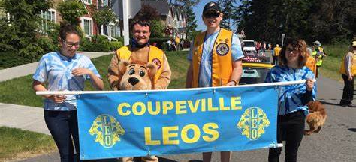
What makes a Leo?
Leadership, Experience, Opportunity
Members of Leo clubs embody the best qualities of our incredible organization. They are devoted young people who realize the power of action.
Together, Leos and Lions form a powerful partnership — one of mutual respect where Lions learn from the innovative insights of Leos, and Leos gain access to the proven strategies from those who’ve successfully served the world for decades.

Slide 7
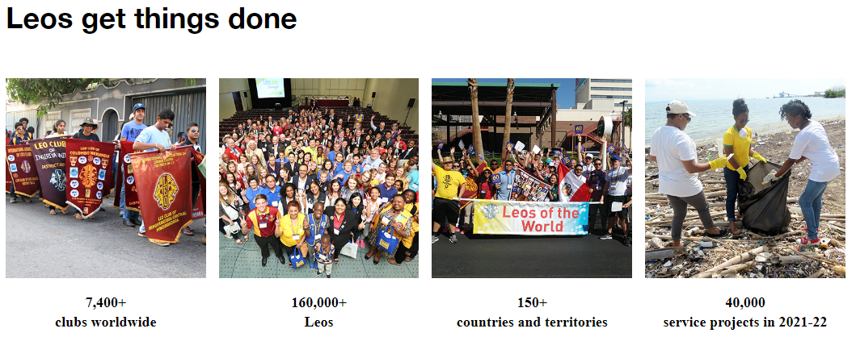

Slide 8

Giving back and assisting others is the basis of community service.

Slide 9


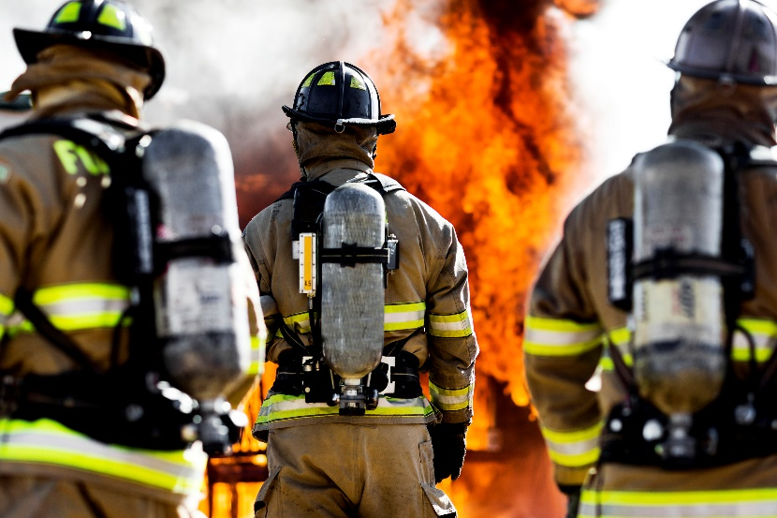
Leadership
Being a Leo can benefit the youth just as much as the community.
Leos will learn to build and improve skills that will be used long after high school graduation.

Slide 10

Leadership
Leos have many opportunities for personal growth and leadership
  Ability to serve as officers in their Leo club, district, and multiple district (state) through peer-based annual elections
  Motivate and lead a group of their peers
  Build self confidence through peer support and experience
  Work as a team to organize, problem solve, and delegate tasks for service projects and fundraisers
  Create an organizational skills toolbox
  Develop public speaking and communication skills
  Exposure to and experience with real-world situations through community service
In addition to advisor guidance, there are in-person Lions Leadership Institutes and online courses through the Lions Learning Center that Leos can access to help build on these skills.

Slide 11
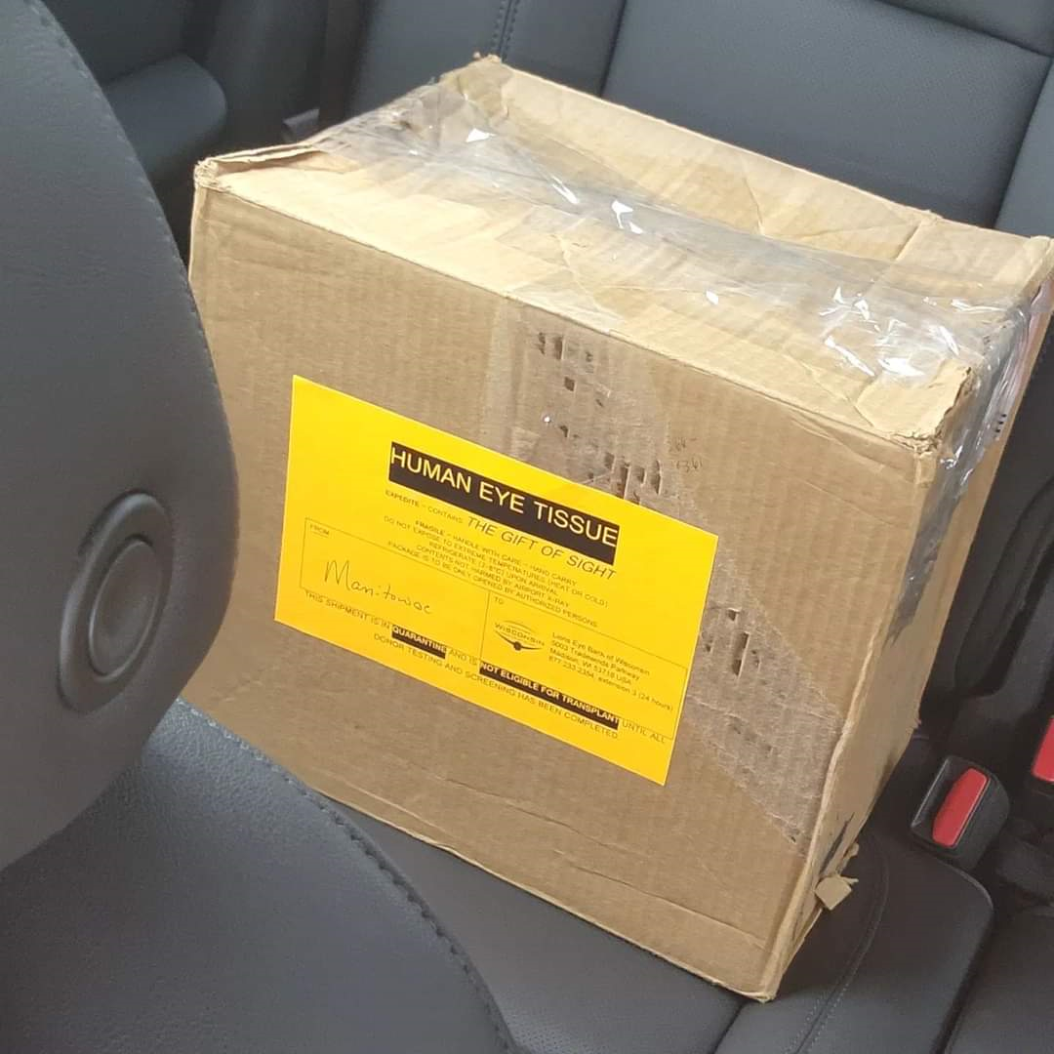
Juneau Lions Leadership in Action
Lion Merlin – Eye Transplant Tissue Transportation Coordinator
  Coordinate pickup
  Communication between Eye Bank dispatcher and transporter
  Dropoff time and location
  Scheduling transporters for the month
Career Application
  Supply Chain Management
  Distribution Management
  Schedule Management

Slide 12
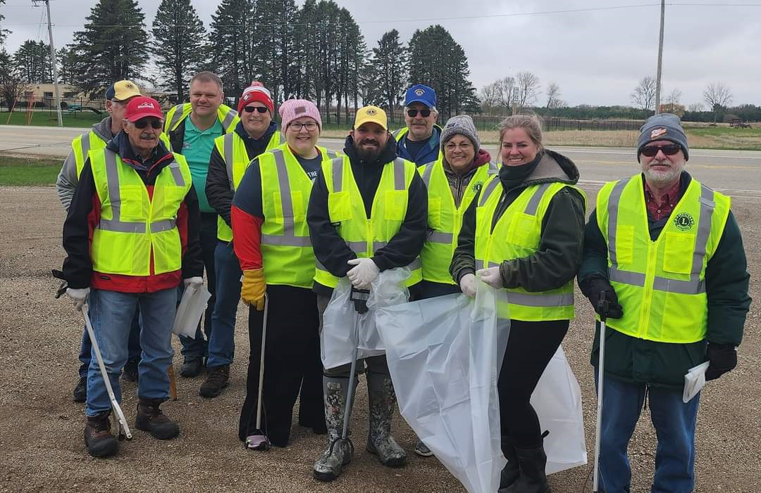
Juneau Lions Leadership in Action
Lion Keith – Highway Cleanup
  Organize date and time
  Distributes materials
  Coordinates team
  Ensures team safety
  Project completion
  Reports project status to club
Career Application
  Program/Project Management
  Supervisory Management
  Implementation of Safety Standards

Slide 13
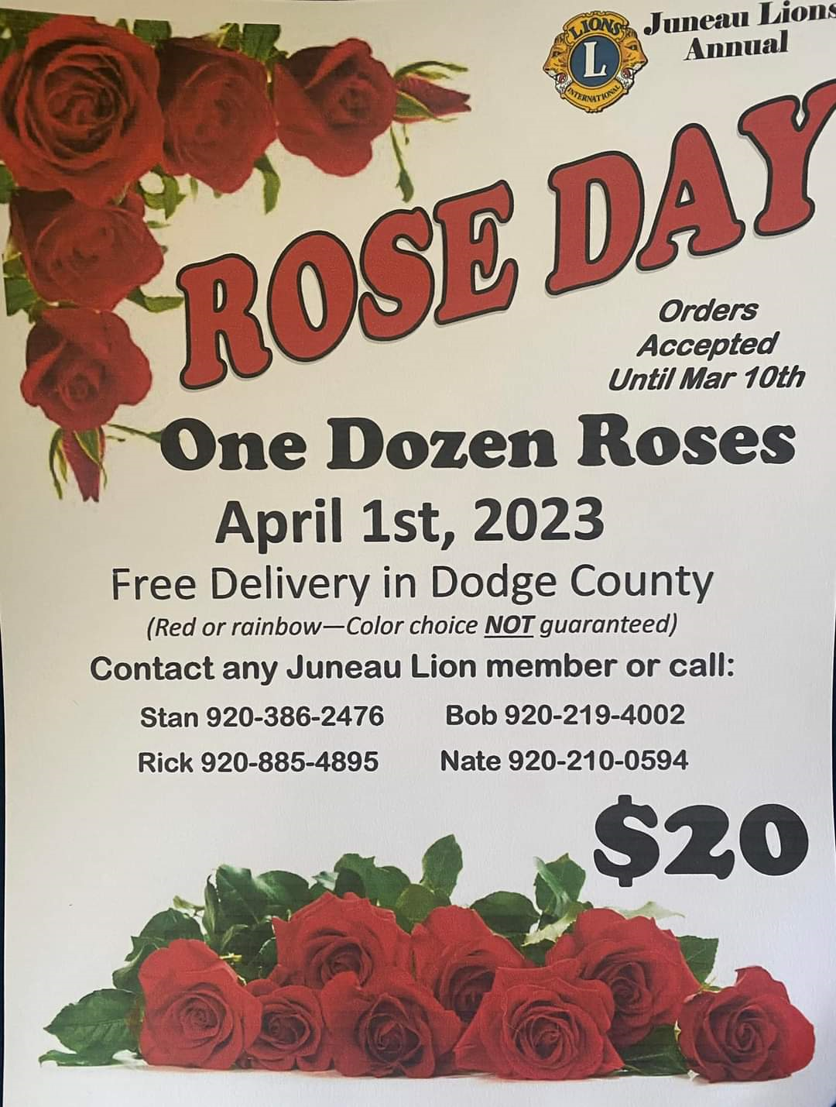


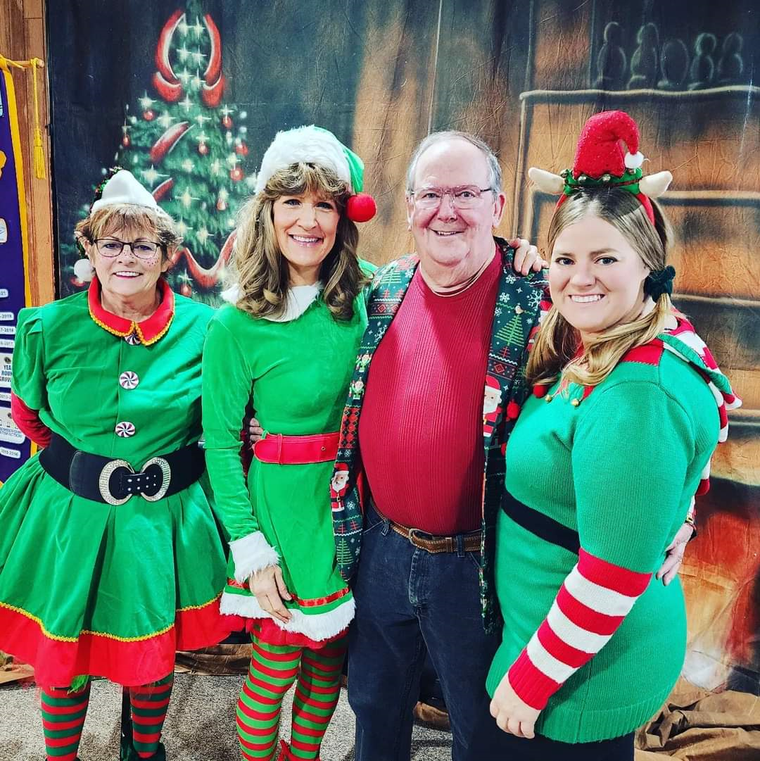

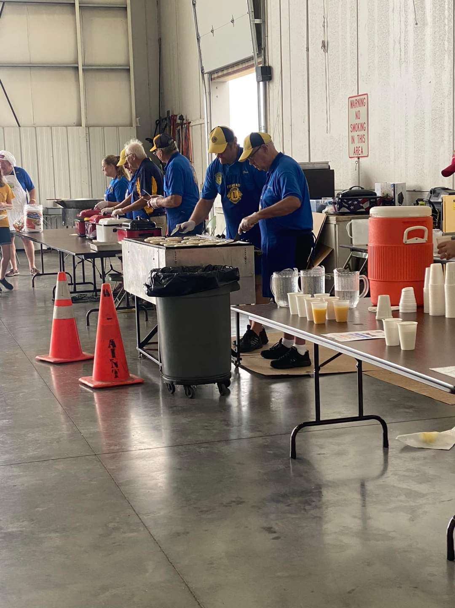
Juneau Lions Leadership in Action
Rose Day – Sales, Marketing, Delivery Coordination, Record Keeping, Ordering Supply
Breakfast with Santa –
Public Relations, Marketing
NEW EVENT IDEAS ARE ENCOURAGED!
Fly in Breakfast – Event Management, Sales, Money Handling, Marketing, Food Safety, Teamwork

Slide 14

Community service teaches us how significant it is to help the ones in need, the ones who are less fortunate than us.
It can open our eyes to a world that we may not otherwise experience and broaden our view of the world.

Slide 15
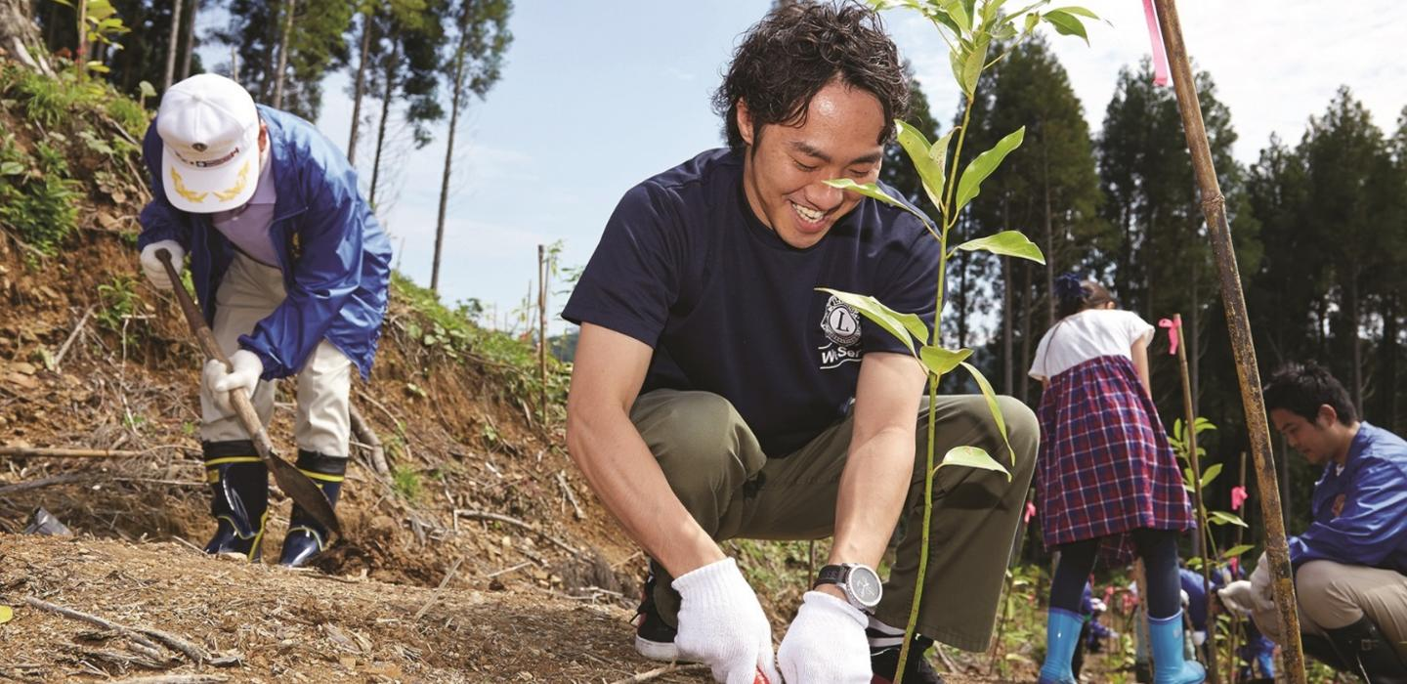
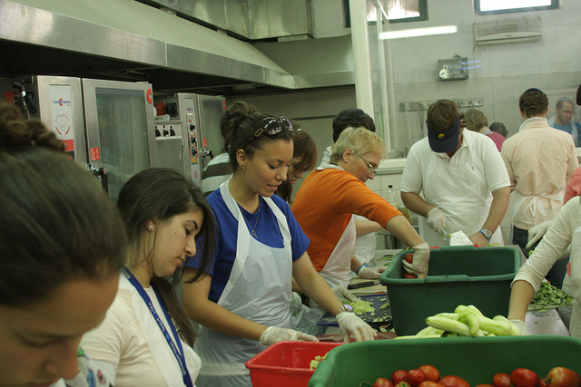
Community Service
  Service projects can include:
    Highway cleanup
    City cleanup & landscaping
    Maintaining parks and bike trails
    Assemble & deliver care packages to local hospitals, assisted living facilities, and nursing homes
    Food / toy drives
    Plant trees
    Eyeglass and hearing aid donation drives
    Volunteering at a food pantry
    Signage projects
    Any service projects where the club identifies a need

Slide 16
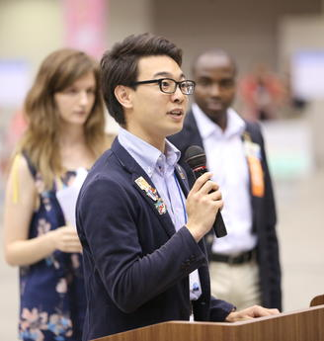
Leo Club Officers lead club membership development efforts and plan service activities.
By accepting an officer position, members have an opportunity to grow their leadership skills and make greater strides in their future professional development.
President
Vice President
Secretary
Treasurer
Notes:
Officer positions are open to all members, anyone interested should fill out an application and be prepared to give a 3 minute speech
Committees allow all members to be part of the function on the club, even if they are not officers

Slide 17
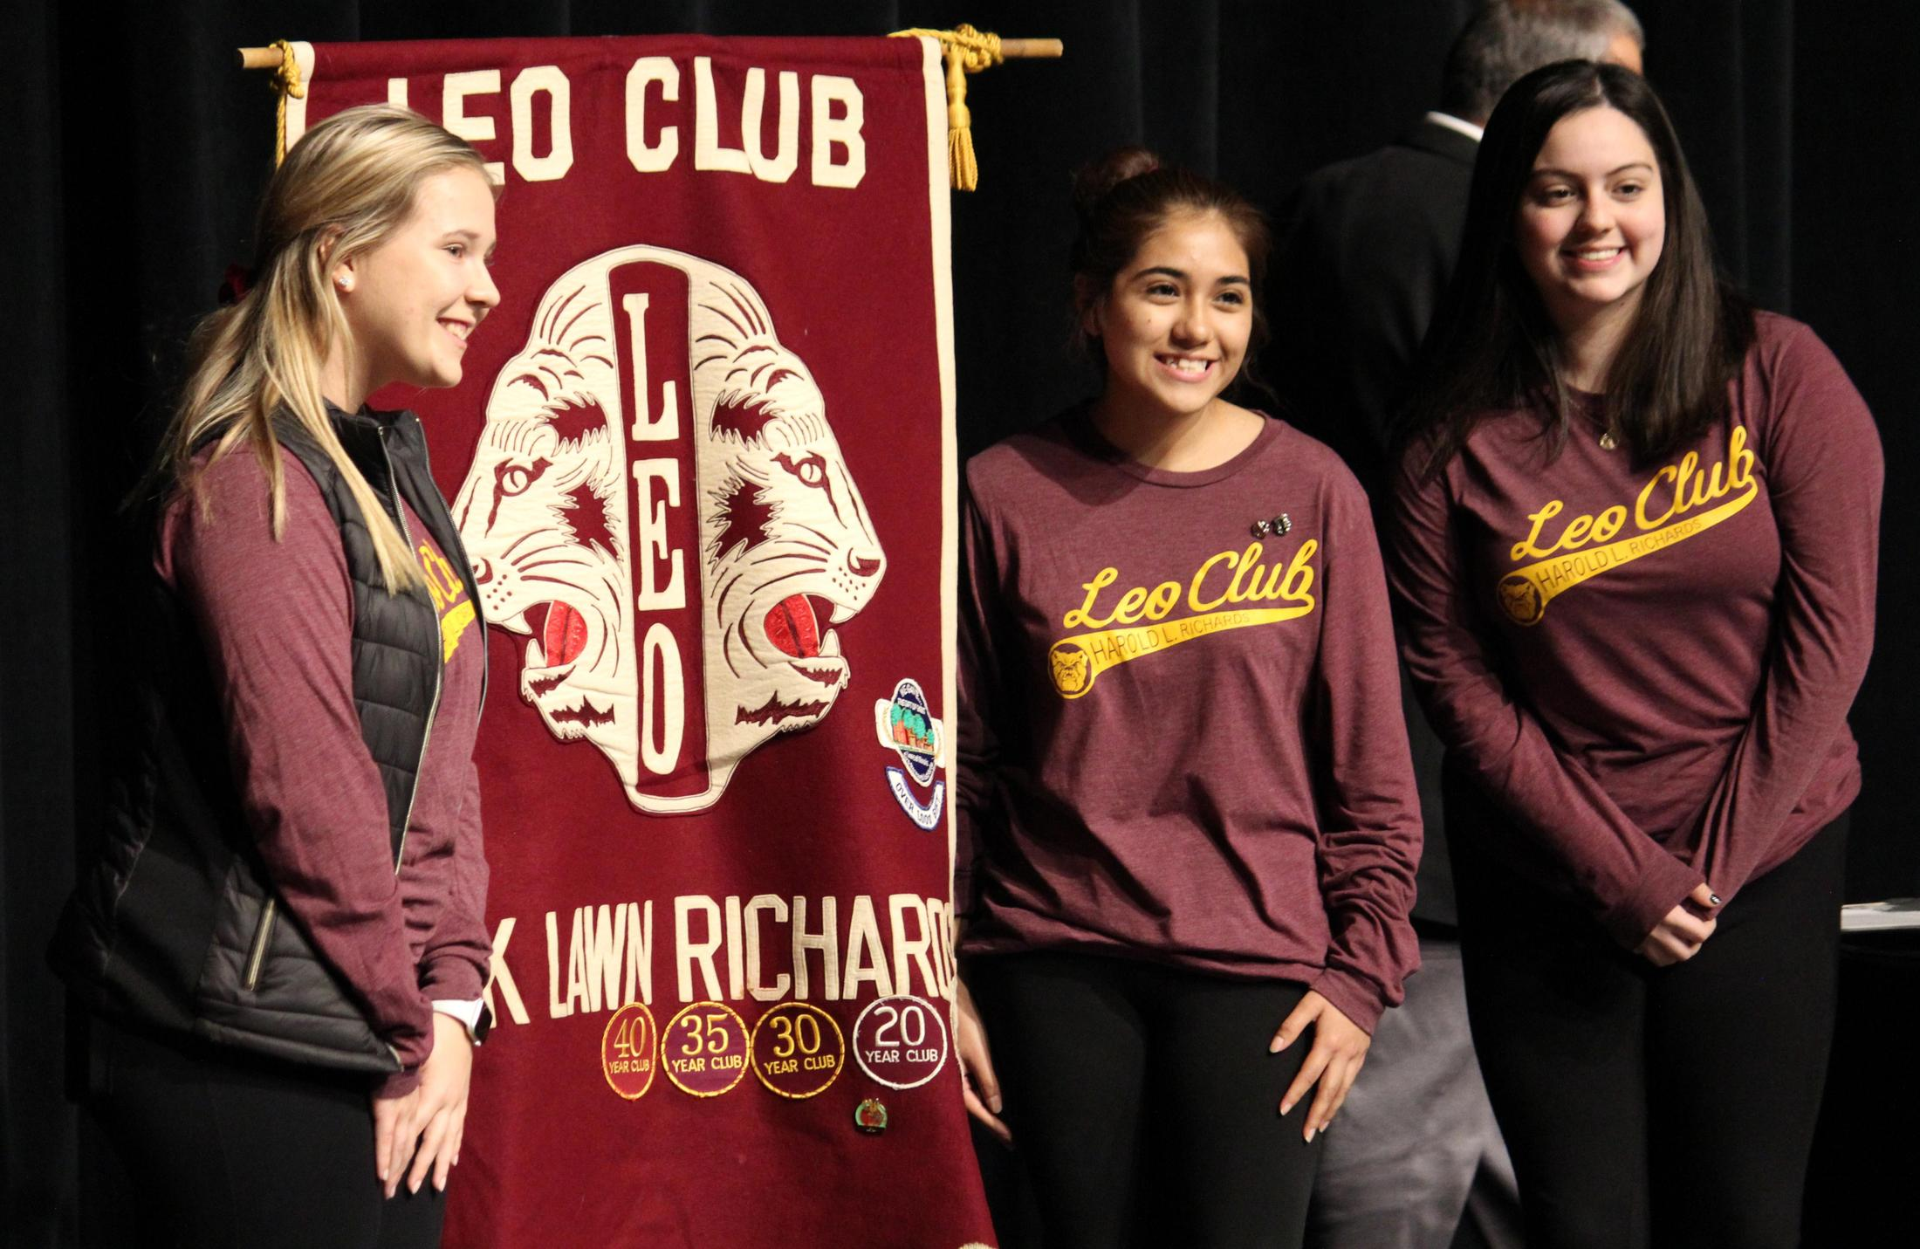
Officer Responsibilities
Leo Club President
Presides over all club and board meetings
Prepares all meeting agendas and keeps the meeting timely and on topic
Maintain communication with all elected officers, committees, and membership
Leo Club Vice President
Assists the president through their term
If the President is unable to fulfill their duties, the Vice president will assume those duties
Help oversee all committees. Will be a second point of contact for all membership questions and concerns

Slide 18
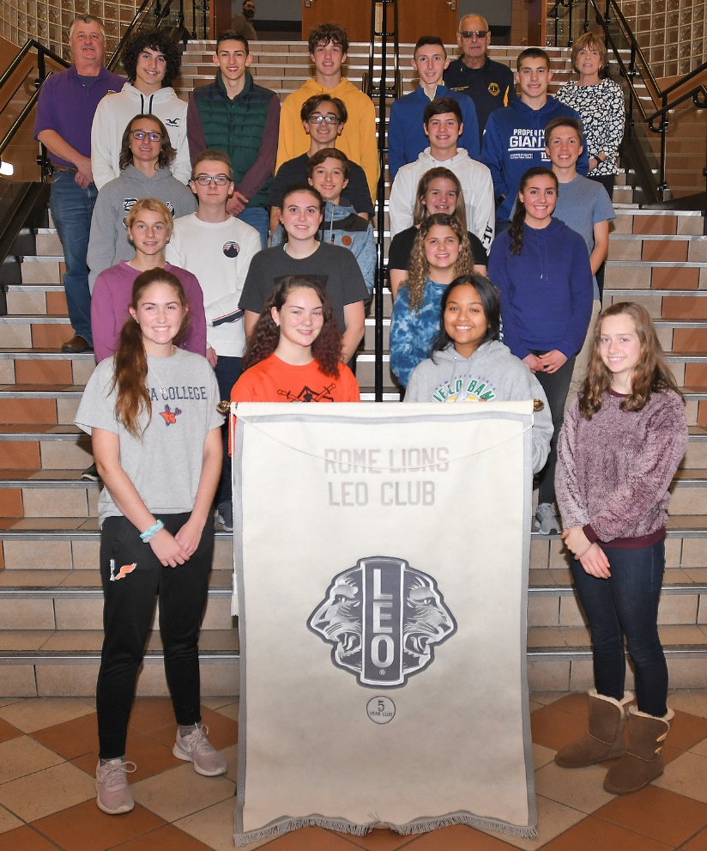
Officer Responsibilities
Secretary
Maintains all records of the club ensuring accuracy and keeping all data current
Responsible for reporting all activities and roles to Lion Club International
Take notes at all meetings and prepare and distribute minutes for those meetings
Responsible for notifying members of upcoming meetings and activities
Treasurer
Maintains the finances for the club including recording of all funds in and out of the banking accounts
Lead the finance committee, and with the President will create annual the budget for the club
If applicable, will invoice and collect dues from Leos

Slide 19
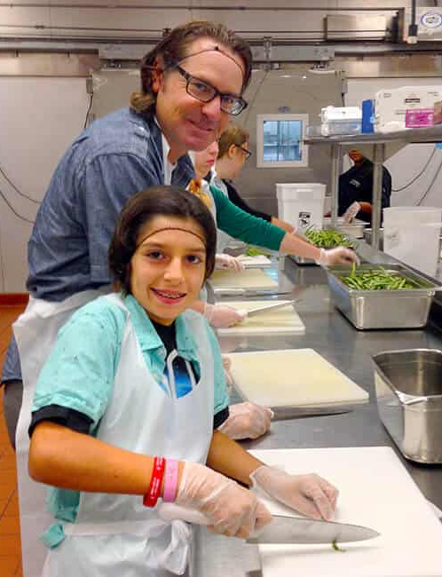
The Leo Advisor
The advisors are members of the Juneau Lions Cub and operate under the mission of guiding and supporting the officers
Advisors will always prioritize physical and emotional safety of the club
There will be at least one advisor present at all meetings, fundraisers, and service activities
Once chartered, the advisor will not have an active part in the decision-making process for the club but will remain available to answer questions and guide the club on proper process

Slide 20

All Club Members
Non officers can (and will) chair committees for projects and events
Officers will ensure that all Leos that wish to chair a committee get the opportunity to
All members will be encouraged to bring new ideas to the table
Leos are encouraged to participate in district, multiple district (state), and national, and international conventions

Slide 21

Meetings
Meetings will be held the first and third Tuesday of each month – time and location to be determined based on club interest
Meetings may include
  Project planning
  Budget discussion
  Speakers
  Team building exercises
  Skills practice
    Public speaking
    Club budgeting
    Leadership
    Etc.
  FUN

Slide 22


What's Next?
June 6, 2023
Leo Club advisors will be at the community center from 6-7 pm to collect applications and answer any additional questions you may have.
Guardian attendance is requested to sign the application.
Anyone Interested in holding an officer position can take an officer application with you tonight and bring back on June 6.

Slide 23


June 20, 2023
FIRST LEO CLUB MEETING *NO PARENTS/GUARDIANS
**Typically, the 3rd Tuesday of the month would be a board meeting only, but the first Tuesday in July will be the 4th

Slide 24

Any Leo who is interested in becoming an officer (and has turned in a completed and signed application on or before June 20) will be asked to prepare a 3-5 minute presentation campaigning for the position. The presentation should tell the club who you are, what you would like to accomplish during your term, and what characteristics you possess that would make you a great charter officer.
The presentations will be held at the June 20 meeting with a club vote planned for the July 18 meeting.

Slide 25

Can’t make it to the June 6 or June 20 meeting? No problem, email us and we can make arrangements to get your application.
www.JuneauLeoClub.org
www.facebook.com/JuneauAreaLeoClub
JuneauLeos@gmail.com

