Slide 1
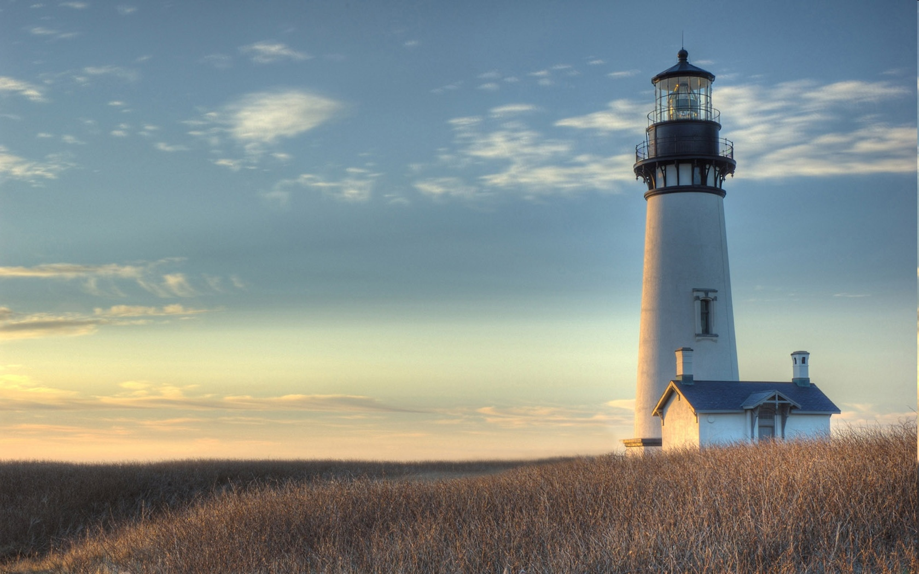
Chestnut Street
Baptist Church
Welcome!
Interim Lead Pastor Jeremy Johnson
Notes:
1

Slide 2

Tuesday 6:30 p.m.
Life Group at the Harmsen’s

Slide 3
Wednesday 6:30 p.m.
Ignition (Youth, Grades 6-12)
Prayer Group

Slide 4
Thursday 6:00 p.m.
Cross Walk for CWU and Young Adults

Slide 5
Friday 4:30 p.m.
LIFE Group (Briarwood)

Slide 6

Giving Options
(Thank you for supporting this ministry!)
Mail: 609 N. Chestnut St. Ellensburg, 98926
Online: Giving link at www.csbcfamily.com
In Person: Offering Box in lobby

Slide 7

Cornerstone Kids club begins
Kids Club will begin every Wednesday in the Fellowship Hall at 6:30 p.m. and conclude at 7:30 p.m. Children grades 1-5 are invited to learn about Jesus and how important He is! Please join us!

Slide 8

Business Meeting October 18
Members, please join us for our business meeting Sunday at 6 p.m. in the Fellowship Hall. We will hear Ministry Reports and any new business. See you there!

Slide 9
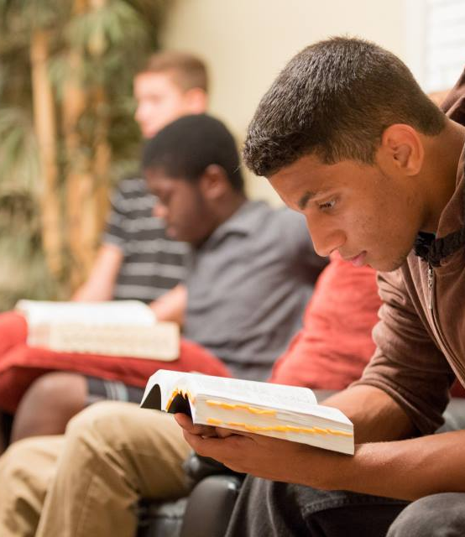
Crosswalk
6 p.m.
Young Adults and College Students!!
Dive into the Word and have free dinner, too!
Join every Thursday in the Fellowship Hall.
Dinner begins at 6 p.m. and Bible Study at 7 p.m.
Please join us!

Slide 10
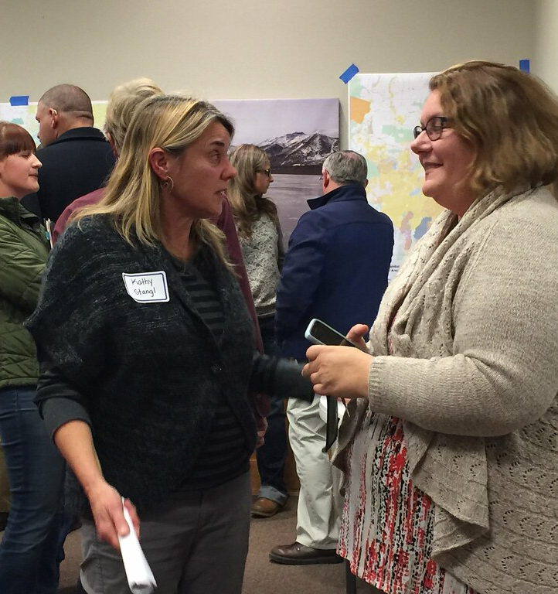
Central Washington Baptist Association
October 6 at 6:30 p.m.
First Baptist Church at 151 W. Wapato Rd.
Wapato, WA
All are welcome to attend the Fall Meeting to worship with our sister churches.
This Photo by Unknown Author is licensed under CC BY

Slide 11

Christmas Choir Begins October 11
Join us in the Fellowship Hall to sing Christmas praises to the Lord!
Choir will start at 4:30 p.m. and last until 6:00 p.m. Childcare will be provided.

Slide 12
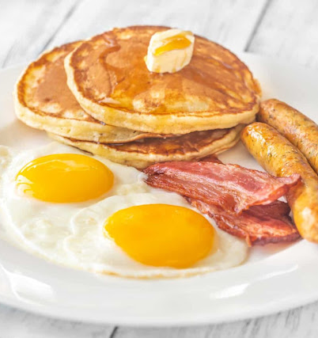
Men’s Breakfast October 10
Men, join us in the Fellowship Hall at 8:00 a.m.
This Photo by Unknown Author is licensed under CC BY-SA-NC

