Slide 1
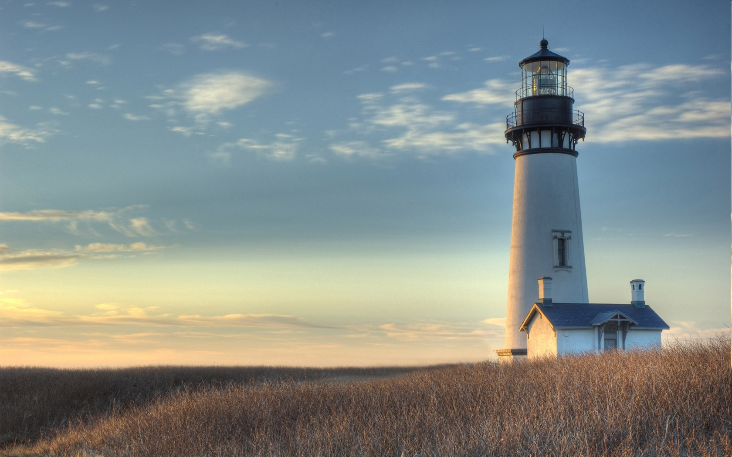
Chestnut Street Baptist Church
Welcome
Pastor Frank R. Johnson Associate Pastor Jeremy Johnson
Notes:
1

Slide 2

Tuesday 6:30 p.m.
Life Group at the Harmsen’s

Slide 3
Wednesday 6:30 p.m.
Prayer Group
Ignition (Grades 6-12)
Cornerstone Kids Club (Grades 1-5)

Slide 4
Thursday 6:00 p.m.
Cross Walk (Young Adults)

Slide 5
Friday 4:30 p.m.
LIFE Group (Briarwood)

Slide 6

Giving Options
(Thank you for supporting this ministry!)
Mail: 609 N. Chestnut St. Ellensburg, 98926
Online: Giving link at www.csbcfamily.com
In Person: Offering Box in lobby

Slide 7
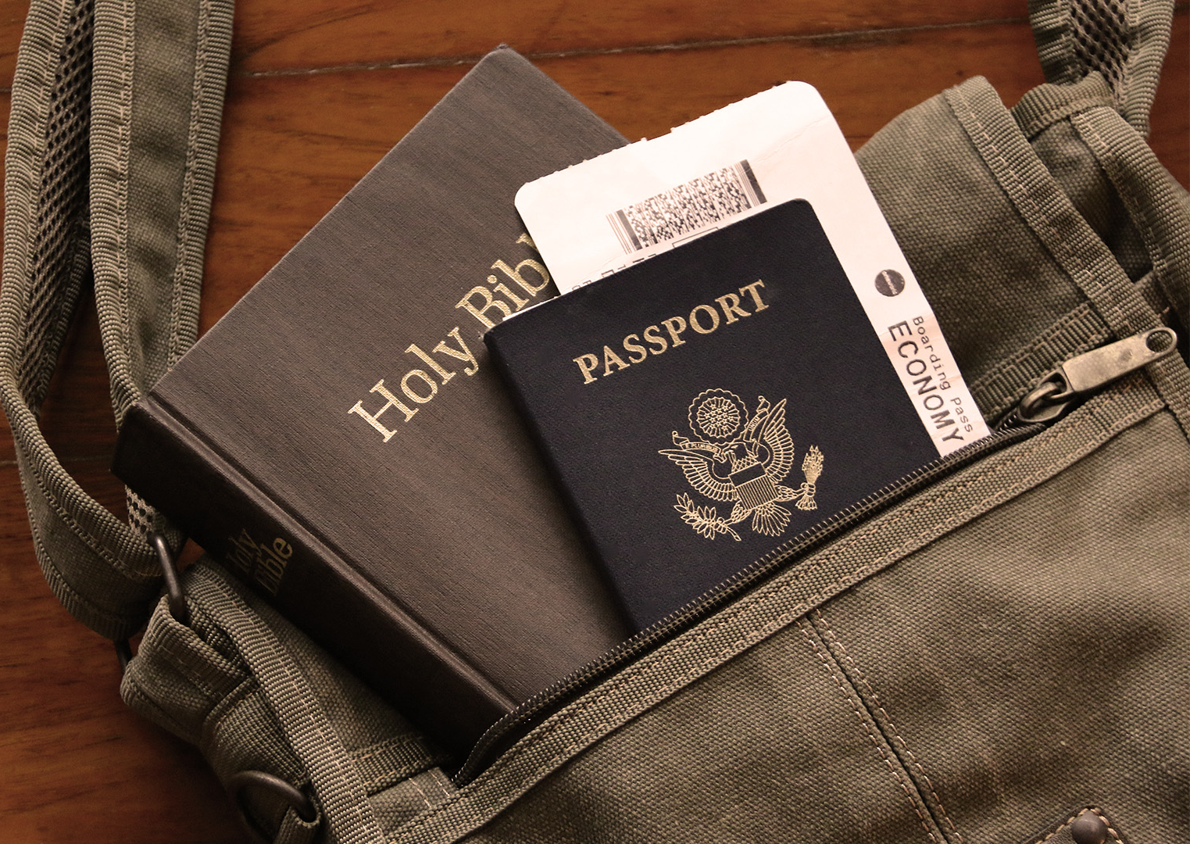

Short Term Mission Trip
We plan to work with Helping Hands International and YWAM in Baja, Mexico, August 23-29. Use the QR for more information about the trip.
We will have a brief meeting right after worship today to answer any questions.

Slide 8

Spring Missions Offering
Our spring missions offering will go into our Short-Term Missions Fund this year. All offerings designated on the “Missions” line of our envelopes will go into this fund.

Slide 9






Women’s Potluck Breakfast
Please join us on Saturday March 21 at 9 a.m. in the Fellowship Hall.
Come for the Fellowship!

Slide 10

Calling All Youth!
Spring Student Conference
May 8-9
Give Aren $35 (conference fee, Saturday’s breakfast and lunch, and a T-shirt).
Deadline is Wednesday, April 1.

