Slide 1
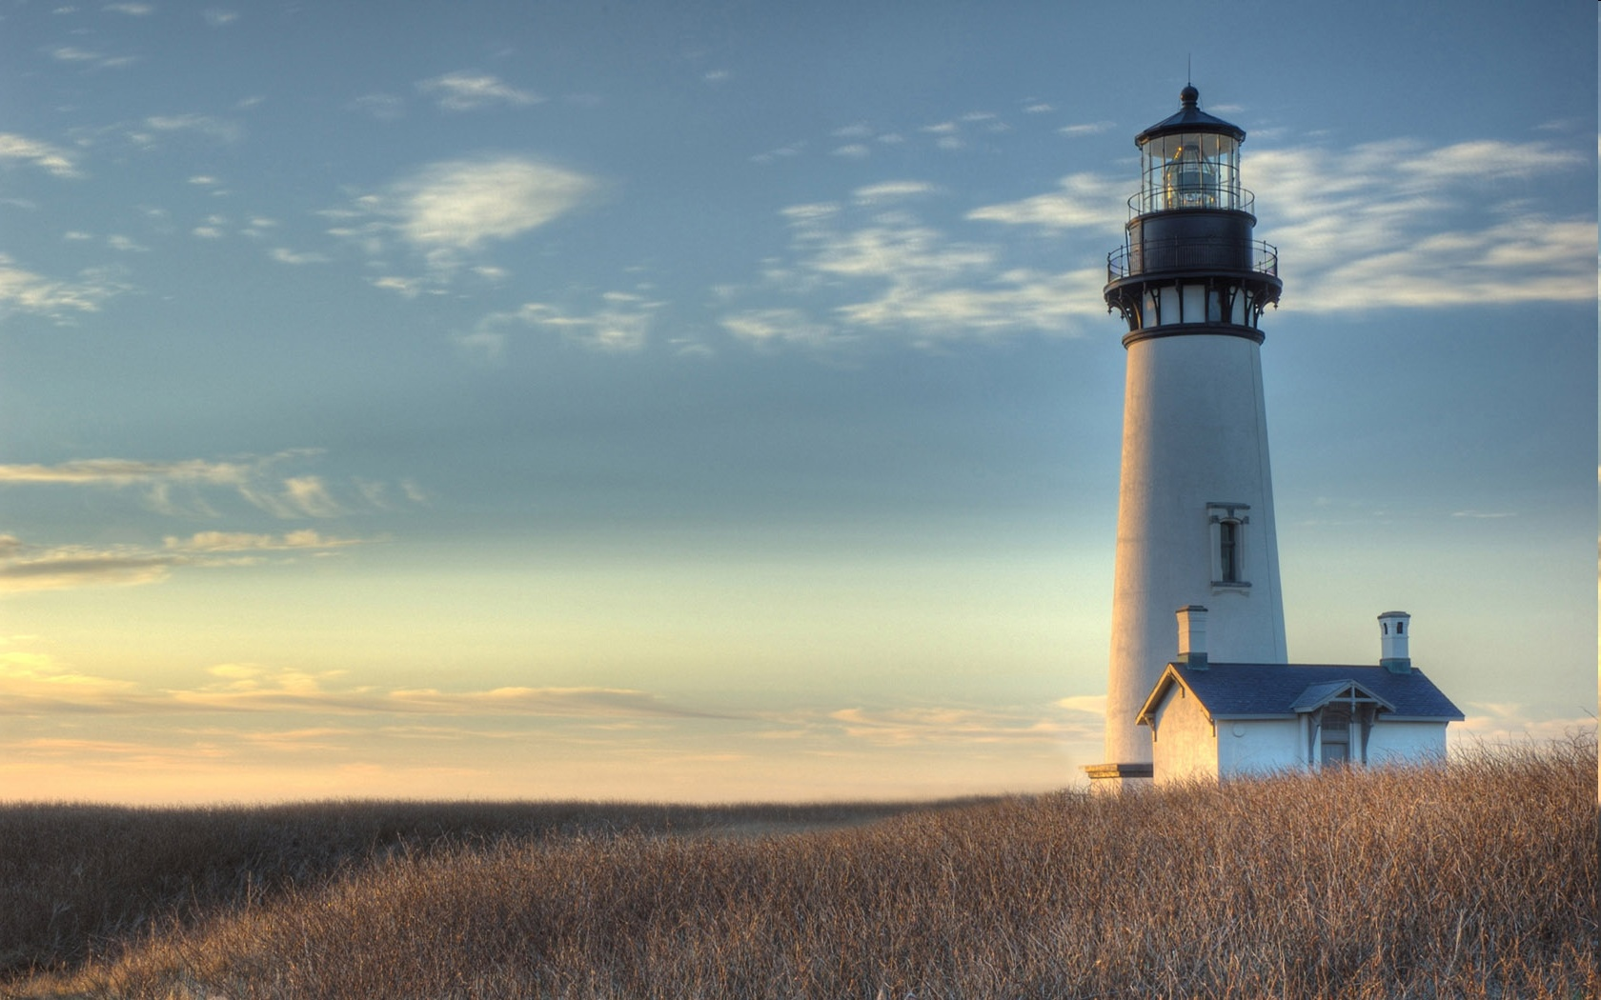
Chestnut Street
Baptist Church
Welcome!
Lead Pastor Frank R. Johnson
Associate Pastor Jeremy Johnson
Notes:
1

Slide 2

Tuesday 6:30 p.m.
Life Group at the Harmsen’s

Slide 3
Wednesday 6:30 p.m.
Ignition (Youth Group), Prayer Group

Slide 4
Thursday 6:00 p.m.
Crosswalk (University and Young Adults)
Summer Sizzle begins June 25
More information to come

Slide 5

Giving Options
(Thank you for supporting this ministry!)
Mail: 609 N. Chestnut St. Ellensburg, 98926
Online: Giving link at www.csbcfamily.com
In Person: Offering Box in lobby

Slide 6
Friday 4:30 p.m.
LIFE Group (Briarwood)

Slide 7

www.fidelitymonth.com

Slide 8

Bus driver outreach
Buy 30 of the same item for the Bus Drivers and Staff.
Some suggestions are granola bars, snacks, puzzle books, anything to make their summer more special.
If there are any questions, please speak to Jeannie Johnson. Today is the deadline!

Slide 9

Local mission Project
An opportunity to bless our sister church, Terrace Heights in Yakima!
The Mission Team is putting together a group to prepare their building to be painted.
Dates will be June 15-19 (Monday through Friday).
If anyone is available to help, please speak with Pastor Jeremy or Bryce Harmsen.

Slide 10
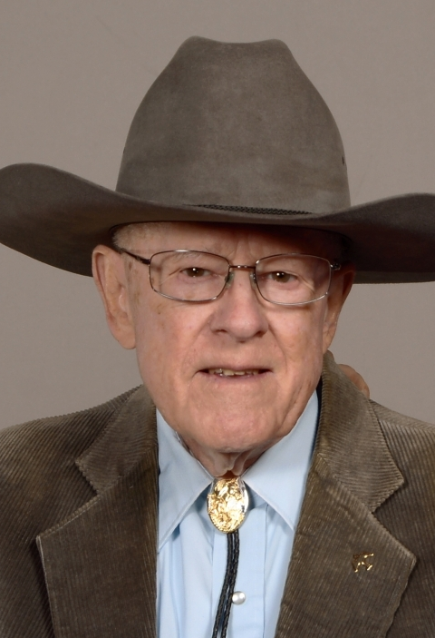
Dwight Bolton Memorial Service
Thursday, June 11
11:00 a.m.
Luncheon Following

Slide 11
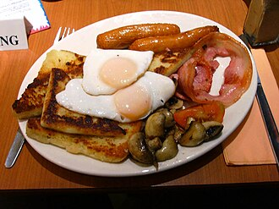
Men’s Breakfast June 13
8 a.m.
Fellowship Hall
Come for fellowship and good food!

Slide 12
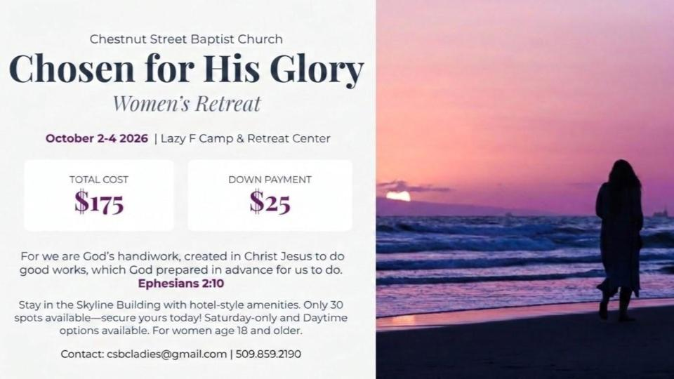

Slide 13


Slide 14
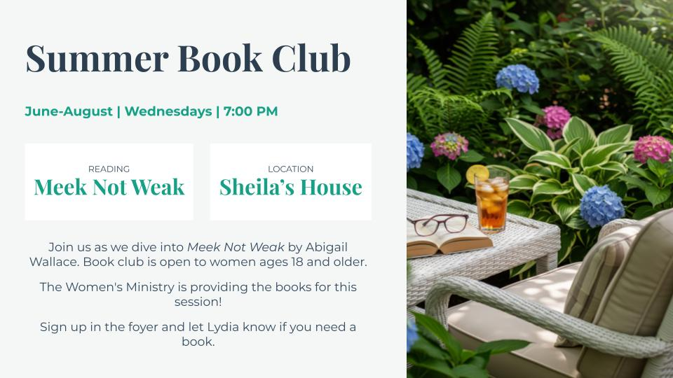

Slide 15
Sign up for lawn mowing!
Please help us this summer by signing up to mow the lawn. Mow on Thurs.-Sat. of the week for which you sign up (after 5:30 p.m. on weekdays).
Building and Grounds Team will have the mower ready. Check with the office or a team member to get the combination to the lock on the shed.

Slide 16

Business meeting June 14
Members, please join us in the Fellowship Hall at 6 p.m. to hear ministry reports and new business (if any).

