Slide 1
Women’s Breakfast are back on! Saturday, May 15, 9 a.m. Bring something to share if able.

Slide 2
Help us Nominate New Deacons!
Called Business Meeting
Sunday, May 16, 6 p.m.

Slide 4
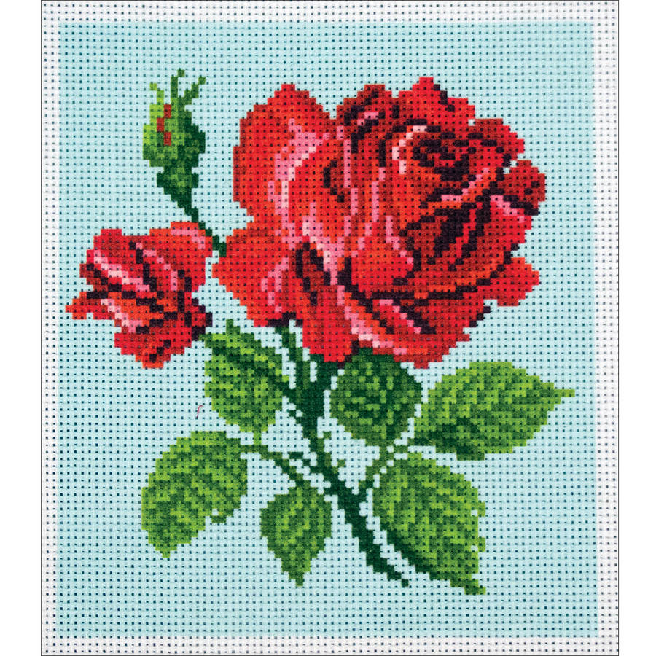
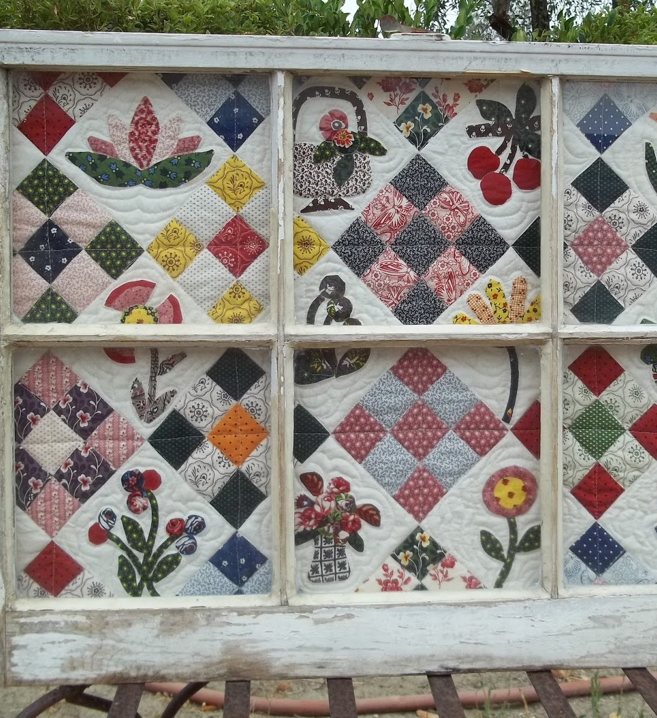
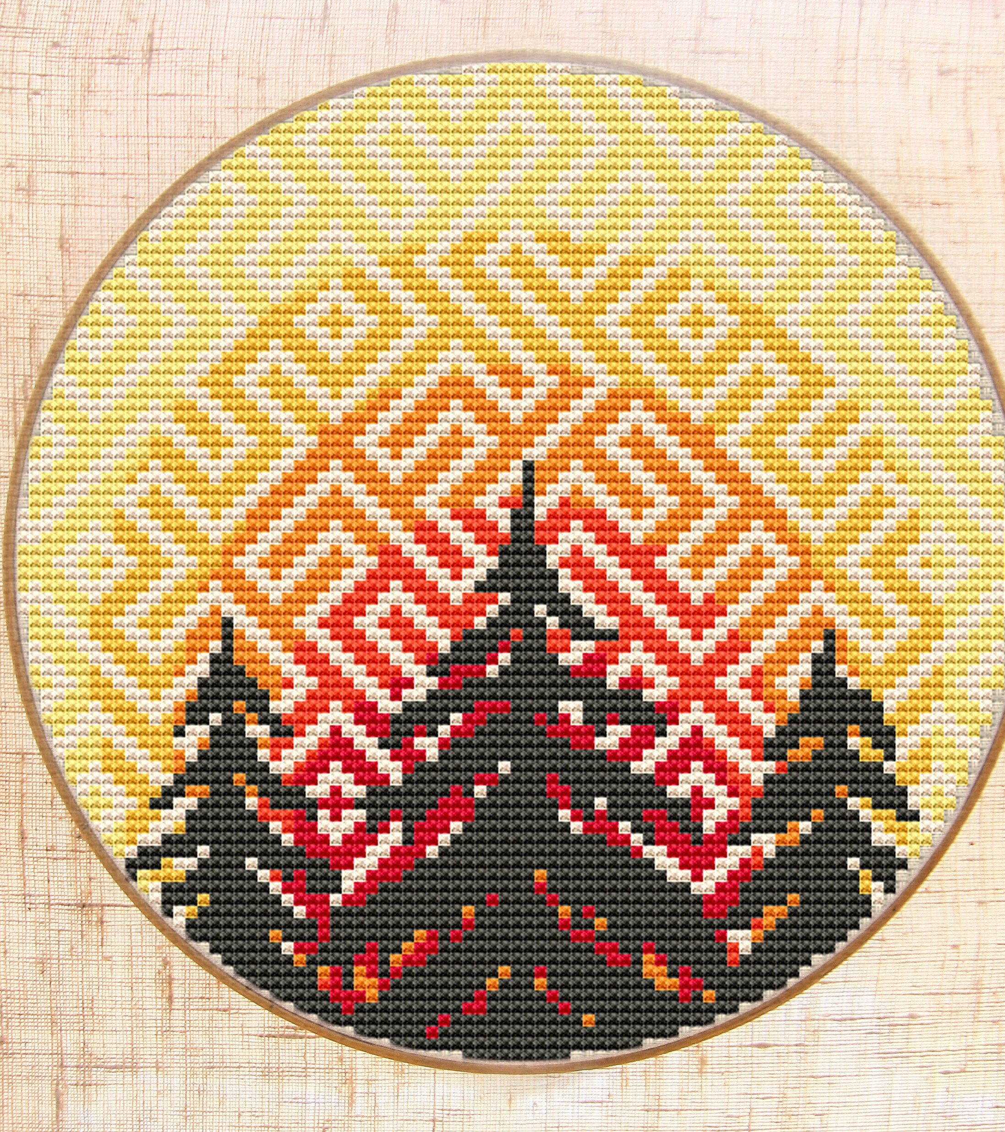
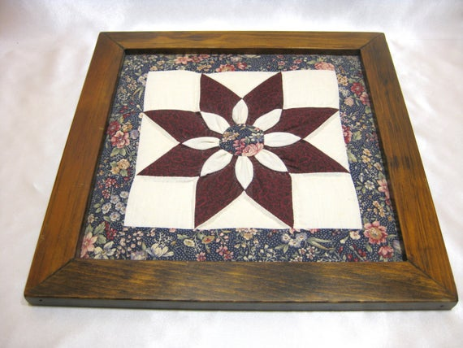
Needle crafted Art for Foyer
To display May-Aug
Clean, framed, ready to hang
Contact Jeannie

