Slide 1
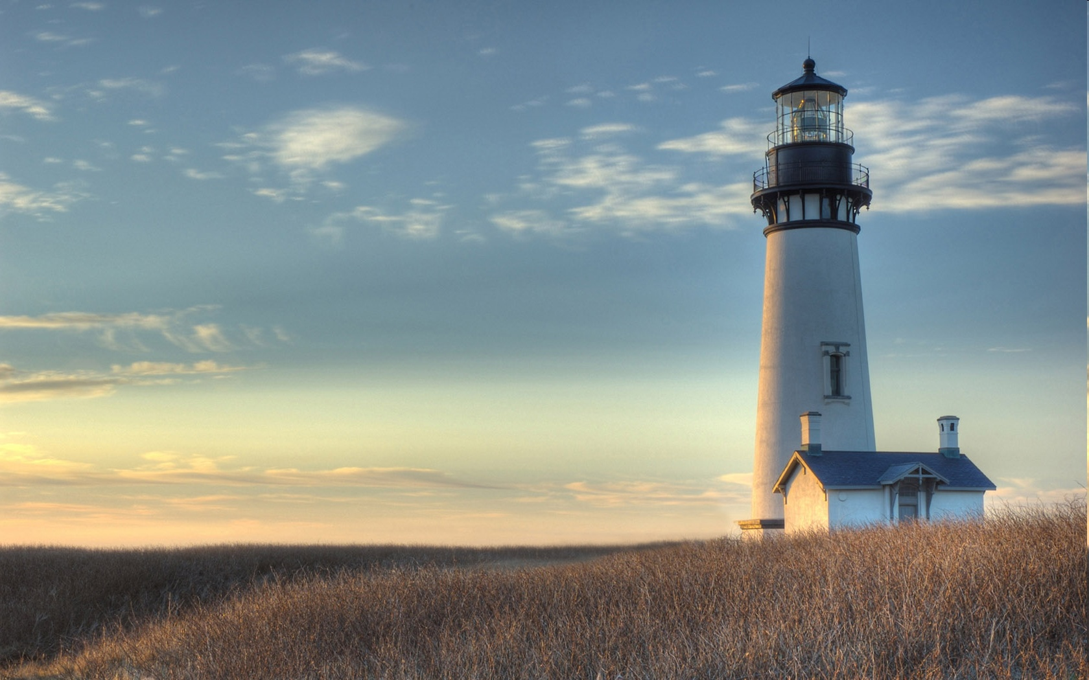
Chestnut Street Baptist Church
Welcome
Pastor Frank R. Johnson Associate Pastor Jeremy Johnson
Notes:
1

Slide 2
SUNDAY
Bible Study- 9 a.m.
Worship - 10:15 a.m.

Slide 3
WEDNESDAY 6:30 p.m.
Prayer Group
Ignition

Slide 4
THURSDAY 6:00 p.m.
Summer Sizzle
(Collegiate & Young Adults)

Slide 5
Keep on Praying!
If you would like to receive PrayerNet Today emails, send us a request at prayer@csbcfamily.com.
Stay connected: www.csbcfamily.com
Find us on Facebook

Slide 6
Giving Options
(Thank you for supporting this ministry!)
Mail: 609 N. Chestnut St. Ellensburg, 98926
Online:
www.csbcfamily.com
In Person:
Offering Box in lobby

Slide 7
About Education
Panel Discussion
Moderator: Frank Johnson
Today
July 25
6:00 p.m.

Slide 8
Women’s Prayer Group
Rachel Conger invites any women who would like to join her for a time of prayer on Thursdays at 10:00 a.m. in July.
The plan is to meet in the Prayer Room at the north end of the Akker Educational Wing upstairs.

Slide 10
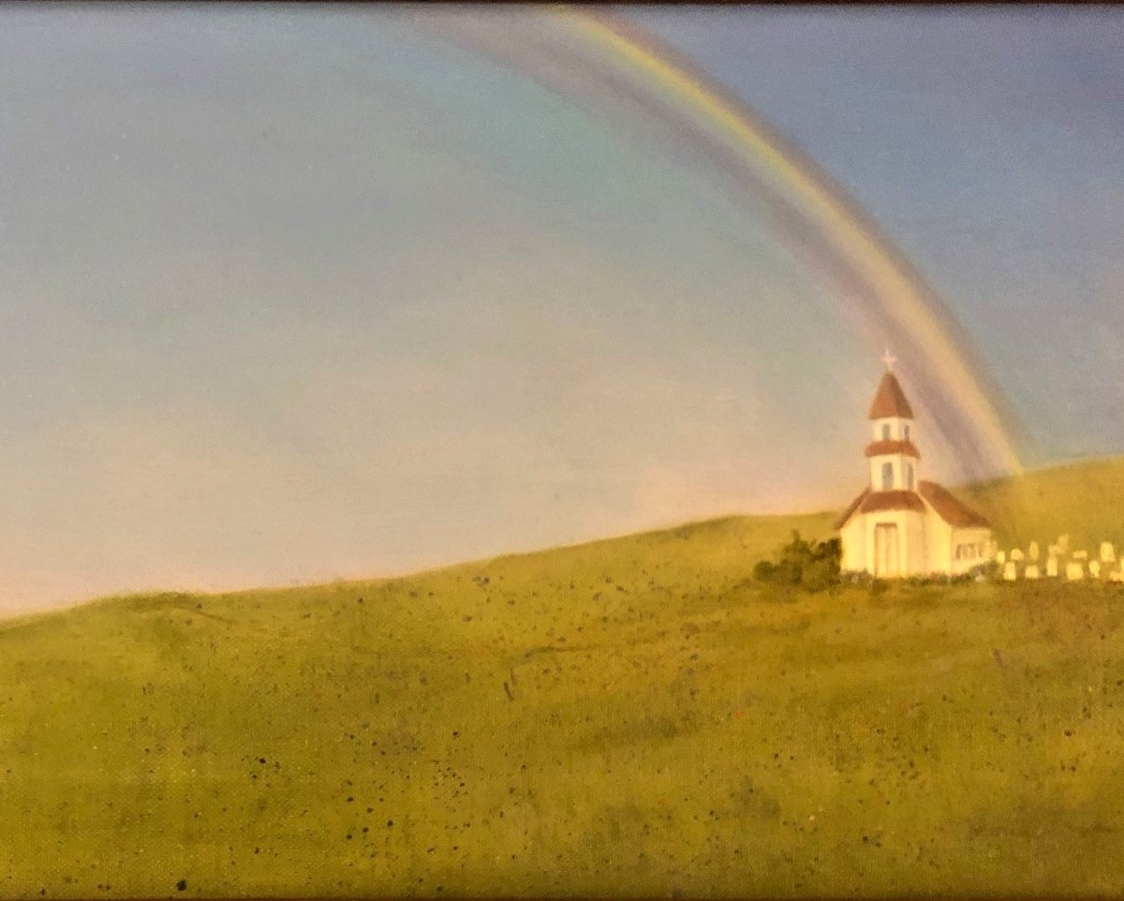
Paintings in the foyer by Meriam Tussinger are for sale to support the building fund.
Talk to Jeannie Johnson about donating

Slide 11
Ronald Work Party
Monday, July 26
7 am in CSBC parking lot, & 8 am Tues-Thurs. in Ronald

