Slide 1
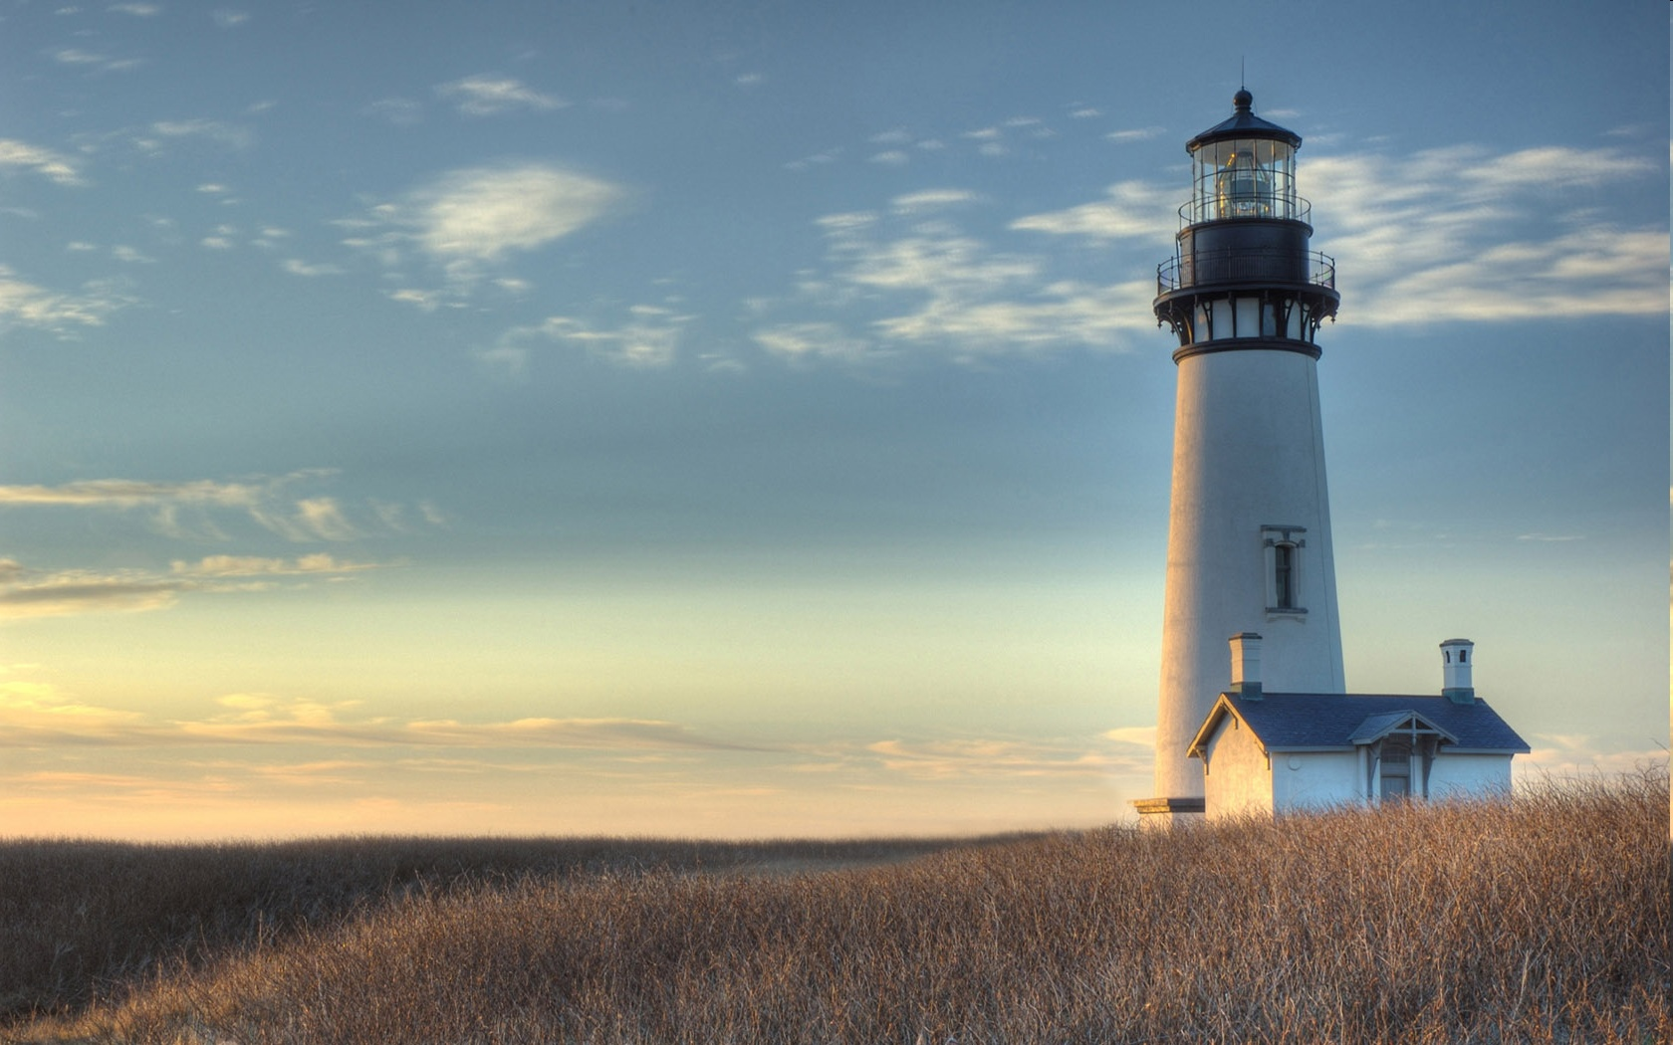
Chestnut Street Baptist Church
Welcome
Pastor Frank R. Johnson Associate Pastor Jeremy Johnson
Notes:
1

Slide 2
SUNDAY
Bible Study- 9 a.m.
Worship - 10:15 a.m.

Slide 3
WEDNESDAY 6:30 p.m.
Prayer Group
Ignition
Cornerstone Kid’s Club

Slide 4
THURSDAY 6:00 p.m.
Summer Sizzle
(Collegiate & Young Adults)

Slide 5
Keep on Praying!
If you would like to receive PrayerNet Today emails, send us a request at prayer@csbcfamily.com.
Stay connected: www.csbcfamily.com
Find us on Facebook

Slide 6
Giving Options
(Thank you for supporting this ministry!)
Mail: 609 N. Chestnut St. Ellensburg, 98926
Online:
www.csbcfamily.com
In Person:
Offering Box in lobby

Slide 7
Find a prayer guide in the PrayerNet for this week.

Slide 8
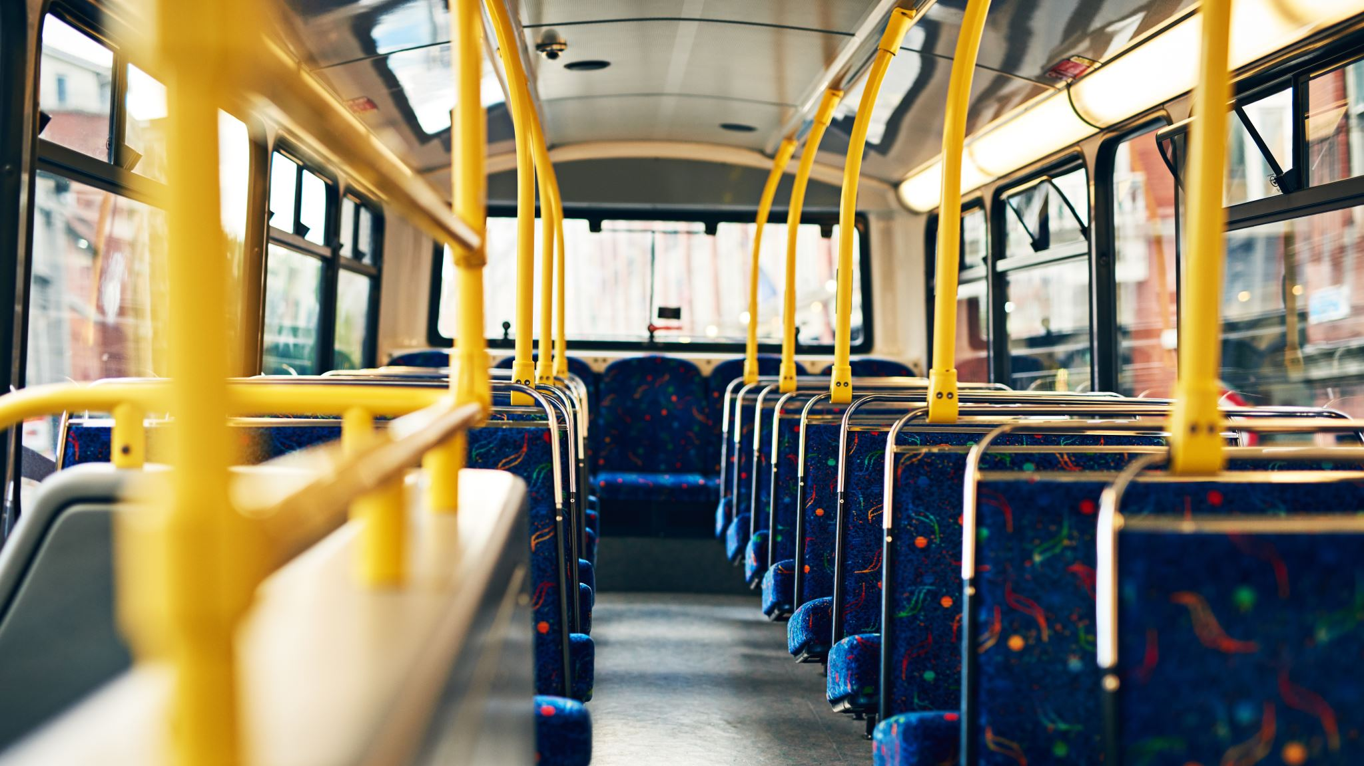
School Bus Driver Blessing Let Jeannie or the office know if you can help.

Slide 9
Cold Weather Shelter
Hosted by: United Methodist Church
Training Session every Wednesday at 6:30 p.m.
Shifts: evening, morning, Sat. laundry

Slide 10
Next Sunday, December 12, 6 p.m.

Slide 11
Take a tag and buy a child a gift! Please bring your unwrapped Angel Tree gifts to the office by Dec. 12

