Slide 1
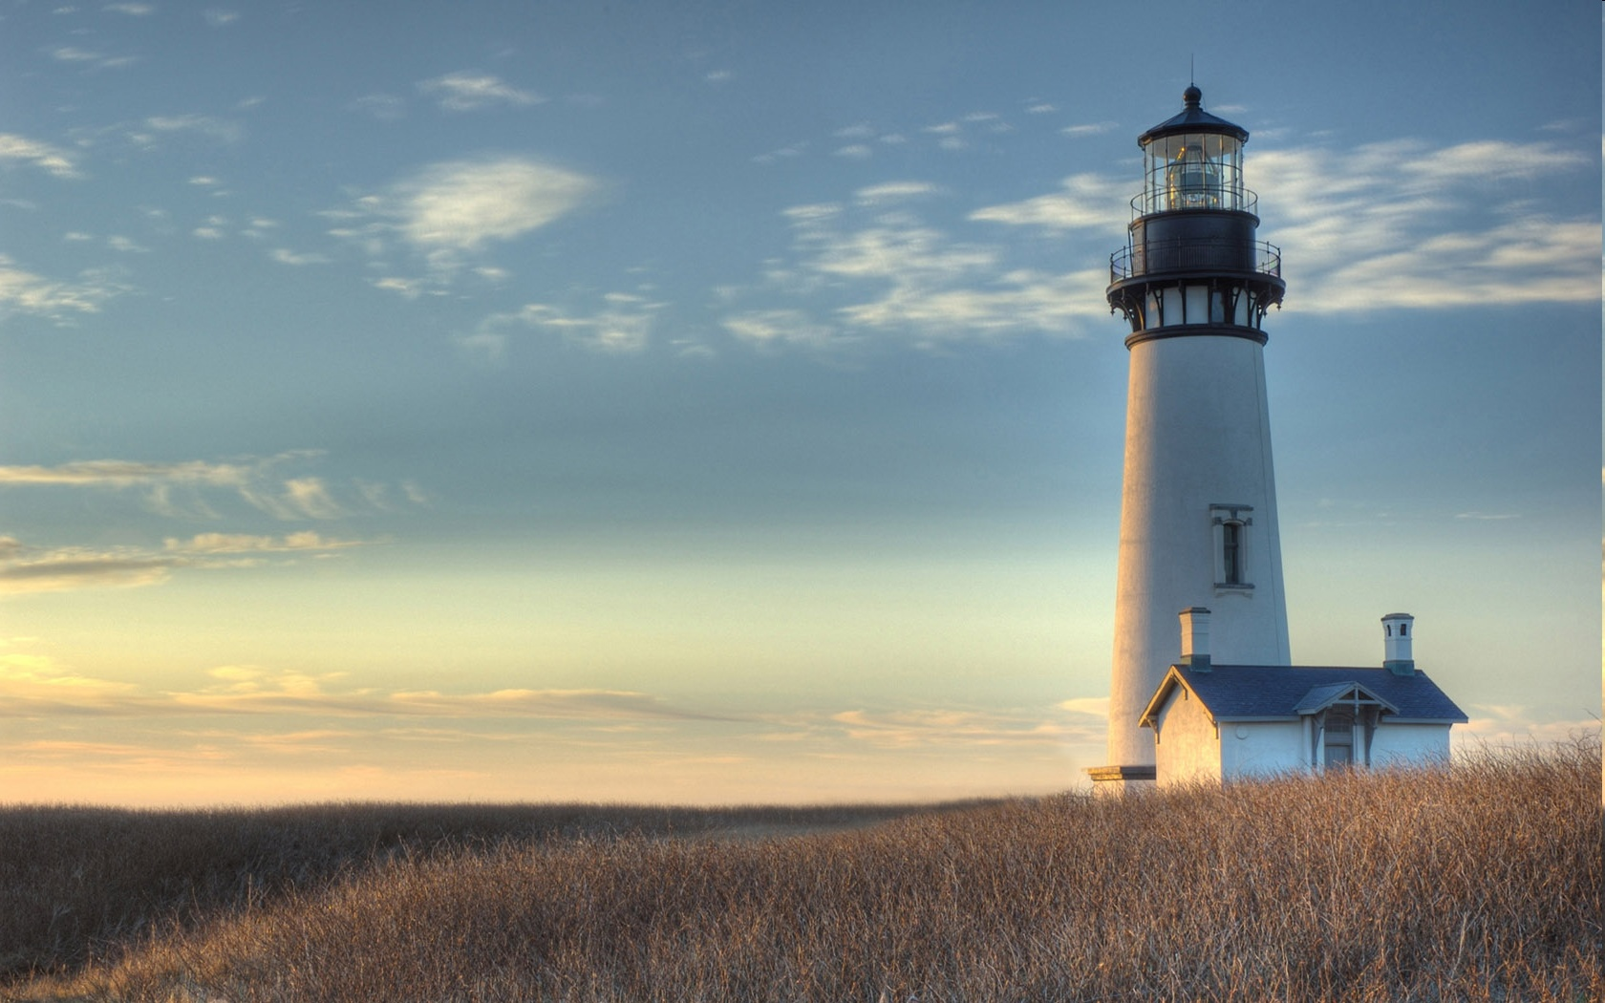
Chestnut Street Baptist Church
Welcome
Pastor Frank R. Johnson Associate Pastor Jeremy Johnson
Notes:
1

Slide 2
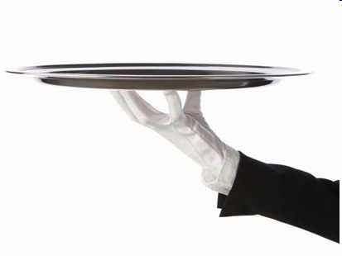
Serving this week
Duty Deacon: Wes Clogston
Counters: Wes Clogston, Dixie Davidson
Nursery: Baylee Hollar, Jessie Blackwood, Autumn Blackwood

Slide 3
SUNDAY
Bible Study- 9 a.m.
Worship - 10:15 a.m.

Slide 4
WEDNESDAY 6:30 p.m.
Prayer Group
Ignition
Cornerstone Kid’s Club

Slide 5
THURSDAY 6:00 p.m.
Crosswalk
(Collegiate & Young Adults)

Slide 6
Keep on Praying!
If you would like to receive PrayerNet Today emails, send us a request at prayer@csbcfamily.com.
Stay connected: www.csbcfamily.com
Find us on Facebook

Slide 7
Giving Options
(Thank you for supporting this ministry!)
Mail: 609 N. Chestnut St. Ellensburg, 98926
Online:
www.csbcfamily.com
In Person:
Offering Box in lobby

Slide 8
Spring Choir
Sundays 4:30 p.m.
No experience needed.
Childcare available.

Slide 9
2021 Giving Statements available in Foyer

Slide 10
LIFE Groups officially begin
February 7-11
Contact Larry Cory for more info

