Slide 1
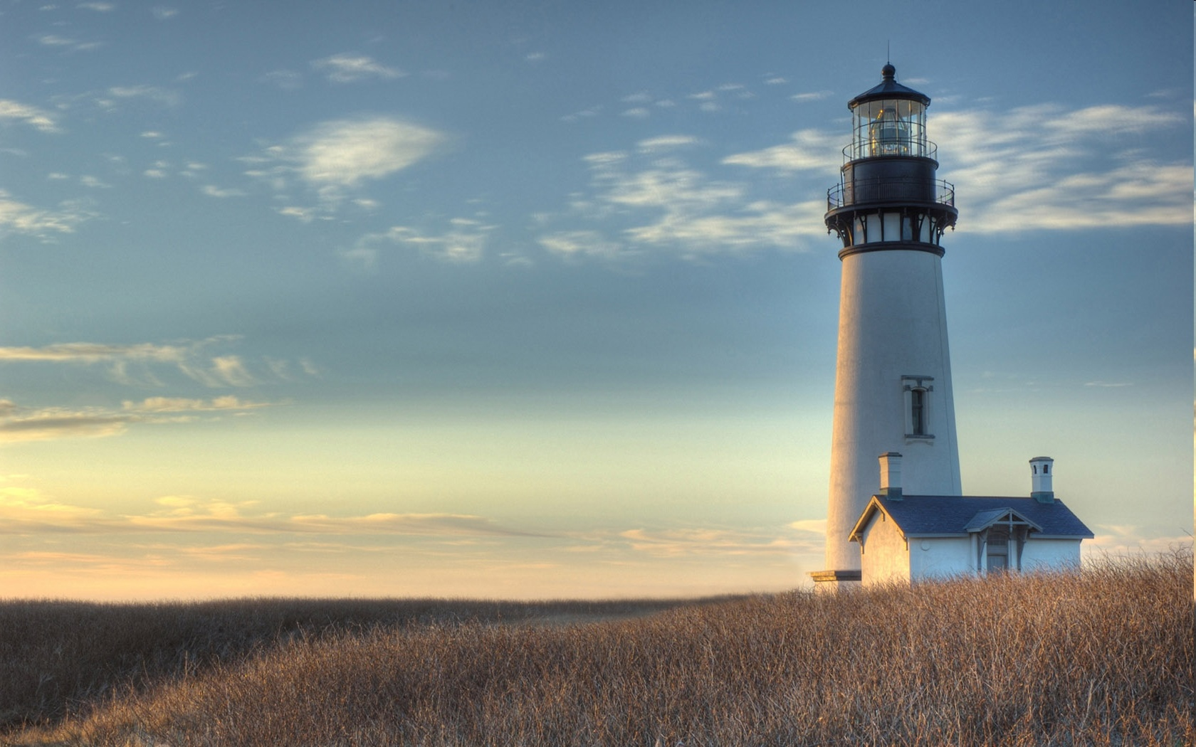
Chestnut Street Baptist Church
Welcome
Pastor Frank R. Johnson Associate Pastor Jeremy Johnson
Notes:
1

Slide 2
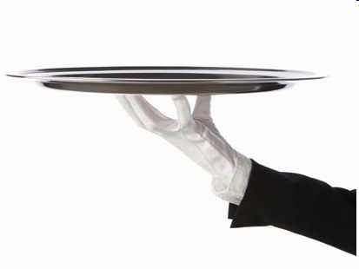
Serving this week
Duty Deacon: Ward Conger
Counters: Meg Mano, Neil Jensen
Nursery: Stacia Harmsen, Karen Roth, Lorien Johnson

Slide 3
SUNDAY
Bible Study- 9 a.m.
Worship - 10:15 a.m.

Slide 4
WEDNESDAY 6:30 p.m.
Prayer Group
Ignition (Youth Group)

Slide 5
THURSDAY 6:00 p.m.
Summer Sizzle
(Collegiate & Young Adults)

Slide 6
Keep on Praying!
If you would like to receive PrayerNet Today emails, send us a request at prayer@csbcfamily.com.
Stay connected: www.csbcfamily.com
Find us on Facebook

Slide 7
Giving Options
(Thank you for supporting this ministry!)
Mail: 609 N. Chestnut St. Ellensburg, 98926
Online:
www.csbcfamily.com
In Person:
Offering Box in lobby

Slide 8
We made our match!
$709.29 from VBS
Over $820 from church giving

Slide 9
Women’s Breakfast Saturday, Aug. 19 9:00 a.m.

Slide 10
Youth Events Coming Up!
Lock-In
Fri. Aug. 12
7 p.m.- 7 a.m.
Bring your friends!
Rodeo Parking
Sept. 1-5
Help fund youth activities

