Slide 1
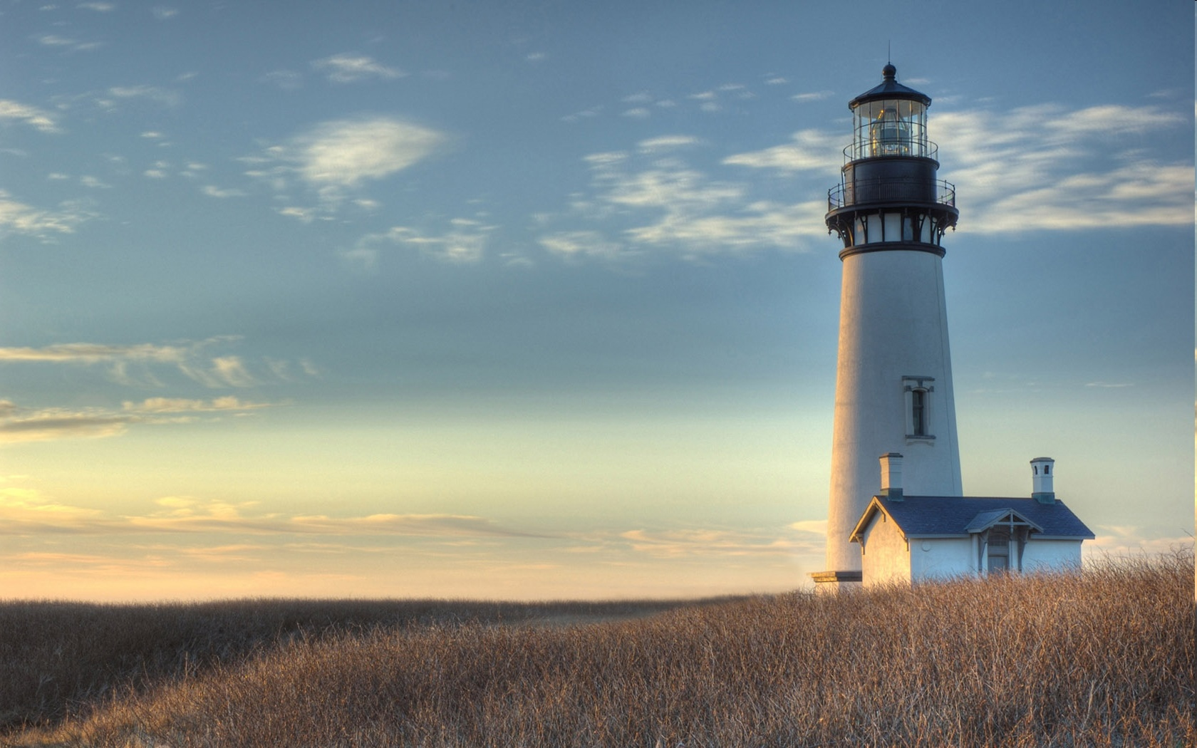
Chestnut Street Baptist Church
Welcome
Pastor Frank R. Johnson Associate Pastor Jeremy Johnson
Notes:
1

Slide 2
Serving this week
Duty Deacon: Lee Bivens
Counters: Neil Jensen, Meg Mano
Nursery: Chris & Susan Cutlip, Natalie Johnson

Slide 3
SUNDAY ACTIVITIES
Bible Study- 9 a.m.
Worship - 10:15 a.m.
Choir Rehearsal- 4:30 p.m.

Slide 4
WEDNESDAY 6:30 p.m.
Prayer Group
Cornerstone Kid’s Club
Ignition (Youth Group)

Slide 5
Keep on Praying!
If you would like to receive PrayerNet Today emails, send us a request at prayer@csbcfamily.com.
Stay connected: www.csbcfamily.com
Find us on Facebook

Slide 6
Giving Options
(Thank you for supporting this ministry!)
Mail: 609 N. Chestnut St. Ellensburg, 98926
Online: www.csbcfamily.com
In Person: Offering Box in lobby

Slide 7
Bible Readers Club Sun. Dec. 4, 6 p.m. December Guides available.

Slide 8
CHRISTMAS CHOIR PERFORMANCE December 4, 6 p.m. Bring cookies to share afterwards!

Slide 9
December 18, at 6 p.m.

Slide 10
Need for Kettle Bell Ringers for Salvation Army
Contact Beth Paul to sign up 509-933-7800

Slide 11
Grab a tag in the foyer today! Bring your gift and the tag back by Dec. 17 See Kim or Kathy with any questions

