Slide 1
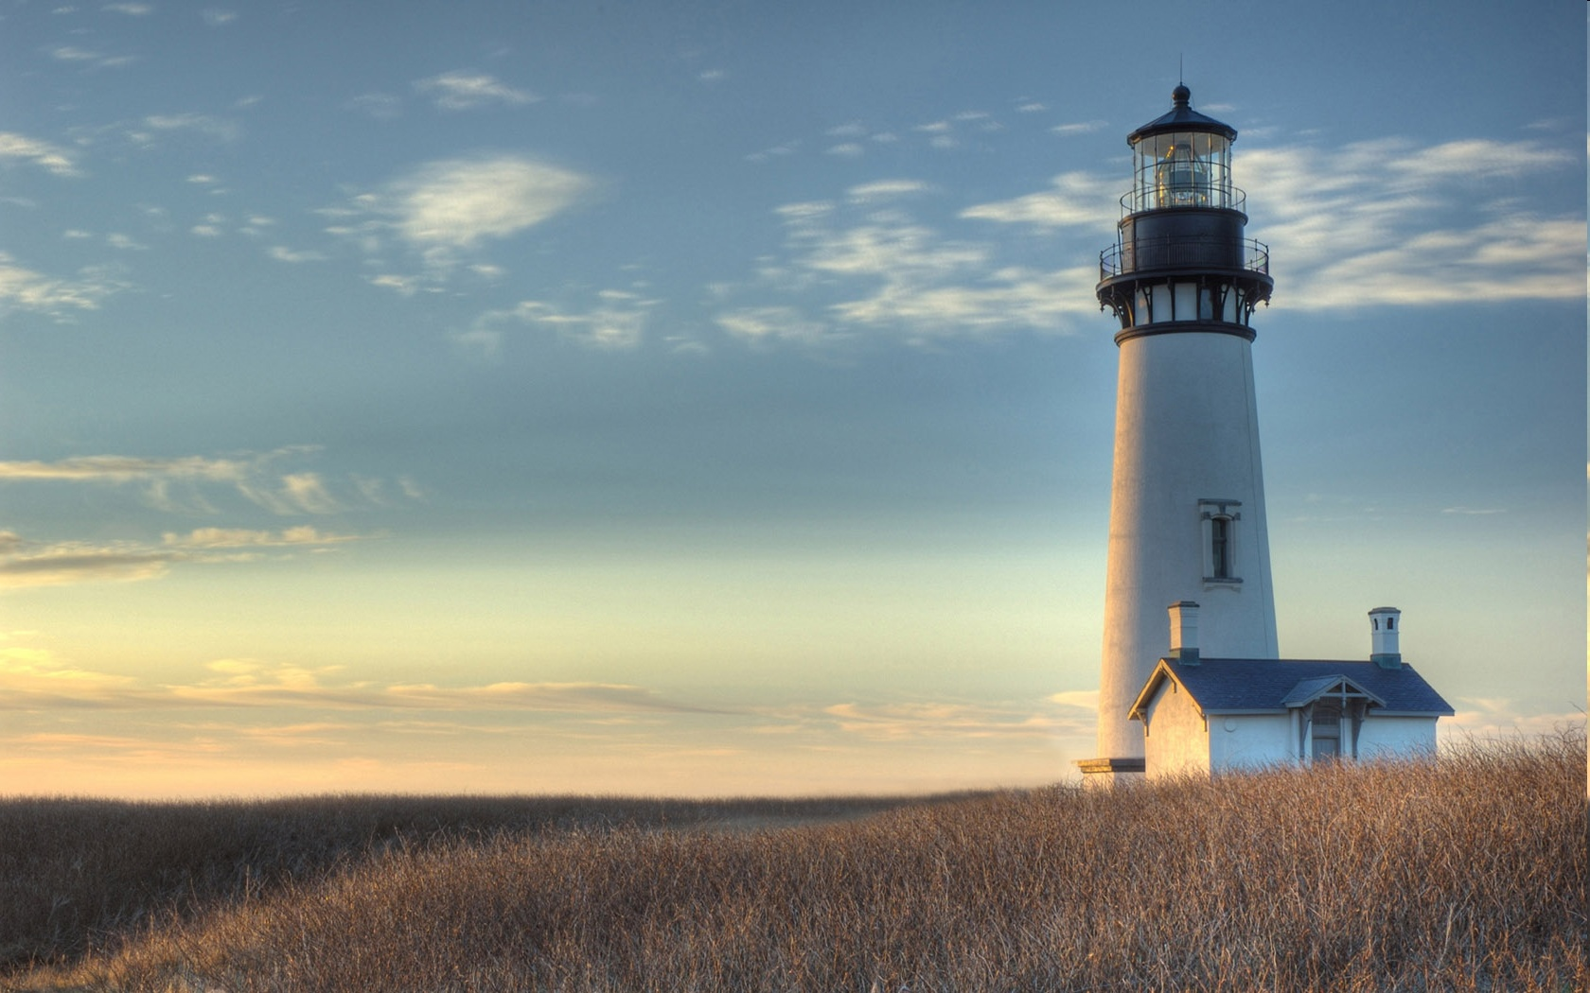
Chestnut Street Baptist Church
Welcome
Pastor Frank R. Johnson Associate Pastor Jeremy Johnson
Notes:
1

Slide 2
Serving this week
Duty Deacon: Clay Myers
Counters: Dixie Davidson, TBD
Nursery: MaryDawn Buntin, Jessica Maurer, Linzi Maurer

Slide 3
Wednesdays 6:30 p.m.
Prayer Group
Cornerstone Kid’s Club
Ignition (Youth Group)

Slide 4
Thursdays 6:00 p.m.
Crosswalk (Collegiate Students & Young Adults)

Slide 5
Keep on Praying!
If you would like to receive PrayerNet Today emails, send us a request at prayer@csbcfamily.com.
Stay connected: www.csbcfamily.com
Find us on Facebook

Slide 6
Giving Options
(Thank you for supporting this ministry!)
Mail: 609 N. Chestnut St. Ellensburg, 98926
Online: www.csbcfamily.com
In Person: Offering Box in lobby

Slide 8
Men’s Breakfast Saturday, February 11, 8 a.m.

Slide 9
Sunday, February 19, 6 p.m.

Slide 10
2022 Giving Statements
Available on table in Foyer

