Slide 1
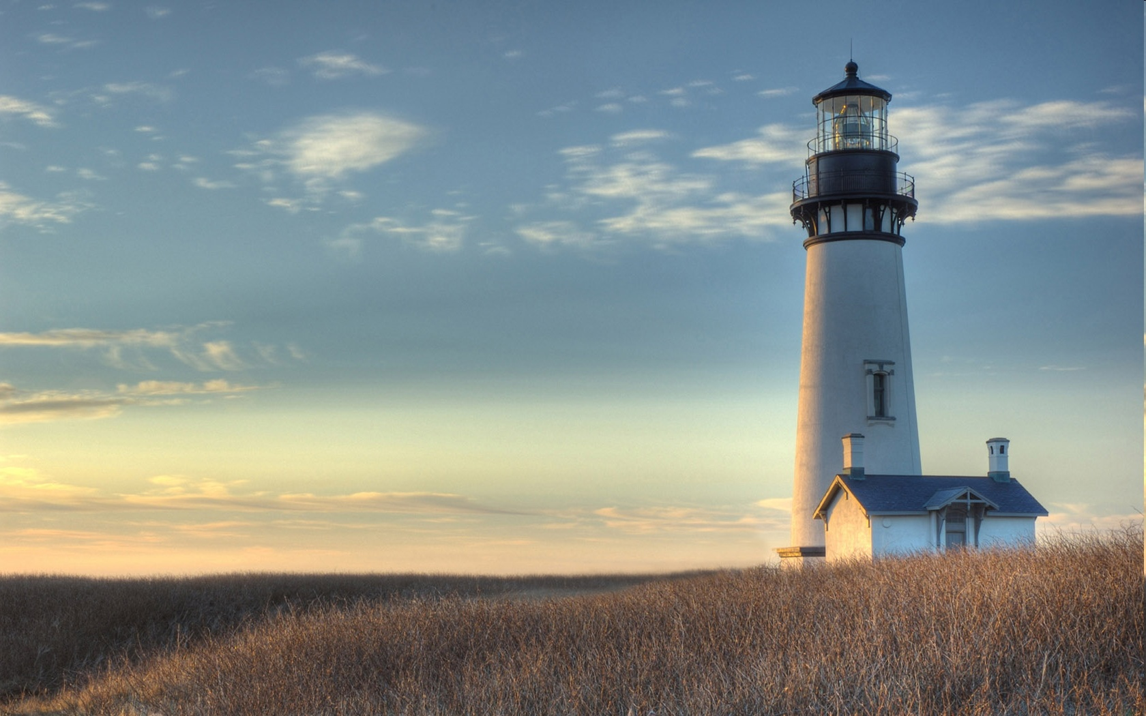
Chestnut Street Baptist Church
Welcome
Pastor Frank R. Johnson Associate Pastor Jeremy Johnson
Notes:
1

Slide 2
WELCOME
GUESTS!
If you are our guest today, please find a Welcome Slip in a chair-back, fill it out, and drop it into the offering box in the foyer. More info at www.csbcfamily.com!
Notes:
2

Slide 3
Serving this week
Duty Deacon: David Drews
Counters: Meg Mano, Holly Hutchinsen
Nursery: Chris & Susan Cutlip, Natalie Johnson

Slide 4
Wednesdays 6:30 p.m.
Prayer Group
Cornerstone Kid’s Club
Ignition (Youth Group)

Slide 5
Thursdays 6:00 p.m.
Crosswalk (Collegiate Students & Young Adults)

Slide 6
Keep on Praying!
If you would like to receive PrayerNet Today emails, send us a request at prayer@csbcfamily.com.

Slide 7
Giving Options
Thank you for supporting this ministry!
Mail: 609 N. Chestnut St. Ellensburg, 98926
Online: www.csbcfamily.com
In Person: Offering Box in lobby

Slide 8
Hearing Assistance Devices available in the Media Booth at the back of the balcony.
Please stop by the booth 10 minutes before worship service begins to check one out.

Slide 9
Baby Bottle Campaign
Pick up a baby bottle
Fill with loose change
Return by Father’s Day.

Slide 10
May Bible Readers Club Tonight, Sun. June 4, 6 p.m. June Guides available.

Slide 11
New Office Hours and Ministry Assistant
Updated hours, Tuesday-Friday 9:00 a.m.-12:00 p.m.
Thank you and best of luck to Lacey on her next chapter in life

Slide 12
Men’s Breakfast Saturday, June 10, 8 a.m.

Slide 13
Baby Shower for McKayla Macgruder
Ladies are invited to attend at Mountain View Park on Saturday, June 10, 2:00 p.m.

Slide 14
Women’s Ministry Events
Women's Summer Book Club
Starting Thursday, June 15, at 7:30 p.m. at Lydia's house.
Sign up with Lydia!

Slide 15
Sunday, June 25, 6:00 p.m.

Slide 16
Lawn-mowing Helpers
Have a few days to spare?
Help keep the church lawn mowed!
Sign up in the foyer after service.

Slide 17
Congratulations Graduates!
Ashley Callan
Ellensburg High School
Kori Evans
Ellensburg High School
Wesley Martin
Kittitas High School
Abi Powell
Othello High School
Ronny Weya
Central Washington University
Ayla Woods
Central Washington University
Baylee Hollar
University of North Dakota
Lacey Myers
Gateway Seminary

Slide 18
Fidelity Month
www.fidelitymonth.com

