Slide 1
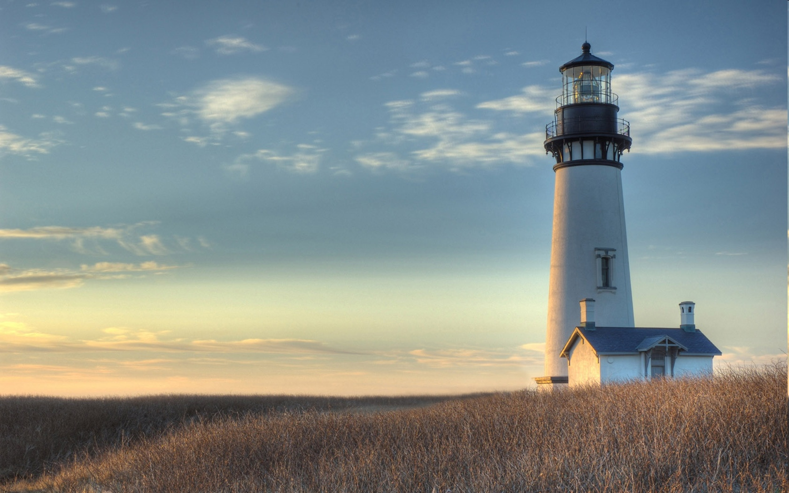
Chestnut Street Baptist Church
Welcome
Pastor Frank R. Johnson Associate Pastor Jeremy Johnson
Notes:
1

Slide 2
WELCOME
GUESTS!
If you are our guest today, please find a Welcome Slip in a chair-back, fill it out, and drop it into the offering box in the foyer. More info at www.csbcfamily.com!
Notes:
2

Slide 3
Wednesdays 6:30 p.m.
Prayer Group
Ignition (Youth Group)

Slide 4
Thursdays 6:00 p.m.
Summer Sizzle (Collegiate/Young Adults)

Slide 5
Fridays 4:30 p.m.
LIFE Group

Slide 6
Keep on Praying!
If you would like to receive PrayerNet Today emails, send us a request at prayer@csbcfamily.com.
Stay connected: www.csbcfamily.com
Find us on Facebook

Slide 7
Giving Options
(Thank you for supporting this ministry!)
Mail: 609 N. Chestnut St. Ellensburg, 98926
Online: www.csbcfamily.com
In Person: Offering Box in lobby

Slide 8
Women’s Retreat
Remember Your Joy!
October 4-6, 2024
Total cost: $165
Non-refundable deposit: $25
Only 30 spots available!
(Saturday only option: $55)

Slide 9
Youth Rodeo Parking Report
Thank you to all who prayed and especially to those who volunteered! We raised over $6,800 this year!

Slide 10
NW Impact Offering
Support this offering that helps fund the starting of new churches in the NW Baptist Convention region, makes leadership training and encouragement possible, equips men and women to serve in disaster relief, supports ministry on university campuses, and prepares the next generation of children and youth to love and serve the Lord. Use the “Missions” line on envelope or online.

Slide 11
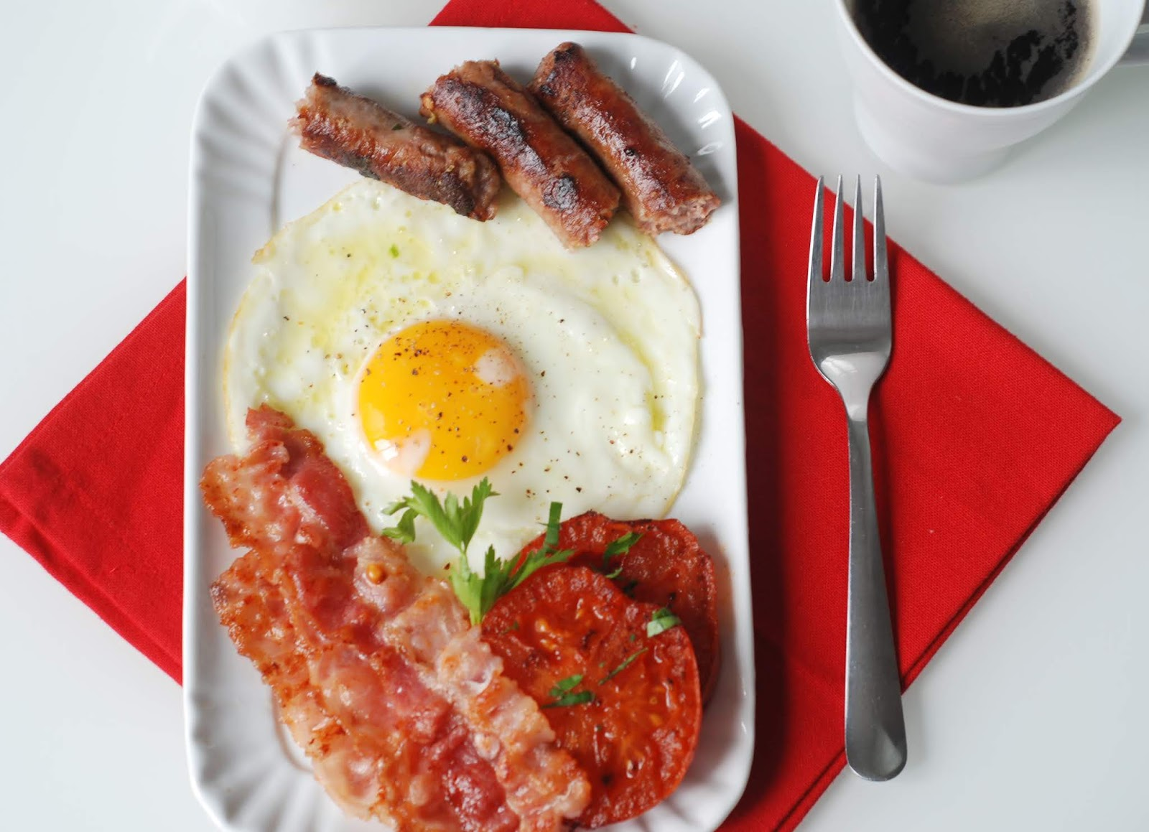
Men’s Breakfast This Saturday
Men, join for breakfast on Saturday, September 14, at 8 a.m. for good food, good fellowship, and encouragement from the Scriptures. Invite a friend!

Slide 12
National Day of Remembrance
For the Unborn
Local event, Saturday, September 14
1-2 p.m.
Sponsored by Care Net Pregnancy Center
of Kittitas County

