Slide 1
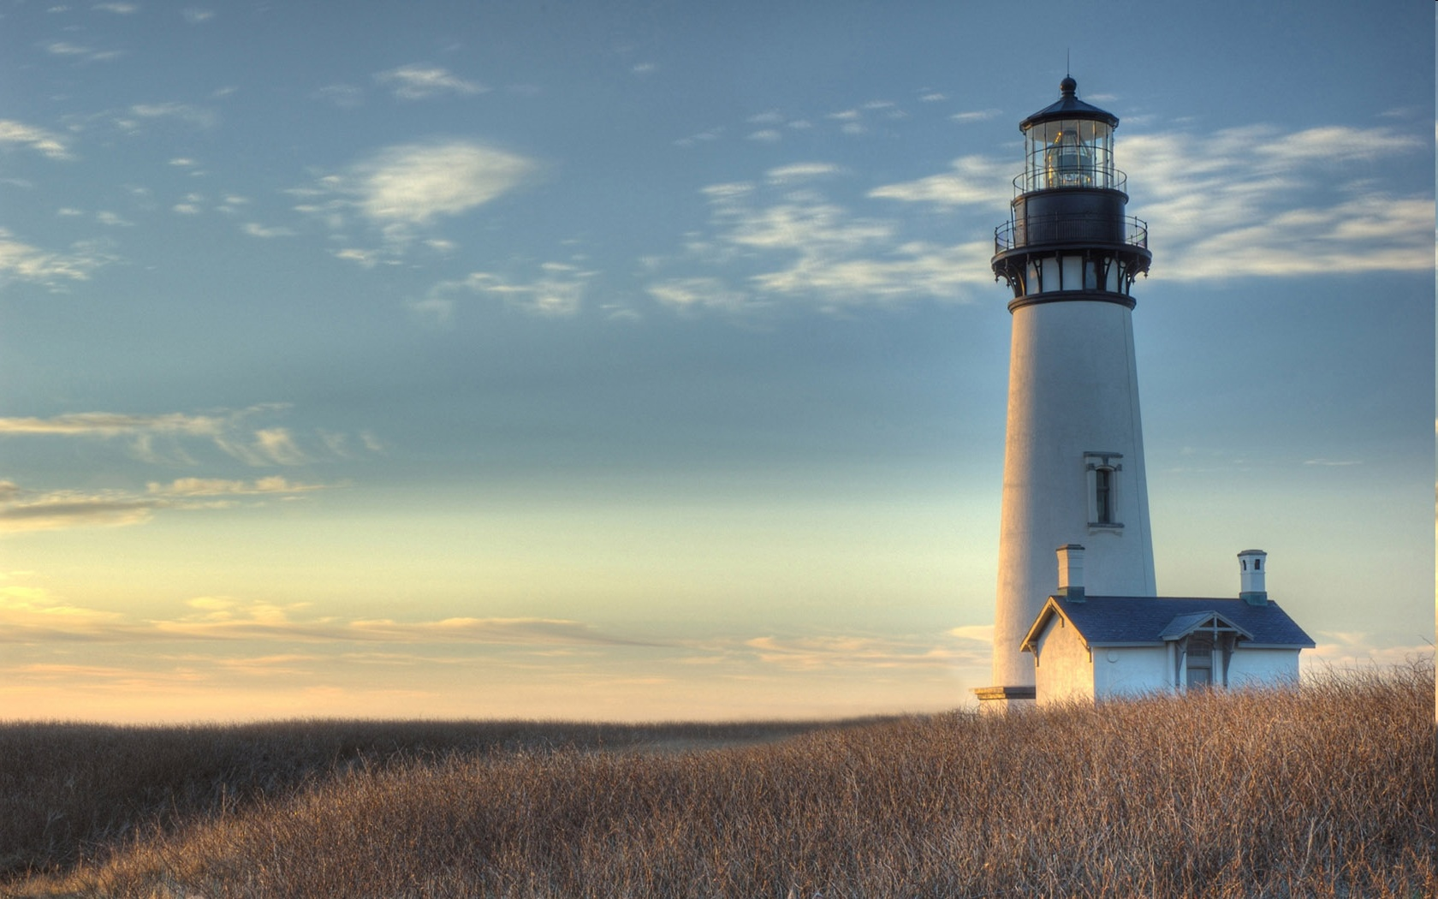
Chestnut Street
Baptist Church
Welcome!
Interim Lead Pastor Jeremy Johnson
Notes:
1

Slide 2

Tuesday 6:30 p.m.
Life Group at the Harmsen’s

Slide 3
Wednesday 6:30 p.m.
Ignition (Youth, Grades 6-12)
Prayer Group

Slide 4
Thursday 6:00 p.m.
Cross Walk for CWU and Young Adults

Slide 5
Friday 4:30 p.m.
LIFE Group (Briarwood)

Slide 6

Giving Options
(Thank you for supporting this ministry!)
Mail: 609 N. Chestnut St. Ellensburg, 98926
Online: Giving link at www.csbcfamily.com
In Person: Offering Box in lobby

Slide 7

Cornerstone Kids club begins
Kids Club will meet every Wednesday in the Fellowship Hall at 6:30 p.m. and conclude at 7:30 p.m. Children grades 1-5 are invited to learn about Jesus and how important He is! Please join us!

Slide 8
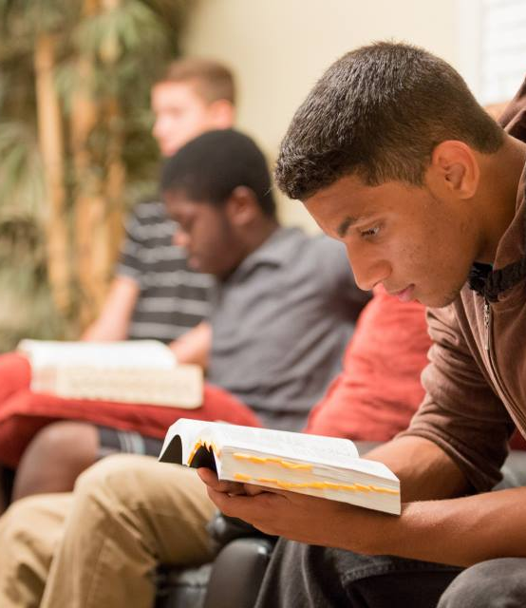
Crosswalk
6 p.m.
Young Adults and College Students!!
Dive into the Word and have free dinner, too!
Join every Thursday in the Fellowship Hall.
Dinner begins at 6 p.m. and Bible Study at 7 p.m.
Please join us!

Slide 9

Business Meeting October 18
Members, please join us for our business meeting Sunday at 6 p.m. in the Fellowship Hall. We will hear Ministry Reports and any new business. See you there!

Slide 10

Christmas Choir Begins Today!
Join us in the Fellowship Hall to sing Christmas praises to the Lord!
Choir will start at 4:30 p.m. and last until 6:00 p.m. Childcare will be provided.

Slide 11
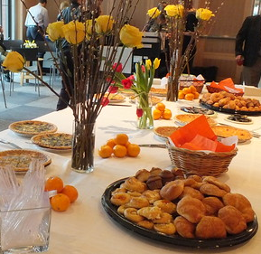
Women’s POTLUCK Breakfast October 17
Ladies, please join us for our monthly breakfast in the Fellowship Hall at 9 a.m. Fun and fellowship will be guaranteed!
Thoto by Unknown Author is licnder CC BY-NC

