Slide 1
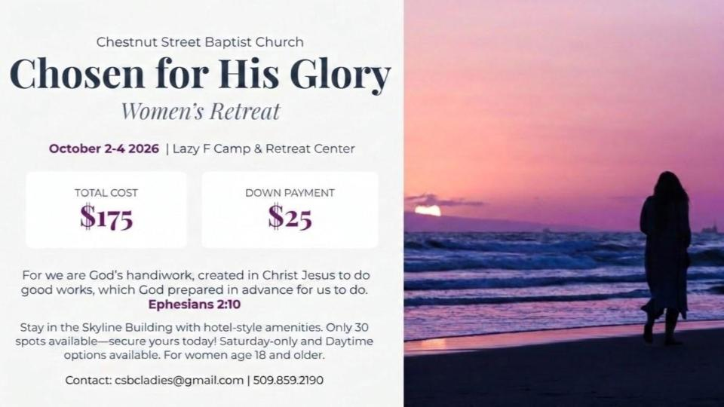

Slide 2

Business meeting august 16
August 16 at 6 p.m.
Fellowship Hall
We will discuss ministry reports and any new business.
Members needed!

Slide 3
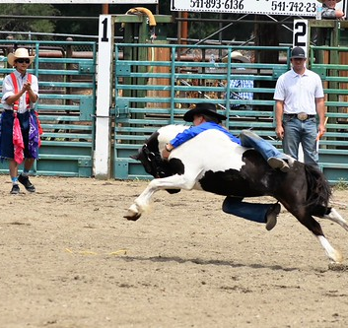
Rodeo & Fair
Fundraiser for Youth
We need adults to sign up with our youth to staff the parking lot during Fair and Rodeo Weekend, September 3-7.
The list is on the table in the foyer.
Help our youth attend Fuge Camp and more!

Slide 4

Women’s Potluck Breakfast
Join us in the Fellowship Hall August 15 at 9 a.m. for a potluck breakfast. If you can, please bring a breakfast item to share. See you there!

