Slide 1

Budget Requests
Ministry Team Leaders, please have all budget request in the office by November 9. Thank you for your expediency.
This Photo by Unknown Author is licensed under CC BY-SA

Slide 2

Choir Rehearsals Last Day to join
If you love to sing, join the Choir, meeting every Sunday at 4:30 p.m. The Choir Concert will be December 14. No experience needed, just a willingness to sing to the Lord! Today is the last day to join.

Slide 3

Bible Readers Club monthly meeting tonight
Join Pastor Jeremy for our monthly meeting to discuss last months readings. If you’d like to start reading, please join us!

Slide 4
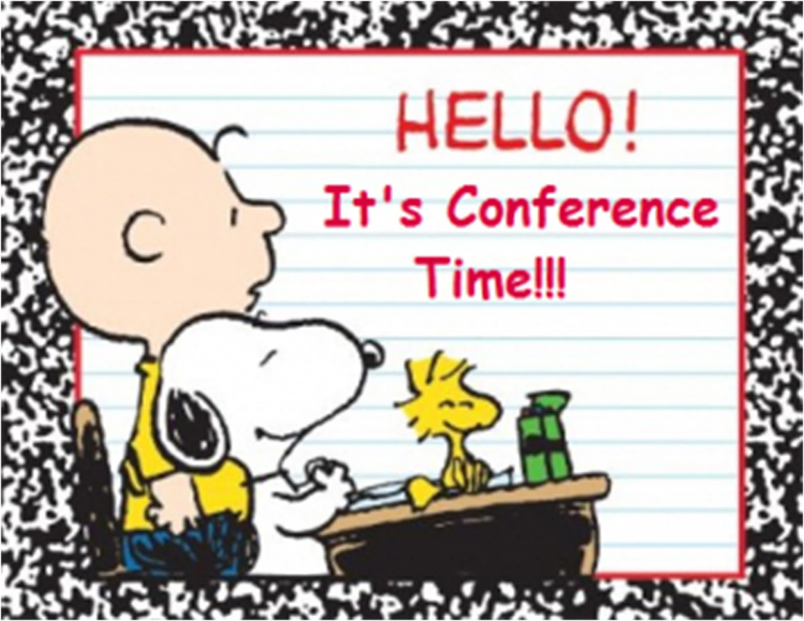
CWBA Fall meeting
Central Washington Baptist Association will be in Yakima at the Terrance Heights Baptist Church on November 4th at 6p.m. All are welcome, please join us.
This Photo by Unknown Author is licensed under CC BY-NC-ND

Slide 5

Men’s Breakfast Saturday November 8
Come and join the men for a wholesome breakfast at 8 a.m.

Slide 6
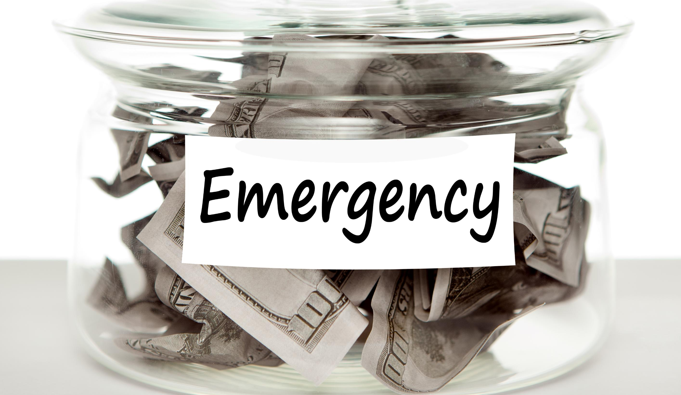
Emergency Medical fund
Help with expenses for our Youth Director, Aren Blackwood. His medical expenses are high, so if you could help, it will be much appreciated. Make sure to designate to “Youth Director Medical Emergency.”

