Slide 1
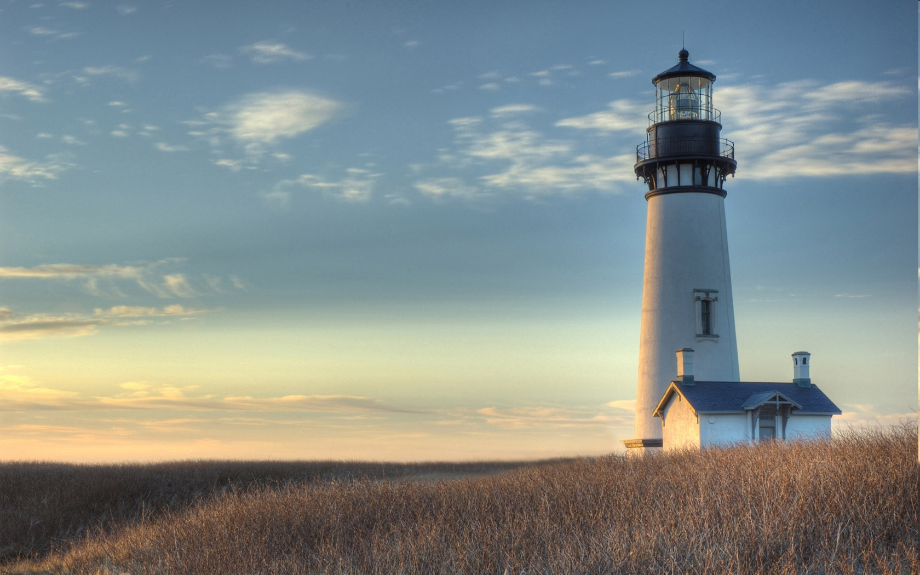
Chestnut Street Baptist Church
Welcome
Lead Pastor Frank R. Johnson Associate Pastor Jeremy Johnson
Notes:
1

Slide 2

Tuesday 6:30 p.m.
Life Group at the Harmsen’s

Slide 3
Wednesday 6:30 p.m.
Ignition (Youth Group), Cornerstone Kids Club,
Prayer Group

Slide 4
Thursday 6:00 p.m.
Cross Walk (University and Young Adults)

Slide 5
Friday 4:30 p.m.
LIFE Group (Briarwood)

Slide 6

Giving Options
(Thank you for supporting this ministry!)
Mail: 609 N. Chestnut St. Ellensburg, 98926
Online: Giving link at www.csbcfamily.com
In Person: Offering Box in lobby

Slide 7

Business Meeting April 26
Members, join us on April 26 for our business meeting at 6 p.m. in the Fellowship Hall. We will be going over ministry reports and seeking the Lord’s Will.

Slide 8

Women’s Potluck Breakfast
Ladies, join for breakfast on Saturday, April 18, at 9:00 a.m. as we share breakfast and discuss spiritual disciplines. Bring an item to share.
See you there!

Slide 9

Choir Performance April 19
Gather with us to hear the sweet sounds of the Chestnut Street Choir as they perform at 6 p.m. on Sunday April 19. Afterwards in the Fellowship Hall will be a Potluck Cookie Social, so bring your favorite cookies to share.

Slide 10
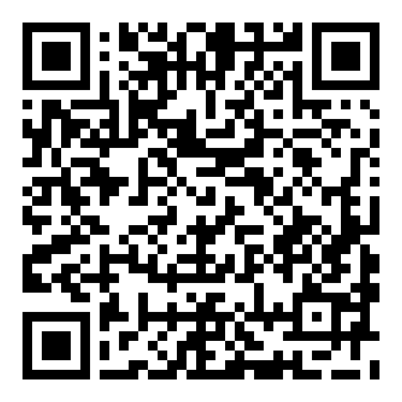

Annual Walk for Life for Care Net
Use the QR Code on the right to register or contribute to this campaign.
Join us on May 2 for the Walk for Life around the track at Morgan Middle School. Sign up to participate and start collecting sponsors now.
On separate note, they have found a traveling nurse to fill in for May & June. Praise God!
See bulletin for information on housing need.

Slide 11

Foyer Art
Next quarter, May through August, we want to do a variety of art in the foyer.
Participants should bring a piece of framed piece of painting or photo or any piece of art ready to hang, to the church building on Sunday April 26, or sometime that week.

