Slide 1
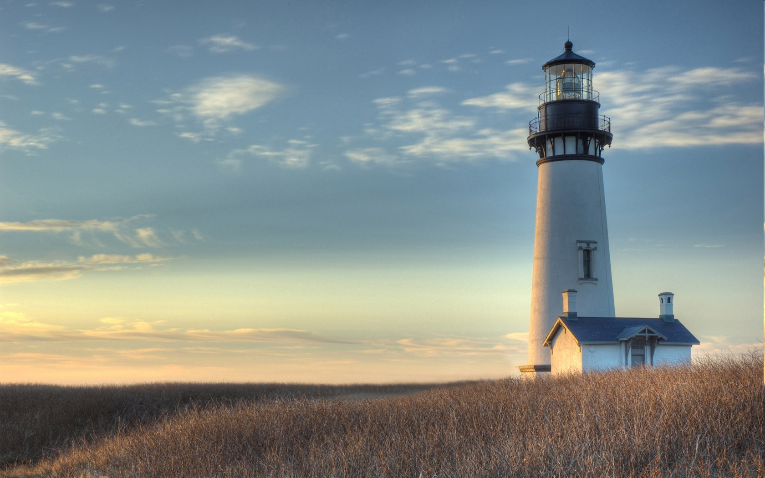
Chestnut Street Baptist Church
Welcome
Pastor Frank R. Johnson Associate Pastor Jeremy Johnson
Notes:
1

Slide 2

Tuesday 6:30 p.m.
Life Group at the Harmsen’s (paused)
Will meet again January 6th, 2026

Slide 3
Wednesday 6:00 p.m.
Christmas Eve Candlelight Service

Slide 4
Thursday 6:00 p.m.
Crosswalk (Young Adults) (paused)
Meeting again January 8th, 2026

Slide 5
Friday 4:30 p.m.
LIFE Group (Briarwood)(paused)
Will meet again on January 9, 2026

Slide 6
Keep on Praying!
If you would like to receive PrayerNet Today emails, send us a request at prayer@csbcfamily.com.
Stay connected: www.csbcfamily.com
Find us on Facebook

Slide 7
Giving Options
(Thank you for supporting this ministry!)
Mail: 609 N. Chestnut St. Ellensburg, 98926
Online: Giving link at www.csbcfamily.com
In Person: Offering Box in lobby

Slide 8
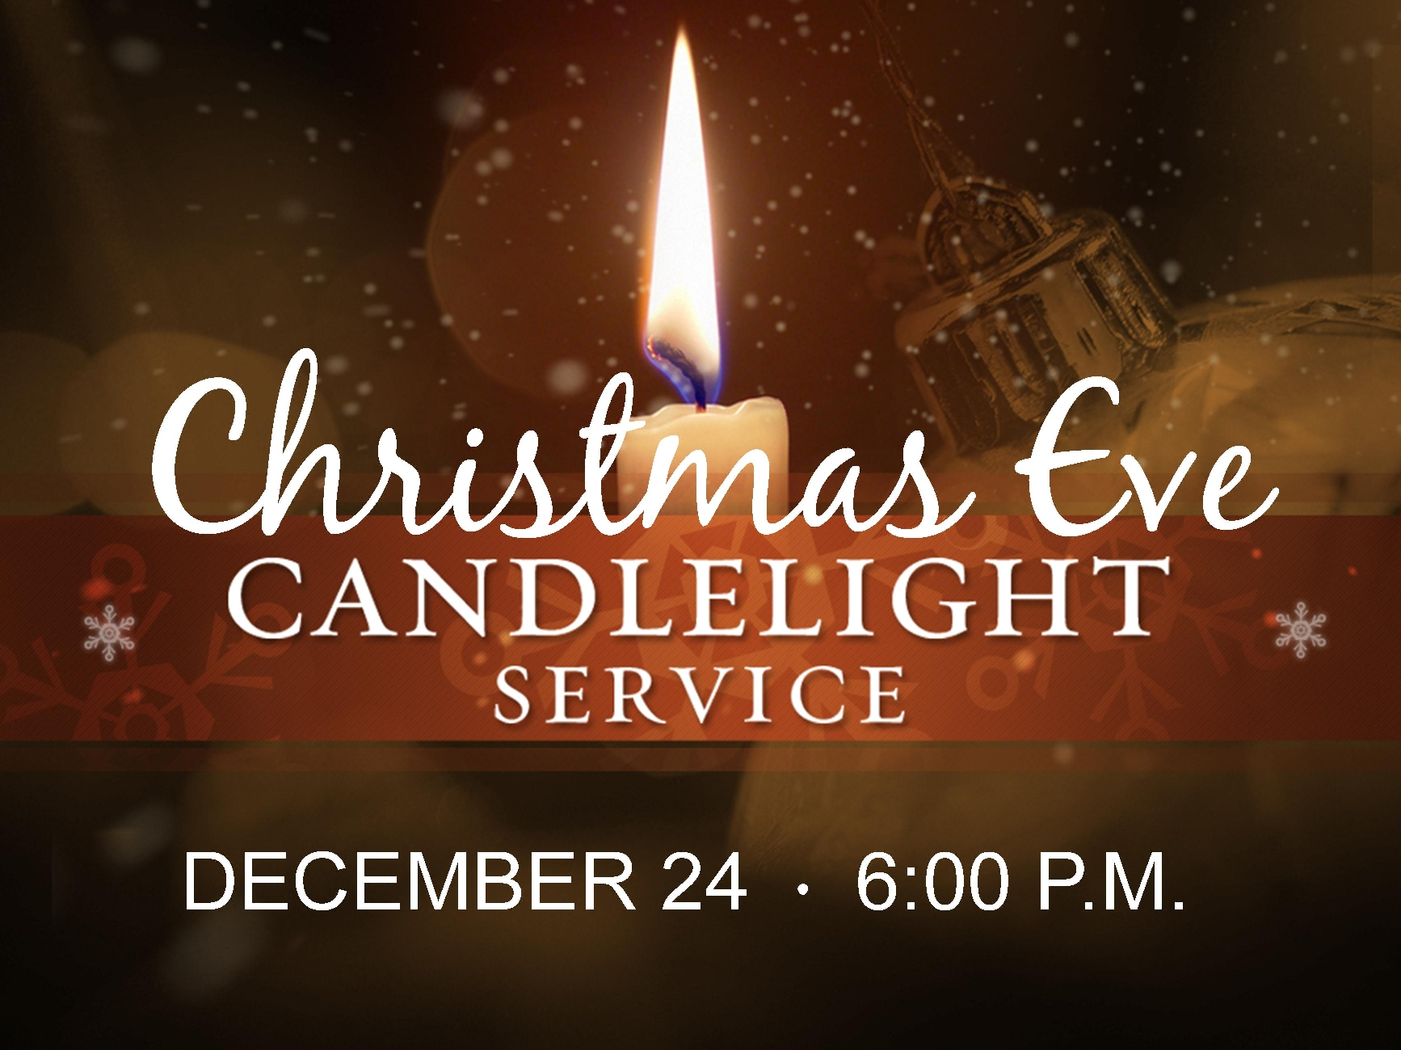
Come join in a brief and meaningful time of songs and readings Christmas Eve night. Bring a friend and expect the service to last under one hour.

Slide 9

Lottie Moon Christmas Offering
Together We Can Do More Our church is joining with others this Christmas in giving to to support missions through the International Mission Board. To give, designate to “Lottie Moon” or select the drop-down online.

Slide 10

Caring for Our Church and Pastors
Deacons Christmas Baskets and Pastors’ Christmas Gifts Share some of the blessings God has provided for you by blessing our members and appreciating our Pastors.

Slide 11

Angel Tree- Thank you for those who participated! There were twenty-two children blessed in the name of their parent! You made many children joyful.

Slide 12

Business Meeting
Members, please join us for our Business Meeting tonight at 6p.m. in the Fellowship Hall.

