Slide 1
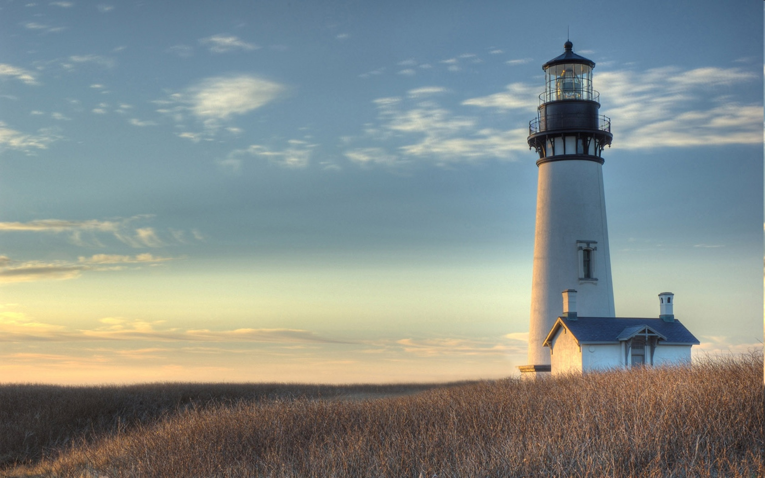
Chestnut Street
Baptist Church
Thank you for joining us!
Notes:
1

Slide 2

Tuesday 6:30 p.m.
Life Group at the Harmsen’s

Slide 3
Wednesday 6:30 p.m.
Ignition (Youth, Grades 6-12)
Prayer Group
Cornerstone Kids Club
(Grades 1-5)

Slide 4
Thursday 6:00 p.m.
Crosswalk for CWU and Young Adults

Slide 5
Friday 4:30 p.m.
LIFE Group (Briarwood)

Slide 6

Giving Options
(Thank you for supporting this ministry!)
Mail: 609 N. Chestnut St. Ellensburg, 98926
Online: Giving link at www.csbcfamily.com
In Person: Offering Box in lobby

Slide 7

CALLED BUSINESS MEETING NOVEMBER 8
The Pastoral Transition Team has called a business meeting at 6 p.m. to present the candidate they have chosen, Jeremy Johnson. Members, please be there to cast your vote. We will meet in the Worship Center.

Slide 8

Church workday Saturday
November 14
Join us on Saturday, November 14 when we gather with the Building and Grounds crew to finish a few things around the church building. We will begin at 9 a.m. and should be finished by 1 p.m. See you there!

Slide 9
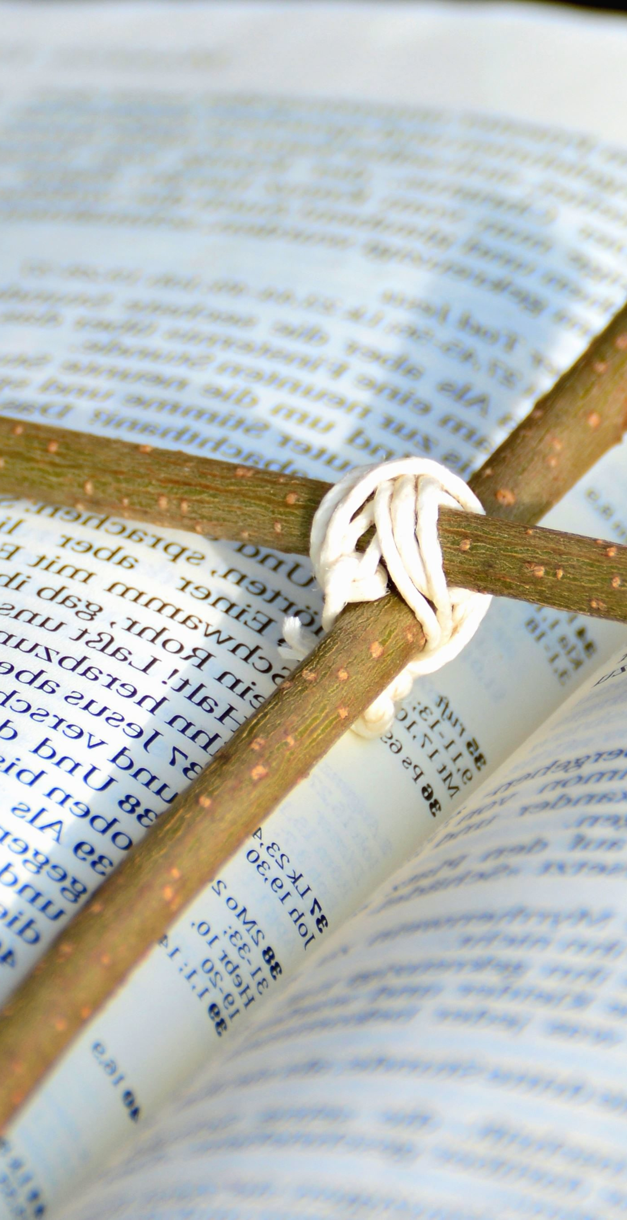
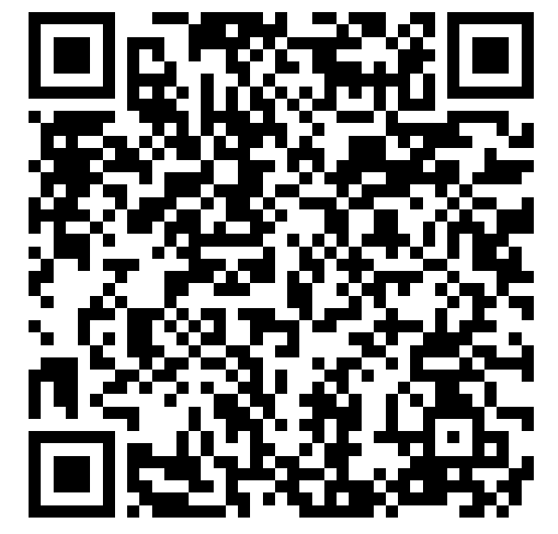
Bible Reader’s Club
Join us tonight at 6 p.m. in the Fellowship Hall to discuss our past month’s readings. If you are reading the Bible on your own, come and talk about it. If you are wanting to join, scan the QR code below. We’d love to have you!

Slide 10

Missed The Nutshell in your mailbox? Update your address on a welcome slip and we’ll send one your way!
The Nutshell

