Slide 1
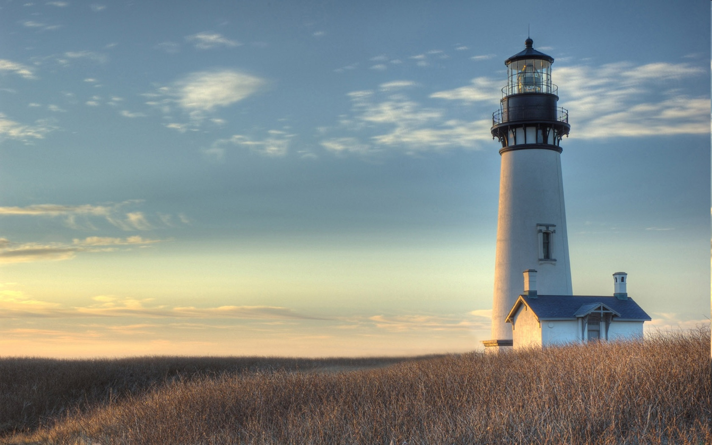
Chestnut Street
Baptist Church
Welcome!
Lead Pastor Frank R. Johnson
Associate Pastor Jeremy Johnson
Notes:
1

Slide 2

Tuesday 6:30 p.m.
Life Group at the Harmsen’s
(On Hiatus for the Summer)

Slide 3
Wednesday 6:30 p.m.
Ignition (Youth Group), Prayer Group

Slide 4
Thursday 6:00 p.m.
Summer Sizzle (Young Adults)

Slide 5
Friday 4:30 p.m.
LIFE Group (Briarwood)

Slide 6

Giving Options
(Thank you for supporting this ministry!)
Mail: 609 N. Chestnut St. Ellensburg, 98926
Online: Giving link at www.csbcfamily.com
In Person: Offering Box in lobby

Slide 7
Sign up for lawn mowing!
Please help us this summer by signing up to mow the lawn. Mow on Thurs.-Sat. of the week for which you sign up (after 5:30 p.m. on weekdays).
Building and Grounds Team will have the mower ready. Check with the office or a team member to get the combination to the lock on the shed.

Slide 8
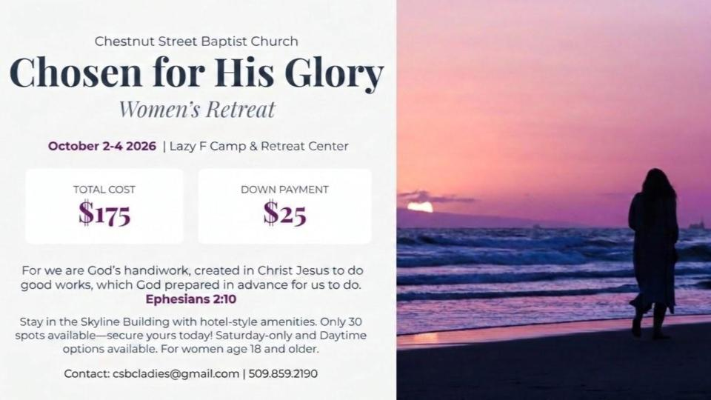

Slide 9


Slide 10

Women’s Potluck Breakfast July 18
Fellowship Hall
9 a.m.
Get together with your fellow believers and bring a dish to share this Saturday.

Slide 11

Vacation Bible School is near!
Sunday-Thursday, July 26-30
Dinner for participating families, 5:30 p.m.
VBS Program, 6-8:15 p.m.
Children age 3-completed 5th grade
Pray! Give! Enlist!

Slide 12

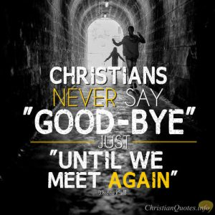
Potluck Dinner Next Sunday
July 19-Fellowship Hall
After the service, approximately noon
Please bring a main dish and a salad/dessert with enough for your family and guests.
A chance to honor the Congers

Slide 13

Thank you for your faithful giving
God bless all who give faithfully and generously to this outpost of God’s kingdom!
We have had a couple of lean months, so we appreciate your faithfulness even more.

