Slide 1
Vacation Bible School
July 28-Aug. 1
3 years-5th Grade
Registration is open!

Slide 2
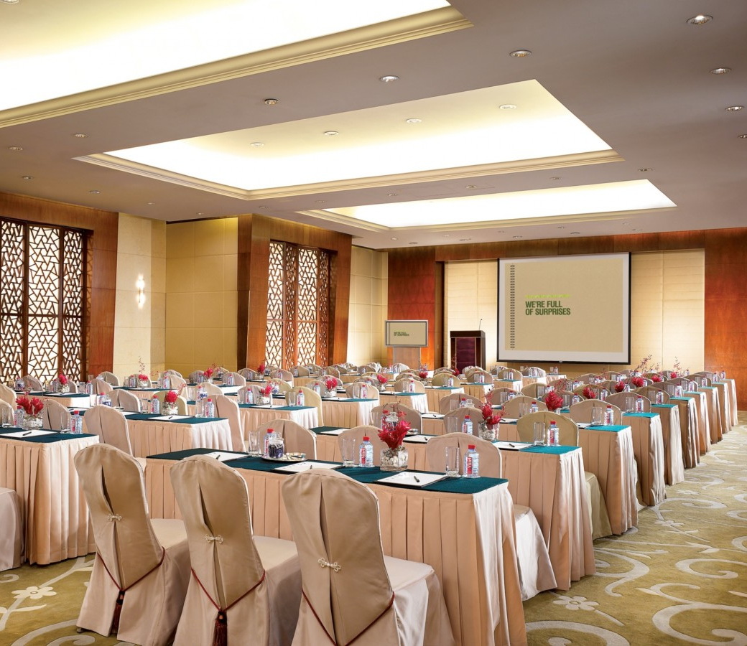
Business Meeting Tonight
All members, please plan to attend the Business Meeting at 6:00 p.m.
Let’s seek the Lord’s will together.

Slide 3
Central Asia Missions Trip
We are sending four members to Central Asia in August to support our missionaries there. The group is raising $4,000 for expenses. You can help! Designate offering to “Central Asia Missions.”

Slide 4
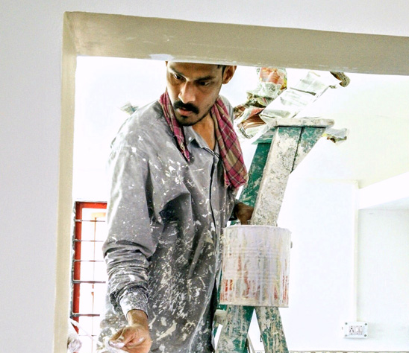
Painting Project Coming
We are planning to paint the outside of our building in August. We need some volunteers to help prepare the building the first week of August. See B+G Team members for more info.

Slide 5
www.fidelitymonth.com

