Slide 1
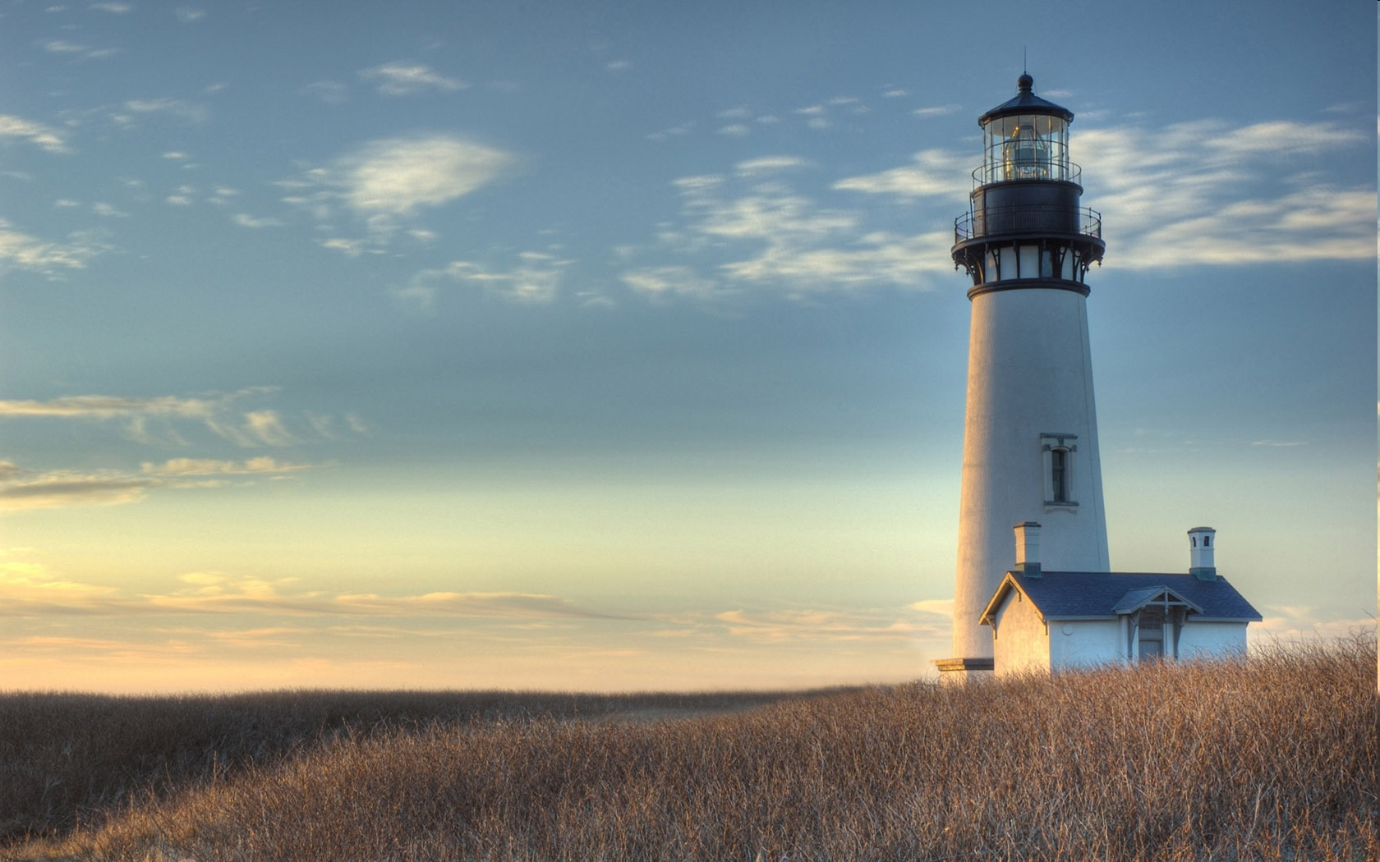
Chestnut Street Baptist Church
Welcome
Pastor Frank R. Johnson Associate Pastor Jeremy Johnson
Notes:
1

Slide 2

Tuesday 6:30 p.m.
Life Group (at the Harmsen’s)

Slide 3
Wednesday 6:00 p.m.
Prayer Group
Ignition (Grades 6-12)
Cornerstone Kids Club (Grades 1-5)

Slide 4
Thursday 6:00 p.m.
Crosswalk (Young Adults)

Slide 5
Friday 4:30 p.m.
LIFE Group (Briarwood)

Slide 6
Keep on Praying!
If you would like to receive PrayerNet Today emails, send us a request at prayer@csbcfamily.com.
Stay connected: www.csbcfamily.com
Find us on Facebook

Slide 7
Giving Options
(Thank you for supporting this ministry!)
Mail: 609 N. Chestnut St. Ellensburg, 98926
Online: Giving link at www.csbcfamily.com
In Person: Offering Box in lobby

Slide 8

Lottie Moon Christmas Offering until January 11, 2026
Together We Can Do More Thank you to all who have given to the missions offering this Christmas season. 100% of the offerings go to missionaries and projects God is asking them to perform. We will continue this special offering though Sunday January 11, 2026.
To give, designate to “Lottie Moon” or select the drop-down online.

Slide 9
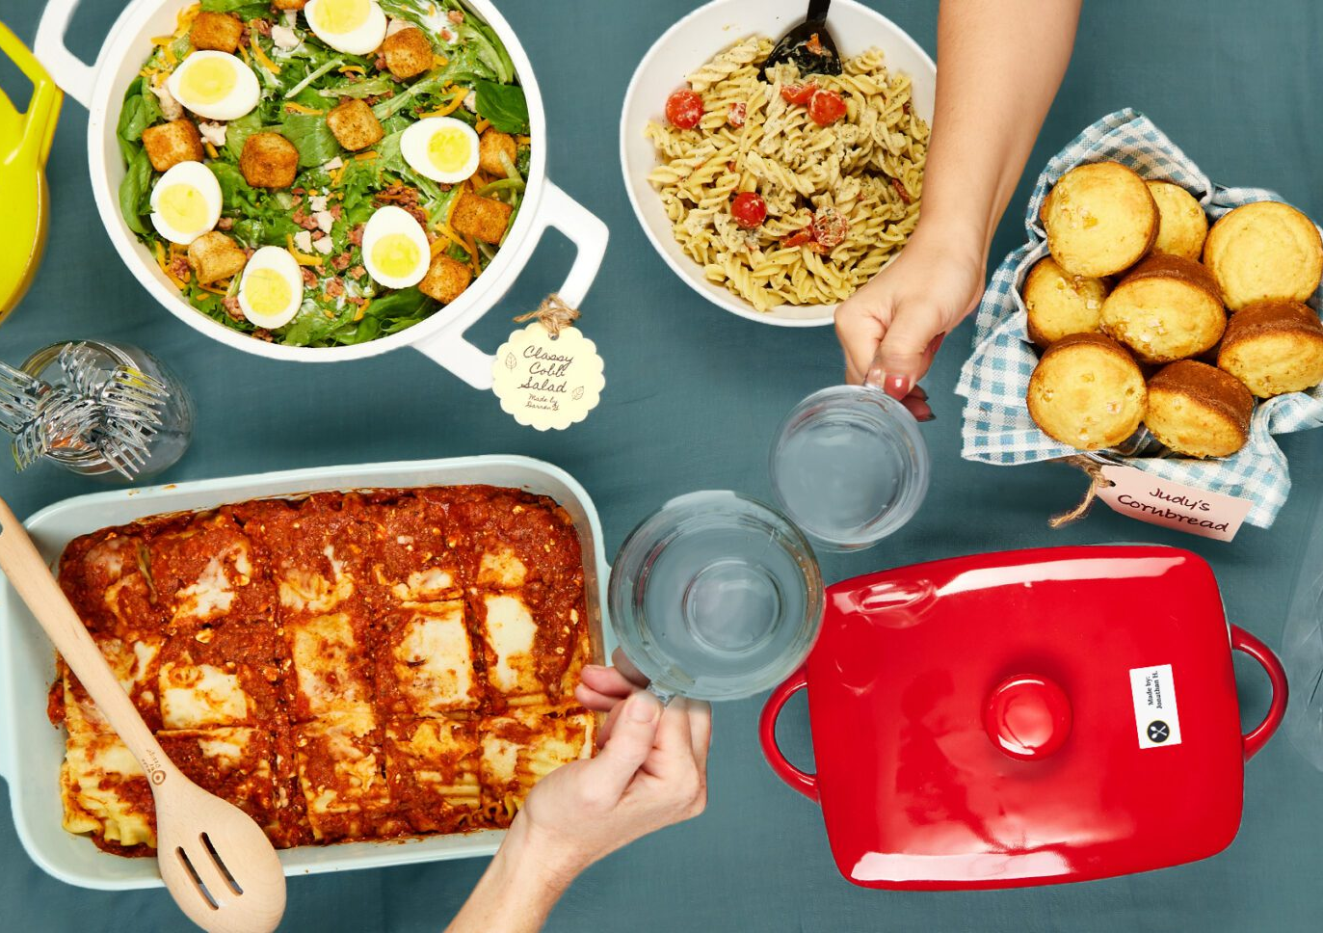
Potluck Today
Join us for a potluck after the morning service to welcome Pastor Frank’s return. Please bring an item to share and come for the fellowship and welcome back Pastor Frank and Jeannie.

Slide 10

Bible Readers Club Meeting Tonight!
Please pick up a reading guide on the table in the foyer and join us for our meeting tonight at 6 p.m. in the Fellowship Hall.
We go through past readings and look forward to the New Year. Come and join us!

Slide 11
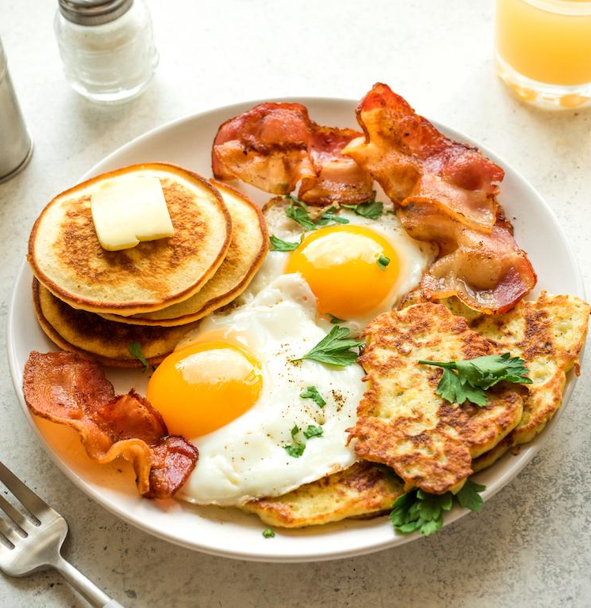
Men’s Breakfast Saturday Jan 10th at 8:00 a.m.

