Slide 1
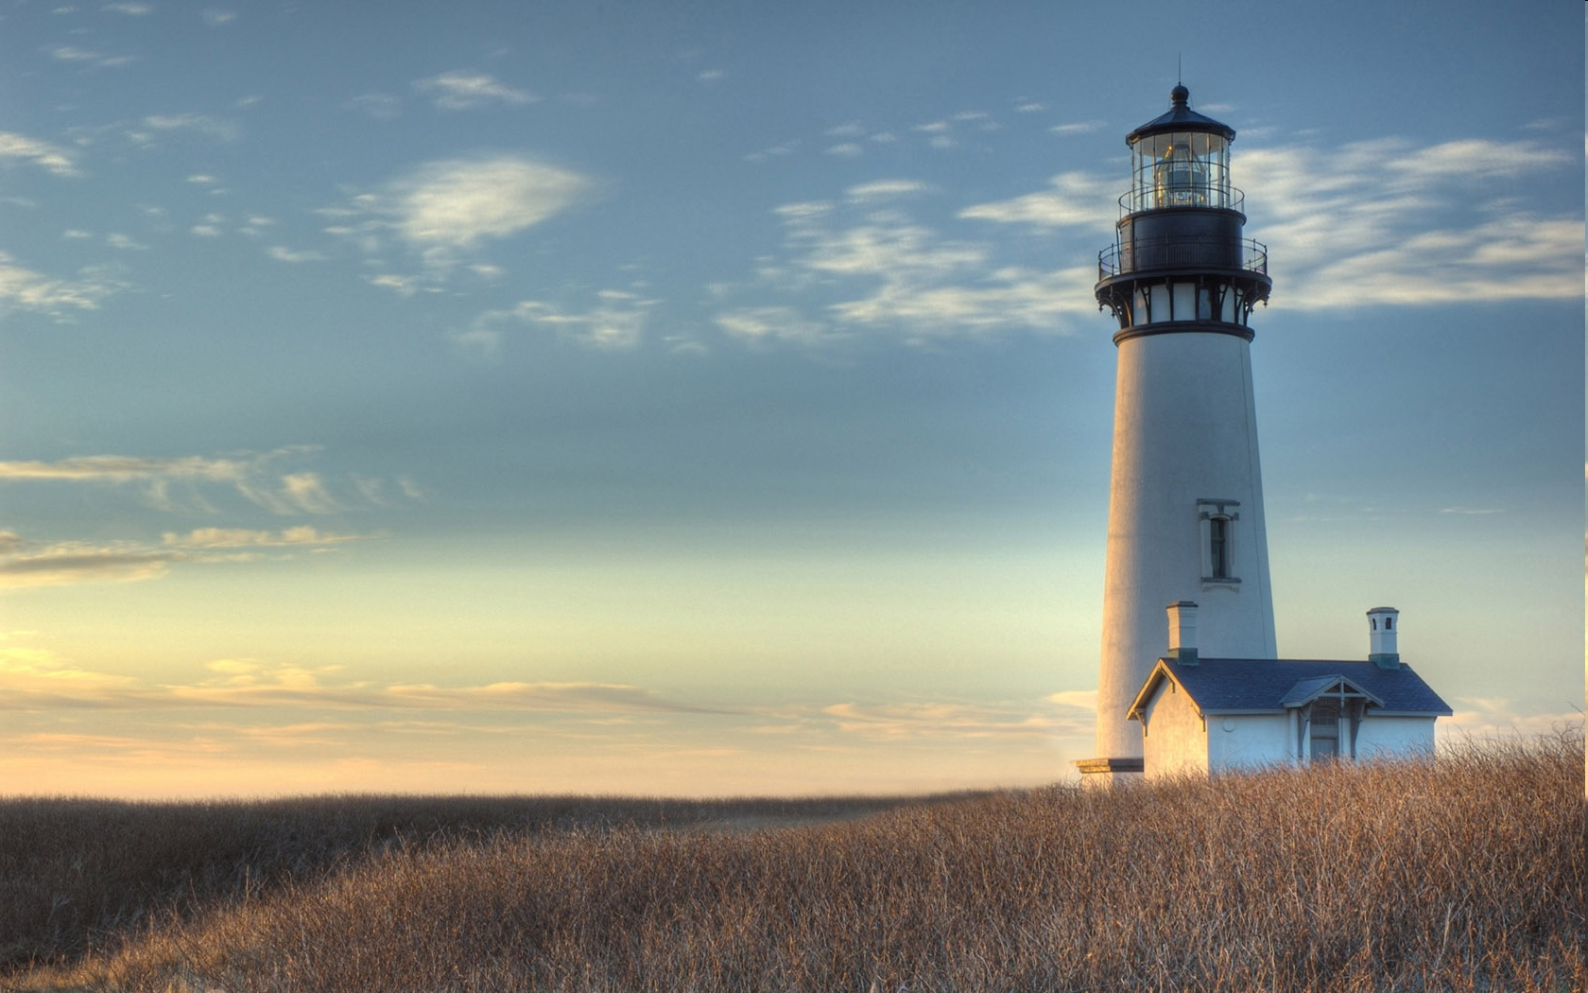
Chestnut Street Baptist Church
Welcome
Lead Pastor Frank R. Johnson Associate Pastor Jeremy Johnson
Notes:
1

Slide 2

Tuesday 6:30 p.m.
Life Group at the Harmsen’s

Slide 3
Wednesday 6:30 p.m.
Ignition (Youth Group), Cornerstone Kids Club,
Prayer Group

Slide 4
Thursday 6:00 p.m.
Cross Walk (University and Young Adults)

Slide 5
Friday 4:30 p.m.
LIFE Group (Briarwood)

Slide 6

Giving Options
(Thank you for supporting this ministry!)
Mail: 609 N. Chestnut St. Ellensburg, 98926
Online: Giving link at www.csbcfamily.com
In Person: Offering Box in lobby

Slide 7
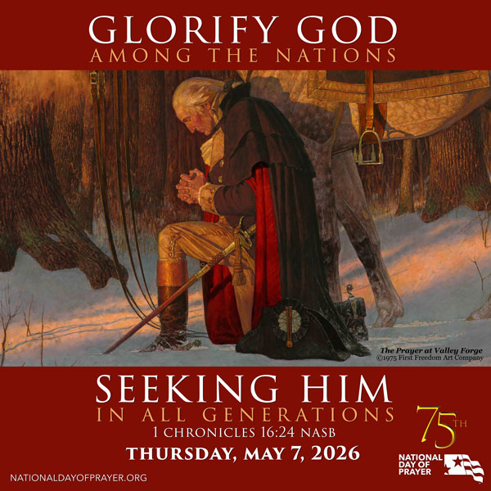

Slide 8
National Day of prayer
Local Christian event on Thursday, May 7, noon
Unity Park in downtown Ellensburg
Sponsored by the Kittitas Valley Ministerial Association

Slide 9
Sign up for lawn mowing!
Please help us this summer by signing up to mow the lawn. Mow on Thurs.-Sat. of the week for which you sign up (after 5:30 p.m. on weekdays).
Building and Grounds Team will have the mower ready. Check with the office or a team member to get the combination to the lock on the shed.

Slide 10

bible Readers Club Today!
Join us in the Fellowship hall at 6 p.m. for the monthly discussion of our April readings. If you would like to take part, please speak to pastor Jeremy or just come!

Slide 11

Pray for the Persecuted Church
Pick up a world watch list 2026 prayer guide from Open Doors International and pray for those persecuted for their faith. The lists are on the table by the elevator.

Slide 12
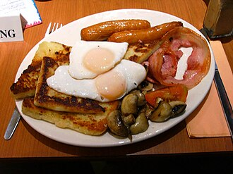
Men’s Breakfast May 9
8 a.m.
Fellowship Hall
Come for fellowship and good food!

Slide 13
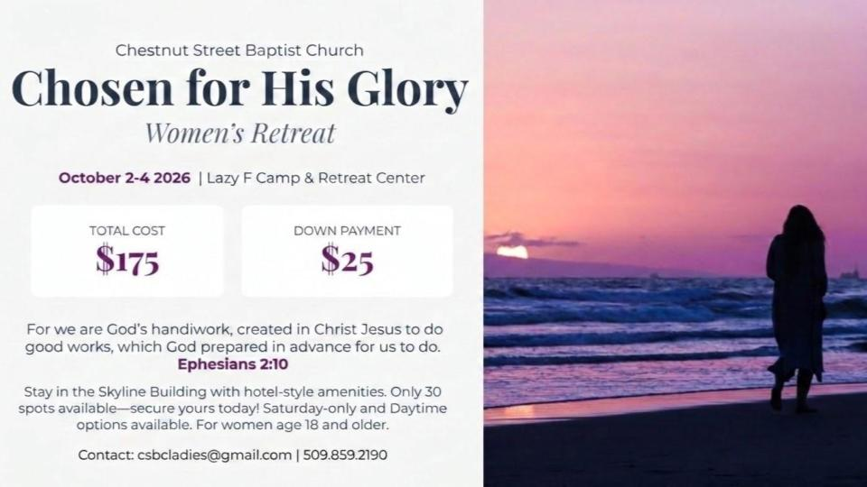

Slide 14


Slide 15


Slide 16


