Slide 1
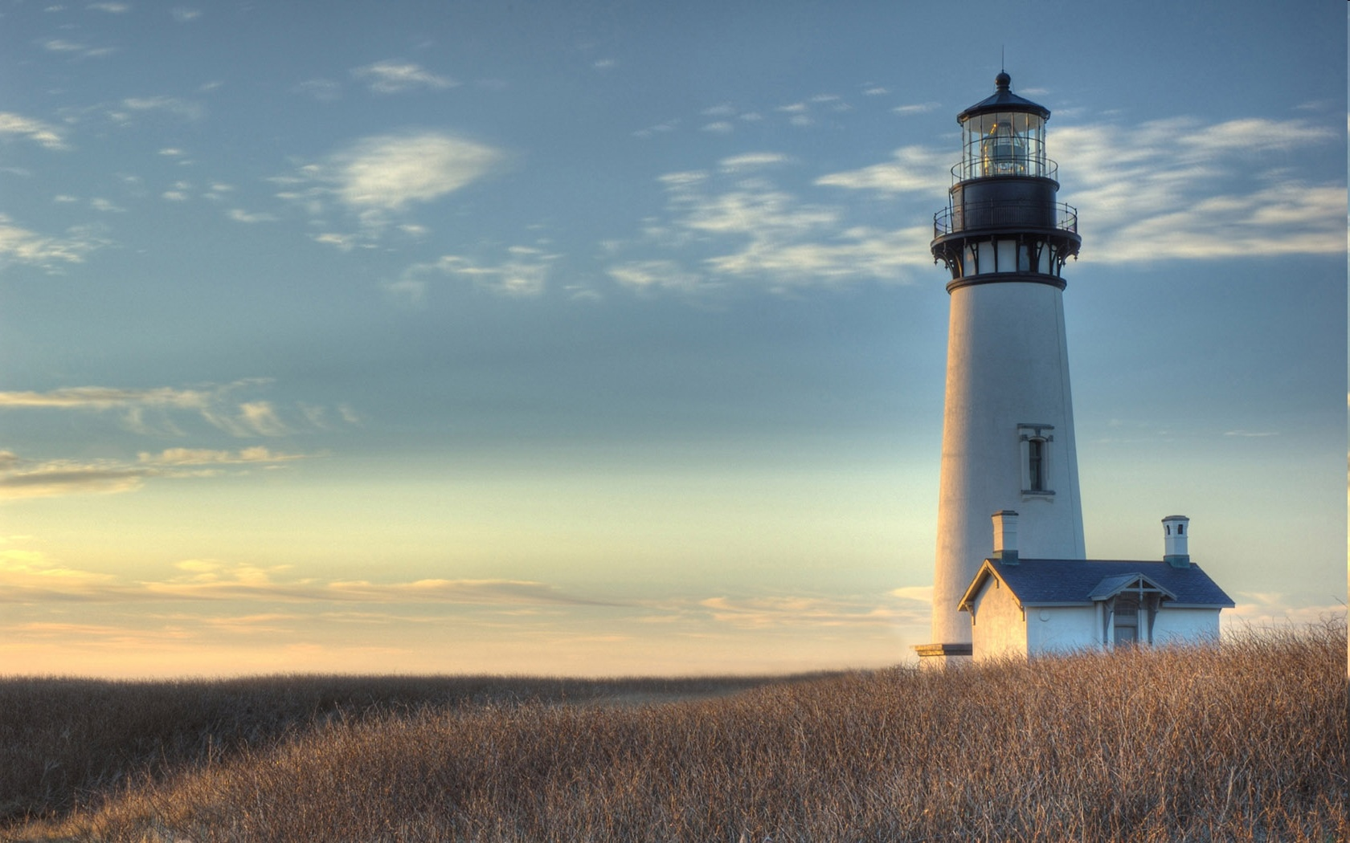
Chestnut Street
Baptist Church
Welcome!
Lead Pastor Frank R. Johnson
Associate Pastor Jeremy Johnson
Notes:
1

Slide 2

Tuesday 6:30 p.m.
Life Group at the Harmsen’s
(On Hiatus for the Summer)

Slide 3
Wednesday 6:30 p.m.
Ignition (Youth, Grades 6-12)
Prayer Group

Slide 4
Thursday 6:00 p.m.
Summer Sizzle for CWU and Young Adults
See Pastor Jeremy

Slide 5
Friday 4:30 p.m.
LIFE Group (Briarwood)

Slide 6

Giving Options
(Thank you for supporting this ministry!)
Mail: 609 N. Chestnut St. Ellensburg, 98926
Online: Giving link at www.csbcfamily.com
In Person: Offering Box in lobby

Slide 7
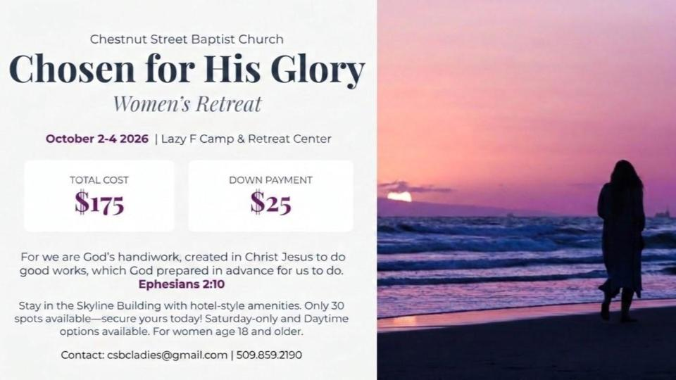

Slide 8
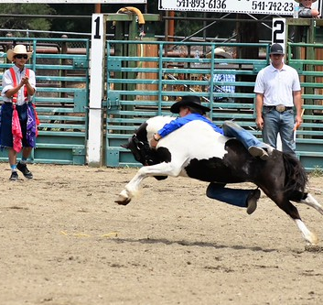
Rodeo & Fair
Fundraiser for Youth
We need adults to sign up with our youth to staff the parking lot during Fair and Rodeo Weekend, September 3-7.
The list is on the table in the foyer.
Help our youth attend Fuge Camp and more!

