Slide 1
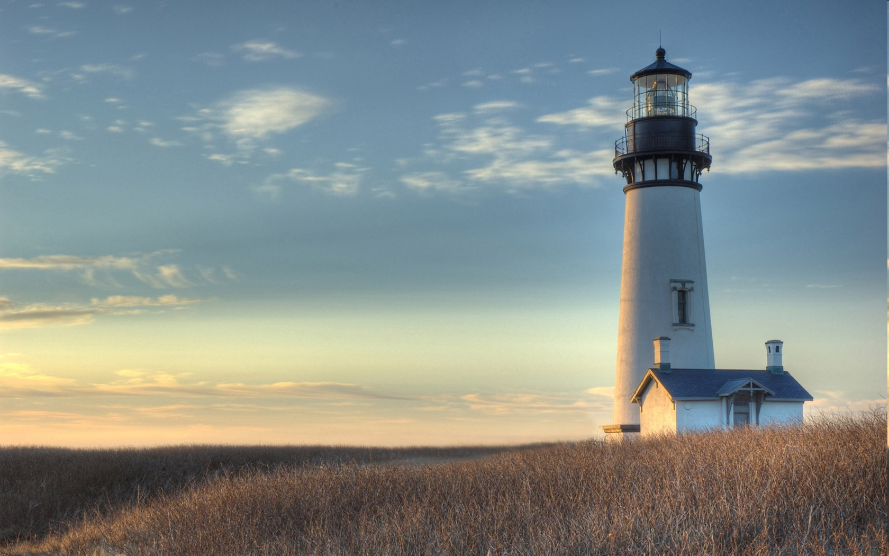
Chestnut Street Baptist Church
Welcome
Pastor Frank R. Johnson Associate Pastor Jeremy Johnson
Notes:
1

Slide 2

Tuesday 6:30 p.m.
Life Group at the Harmsen’s

Slide 3
Wednesday 6:30 p.m.
Prayer Group
Ignition (Grades 6-12)
Cornerstone Kids Club (Grades 1-5)

Slide 4
Thursday 6:00 p.m.
Cross Walk (Young Adults)

Slide 5
Friday 4:30 p.m.
LIFE Group (Briarwood)

Slide 6

Giving Options
(Thank you for supporting this ministry!)
Mail: 609 N. Chestnut St. Ellensburg, 98926
Online: Giving link at www.csbcfamily.com
In Person: Offering Box in lobby

Slide 7
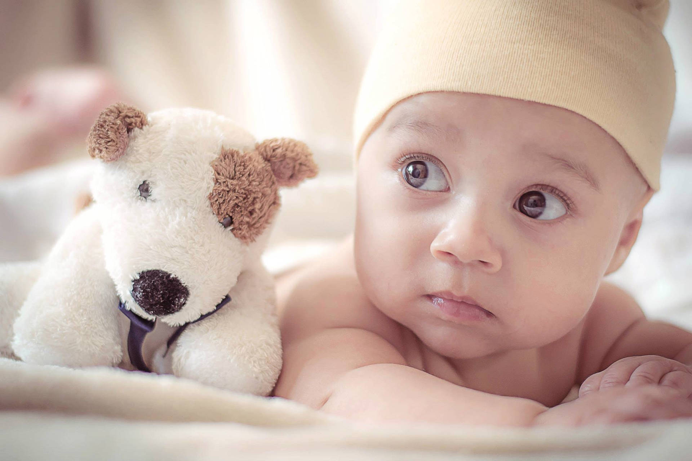

Baby Bottle Campaign
We are at the end of our Baby Bottle Campaign for the Care Net Pregnancy Center. Please put your bottles in front of the pulpit today, March 1. Thank you for being an important part of Care-Net!

Slide 8
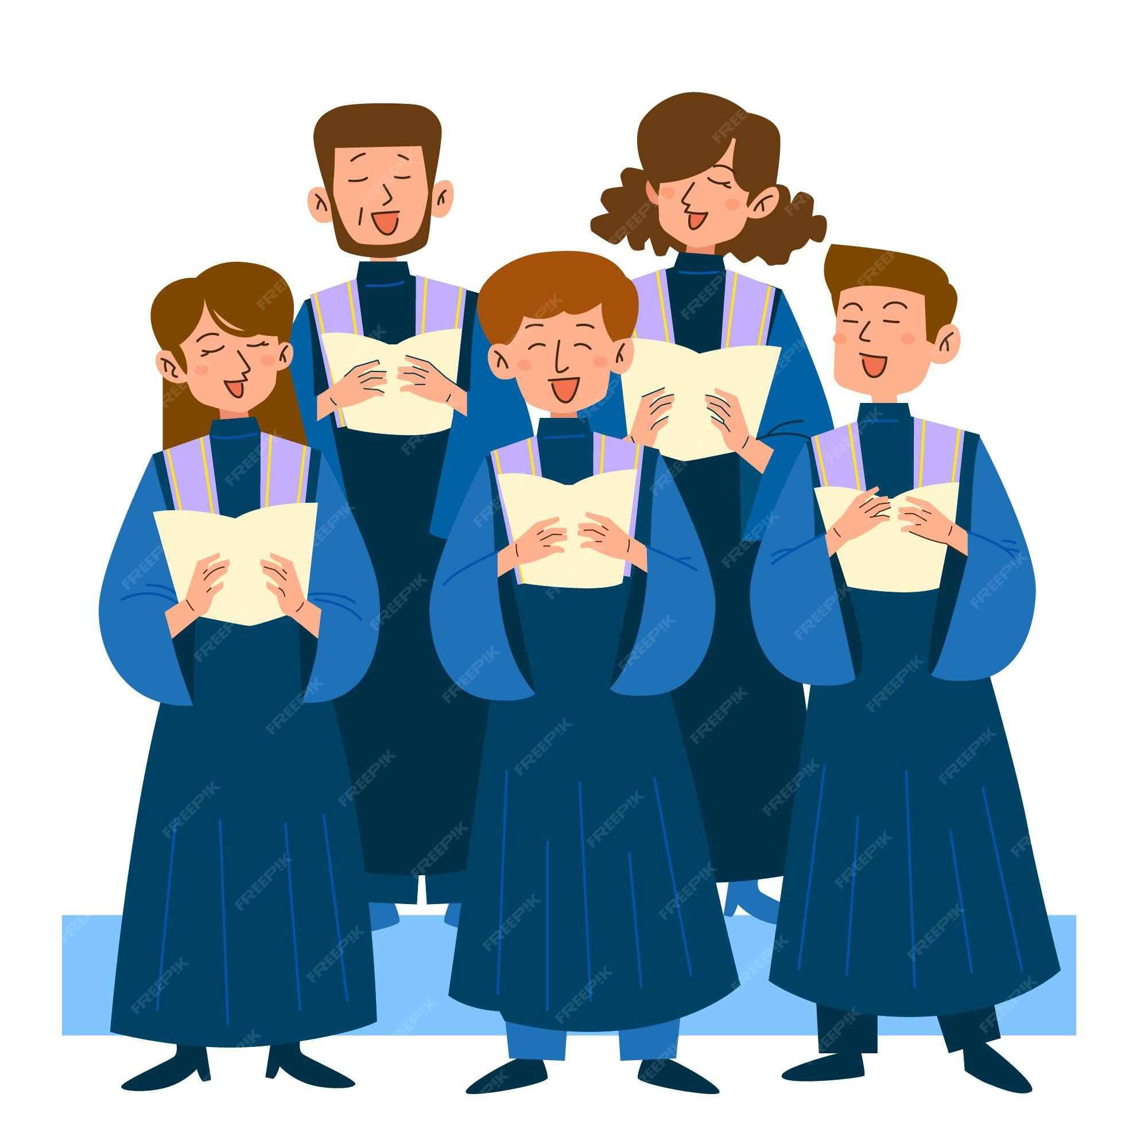
Today is the Last day to join the Easter choir
Rehearsals are Sunday at 4:30 p.m.
Performance April 19 at 6 p.m.
No experience needed (7th grade to adult) Childcare provided.

Slide 9
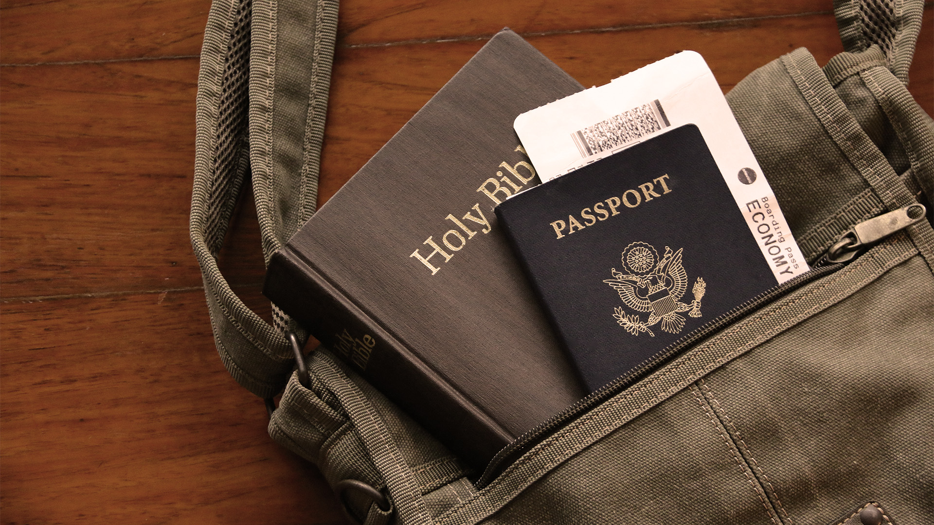

Short Term Mission Trip
Our Missions Team is partnering with Solid Rock Church in Grant’s Pass, Oregon to work with Helping Hands International in Baja, Mexico, August 23-29. Here is the QR code where you can find out information about the trip. See bulletin for more information.

Slide 10
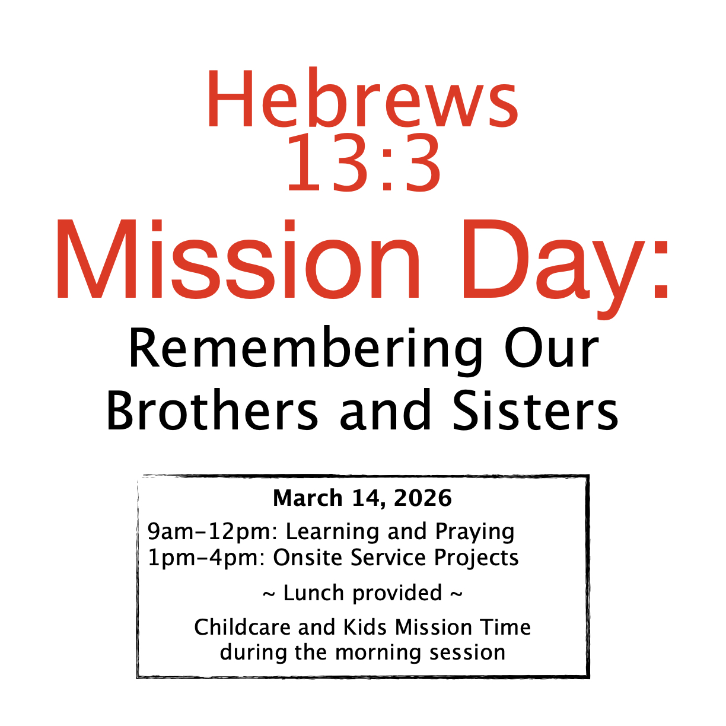
Join us to learn about our brothers and sisters who are being persecuted. Learn about which countries and the people who are involved. Help us to pray mightily for them.

Slide 11

Bible Readers Club Meets Tonight
Join us in the Fellowship Hall at 6 p.m. to discuss February readings. If you would like to read with us, find a March slip on the table in the Foyer. See you there!

