Slide 1
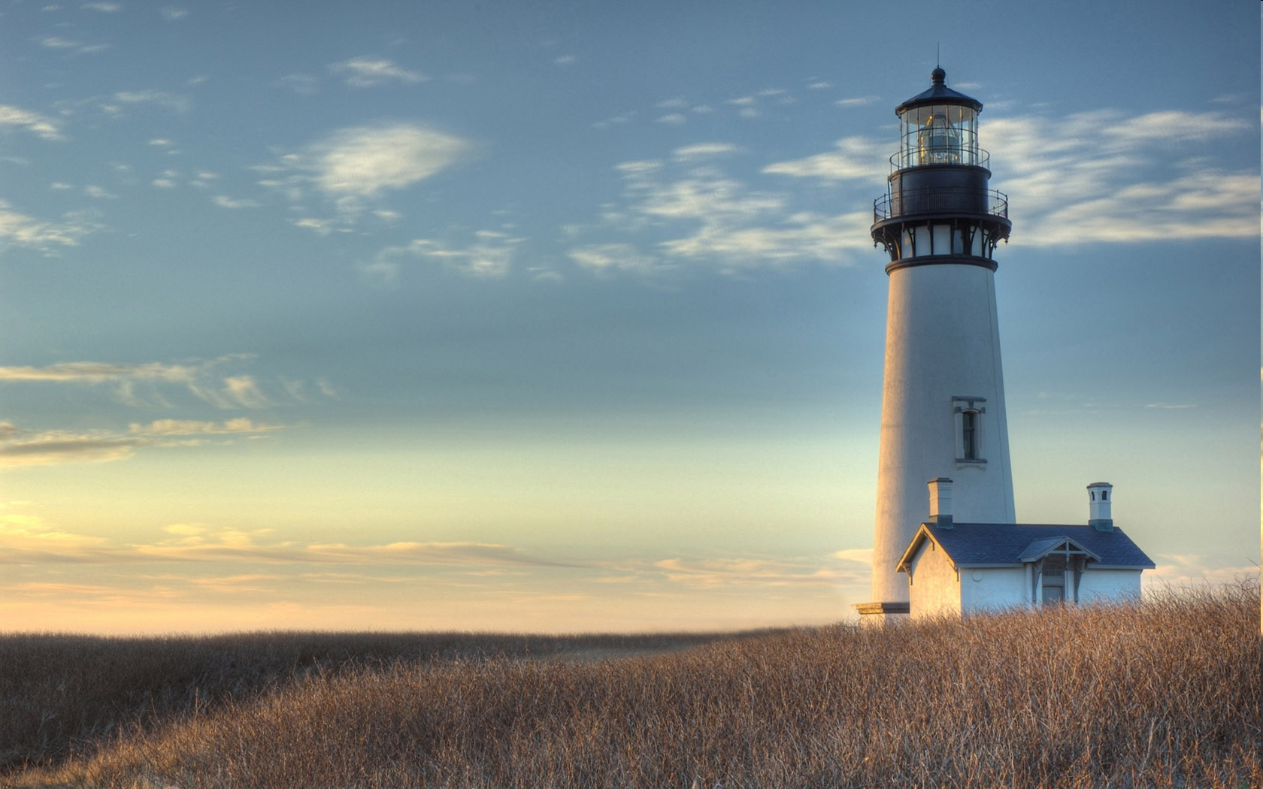
Chestnut Street
Baptist Church
Welcome!
Lead Pastor Frank R. Johnson
Associate Pastor Jeremy Johnson
Notes:
1

Slide 2

Tuesday 6:30 p.m.
Life Group at the Harmsen’s

Slide 3
Wednesday 6:30 p.m.
Ignition (Youth Group), Cornerstone Kids Club,
Prayer Group

Slide 4
Thursday 6:00 p.m.
Cross Walk (University and Young Adults)

Slide 5

Giving Options
(Thank you for supporting this ministry!)
Mail: 609 N. Chestnut St. Ellensburg, 98926
Online: Giving link at www.csbcfamily.com
In Person: Offering Box in lobby

Slide 6
Friday 4:30 p.m.
LIFE Group (Briarwood)

Slide 7

Bus driver outreach
This is an opportunity to make our Bus Driver’s Summer great!
Buy 30 of the same item for the Bus Drivers and Staff
Some suggestions are granola bars, snacks, puzzle books, anything to make their summer more special.
If there are any questions, please speak to Jeannie Johnson

Slide 8

Local mission trip
An opportunity to bless our sister church, Terrace Heights in Yakima
The Mission Team is putting together a group to prepare the building to be painted.
Dates will be June 15-19 (Monday through Friday)
If anyone is available to help, please speak with Pastor Jeremy or Bryce Harmsen

Slide 9

Bible readers club tonight
Please join us tonight as we discuss our May readings. If you would like to join, please pick up a slip for June on the table in the Foyer or please come to the Fellowship Hall at 6 p.m. See you there!

Slide 10
Sign up for lawn mowing!
Please help us this summer by signing up to mow the lawn. Mow on Thurs.-Sat. of the week for which you sign up (after 5:30 p.m. on weekdays).
Building and Grounds Team will have the mower ready. Check with the office or a team member to get the combination to the lock on the shed.

Slide 11

Pray for the Persecuted Church
Pick up a world watch list 2026 prayer guide from Open Doors International and pray for those persecuted for their faith. The lists are on the table by the elevator.

Slide 12
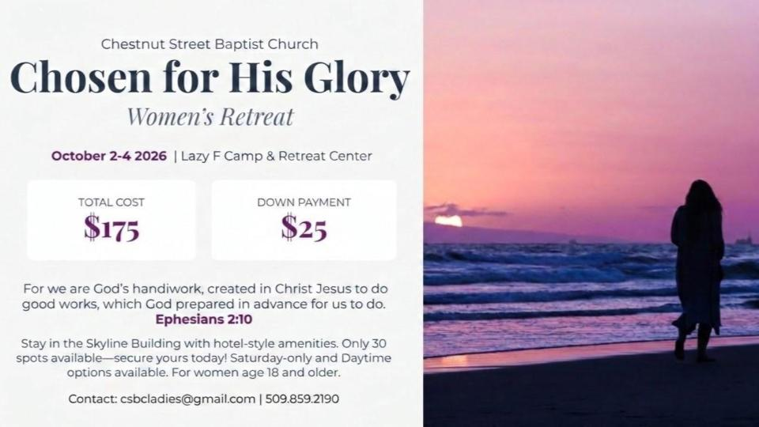

Slide 13


Slide 14


