Slide 1
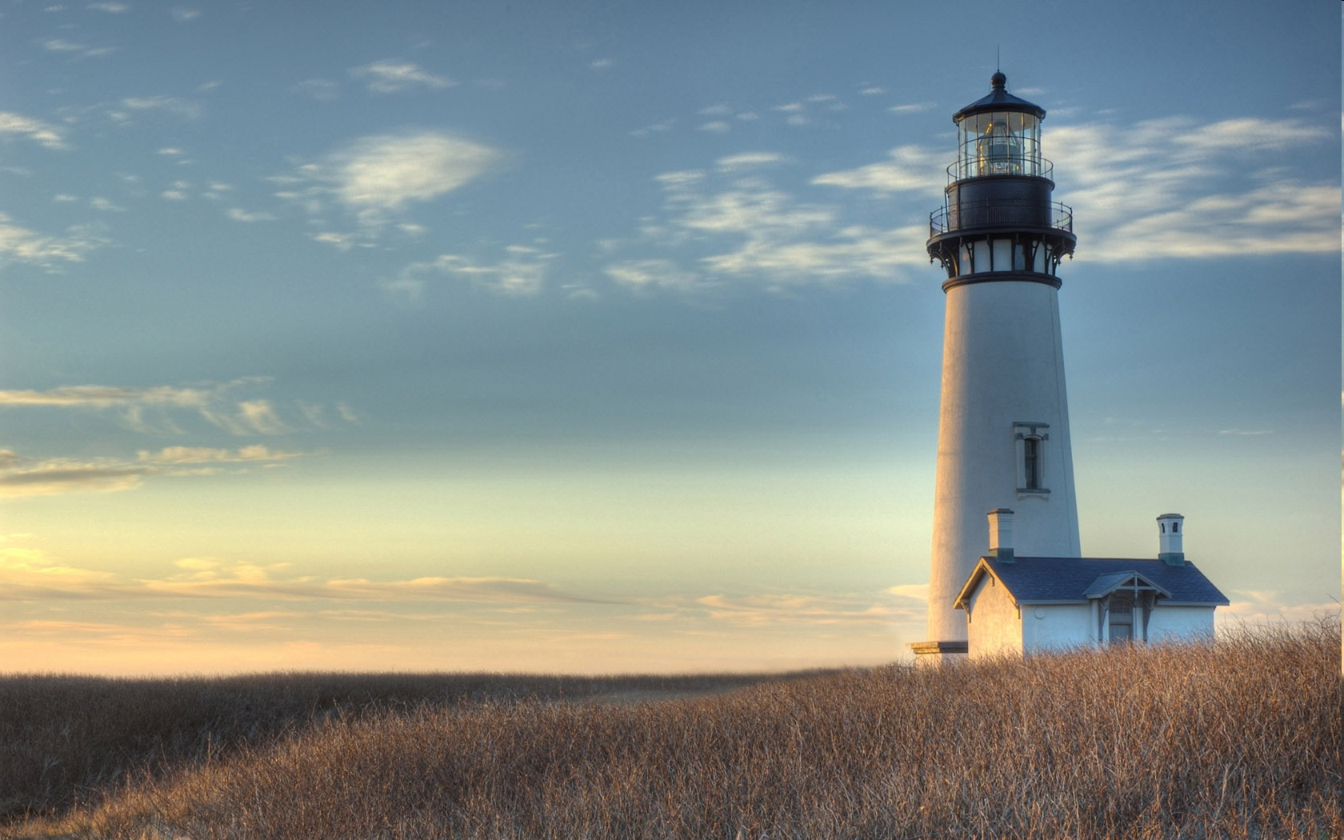
Chestnut Street
Baptist Church
Welcome
Pastor Frank R. Johnson
Associate Pastor Jeremy Johnson
Notes:
1

Slide 2

Tuesday 6:30 p.m.
Life Group at the Harmsen’s

Slide 3
Wednesday 6:30 p.m.
Prayer Group
Cornerstone Kids Club (Grades 1-5)
Ignition (Youth Group, Grades 6-12)

Slide 4
Thursday at 6 p.m.
Cross Walk (Collegiate/Young Adults)

Slide 5
Friday 4:30 p.m.
LIFE Group (Briarwood)

Slide 6
Keep on Praying!
If you would like to receive PrayerNet Today emails, send us a request at prayer@csbcfamily.com.
Stay connected: www.csbcfamily.com
Find us on Facebook

Slide 7
Giving Options
(Thank you for supporting this ministry!)
Mail: 609 N. Chestnut St. Ellensburg, 98926
Online: Giving link at www.csbcfamily.com
In Person: Offering Box in lobby

Slide 8
Opportunities for Giving
Lottie Moon- Many churches are joined together to give this Christmas to the International Mission Board. Any amount can be added to your offering and is also available online.
Deacon Christmas baskets and our Pastor’s Christmas gift- this is how we share the blessings God has provided for us by blessing our members and appreciating our Pastors.
Angel Tree- We are thankful to partner with Angel Tree and provide gifts for children with incarcerated parents. If you would like to participate, pick up a tag on the Angel Tree in the foyer. Just buy a gift and bring it back to the office, unwrapped, by December 19!

Slide 9

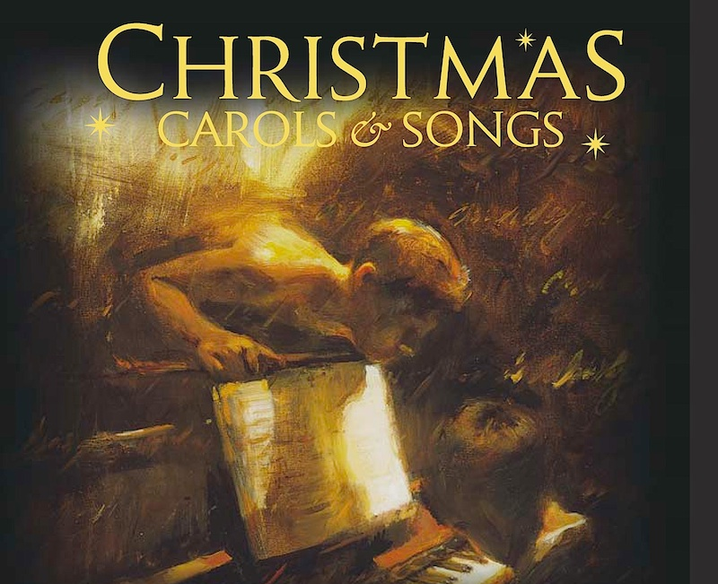
Christmas Choir on December 14
The Christmas Choir and Cookie Social will be on December 14 at 6 p.m. Join us afterwards for fellowship with our Cookie Social. Please bring a favorite cookie to share.

Slide 10
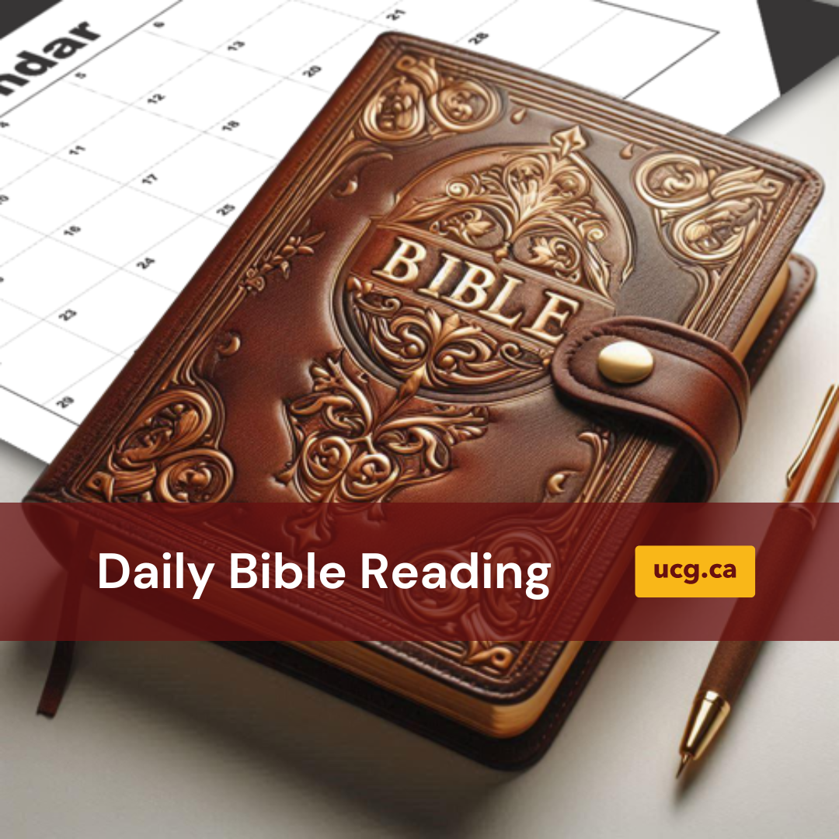
Bible Readers Club Meeting
Join us tonight for our month-end Bible Readers Club in the Fellowship Hall at 6 p.m. We will discuss our November readings and talk over the Bible Workshop we had on Friday and Saturday. You can begin any time. If you want to get involved, come tonight. See you then!

