Slide 1

Chestnut Street
Baptist Church
Welcome!
Interim Lead Pastor Jeremy Johnson
Notes:
1

Slide 2

Tuesday 6:30 p.m.
Life Group at the Harmsen’s

Slide 3
Wednesday 6:30 p.m.
Ignition (Youth, Grades 6-12)
Prayer Group

Slide 4
Thursday 6:00 p.m.
Cross Walk for CWU and Young Adults

Slide 5
Friday 4:30 p.m.
LIFE Group (Briarwood)

Slide 6

Giving Options
(Thank you for supporting this ministry!)
Mail: 609 N. Chestnut St. Ellensburg, 98926
Online: Giving link at www.csbcfamily.com
In Person: Offering Box in lobby

Slide 7

Business Meeting Tonight!
Members, please join us for our business meeting tonight at 6 p.m. in the Fellowship Hall. We will hear Ministry Reports and any new business. See you there!

Slide 8

Christmas Choir Not too late to Get Involved!
Join us, today, in the Fellowship Hall to sing Christmas praises to the Lord!
Choir will start at 4:30 p.m. and last until 6:00 p.m. Childcare will be provided for choir members.
Choir Performance will be Sunday December 13th.

Slide 9

New Office Hours!
Our Office Hours have changed. Note the new schedule below:
Tuesday and Wednesday
9 a.m. – 12:00
12:30 p.m. – 2:30 p.m.
Thursday
12:00 – 2:00 p.m.
Stop in and say hi!

Slide 10

Redeem Trick or Treating
Expect trick or treaters? Use these stickers to remind them the Lord is indeed Good. Just paste on your candy.
Pick some up next week on the table in the foyer!

Slide 11
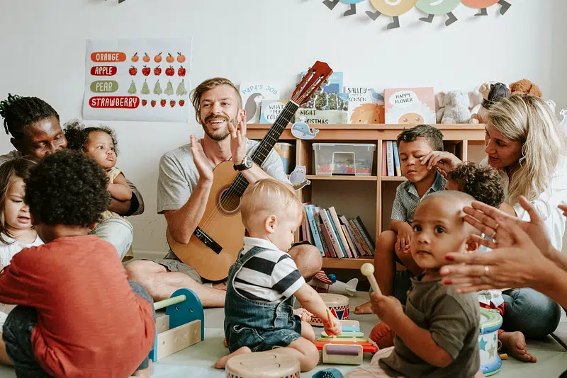
Nursery Volunteers needed
We would love to have you volunteer for Nursery Duty!
You will not be alone. Usually, two people will be with you. If you’d like to join us, please speak with Risa Wood or contact the Office at 509-925-2424. Guitar playing isn’t needed!

